Slide 1
An Accessible Extensible API Layered over OpenGL
Jon Neel
EECS 466
Fall 2013

Slide 2
Background and Motivations
OpenGL is a very powerful, robust API for rendering graphics
Despite its offerings, it can be very difficult to understand, even when using built-in functionality that handles complex math
The typical program written using OpenGL functionality (IE not implemented by the developer):
Configures some OpenGL settings
Defines and sets callback functions to dictate what happens in the main display loop, how to handle user input, and what to do when the window is resized
Sets and configures the projection mode
Initializes the modelview matrix
Sets some initial states for user defined constructs and variables essential to the program
Starts the main display loop

Slide 3
Background and Motivations
The main display loop is where much of the difficulty of working OpenGL became apparent for me
The model matrix and view matrix are inextricable linked
Because of this, developers will constantly be transforming the modelview matrix and/or loading a transformed matrix into OpenGL, often for every object in the scene.
They need to programmatically create structures, which can be computationally expensive, messy, and not feasible for larger or production quality programs, OR more often, load in object files manually, and maintain lists of information pertaining to those models.
This requires a large amount of code, prohibits adequate scene and view management, and is generally tedious to code and debug.
For more advanced techniques, the complexity and amount of code can be overwhelming.

Slide 4
Background and Motivations
For these reasons, I decided to implement an easy-to-use and highly extensible API layered on top of OpenGL that gives novices and experts alike the ability to focus more on their programs, and less on struggling with what I at first saw as quirks and potential for inefficiencies of OpenGL proper.

Slide 5
Goals
The first and most crucial part of creating this API was allowing developers to work in a consistent coordinate frame (the world frame), while still allowing quick and well-scoped access to the model, view, and projection matrices associated with respective models and views.
The second goal was to implement classes that enabled the first goal and eliminated the need for developers to maintain complex data structures or create their own methods of dealing with this perceived issue, while not outright preventing it.
The Mesh class provides methods for loading meshes from file, tracking object properties such as model matrices and material properties, and calculating intersections
The Camera class provides a way to define projection modes, access view and projection matrices and quickly alter those matrices in a way conducive to manipulating views of a scene.
The Scene class stores lists of Lights, Meshes, and Cameras to allow quick swapping to and from different scenes, views, and object and lighting scenarios dynamically while preserving state information.

Slide 6
Goals
The final goal was to create a way of easily loading GLSL shaders, and automatically set per-vertex variables and attributes by implementing a callback function used by a helper class attached to a Scene that passed Mesh fields along to the GPU.
The ShaderHelper class is meant to track the GLSL program, and allow for quick and easy integration of GLSL shaders into scenes and allow users to define more advanced vertex and fragment operations simply by defining a function to set parameters and by loading shader files.

Slide 7
Applications
The simple demo program implemented shows how to load multiple scenes with multiple cameras and cycle between cameras and scenes, and integrate a few simple shaders for texture mapping.

Slide 8
Applications – Loading Scenes
Configuration File (.dat):
<[number of lights]> <[number of meshes]>
L <[light type: 0 for directional, 1 for point]> <[x coordinate position] [y coordinate position] [z coordinate position]> <[r channel value] [g channel value] [b channel value]>
M < [file name] > <[scale]> <[local x rotation] [local y rotation] [local z rotation]> <[x coordinate position] [y coordinate position] [z coordinate position]> <[ambient r channel value] [ambient g channel value] [ambient b channel value]> <[diffuse r channel value] [diffuse g channel value] [diffuse b channel value]> <[specular r channel value] [specular g channel value] [specular b channel value]> <ambient reflection coefficient> <diffuse reflection coefficient> <specular reflection coefficient> <specular exponent> <index of refraction> <reflective percentage> <refractive percentage>
Code:
std::vector<Scene*> scenes;
// tracks active scene; can be altered to swap scenes within rendering loop or user input methods
int activeScene = 0;
…
scenes.push_back(new Scene);
scenes[0]->Load("scene.dat");
…
scenes.push_back(new Scene);
scenes[1]->Load("scene1.dat");
…
scenes.push_back(new Scene);
scenes[2]->Load("scene2.dat");

Slide 9
Applications – Adding and Manipulating Cameras
// default perspective camera at (0,0,0) facing along –z with up vector (0,1,0)
scenes[0]->addCamera(PERSPECTIVE);
// perspective camera with an enormous clipping window shifted to (0,0,10)
scenes[0]->addCamera(PERSPECTIVE);
scenes[0]->cams[1]->NearPlane = 0;
scenes[0]->cams[1]->FarPlane = 10000;
scenes[0]->cams[1]->Position.z = 10;
scenes[0]->cams[1]->ViewWidth = (float)WindowWidth/32;
scenes[0]->cams[1]->ViewHeight = (float)WindowHeight/32;
// orthographic camera with an enormous clipping window shifted to (10,10,10)
// rotated pi/3 on local x axis and pi/8 on local y axis
scenes[0]->addCamera(ORTHOGRAPHIC);
scenes[0]->cams[2]->NearPlane = 0;
scenes[0]->cams[2]->FarPlane = 10000;
scenes[0]->cams[2]->Position.x = 10;
scenes[0]->cams[2]->Position.y = 10;
scenes[0]->cams[2]->Position.z = 10;
scenes[0]->cams[2]->Pitch = M_PI/3;
scenes[0]->cams[2]->Yaw = M_PI/8;
scenes[0]->cams[2]->ViewWidth = (float)WindowWidth/32;
scenes[0]->cams[2]->ViewHeight = (float)WindowHeight/32;
// set the active camera for the scene to be used during default rendering loop
// can be called at any time to swap views within the scene
scenes[0]->setActiveCamera(0);

Slide 10
Applications – Active Scene/Camera Manipulation
Get active scene
scenes[activeScene]
Get active scene’s active camera
scenes[activeScene]->getActiveCamera()
Switch to view 2
scenes[activeScene]->setActiveCamera(2)
Switch to scene 3
activeScene = 3

Slide 11
Applications – GL Configuration and Default Rendering
Configuration
// Simple wrapper for one line configuration loading
GLConfig::load(argc, argv, GLUT_RGB | GLUT_DOUBLE | GLUT_DEPTH, WindowWidth, WindowHeight, "EECS 466 Final Project");
Default Scene Rendering
// Allow for specific configuration for models
scenes[activeScene]->meshes[0].polygonModeFace = GL_LINE;
// Render all meshes with lights within the scene
scenes[activeScene]->RenderAll();
Default Mesh Rendering
// Render in the view specified by the parameter
mesh.Render(scenes[activeScene->getActiveCamera());

Slide 12
Applications – GLSL Integration
ShaderHelper
// enables the ShaderHelper instance for scene
scenes[0]->useGLSL = true;
// load shaders
scenes[0]->shaderHelper = ShaderHelper(vertFile, fragFile);
// define ShaderHelper callback
void ShaderHelper::setParameters(Scene* scene, Mesh* mesh) {
int colorLocation = getUniformVariable(this->p, “color”);
glUniform3fvARB(colorLocation, mesh->material.color.r, mesh->material.color.g, mesh->material.color.b);
}
CAVEATS:
If you are using the GLSL integration, you lose the capability to use the default fixed pipeline functionality.
Because of the custom Camera projection information, you must define a position attribute vec3 “pos” in your vertex shader to access the non-projected 3D position of your vertices.
Note:
ShaderHelper should really be updated to be a singleton class. You can still load different shaders as needed, but the fact that you only have one active GLSL program precludes the need for separate ShaderHelpers per scene.
The setParameters method should be a function that takes a callback as a parameter to swap out these functions when you want to use different shaders, but I couldn’t get that working.

Slide 13
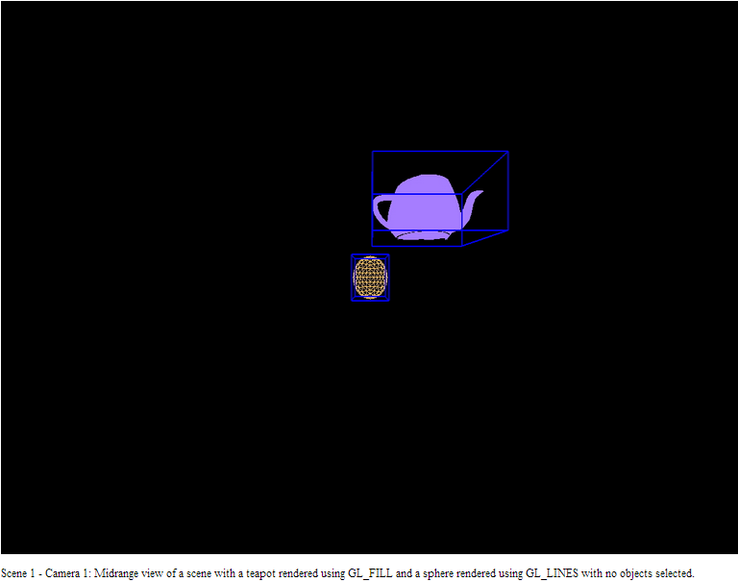
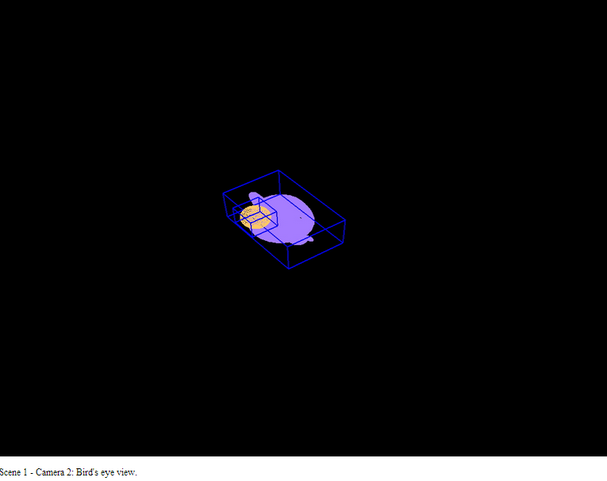
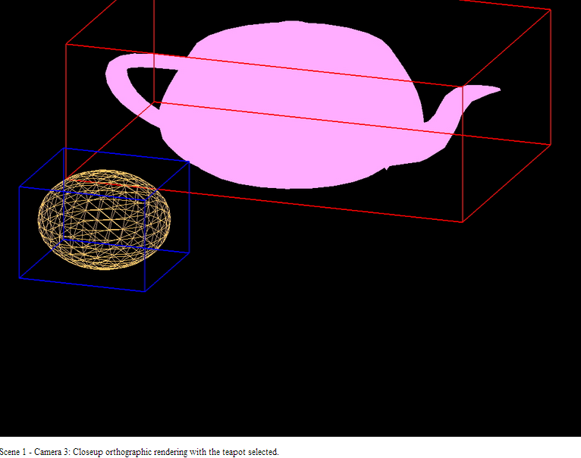
Applications - Examples

Slide 14
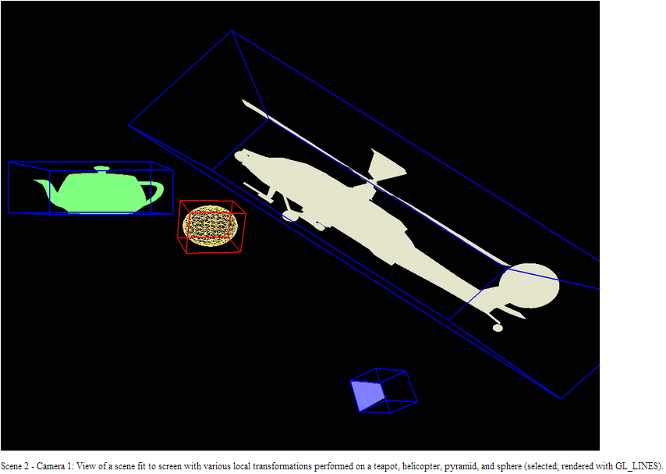
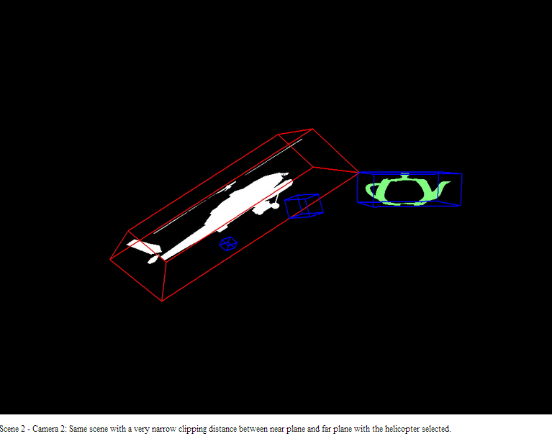
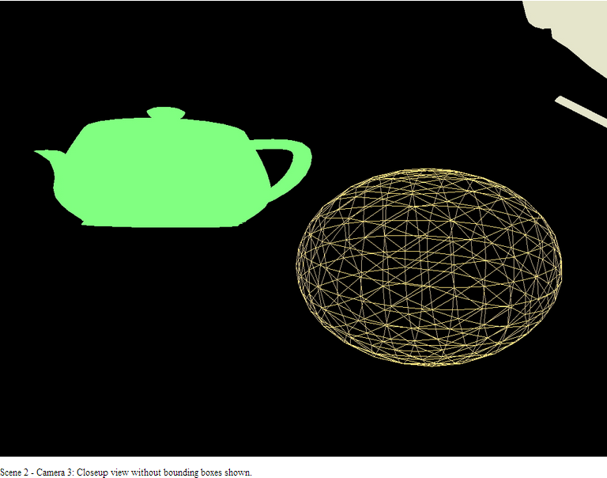
Applications - Examples

Slide 15
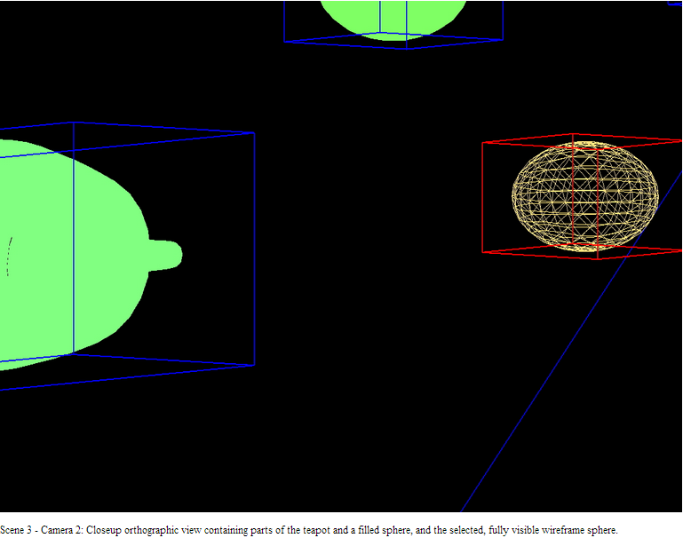
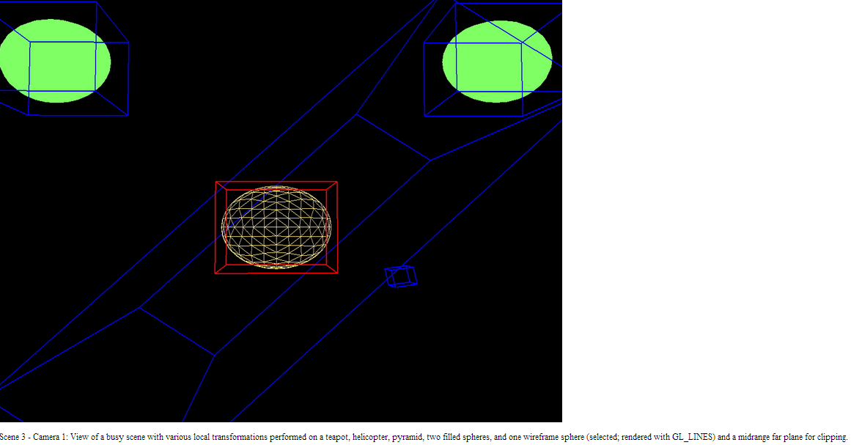
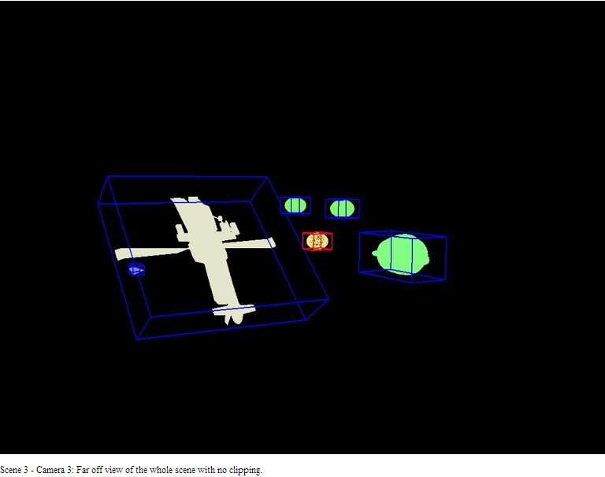
Applications - Examples

Slide 16
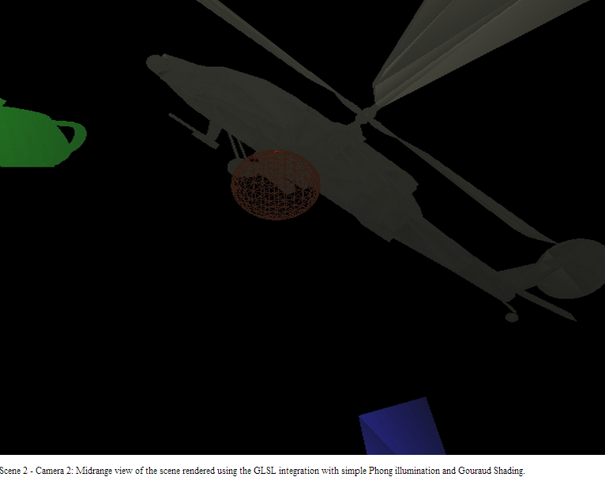
Applications - Examples

