Slide 1
Personality Traits Identification Using Machine Learning
Elliott Saslow – B.S. Engineering Physics
GitHub: Esaslow

Slide 2
The Data - Big 5 Personality
153,000 answers to 300 question set
Possible to split users based on sex/age
Looked at PCA to identify where the highest variance is in the set
Male Top Dividing Questions | Female Top Dividing Questions
Believe that there is no absolute right or wrong. | Boast about my virtues.
Tend to vote for liberal political candidates. | Believe that I am better than others.
Believe that I am better than others. | Love to eat.
Boast about my virtues. | Believe that we coddle criminals too much.
Notes:
150,000 answers
Break out users based on questions that separate them the most
Pca = EDA

Slide 3
Goal: 60 Q’s per Trait -> Less than 10 Q’s per Trait
Traits
Openness
Conscientiousness
Extraversion
Agreeableness
Neuroticism
Facet 1
Facet 2
Facet 3
Facet 4
Facet 5
Question1
Question2
Question3
Question4
Question5
Notes:
5 traits
5 facets per trait
6 questions per facet

Slide 4
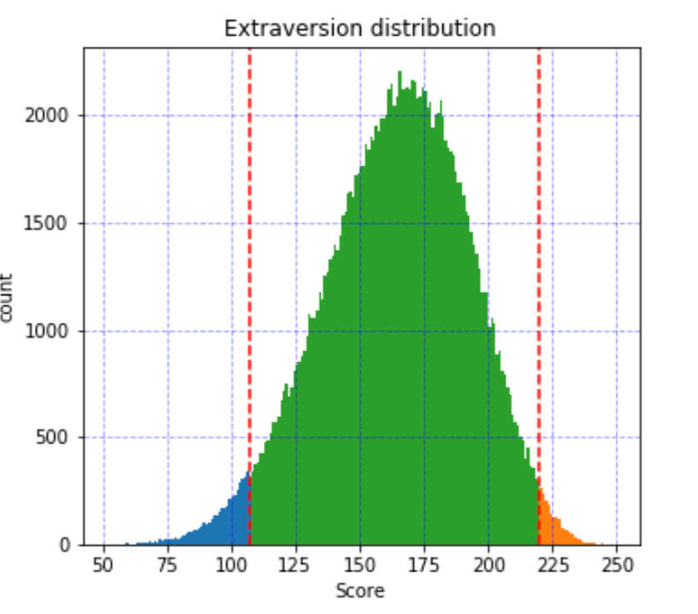
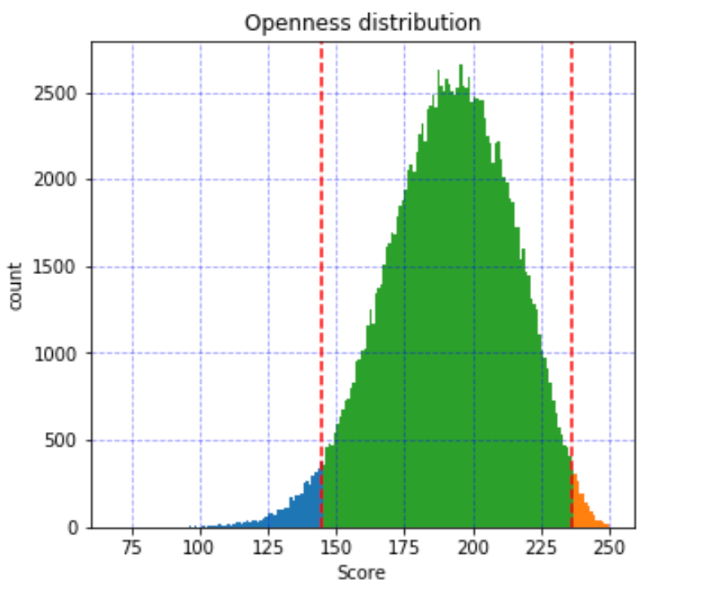
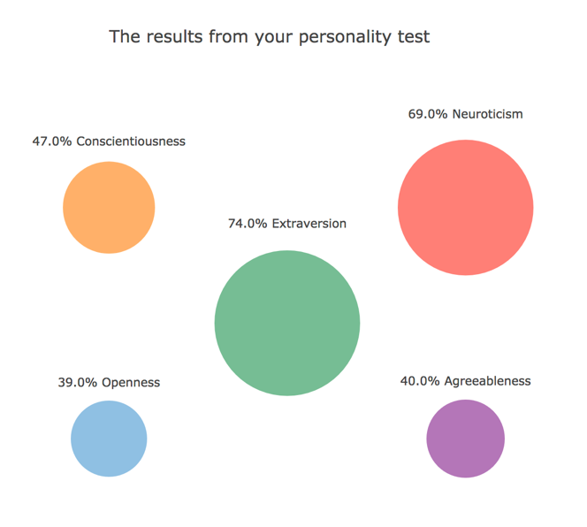
Big 5 personality traits:
Neuroticism
Neuroticism is a trait characterized by sadness, moodiness, and emotional instability. Individuals who are high in this trait tend to experience mood swings, anxiety, irritability and sadness. Those low in this trait tend to be more stable and emotionally resilient. Agreeableness
This personality dimension includes attributes such as trust, altruism, kindness, affection, and other prosocial behaviors. People who are high in agreeableness tend to be more cooperative while those low in this trait tend to be more competitive and even manipulative.
Extraversion
Extraversion is characterized by excitability, sociability, talkativeness, assertiveness, and high amounts of emotional expressiveness. People who are high in extraversion are outgoing and tend to gain energy in social situations. People who are low in extraversion (or introverted) tend to be more reserved and have to expend energy in social settings
Conscientiousness
Standard features of this dimension include high levels of thoughtfulness, with good impulse control and goal-directed behaviors. Highly conscientiousness tend to be organized and mindful of details.
Openness
This trait features characteristics such as imagination and insight, and those high in this trait also tend to have a broad range of interests. People who are high in this trait tend to be more adventurous and creative. People low in this trait are often much more traditional and may struggle with abstract thinking.
.
Notes:
What percentile do users fall on
Output results in traits
Percentile is nonlinear transformation

Slide 5
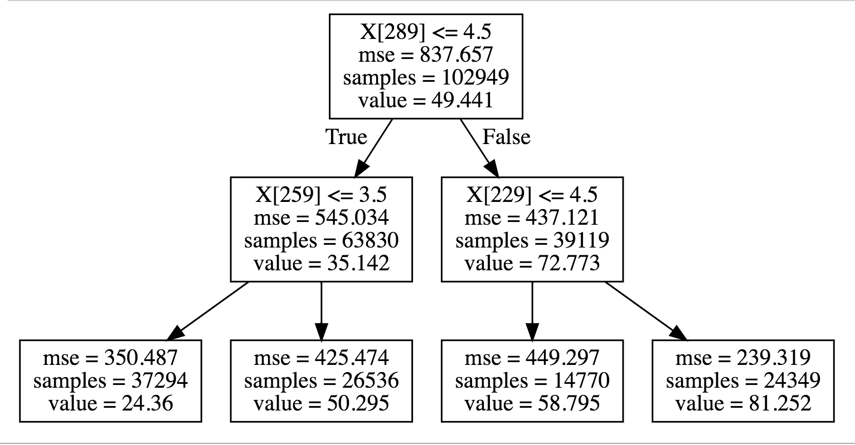
Basic Decision Tree Graph
4 Questions per model
Mean Absolute Error < 15%
8 Questions per model
Mean Absolute Error < 10%
Notes:
Users traverse decision tree to predict percentile
**Error

Slide 6
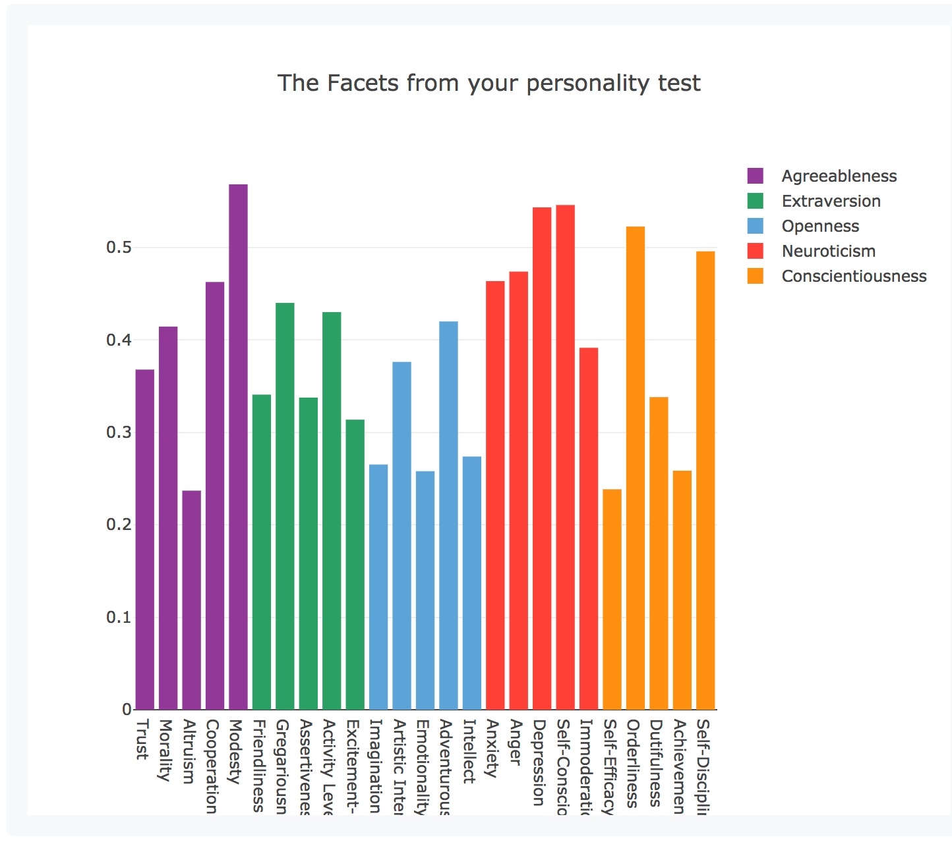
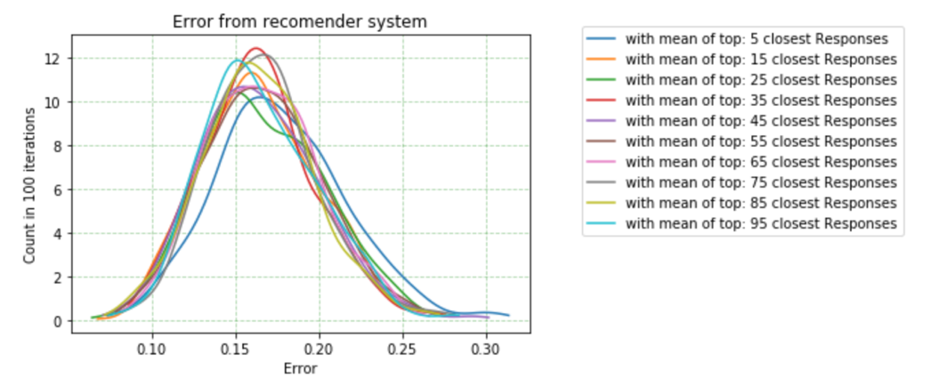
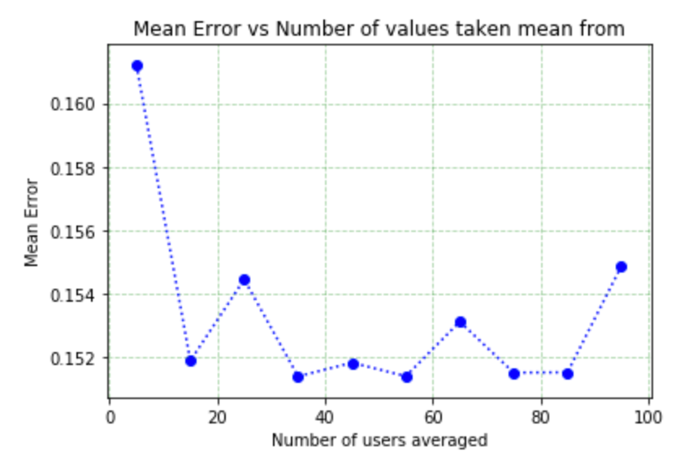
Recommender System:
No Cold Start Problem
Take average of similar users to identify percentile in facets
Run permutation analysis to identify minimum error
Notes:
Recommend to identify the facets
Closest users
error

Slide 7
Web Application:
Getting Each Question for web application
Web Page
User Inputs a value
JQuery sends a request to the Flask Server on AWS EC2
User Input
Route to endpoint
Python Server loads model and keeps track of current location within current tree
Decide Next Question
Model
Return Next Question to webpage
Do not like art.
If answer < 25 : Otherwise
Am not interested in theoretical discussions.
Have difficulty imagining things.
Notes:
How traversing the tree works backend

Slide 8
Server.py
Quiz.css
Quiz.html
Formats media on page
Adds aesthetics
Guide for where to put information on screen
Generic HTML Code
EC2 Server in AWS cloud
Quiz.js
Keeps track of users location in the quiz
Saves the users answers for recommender use
Routes calls to correct endpoints
Async Communication
Uses jquery to send and receive data from server
Keeps track of what to show on webpage
Notes:
How all the pages are hooked together
Async
Jquery

Slide 9
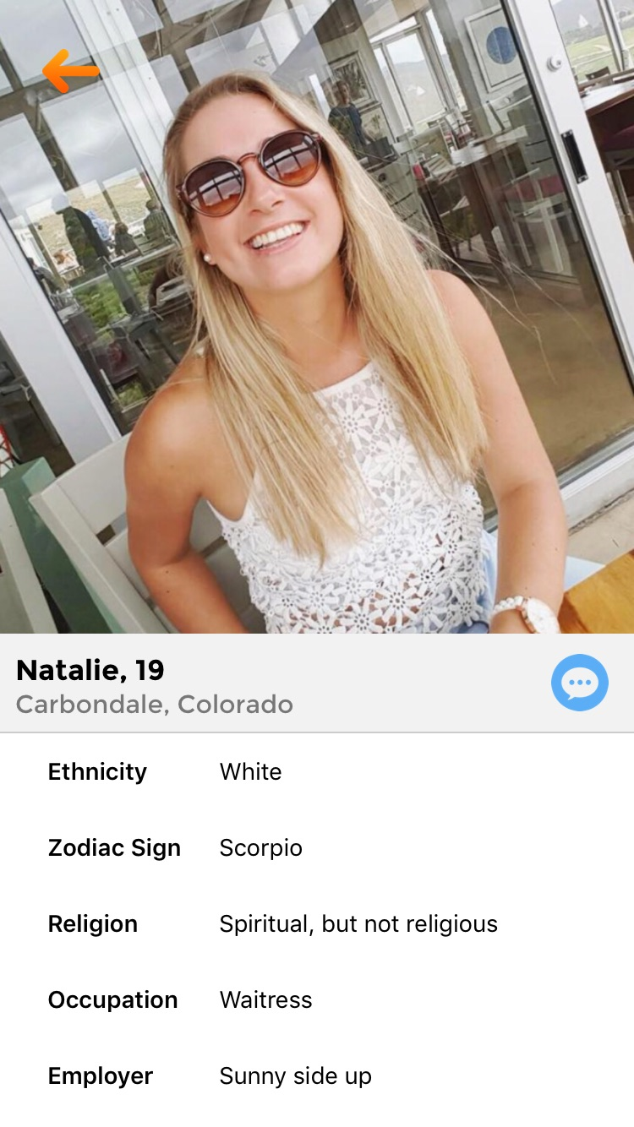
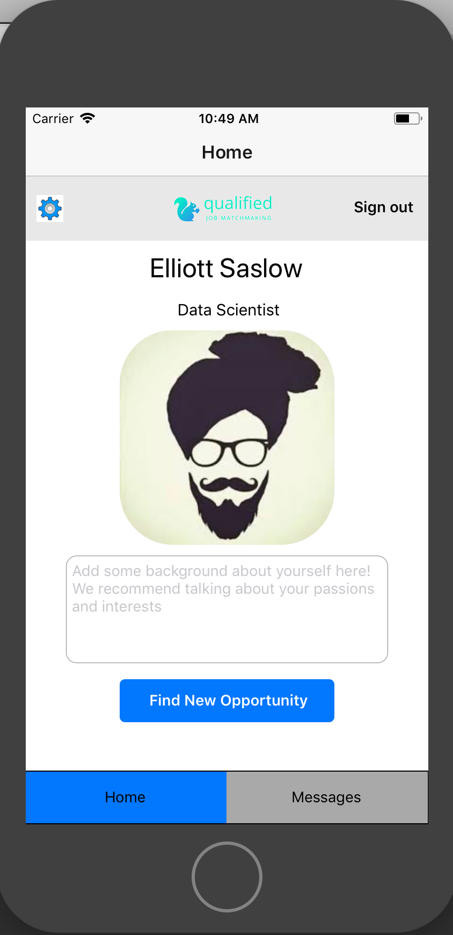
Grand Vision
Use quick & easy personality assessment to match users in both dating and professional discovery
Qualify College Dating
(On the app store)
Professional Discovery Application
Python Question Server
Firebase storage for user data
Requests to server
Requests to server
*Both applications written in React-Native
Notes:
lol

Slide 10
Next Steps
Secure more funding
Continue development on IOS applications
Merge production branch with branch for splitting based on gender
Hook up Firebase storage and IOS applications to flask server

