Slide 1
Project
Hello

Slide 2
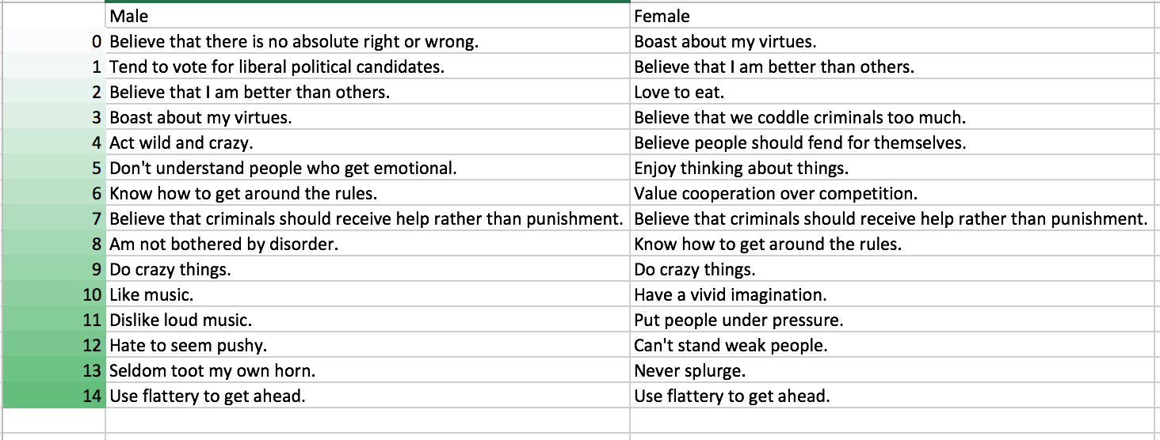
The Data - Big 5 Personality
153,000 answers to 300 question set
Possible to split users based on sex/age
Looked at PCA to identify where the highest variance is in the set

Slide 3
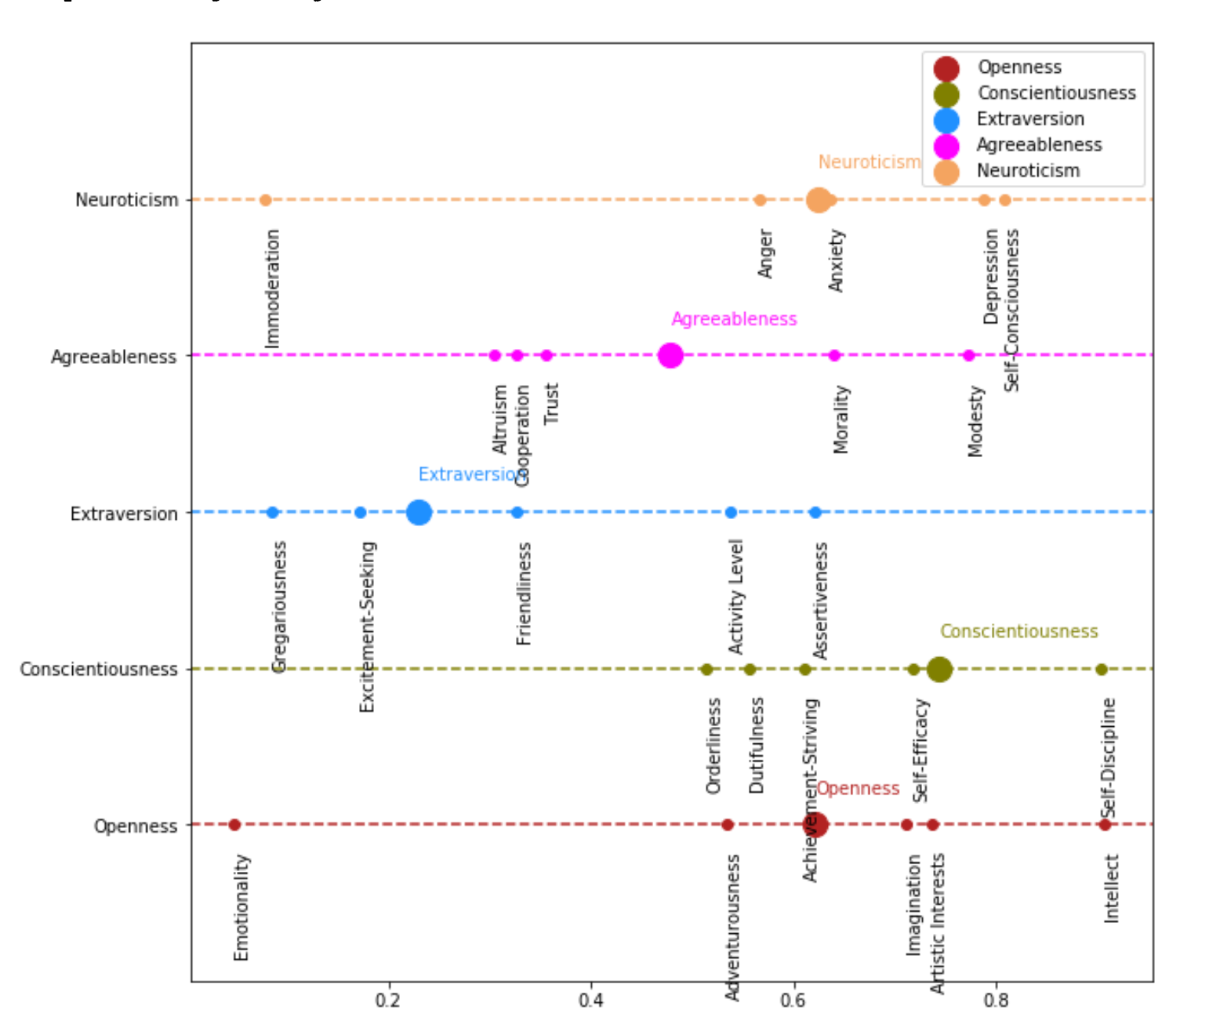
Big 5 personality traits:
Neuroticism
Neuroticism is a trait characterized by sadness, moodiness, and emotional instability. Individuals who are high in this trait tend to experience mood swings, anxiety, irritability and sadness. Those low in this trait tend to be more stable and emotionally resilient. Agreeableness
This personality dimension includes attributes such as trust, altruism, altruism, kindness, affection, and other prosocial behaviors. People who are high in agreeableness tend to be more cooperative while those low in this trait tend to be more competitive and even manipulative.
Extraversion
Extraversion is characterized by excitability, sociability, talkativeness, assertiveness, and high amounts of emotional expressiveness. People who are high in extraversion are outgoing and tend to gain energy in social situations. People who are low in extraversion (or introverted) tend to be more reserved and have to expend energy in social settings
Conscientiousness
Standard features of this dimension include high levels of thoughtfulness, with good impulse control and goal-directed behaviors. Highly conscientiousness tend to be organized and mindful of details.
Openness
This trait features characteristics such as imagination and insight, and those high in this trait also tend to have a broad range of interests. People who are high in this trait tend to be more adventurous and creative. People low in this trait are often much more traditional and may struggle with abstract thinking.
.

Slide 4
Goal: 60 Q’s per Trait -> Less than 10 Q’s per Trait
Traits
Openness
Conscientiousness
Extraversion
Agreeableness
Neuroticism
Facet 1
Facet 2
Facet 3
Facet 4
Facet 5
Question1
Question2
Question3
Question4
Question5

Slide 5
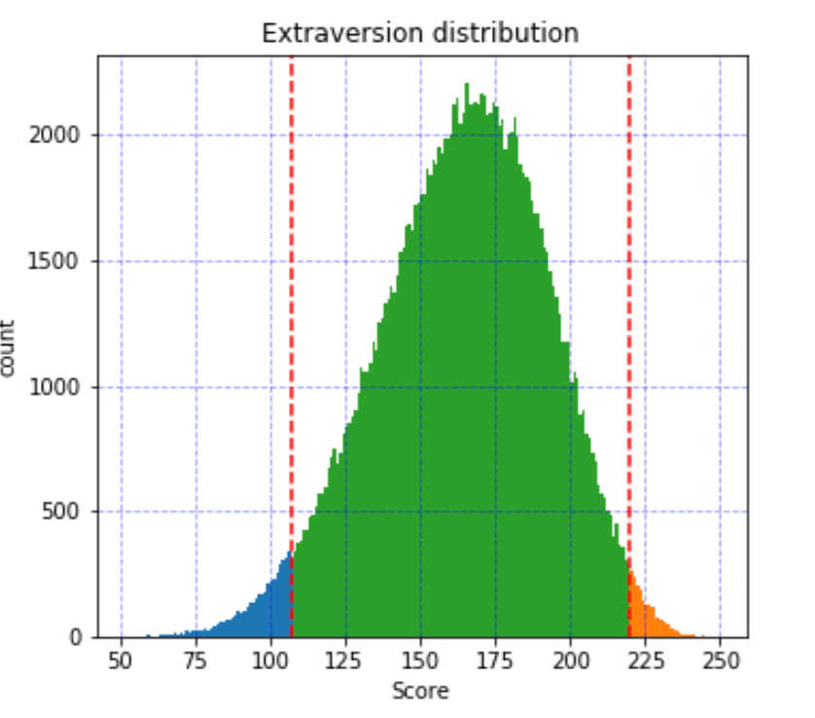
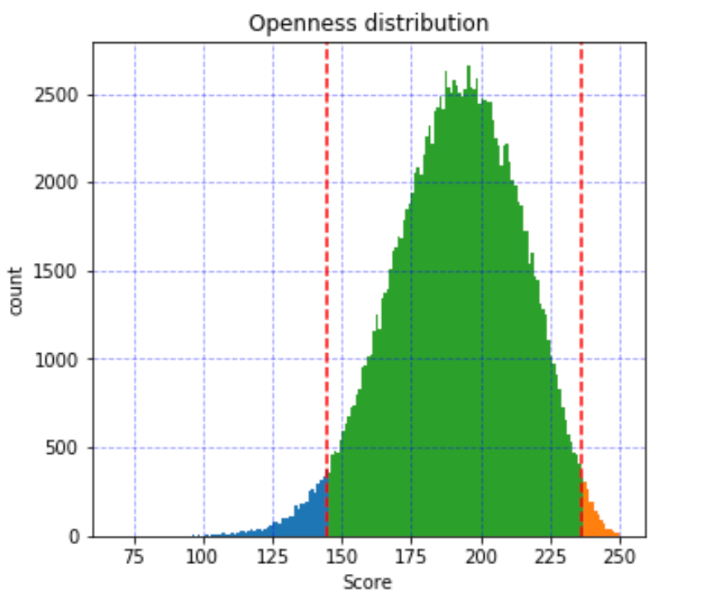
Find the User Percentile in certain trait
Use the percentile as a target
Train a decision tree
Use splits to feed user new questions

Slide 6
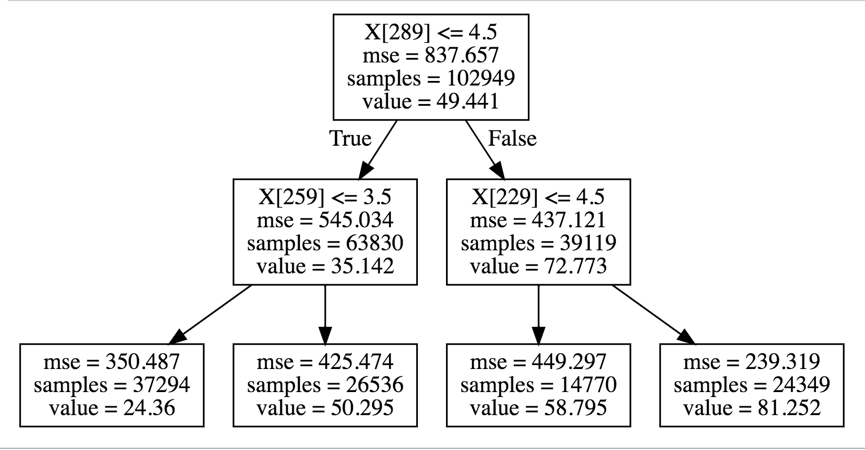
Basic Decision Tree Graph

Slide 7
Challenges so far
Reverse Scored questions for the game
Loading all the transformed data (thanks Pickle)
Calculating percentiles in in O(n)
Building a class system for the game
Checking to see if player already answered that question

Slide 8
Next week:
Use another algorithm as a recommender to create predictions
Facet Prediction addition
Create Graph of Traits to facets
Apply Neural network to create the predictions
Ensample recommender and decision tree
Visual after taking quiz where you fall
WEB APP!
Keep user id
Send use message if they match – idk
T – sne
Up or down next day bitcoin price

