Slide 1


Slide 2

Plan
Introduction
Advantages of advertising
Disadvantages
Conclusion

Slide 3


Slide 4
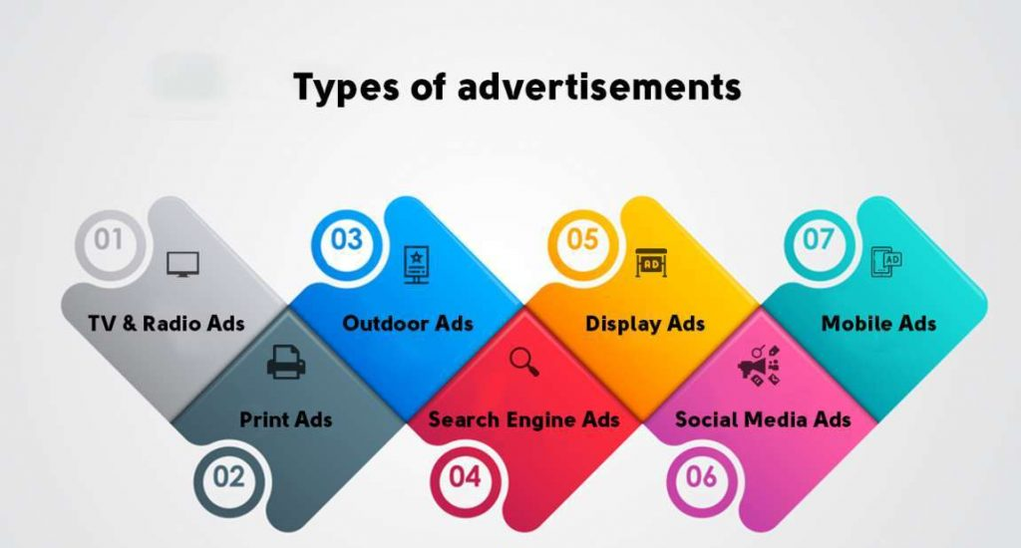

Slide 5


Slide 6


Slide 7
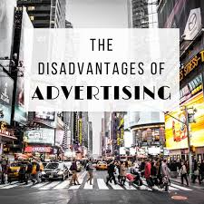

Slide 8


