Slide 1


Slide 2

Plan
What is advertising?
Types of advertisement
Advantages of advertising
Disadvantages
Conclusion

Slide 3


Slide 4


Slide 5


Slide 6


Slide 7
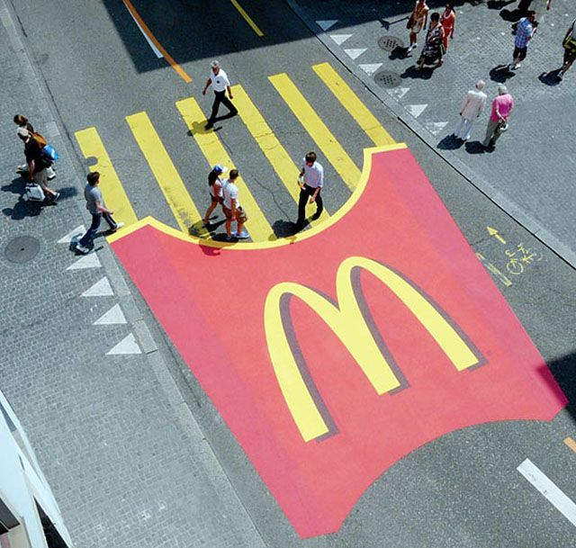

Slide 8


Slide 9


Slide 10
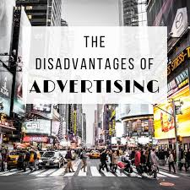

Slide 11


