Slide 1
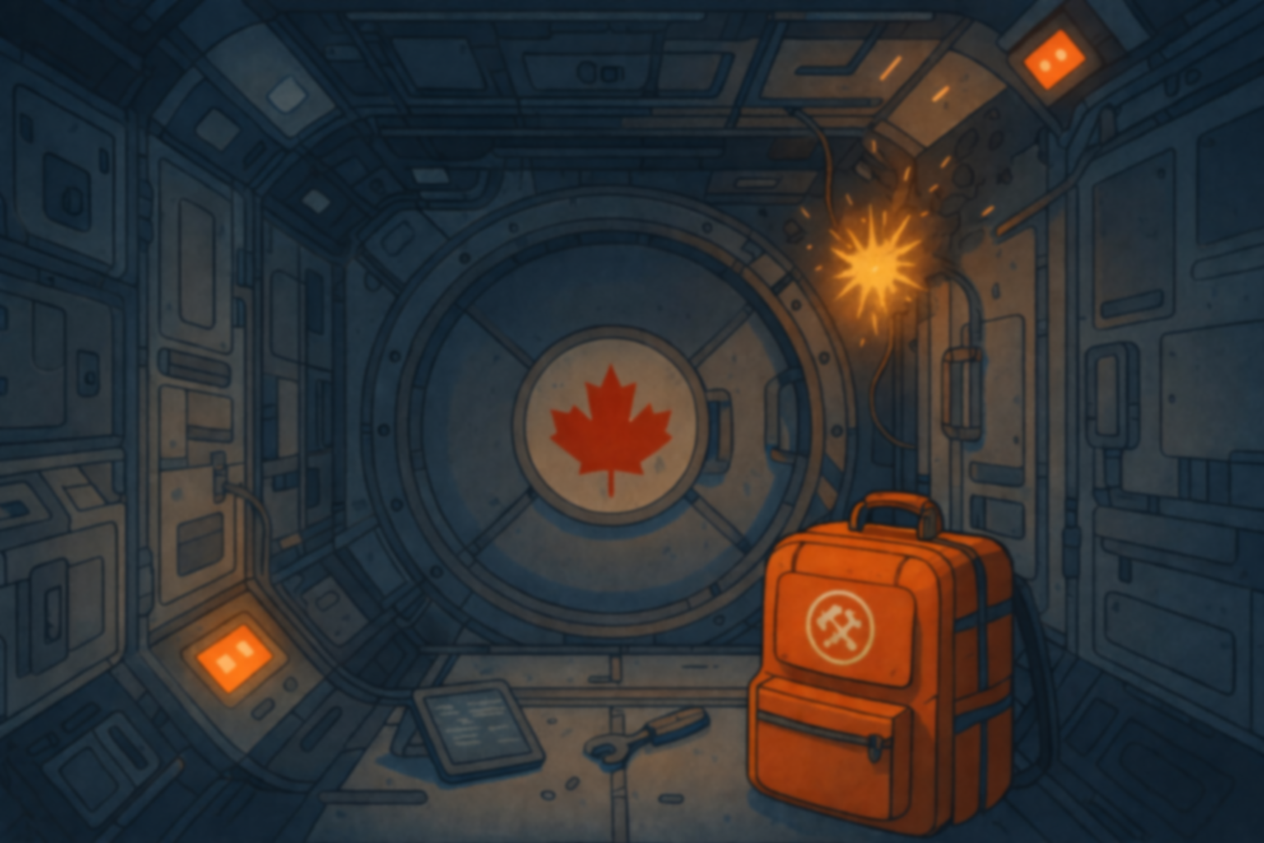
Space Station Aurora
You're aboard the International Space Station Aurora when a micrometeorite strike damages critical systems. The chief engineer's emergency toolkit backpack contains repair protocols, backup codes, and tools needed to prevent catastrophic failure. Restore all systems and initiate emergency evacuation.

Slide 2
Story Details
You are the biologist on the Aurora Space Station. While you were on duty during the night shift, a meteorite shower struck vital parts of the space station.
The station computer is also impacted: most of the information it displays is scrambled and doesn’t seem to make sense.
You are now isolated from the other crew and more importantly from the engineer that is stuck in the crew quarters.
It rests on you to repair the damages to the space station and help the crew evacuate safely.
You find the engineer tool bag, but it seem he decided to add extra security features. To access the tools needed for the repairs, you first need to find the codes for the different locks.
Crew:
Dr Helena Chen – Captain/Pilot
Alistair Johnson – Engineer/Communication Officer
Sarah Lancaster – Biologist/Physician

Slide 3
Puzzle/clues/story Ideas
Briefing note explaining you just arrived, engineer was replaced, blueprint of the station
Engineer is working with rich corporations to sabotage the space station so that it is dismantled and a new one is constructed by them. (that’s why he locked his bag). Discover he is actually not Canadian and was not expecting to be the backup. He had to poison the 1st choice. He was helped by a higher government employee to hide his tracks. Real name is linked to a corporation name.
  One puzzle is to find the corporations involved
One puzzle is to restore internal communication: build a QR code that links to a website page.
  You have now limited communication with the crew.
Final clue opens the compartment for the specialized tool to repair the station.
  This special tool, opens the panel that contains the evidence needed to incriminate the corporations (that’s why it was to well protected)
You have to juggle between repairing the station/opening the bag/finding clues

Slide 4
Puzzle/clues/story Ideas
Station AI name: H.A.R.O.L.D. (Highly Advanced Robotic Orbital Logistic Director)
Computer is scrambled but still gives you clues:
  Map of the station as a grid, cross out the affected sections, either gives a number or the path direction (up, down, left, right…)
  Start off mentioning the meteorite strike and what need to be done but gets more and more scrambled as we go.
    Could use futuristic symbols that translate into text (maybe binary or HEX code)
Restore communication with the space center: emergency codes to enter – one for the meteorite strike – one for the sabotage
  For the sabotage, space center request to find proof of sabotage

Slide 5

Puzzle/clues/story Ideas
Bank statements for the Engineer: B.A.D (Bank of American Deposit)
  Payments to gambling sites: B.O.O. Betting Only Online S.A.P. Stakes And Punts
  Payment for nuts
  Deposit from corporation: E.V.I.L. Earth Vehicle Interstellar Landers
  Statement shows gambling + drinking through the month and a large payment from E.V.I.L.
Receipt from grocery store for: peanuts and shellfish. Total price could be a solution.
Station AI name: H.A.R.O.L.D. (Highly Advanced Robotic Orbital Logistic Director)

Slide 6
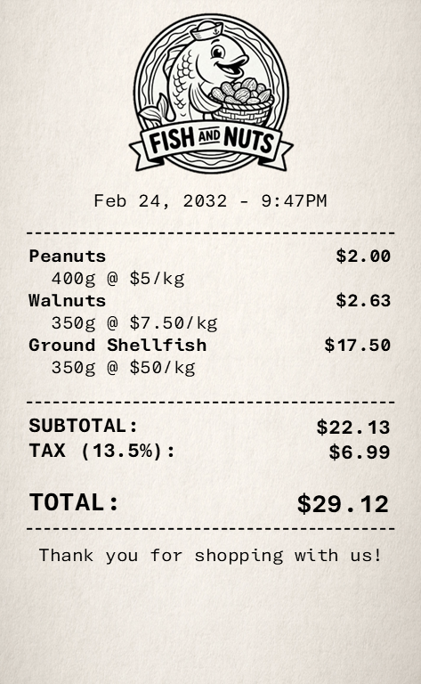


Receipts
Feb 24, 2032 - 9:47PM
------------------------------------------
Peanuts
400g @ $5/kg
Walnuts
350g @ $7.50/kg
Ground Shellfish
350g @ $50/kg
$2.00
$2.63
$17.50
------------------------------------------
SUBTOTAL:
TAX (13.5%):
TOTAL:
$22.13
$6.99
$29.12
------------------------------------------
Thank you for shopping with us!
Receipt size: 80mm wide (https://tritonstore.co.nz/receipt-rolls/)

Slide 7

Gambling emails
Dear Customer,
We have noticed that you placed significant bets recently. Below is a breakdown of your bets. We noticed that your account balance reach $0 in a short amount of time. As such, we decided to add a 5% fee on any new deposits according to our Terms and Conditions.
Dear Customer,
We have assessed that the recent activity in your account did not meet our Terms and Conditions. As such, we have decided to close your account for the time being.
Thank you,
Betting Only Online
Customer Representative
BettingOnlyOnline.com

Slide 8
Electronic Puzzle

Slide 9





Logos/names
B.A.D
Bank of American Deposits
Fish and Nuts
E.V.I.L.
Earth Vehicle Interstellar Landers
B.O.O.
Betting Only Online
H.A.R.O.L.D. Highly Advanced Robotic Orbital Logistic Director
S.A.P.
Stakes and Punts

Slide 10
Design elements
Font printed text: Orbitron https://fonts.google.com/specimen/Orbitron
Font handwritten: Dreaming Outloud Pro
Corporate “EVIL” font: Times New Roman
Corporate “EVIL” font 2: Down City: https://www.fontspace.com/downcity-font-f15115
Receipt font: Aptos Mono
Colour Scheme:
#16253C
#A84420

Slide 11
Crew
Role | Name | Hometown | Date of Birth | Note
Commander | Dr. Helena Chen | Ottawa, ON | 1977/12/30
Pilot | Jean Bouchard | Moncton, NB
Chief Engineer | Alistair Johnson | Waco, TX |  | Traitor
Science Officer | Dr. Sarah Lancaster | Victoria, BC |  | Player’s character
Medical Officer | Dr. Yuki Nakamura | Vancouver, BC
Mission Specialist | Anika Johansson | Regina, SK
Flight Director | Gilles Ouellet | Montreal, QC
Science Specialist | Dr. George Leavitt | Calgary, AB
Flight Surgeon | Dr. Henrik Baird | Halifax, NS
Public Affairs Officer | Priya Chandra | Toronto, ON

Slide 12
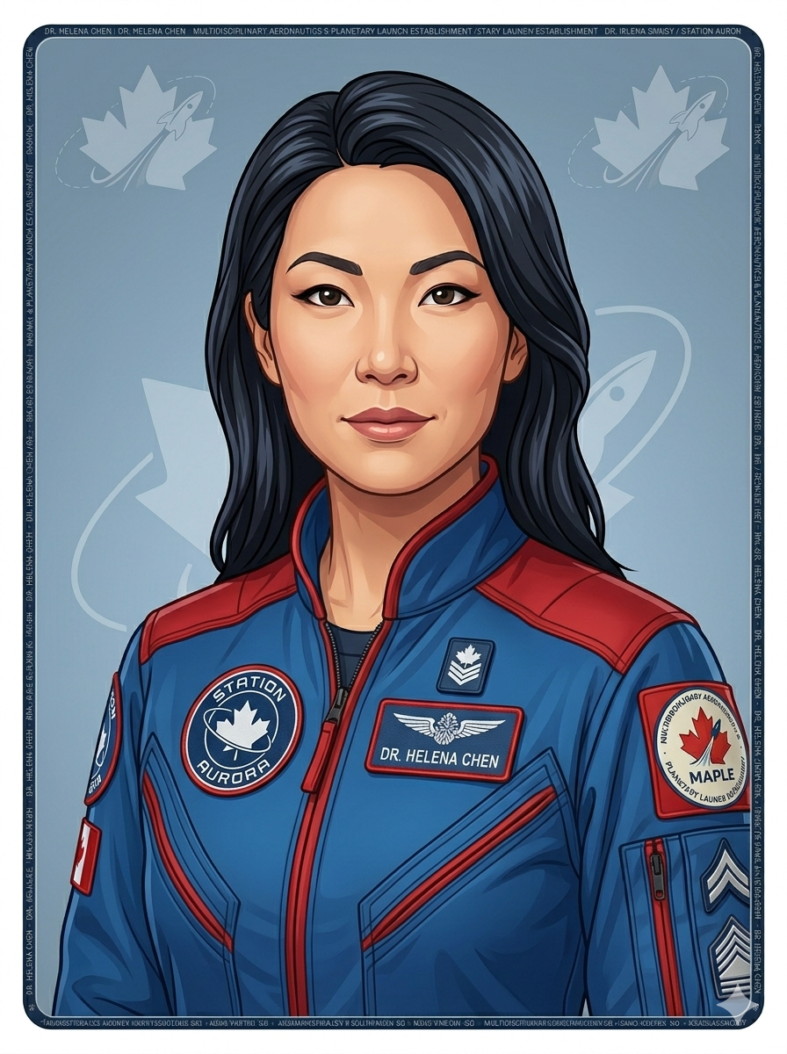

Crew - New
MPL-001
DR. HELENA CHEN
COMMANDER
Blood type
O+
Allergies
None
Gravity Rating
6.4 G
Date of birth
12/30/1973
Station Aurora

Slide 13
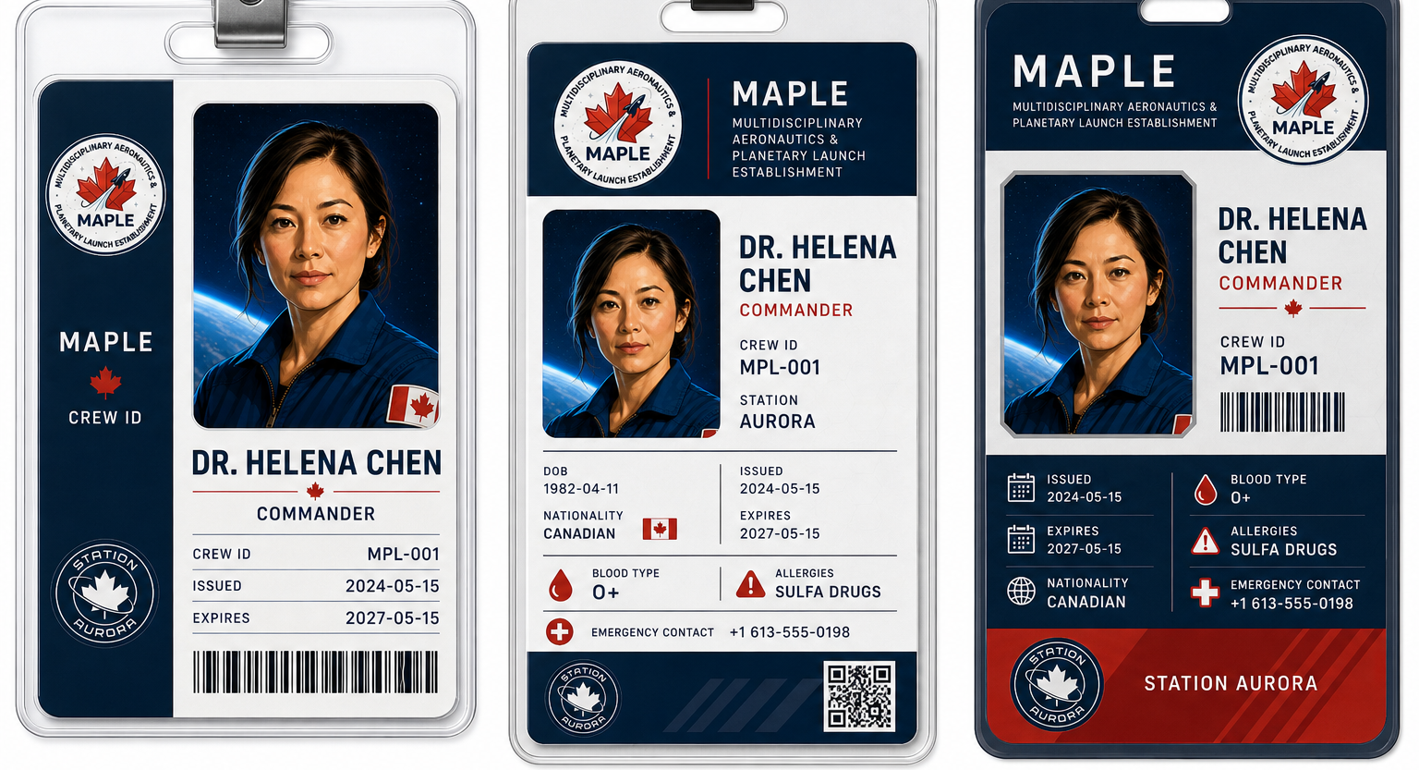
Crew - New
Captain
Pilot
Dr. Helena Chen
Id: 1259375
Ottawa, ON
1977/12/30

Slide 14




Crew
Captain
Pilot
Biologist
Physician
Engineer
Comms
Engineer
Comms
Dr. Helena Chen
Dr. Sarah
Lancaster
Alistair
Johnson
Pascale
Tremblay
Id: 1259375
Ottawa, ON
1977/12/30
Id: 6830102
Victoria, BC
1989/10/09
Id: 573302
Red Deer, AB
1982/05/03
Id: 875963
Montréal, QC
1987/02/24

Slide 15
Crew
Dr. Chen
Dr. Lancaster
A. Johnson
P. Tremblay
Id: 1259375
Id: 6830102
Id: 573302
Id: 875963
Blood Type:
O+
Allergies:
None
Clearance level:
Level 4
Gravity Rating:
7.2 g
Blood Type:
AB-
Allergies:
Tree Pollen
Clearance level:
Level 3
Gravity Rating:
6.8 g
Blood Type:
B+
Allergies:
Pet Dander
Clearance level:
Level 2
Gravity Rating:
6.3 g
Blood Type:
O-
Allergies:
Peanuts – Shellfish
Clearance level:
Level 3
Gravity Rating:
7.1 g

Slide 16

Design elements

Slide 17
Space Station Layout
Module | Icon | Description
Copula |  | Centre of station, observation
Storage |  | Storage of food/equipment
Engineering |  | Power, environmental controls
Power Module |  | Nuclear Power plant
Crew quarter |  | Sleeping quarters
Kitchen |  | Meal Prep + Food storage
Hydroponics |  | Growing food + nature area
Med Bay |  | Medical exams + emergency surgeries
Bridge |  | Control module
Science Lab |  | For science experiments

Slide 18

Design elements

Slide 19


Design elements
Welcome to Escape Backpack!
Enjoy the game!
For help, go to our website

Slide 20
Design elements

Slide 21
Design elements
Mission Brief -

