Slide 1
The A* Algorithm

Slide 2
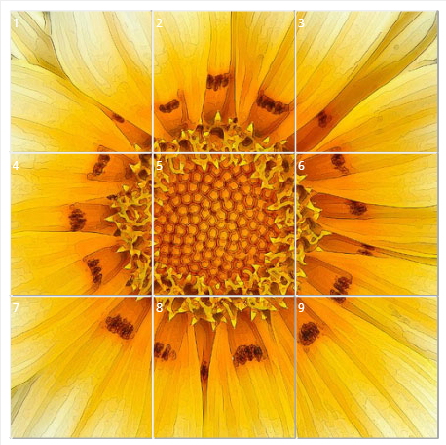
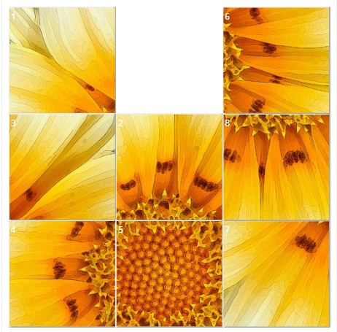
8 puzzle

Slide 3
8 puzzle
8 | 5 | 4
6 | 2 | 7
1 | 3
1 | 2 | 3
4 | 5 | 6
7 | 8
The goal is to go from the initial state to the goal state

Slide 4
8 puzzle
8 | 5 | 4
6 | 2
1 | 3 | 7
8 | 5 | 4
6 | 2 | 7
1 | 3
8 | 5 | 4
6 | 2 | 7
1 |  | 3

Slide 5
8 puzzle
8 | 5
6 | 2 | 4
1 | 3 | 7
8 | 5 | 4
6 | 2
1 | 3 | 7
8 | 5 | 4
6 | 2 | 7
1 | 3
8 | 5 | 4
6 |  | 2
1 | 3 | 7

Slide 6
8 puzzle
8 |  | 4
6 | 5 | 2
1 | 3 | 7
8 | 5 | 4
6 | 2
1 | 3 | 7
8 | 5 | 4
6 |  | 2
1 | 3 | 7
8 | 5 | 4
6 | 3 | 2
1 |  | 7
8 | 5 | 4
 | 6 | 2
1 | 3 | 7

Slide 7
8 puzzle
8 | 5 | 4
6 | 2 | 7
1 | 3
8 | 5 | 4
 | 6 | 2
1 | 3 | 7
1 | 2 | 3
4 | 5 | 6
7 | 8
The goal is to go from the initial state to the goal state via other states in minimum number of moves

Slide 8
Can be considered as a graph
Starting from a node n find the shortest path to a goal node g
1 | 2 | 3
4 | 5 | 6
7 | 8
8 | 5 | 4
6 | 2 | 7
1 | 3
?
State Space Search

Slide 9
The Generalized Search Problem
Starting from a node n find the shortest path to a goal node g
20
15
10
5
15
?
18
20
25
33
We want:
A path → v1 → v2 → … →
Such that g( ) = cost( →v1) + cost(v1→ v2) + …
+ cost ( vn-1 → ) is minimum

Slide 10
How to solve this problem ??

Slide 11
Djikstra Algorithm ???

Slide 12

Example
What does Djikstra’s algorithm will do? (minimizing g(n))
Problem: Visit too many nodes, some clearly out of the question

Slide 13
Complexity
Actual complexity is O(|E|log₂ |E|)
Is this good?
Actually it is bad for very large graphs!
Branching factor: b
….
# nodes = b^{(# levels)}
….
Another Example: think of the search space in chess

Slide 14
Better Solution: Make a “hunch”!
Use heuristics to guide the search
  Heuristic: estimation or “hunch” of how to search for a solution
We define a heuristic function:
  h(n) = Estimate of the cost of the cheapest path from the initial state to the goal state”

Slide 15
Lets Try A Heuristic
Heuristic: minimize h(n) = “Euclidean distance to destination”
Problem: not optimal (through Rimmici Viicea and Pitesti is shorter)

Slide 16
The A* Search
Difficulty: we want to still be able to generate the path with minimum cost
A* is an algorithm that:
  Uses heuristic to guide search
  While ensuring that it will compute a path with minimum cost
“estimated cost”
A* computes the function f(n) = g(n) + h(n)
“actual cost”

Slide 17
A*
f(n) = g(n) + h(n)
  g(n) = “cost from the starting node to reach n”
  h(n) = “estimate of the cost of the cheapest path from n to the goal node”
h(n)
20
g(n)
15
n
10
5
15
18
20
25
33

Slide 18
Example
A*: minimize f(n) = g(n) + h(n)

Slide 19
Properties of A*
A* generates an optimal solution if h(n) is an admissible heuristic and the search space is a tree:
  h(n) is admissible if it never overestimates the cost to reach the destination node
A* generates an optimal solution if h(n) is a consistent heuristic and the search space is a graph:
  h(n) is consistent if for every node n and for every successor node n’ of n:
  h(n) ≤ c(n,n’) + h(n’)
h(n)
n
d
c(n,n’)
h(n’)
n’
If h(n) is consistent then h(n) is admissible
Frequently when h(n) is admissible, it is also consistent

Slide 20
Admissible Heuristics
A heuristic is admissible if it is optimistic, estimating the cost to be smaller than it actually is.
Example:
In the road map domain,
h(n) = “Euclidean distance to destination”
is admissible as normally cities are not connected by roads that make straight lines

Slide 21
What if the heuristic is too optimistic??

Slide 22
How to Create Admissible Heuristics
Relax the conditions of the problem
  This will result in admissible heuristics!
Lets look at an 8-puzzle game:
/
Possible heuristics?

Slide 23
8 puzzle
8 | 5 | 4
6 | 2 | 7
1 | 3
1 | 2 | 3
4 | 5 | 6
7 | 8
The goal is to go from the initial state to the goal state

Slide 24
Example: Admissible Heuristics in 8-Puzzle Game
Heuristic: a tile A can be moved to any tile B
  H1(n) = “number of misplaced tiles in board n”
Heuristic: a tile A can be moved to a tile B if B is adjacent to A
  H2(n) = “sum of distances of misplaced tiles to goal positions in board n”
Some experimental results reported in Russell & Norvig (2002):
  A* with h2 performs up to 10 times better than A* with h1
  A* with h2 performs up to 36,000 times better than a classical uninformed search algorithm (iterative deepening)

Slide 25
A* in Games
Path finding
  http://aigamedev.com/open/interviews/mario-ai/
A* can be used for planning moves computer-controlled player (e.g., chess)

Slide 26
☺

