Slide 1
Samuel’s Password Generator
By Samuel Caraballo Vazquez

Slide 2
What is it:
Samuel’s Password Generator is an application that generates a random password by making use of a set of characters from the ASCII table.
It has an user-friendly interface.
It only uses ASCII characters that are printable. This is a set of 95 characters.
It allows users to choose the length of their passwords.
It is written in and tested to run with Python 3.8.0.

Slide 3
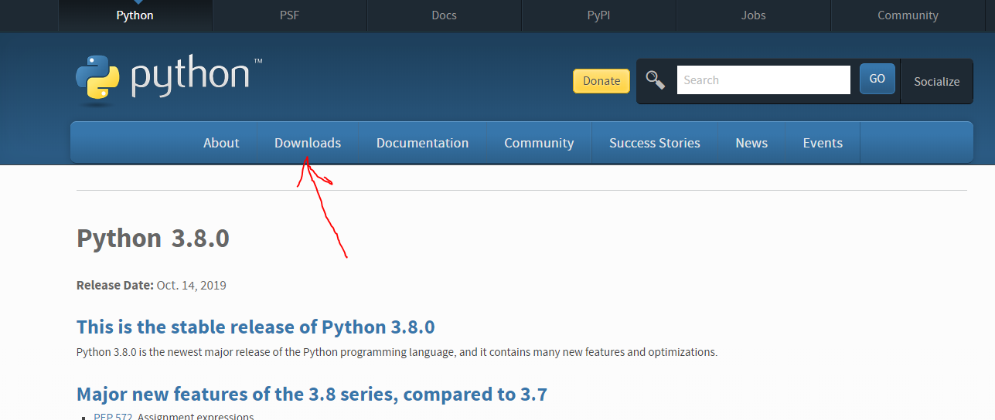
How to install & run:
Python 3.8.0 needs to be installed as it was used to build it.
Python 3.8.0 can be downloaded here

Slide 4

How to install & run:
When installing password, make sure that these options are clicked:

Slide 5
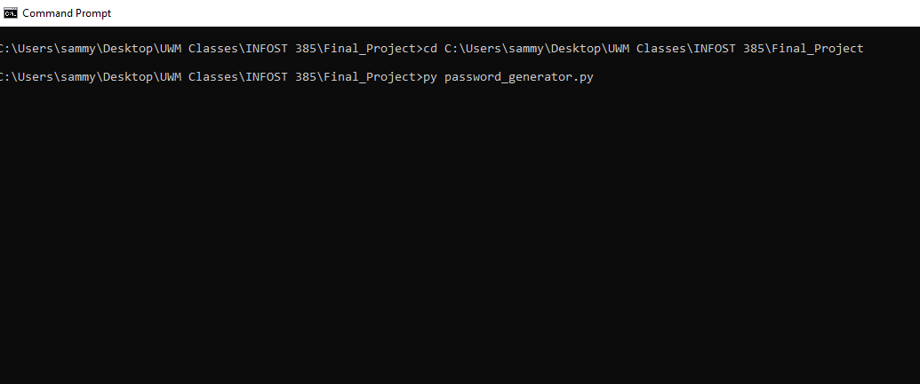
How to install & run:
Find where the python file resides with your terminal and run the program like so:
Important command!

Slide 6
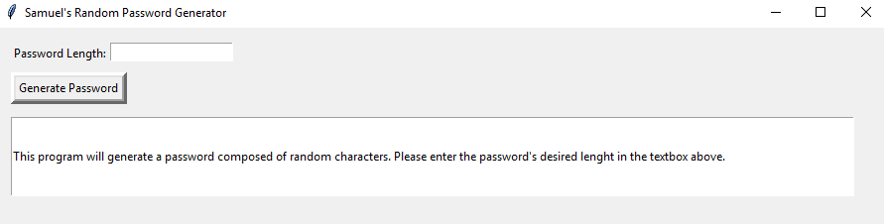
How to use the application:
Samuel’s Password Generator is very easy to use!
Enter a number between 8 and 127 (including)
Press Generate Password. That’s it!
Information on how to use is also displayed on the bigger text box.

Slide 7
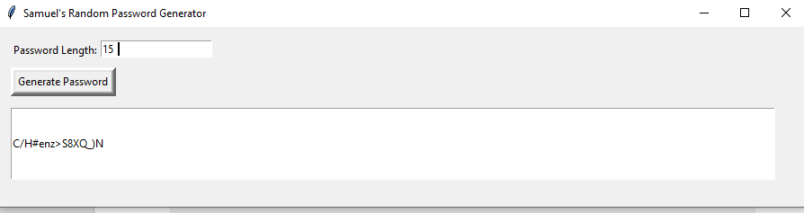
How to use the application:
After a number between 8 and 127 is entered and Generate Password is pressed. Note how the generator gives 15 random characters exactly.

Slide 8
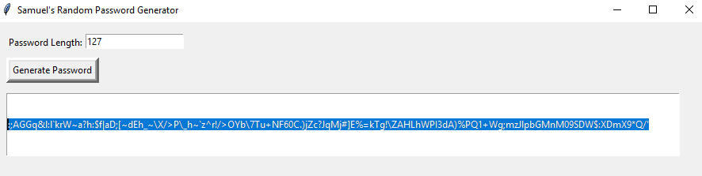
How to use the application:
Password text can be copied (and pasted) to add to any kind of form and for easy storage.

Slide 9
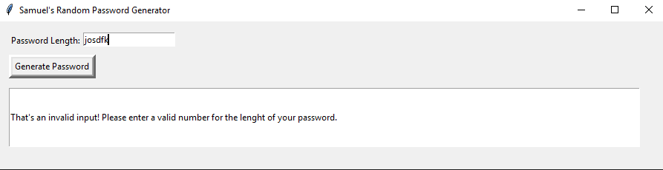
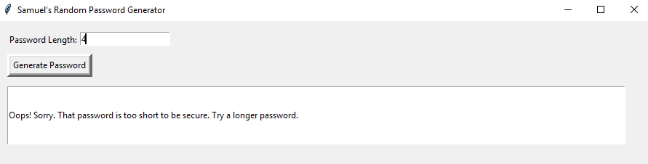
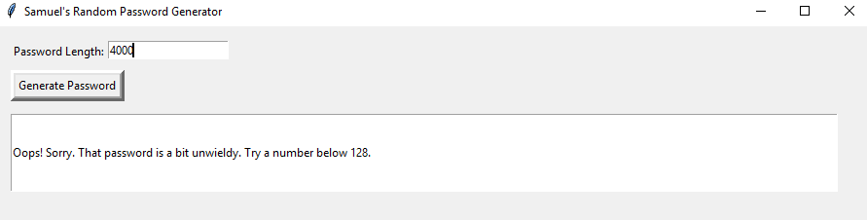
It catches common errors automatically

Slide 10
What to improve. What comes Next:
I personally will be using this password in my day to day life and I enjoyed working on this project a lot.
I will be working on turning this project into a password storing program for the future (after class).
I will build a better deployment model as to not have users rely on installing Python.

Slide 11
Helpful Links:
Python:
https://www.python.org/downloads/release/python-380/
GUI-Less Version:
https://drive.google.com/file/d/1LxzwnjEHg4Ha3DvHtHo5yeLenSJXwlL1/view?usp=sharing
Please use GUI-Less version if GUI version do not work or GUI version is too hard too install. GUI version may not work on older versions of Python.

