Slide 1
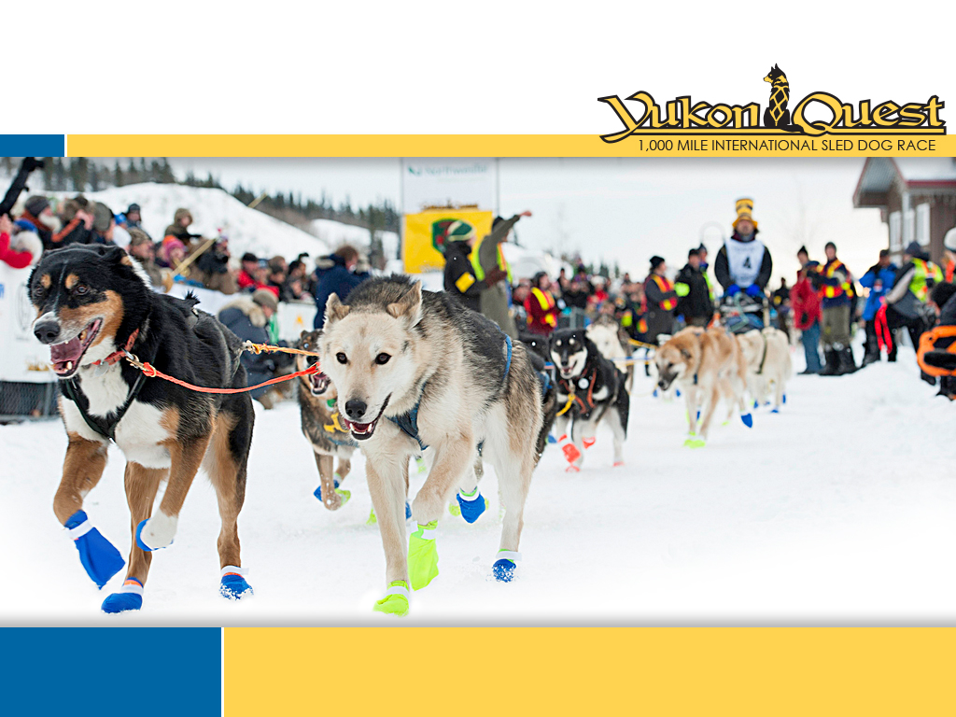

2020 Bib Sponsorship Outline
2020 Race Start Saturday, February 1 Fairbanks, Alaska

Slide 2
2020 Bib Sponsorship
The 2020 ##### Quest will:
Celebrate 37 years as the only 1,000 mile international sled dog race in the world
Run 1,000 miles through 11 communities in Alaska and the #####
Take place for 9 to 14 days around-the-clock under extreme winter conditions
Follow historic Northern travel routes that cross the border between the US and ######
Partner with six levels of government and six First Nations
The Teams
Race Veterinarians from around the world will volunteer their professional time and services to the ##### Quest Veterinary Care Program
Experienced Race Officials monitor all aspects of the race
Race Logistics team will work 24/7 to keep everything running smoothly
1,000 local and international volunteers will contribute approximately 25,000 hours to the race - everything from graphic design, to truck driving, to managing checkpoints
The Participants
Veteran and rookie mushers from around the world will participate
#### 400 canine athletes lead their humans across the wilderness

Slide 3
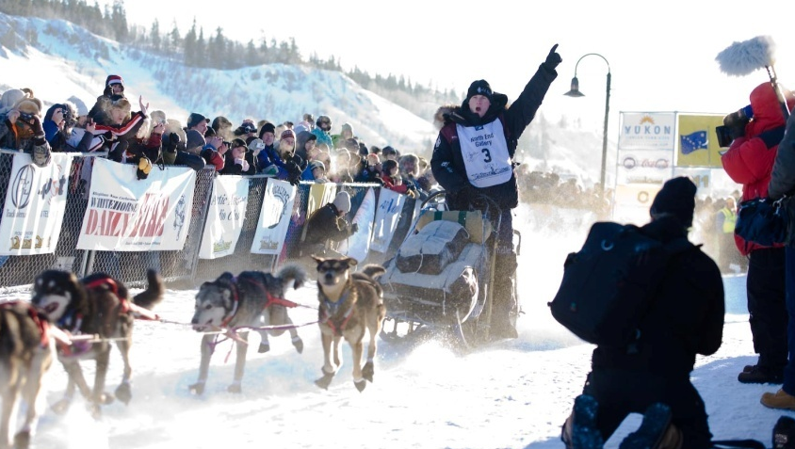
2020 Bib Sponsorship
Business Name: __________________________________________________________
Contact Person: ___________________________________________________________
Mailing Address: _________________________________________________________
________________________________________________________________________
Phone: _______________________ Fax: ____________________________________
Email: _________________________________________________________________
BIB SPONSORSHIP
2020 Finish Bib - $700
Your business name on the front & back of a mushers bib
Musher wearing your bib at the finish of the 2020 ##### Quest
Autographed ½ bib for display and/or framing
Framed photograph of musher wearing YOUR bib
Bib sponsor listing on the ##### Quest #######
MC announcement of bib sponsor as mushers approach finish line
Facebook and Twitter posts as mushers approaches finish line
Payment Info:
Please invoice
Cash
Credit card (Visa or Mastercard only) Credit Card Number: ___________________________________ Expiry Date: ____/____
Cheque: Cheque Number ___________
______________________________________ ________________
Business Owner/Manager Signature Date
Please return completed business and payment info to the ##### Quest Whitehorse office:
#2-1109 Front Street
Whitehorse, #####
Y1A 5G4
P: (867)668-4711
yukondirector@yukonquest.com

