Slide 1
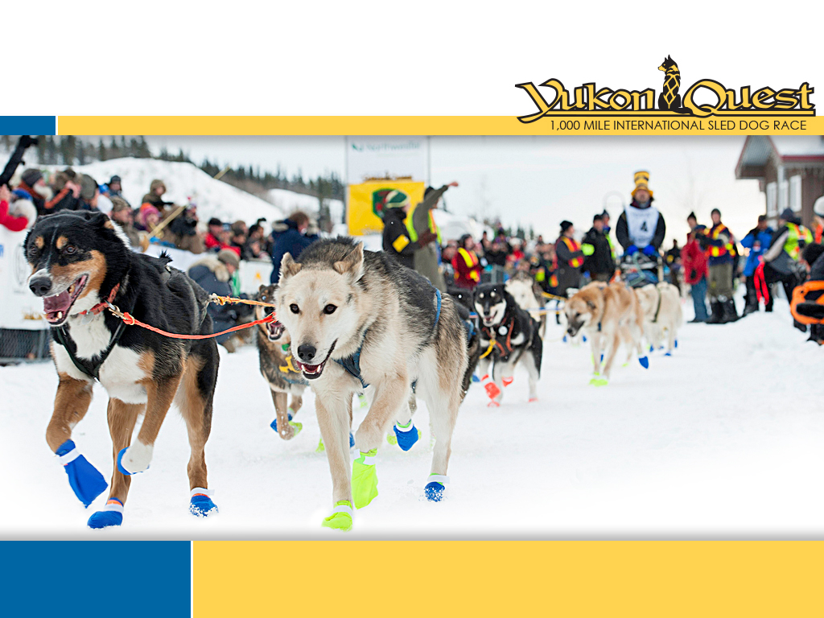

2020 Bib Sponsorship Outline
2020 Race Start Saturday, February 1 Fairbanks, Alaska

Slide 2
2020 Bib Sponsorship
The 2020 Yukon Quest will:
Celebrate 37 years as the only 1,000 mile international sled dog race in the world
Run 1,000 miles through 11 communities in Alaska and the Yukon
Take place for 9 to 14 days around-the-clock under extreme winter conditions
Follow historic Northern travel routes that cross the border between the US and Canada
Partner with six levels of government and six First Nations
The Teams
Race Veterinarians from around the world will volunteer their professional time and services to the Yukon Quest Veterinary Care Program
Experienced Race Officials monitor all aspects of the race
Race Logistics team will work 24/7 to keep everything running smoothly
1,000 local and international volunteers will contribute approximately 25,000 hours to the race - everything from graphic design, to truck driving, to managing checkpoints
The Participants
Veteran and rookie mushers from around the world will participate
Over 400 canine athletes lead their humans across the wilderness

Slide 3
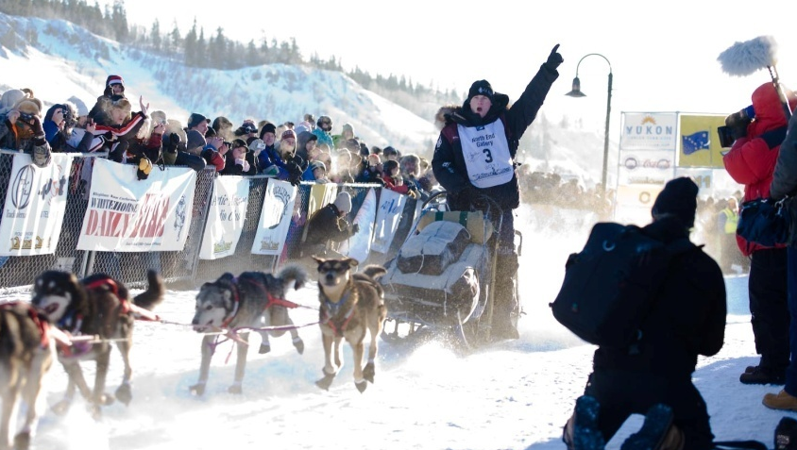
2020 Bib Sponsorship
Business Name: __________________________________________________________
Contact Person: ___________________________________________________________
Mailing Address: _________________________________________________________
________________________________________________________________________
Phone: _______________________ Fax: ____________________________________
Email: _________________________________________________________________
BIB SPONSORSHIP
2020 Finish Bib - $700
Your business name on the front & back of a mushers bib
Musher wearing your bib at the finish of the 2020 Yukon Quest
Autographed ½ bib for display and/or framing
Framed photograph of musher wearing YOUR bib
Bib sponsor listing on the Yukon Quest website
MC announcement of bib sponsor as mushers approach finish line
Facebook and Twitter posts as mushers approaches finish line
Payment Info:
Please invoice
Cash
Credit card (Visa or Mastercard only) Credit Card Number: ___________________________________ Expiry Date: ____/____
Cheque: Cheque Number ___________
______________________________________ ________________
Business Owner/Manager Signature Date
Please return completed business and payment info to the Yukon Quest Whitehorse office:
#2-1109 Front Street
Whitehorse, Yukon
Y1A 5G4
P: (867)668-4711
yukondirector@yukonquest.com

