Slide 1

KNOWLEDGE MAPPING and DATA VISUALIZATION
Project Theme: COVID-19
Inequality of opportunity (access) in education in the Covid-19 period in Turkey.
ESENGÜL ERGÜN-17030411028

Slide 2
Why I choose this topic?
In this project, I wanted to do research on education, a social and political issue most affected by the pandemic. Because many students do not have personal computers or broadband internet networks. There are those who still cannot access the computer and the internet, which have become a necessity in this period. Along with this situation, pandemic conditions reduce the student's quality of education life.

Slide 3
I will use this tool called DataWrapper.
I tried to get data from the Turkish Statistical Institute (TUIK) and reliable institutions that have done research on this subject.
I have compiled my data in two different ways: There are two types of data: internet access data and access data to tools such as computers and tablets.

Slide 4
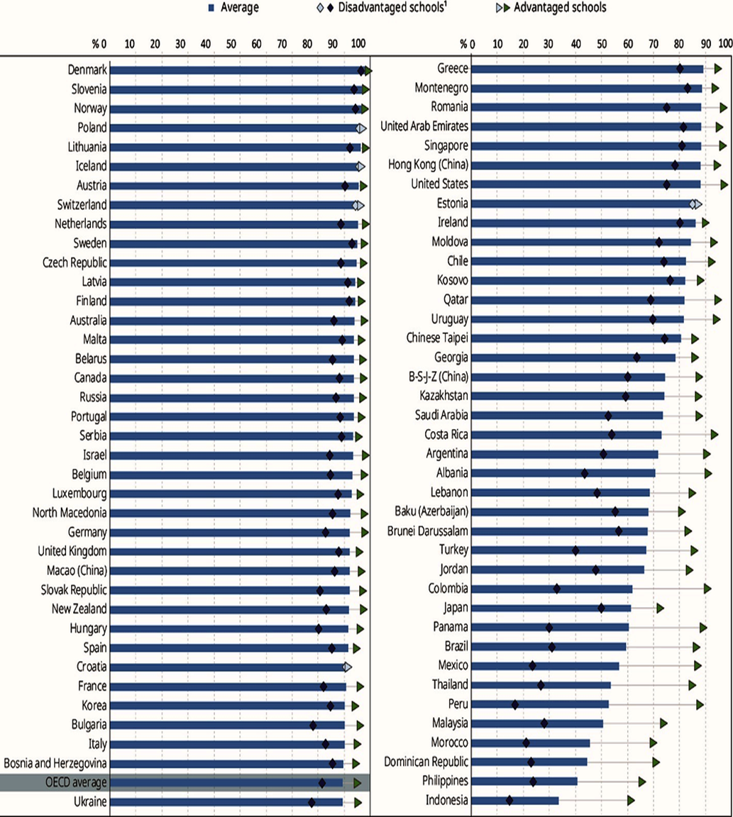
The Organization for Economic Co-operation and Development (OECD) published a report called ‘’Education in the Covid-19 Pandemic 2020‘’.
Turkey ranked 64th from 77 countries in the list of countries.

Slide 5
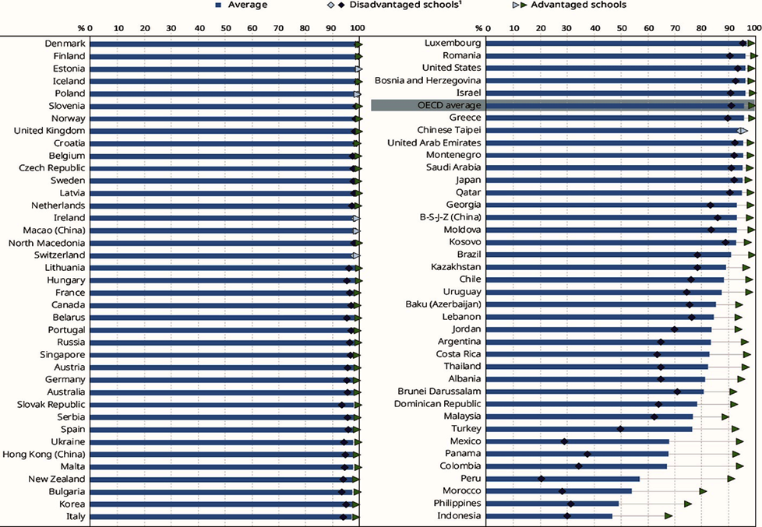
The rankings of countries for accessing the internet according to OECD.
Turkey ranked 70th in the list of "students with internet access".

Slide 6
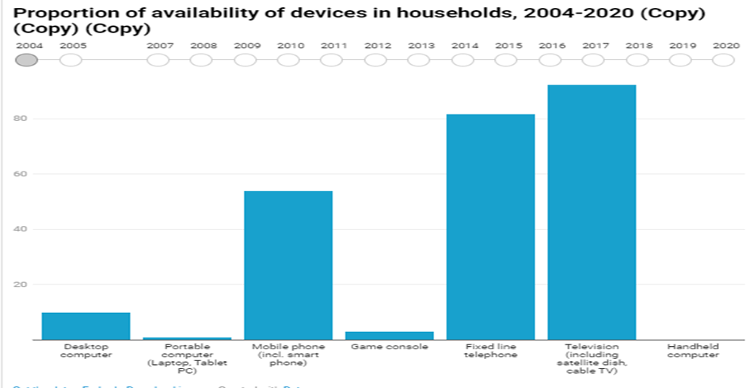
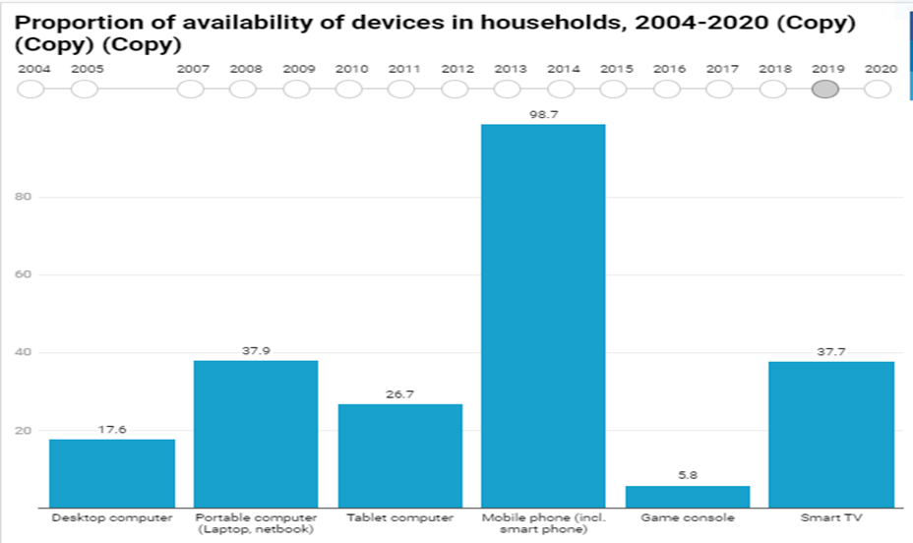
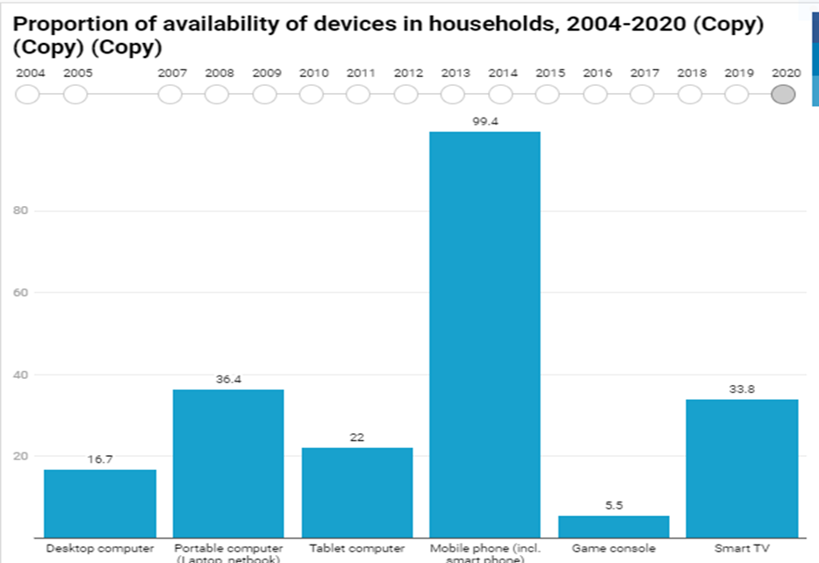
According to TUIK data, households in Turkey the rate of having internet access is 90.7%
16.7% of households with desktop computers,
36.4% of households with portable computers,
22% of households with tablets and
99.4% of households with mobile phones.

Slide 7
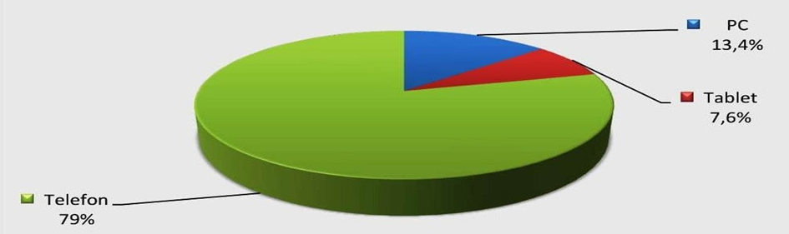
According to these data, nearly every Internet connection in 1 in 10 households not available and approximately 30% of students cannot access devices such as computers and tablets. Most of the time, they can take classes from a small-screen mobile phone.

Slide 8
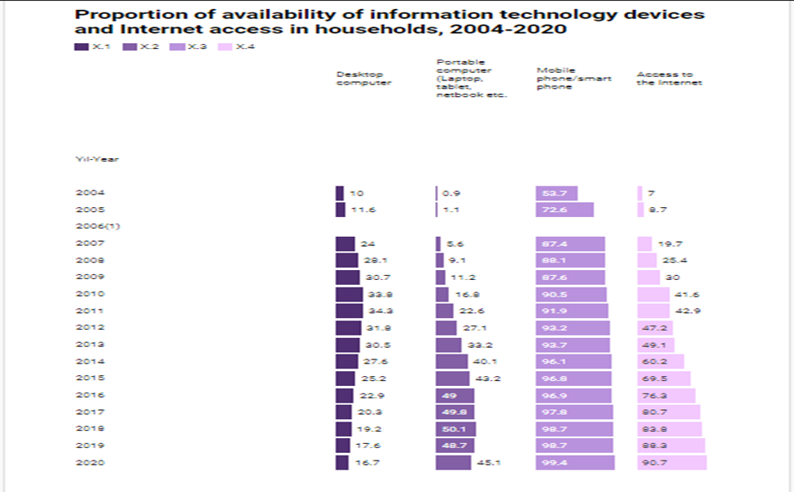
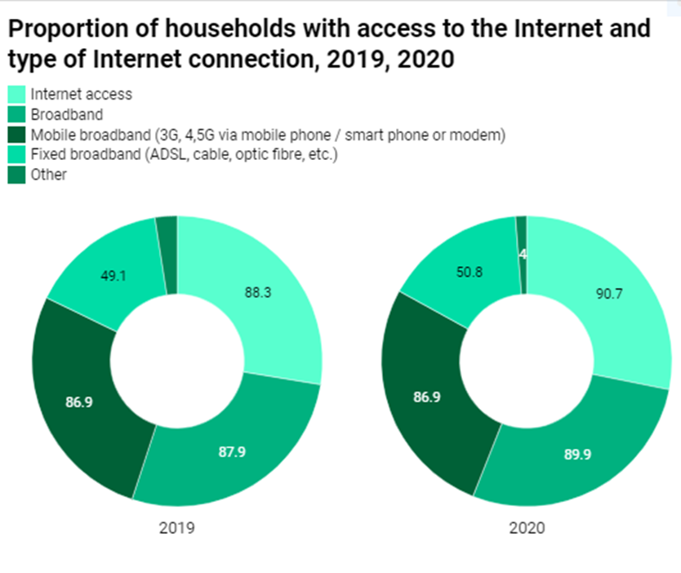
The rate of access to the internet has increased from 2019 to 2020 due to the distance education that came with Covid, but the rates still show that approximately 1 out of 10 people cannot reach us.
49.1% of households in Turkey use ADSL, cable Internet, fiber etc. with fixed broadband connection and 86.9% with mobile broadband connection.

Slide 9
In a study conducted among university students during the pandemic period;
It has been determined that only;
63% of the students have an internet connection at home
66% have a computer or tablet.
One third of the students do not have computers and tablets.
64% of students have distance access education from computers or tablets;
32% of them are using their smartphones;
It was found that 23% of them could not participate in distance education.

Slide 10
YouTube Link for video : https://youtu.be/UEkIDpV2ax0
THANKS FOR WATCHING…

