Slide 1
Activity Tracker Demo
Rex Ferrer, Amanda Guinyard, Meena Rahimi

Slide 2
Vision
The vision of this project is to implement an aesthetically pleasing personal health monitor that controls and monitors the users physical activities. The user will be able to see the time and date when the device is powered on and be able to swipe through different screens. They will be able to see a summary of how long they have slept for that day and their sleeping patterns throughout the duration of its wear. The user will be able to track their steps along with how many calories they burn.

Slide 3
The major features include:
Time Display
Tracks Activity
Recognize and track Sleep Patterns
Data Transmission

Slide 4
Use Case Name | Display time to User
Scope | Activity Tracker Software
Level | User Goal
Primary Actor | User
Stakeholders and Interests | User: Wants accurate time displayed Tracker: Accurate time displayed
Preconditions | Tracker must be on
Success Guarantee | User can see the time whether it’s on their wrist or not.
Main Success Scenario | User looks at Tracker. Tracker displays correct time.
Extensions | User looks at Tracker. A non-time screen is displayed. User swipes/navigates to time display. Tracker displays correct time.
Special Requirements | Allow user to change the time Time zones? Allow user to switch between Analog or Digital display.
Technology and Data Variations List | N/A
Frequency of Occurrence | Continuous
Miscellaneous | N/A

Slide 5
Use Case Name | Display steps to user
Scope | Activity Tracker Software
Level | User Goal
Primary Actor | User
Stakeholders and Interests | User: Wants accurate data for steps presented Tracker: Wants to accurately record steps
Preconditions | User is identified and “wearing” the activity tracker.
Success Guarantee | Step data is logged and saved. User’s total daily steps are calculated and then updated. Daily steps display generated.
Main Success Scenario | User uses the activity tracker and adds input regarding steps walked.. Tracker tracks the steps. Software calculates the total daily steps and displays it on the appropriate screen. User checks the display to see how many steps they took throughout the day.
Extensions | At any time, User can swipe to a different display.
Special Requirements | User interface with swipe capabilities
Technology and Data Variations List | Tracker display determined by User swiping through the interface
Frequency of Occurrence | Could be continuous
Open Issues | Explore data protection and security.

Slide 6
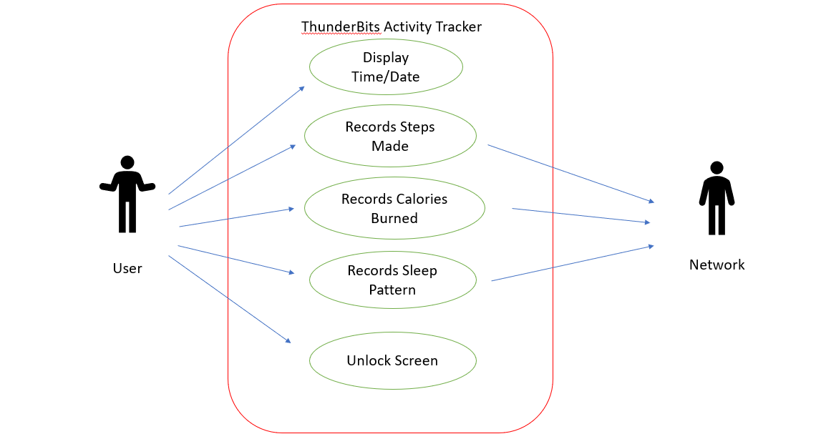

Slide 7
