Slide 1
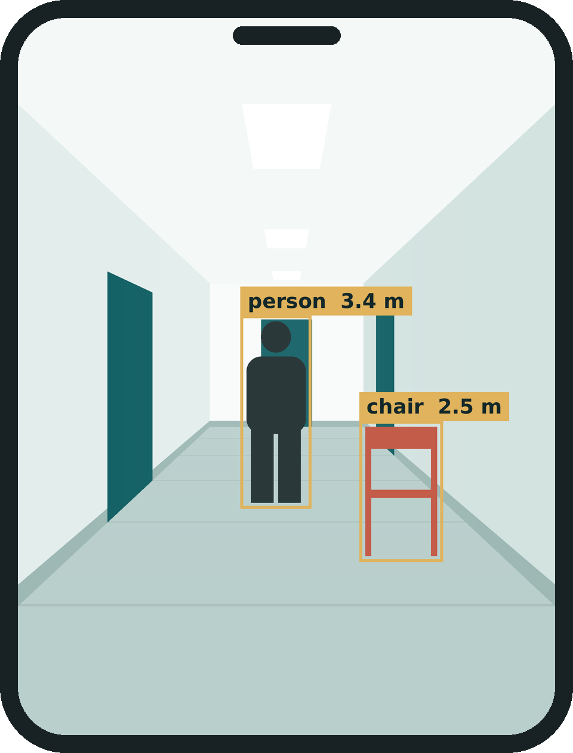
Team Tech Titans presents:
ASSISTIVE VISION · ANDROID + AI
Raahi
LIVE GUIDANCE
راہی
“Stop.”
“Chair ahead, 3 steps.”
آپ کے سفر کا ساتھی
Point your phone. Hear where to step.
“Move 2 steps left.”
Indoor Urdu voice + vision
Not a headset
Multi-lingual Support
TRACK: AI in HealthCare

Slide 2
Vision loss is common. Aids are not affordable
2.2 billion
43 million
~90%
26 million
people with some vision impairment
completely blind
live in low- and middle-income countries
impaired in Pakistan; 1.5–1.8 million blind
Source: WHO
$1,500–$4,500
• GPS dies indoors
• English apps fail
price of glasses and wearables
• Photo-AI doesn’t say where to step

Slide 3
THE SOLUTION
See. Measure. Speak.
1
2
3
See
Measure
Speak
Phone camera. YOLOE names door, chair, person.
Depth Anything V2. Metres, left / centre / right.
Recorded Urdu clips and vibration.
HEAR
“Stop — person ahead — 3 steps — move 2 left.”

Slide 4
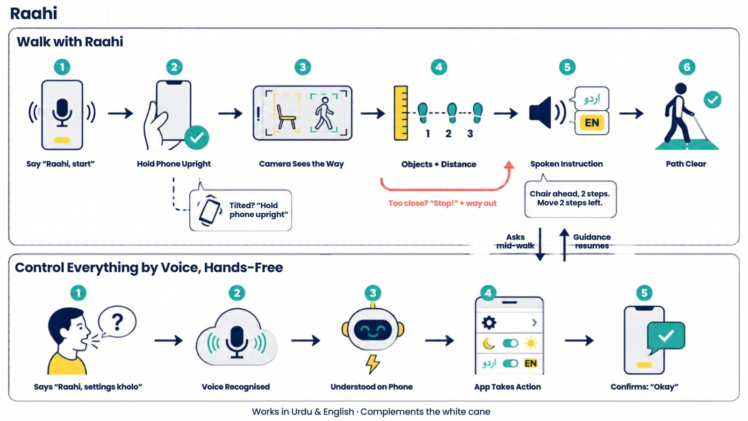
USER FLOW
Walk, ask, hear. Hands-free.

Slide 5
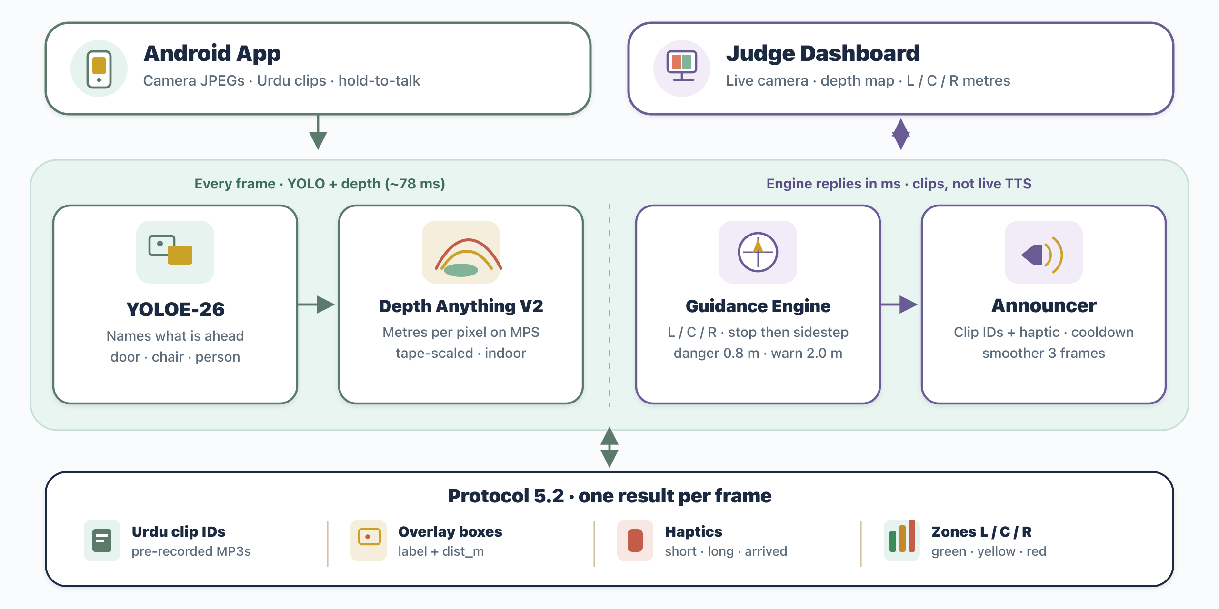
ARCHITECTURE
From camera frame to guidance in ~78 ms.

Slide 6

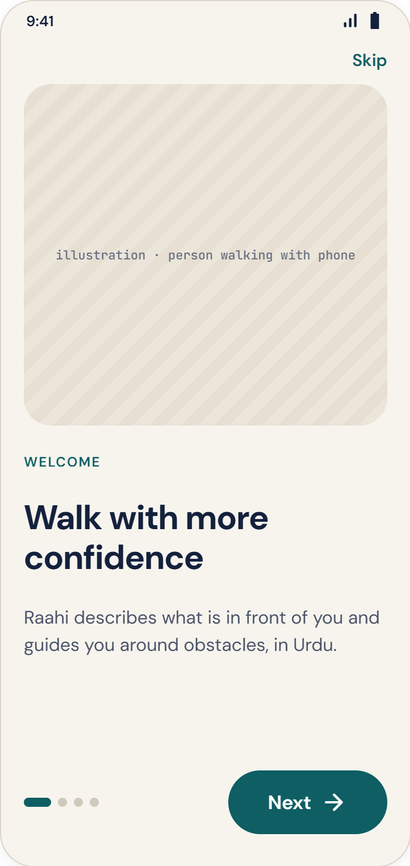
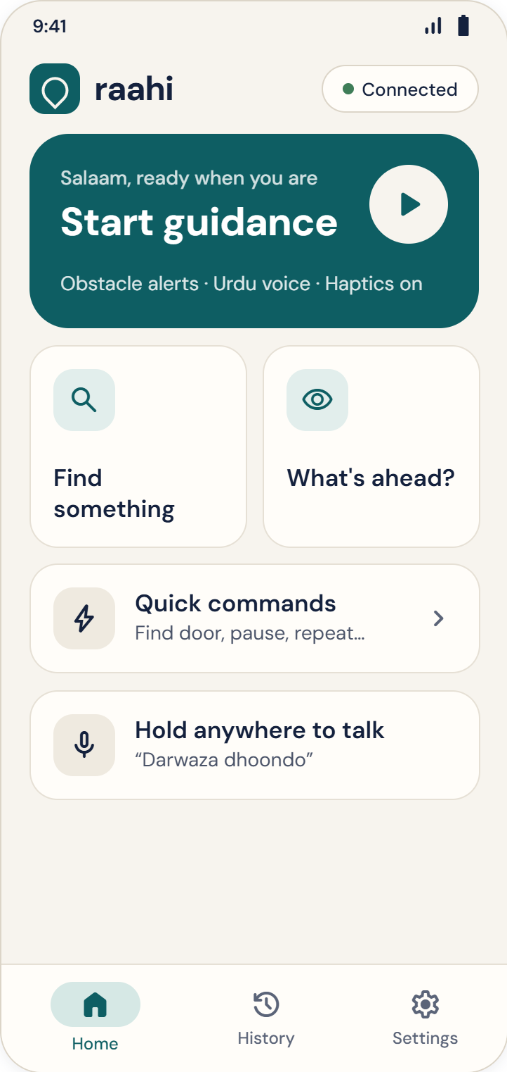
THE APP · START
Open, learn, go.
Splash
Onboarding
Home

Slide 7
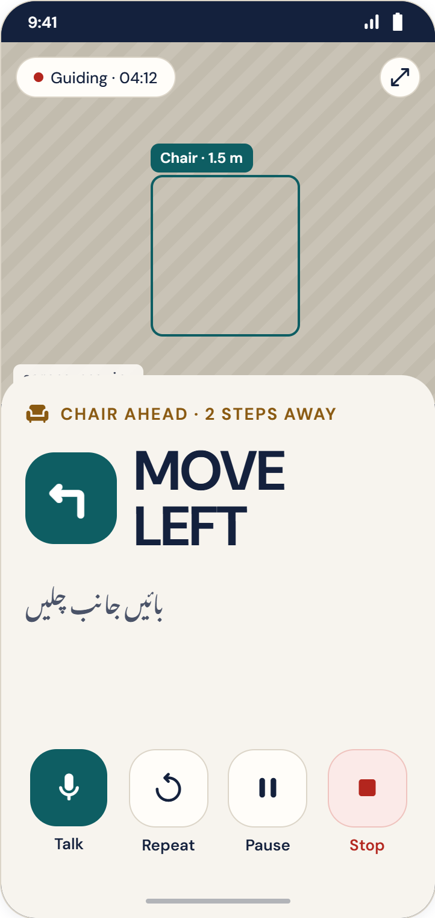
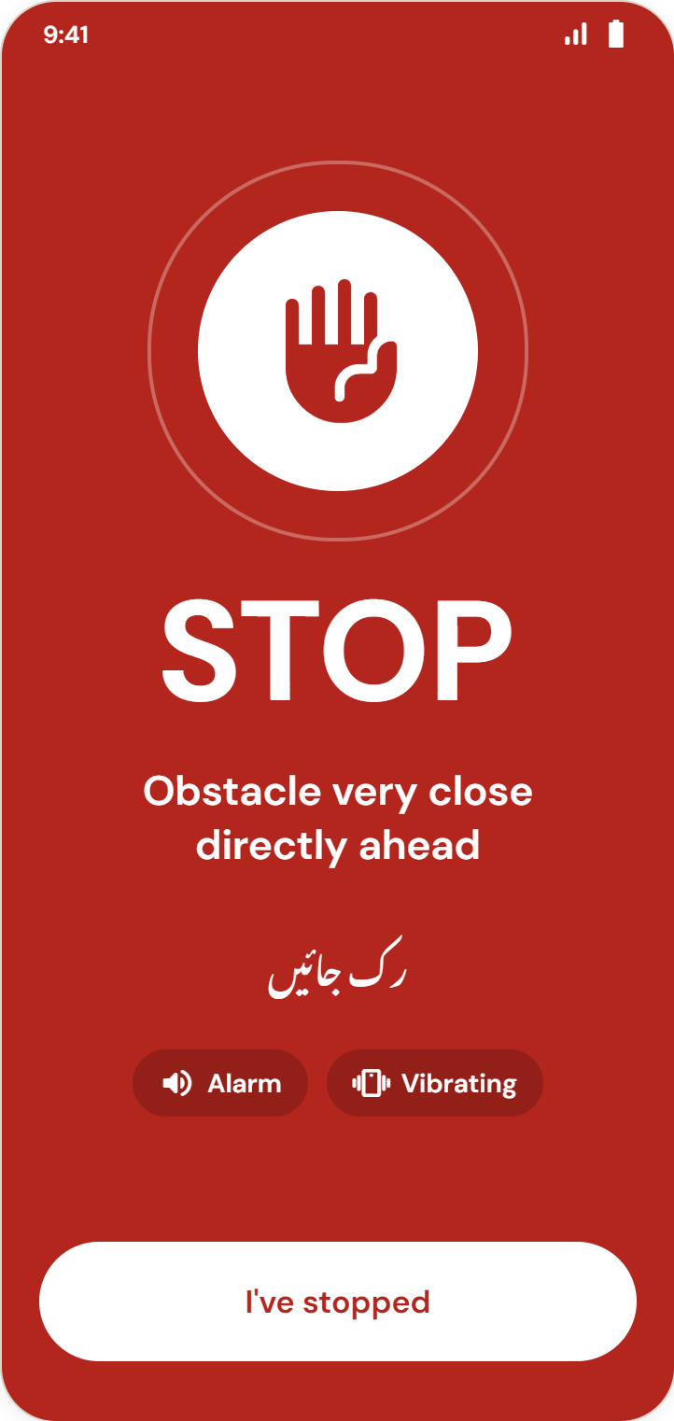
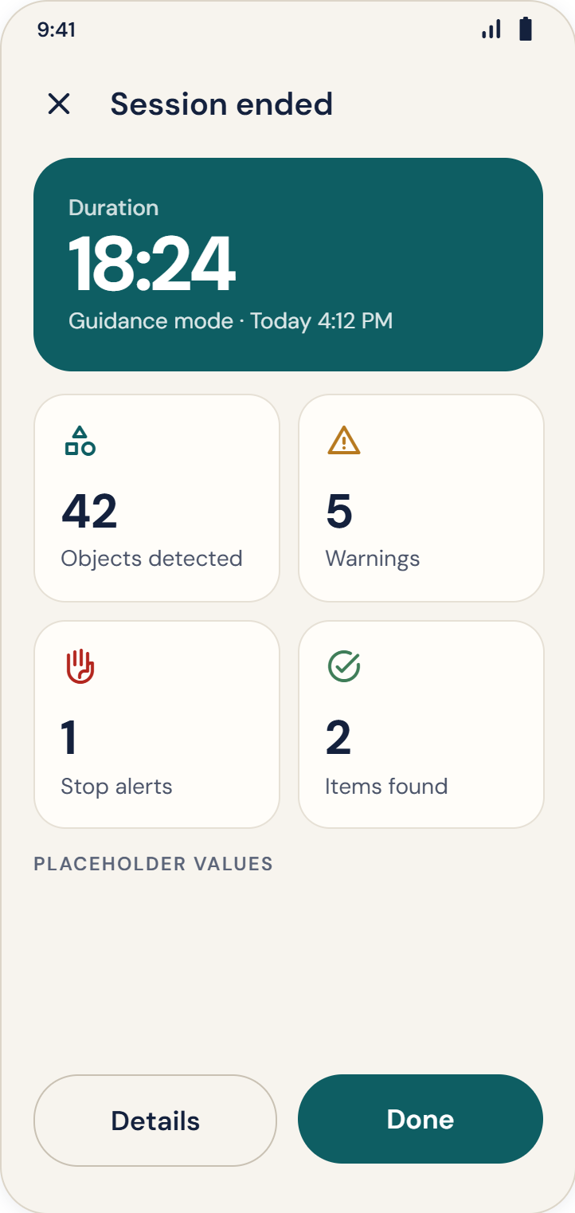
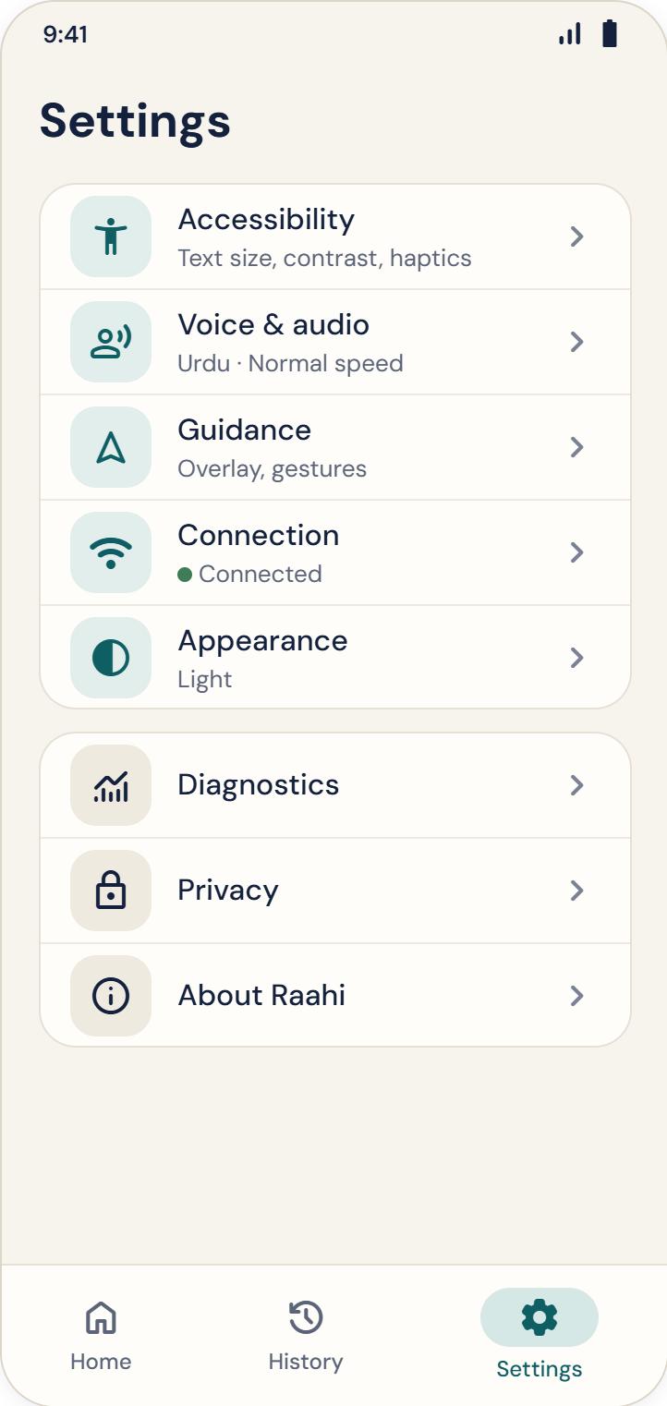
THE APP · CONTROL
Ask, review, adjust.
Active guidance
Danger alert
Session summary
Settings

Slide 8
THANK YOU..
Any Questions?

