Slide 1

Coimbatore Institute Of Technology Department of Computer Science and Engineering External Project Review 15/05/2023
DESIGN AND DEVELOP AN IDS FOR DETECTION OF RPL ATTACKS IN IOT NETWORKS USING DEEP LEARNING TECHNIQUE
Team Members
Reg .No. | Name of the student
1905012 | A. Esha
1905024 | M. Kousika
1905049 | J. Shubashini
2005202 | M. Asiya Begam
Project Guide
Dr. M Mohanapriya,
Associate Professor,
Department of Computer Science and Engineering

Slide 2
PROBLEM STATEMENT
The Aim of the work is to create a dataset, including normal traffic data and RPL attacks in 6LOWPAN network using the Cooja simulator.
The Aim of the work is to detect and classify the RPL attacks using deep learning methods.
To design and develop an Intrusion Detection System for detection of RPL attacks in IOT networks using deep learning technique.

Slide 3
OBJECTIVE
The main objective of the proposed System is to simulate Routing protocol attacks(Version Number Change, Sinkhole, DIS-Flood) in a 6LOWPAN using cooja simulator and detect them using deep learning approach.

Slide 4
ABSTRACT
The Internet Of Things (IoT) technology has led to numerous challenges in various life domains, such as healthcare, smart systems, and mission-critical applications.
IoT uses the routing protocol for low-power and lossy networks (RPL) for data communication among the devices.
RPL comprises a lightweight core and thus does not support high computation and resource-consuming methods for security implementation.
A model has been proposed to identify and classify IoT routing attacks. To generate IoT routing datasets, the Cooja simulator is used.
The objective is to perform an accurate and efficient detection of various types of routing attacks such as version number change attack, flooding attacks, Sinkhole attack.

Slide 5
LITERATURE SURVEY

Slide 6
PAPER 1 - RPL rank attack detection using Deep Learning
AUTHORS – Wijdan Choukri, Hanane Lamaazi, Nabil Benamar
Published In: 2020 International conference on innovation abd intelligence for informatics,computing and technologies..
Methodology | The proposed work focus on 1) Creating a misbehaving of RPL protocol by implementing a rank attack in the network and 2) proposing an IDS based on the multi-Layer Perceptron (MLP) neural network with the aim to verify and classify normal and abnormal network traffic.
Algorithm Used | ANN(Artificial Neural Network)
Advantages | It uses self generated dataset. It detect attacks with high accuracy of 98.96%.
Disadvantages | Its only detect the attack and it doesn’t provide classification.

Slide 7
PAPER 2- DETONAR: Detection of Routing Attacks in RPL-Based IoT
AUTHORS – Andrea Agiollo , Mauro Conti , Senior Member, IEEE, Pallavi Kaliyar , Tsung-Nan Lin , Senior Member, IEEE, and Luca Pajola
Published In: IEEE TRANSACTIONS ON NETWORK AND SERVICE MANAGEMENT, VOL. 18, NO. 2, JUNE 2021
Methodology | This work aim to develop an Intrusion Detection System (IDS) capable of dealing with multiple attacks while avoiding any RPL overhead. This system is called DETONAR - DETector of rOutiNg Attacks in Rpl and it relies on a packet sniffing approach.
Algorithm Used | It involves i)detection of anomalous traffic behaviors ii) identification of the corresponding attack and compromised device
Advantages | It identifies fourteen different kinds of RPL attacks.
Disadvantages | It doesn’t provide any implementation on real time network.

Slide 8
PAPER 3 - SIMULATING RPL ATTACKS IN 6LOWPAN FOR DETECTION PURPOSES
AUTHORS – Marius Preda and Victor-Valeriu Patriciu
Published In: IEEE 2020
Methodology | In this paper the most well-known routing attacks against 6LoWPAN networks were studied and implemented through simulation, conducting a behavioral analysis of network components (resources, topology, and data traffic) under attack condition. In order to achieve a better understanding on how attacks in 6LoWPAN work, a study on 6LoWPAN networks and RPL protocol functioning was conducted.
Algorithm Used | Contiki simulation
Advantages | Attack Dataset for future use was generated.
Disadvantages | Classification and detection was not done.

Slide 9
PAPER 4 - An Intelligent RPL attack detection using Machine Learning-Based IDS for IoT
AUTHORS – Raghavendra.T , Anand M , Selvi M, Thangaramya K , Santhosh Kumar SVN,Kannan A
Published In: 4th International Conference on Innovative Data Communication,2022
Methodology | In this paper, efficient machine learning based Intrusion Detection System for Internet of Things is proposed to monitor the network activities against attacks and to detect the intruders.
Algorithm Used | Logistic regression KNN
Advantages | It detects and classifies the attacks more efficiently.
Disadvantages | Mobility was not considered. It uses the pre generated dataset.

Slide 10
DATA GENERATION
Simulation of 6LOWPAN network in Cooja Simulator
Normal data traffic pcap files collection.
Attack creation:
Version Change
Flooding
Sinkhole
Attack data traffic pcap files collection
Pcap to csv file conversion using wireshark.

Slide 11
CLASSIFICATION MODEL
Data Preprocessing
- Feature Expansion
- Labeling Attack and Normal packets
Training Phase
- Learning with Deep Learning Model
Testing Phase
- Attack Detection
Attack Classification
- Classification of normal and three different types of attacks.

Slide 12
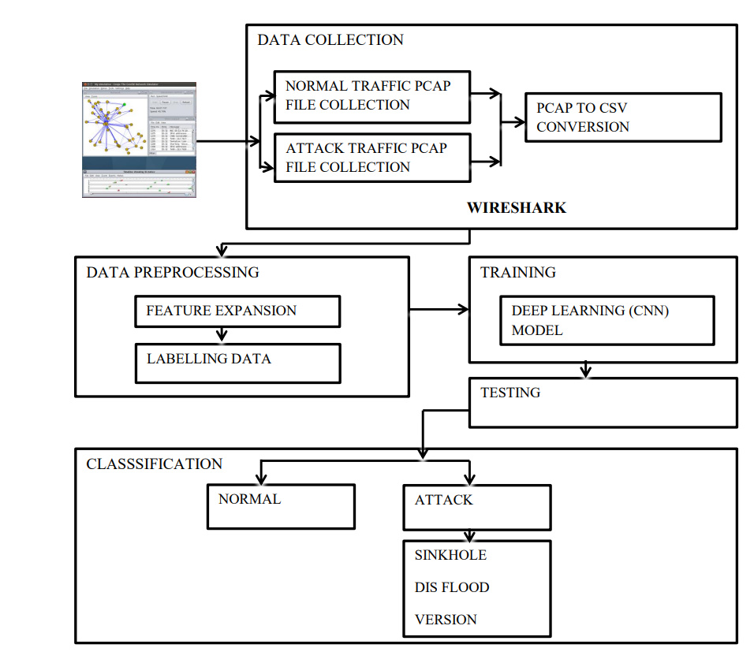
ARCHITECTURE

Slide 13
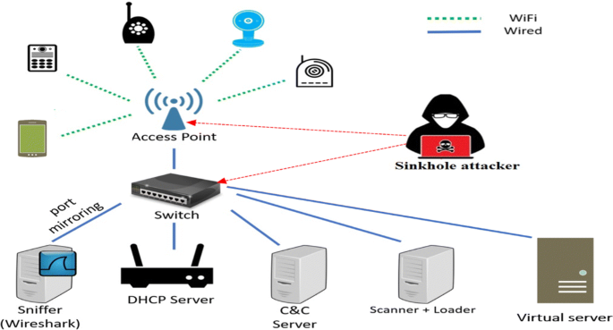
SINKHOLE ATTACK
Sinkhole attack is another variant of isolation attack.
Sinkhole attack in RPL is actually a combination of two types of attacks.
Rank decrease attack
Blackhole attack
Attacking node uses rank decrease attack to attract more nodes to select it as their preferred parent.
It will drop all their packets thereby isolating them from root node and the network.

Slide 14
RANK DECREASED ATTACK
To implement rank decrease attack, some changes are made in normal source code of RPL implementation in Contiki.
The files to be modified are located in the directory “contiki/core/net/rpl/”
rpl-private.h – contains private declarations for Contiki RPL implementation(ICMP control messages, timers, modes of operation, DAG routing tables etc.) .
rpl-timers.c – RPL timer management implementation in Contiki.

Slide 15
RANK DECREASED ATTACK
Changes to rpl-private.h
The file “rpl-private.h” contains various constant definitions related to DAG rank calculation.
The decreased rank attack can be implemented by altering constants like RPL_CONF_MIN_HOPRANKINC .
It is changed from (7* RPL_CONF_MIN_HOPRANKINC to 0).

Slide 16
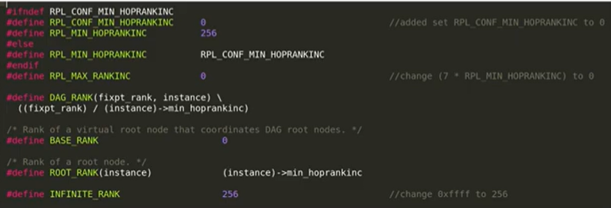
RANK DECREASED ATTACK
Modified rpl-private.h

Slide 17
RANK DECREASED ATTACK
Changes to rpl-timers.c
The file “rpl-timers.c” contains code that recalculates the node ranks used in RPL.
Implementation of decreased rank attack also requires to disable the recalculation, so that the effects of rank decrease are not undone.

Slide 18
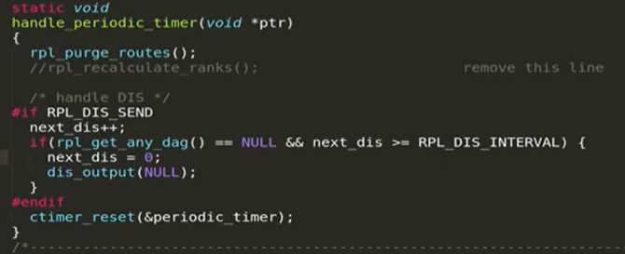
RANK DECREASED ATTACK
Modified rpl-timer.c

Slide 19
BLACKHOLE ATTACK
To implement blackhole attack, some changes are made in normal source code of RPL implementation in Contiki.
The files to be modified are located in the directory “contiki/core/net/ipv6/”
uip6.c – contains implementation of uIP TCP/IPv6 stack for Contiki.

Slide 20
BLACKHOLE ATTACK
Changes to uip6.c
The file “uip6.c” includes code that forwards packets not intended for the current node to their destination.
To implement the blackhole attack , the malicious node should drop all such packets.
This will cause the affected nodes to stop receiving traffic from nodes with which they have no other connection.

Slide 21
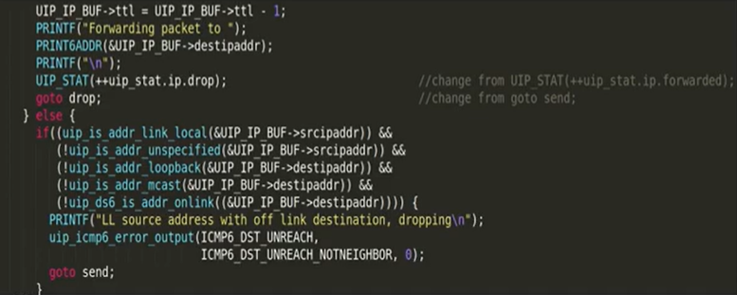
BLACKHOLE ATTACK
Modified uip6.c

Slide 22
DIS FLOODING ATTACK
Flooding attack consist of generating a large amount of traffic in the network with the purpose of making nodes and links unavailable.
Using solicitation messages to perform the flooding attack is called “Hello Flood Attack”.
To perform flooding attacks in RPL networks an attacker can Broadcast DIS(DODAG Information Solicitation) messages to neighboring nodes.

Slide 23
DIS FLOODING ATTACK
To implement flooding attack, some changes are made in normal source code of RPL implementation in Contiki.
The files to be modified are located in the directory “contiki/core/net/rpl/”
rpl-private.h – contains private declarations for Contiki RPL implementation(ICMP control messages, timers, modes of operation, DAG routing tables etc.) .
rpl-timers.c – RPL timer management implementation in Contiki

Slide 24
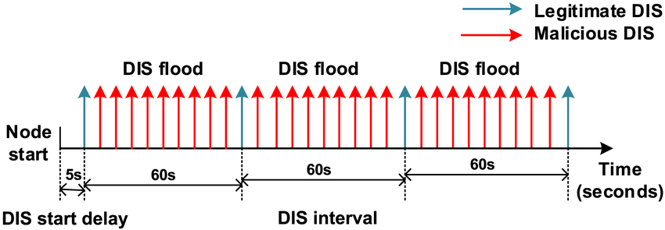
DIS FLOODING ATTACK
Changes to rpl-private.h
The file “rpl-private.h” contains various constant definitions related to DIS operation.
The flooding attack can be implemented by decreasing the value of DIS message interval and the DIS start delay, to force the malicious mote to send DIS messages as quickly as possible.
Both the values were set to 0 for maximum effect.

Slide 25
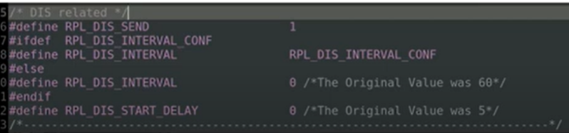
DIS FLOODING ATTACK
Modified rpl-private.h

Slide 26
DIS FLOODING ATTACK
Changes to rpl-timers.c
The file “rpl-timers.c”includes functions related to the way in which DIS message timers are handled.
A loop is added in the periodic timer function to send a total of 20 DIS messages without any conditions.

Slide 27
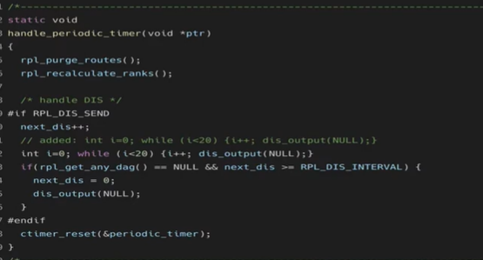
DIS FLOODING ATTACK
Modified in rpl-timer.c

Slide 28
VERSION CHANGE ATTACK
To identify and maintain a network topology, RPL uses the DODAG version number and rank mechanism.
DODAG version is a specific DODAG iteration with a given ID and the version number is a sequential counter incremented by DODAG root.
An attacker can change the version number by illegitimately increasing the value of version field of DIO messages when it forwards them to its neighbors.
It causes the unnecessary rebuilding of the whole DODAG graph which wastes node resources.

Slide 29
VERSION CHANGE ATTACK
To implement DODAG version number attack, some changes are made in normal source code of RPL implementation in Contiki.
The files to be modified are located in the directory “contiki/core/net/rpl/”
rpl-icmp6.c – manages the input and output of RPL control messages.

Slide 30
VERSION CHANGE ATTACK
Changes to rpl-icmp6.c
The file “rpl-timers.c” includes a function that constructs the DAG object and stores DAG version number.
To implement DODAG version attack DAG version variable is incremented internally.
This will cause the protocol to continuously recompute the network topology.

Slide 31
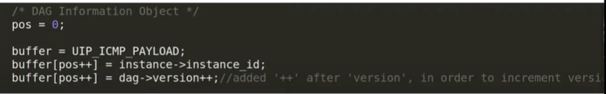
VERSION CHANGEATTACK
Modified in rpl-icmp6.c

Slide 32
DATA PREPROCESSING
Converting Raw_Data to numpy array
Features are expanded from raw data as per the need.
For Eg
packetDurations list is used for calculating packet durations.
add packetDurations column to the np_Raw_Data as 1st column
Use sklearn labelEncoder to give numbers to the ip addresses.

Slide 33
DATA PREPROCESSING
Dataframe with the columns(Features)
Second
Src
Dst
Packetcount
src_ratio
dst_ratio
src_duration_ratio
dst_duration_ratio

Slide 34
DATA PREPROCESSING
Dataframe with the columns
TotalPacketDuration
TotalPacketLength
src_packet_ratio
dst_packet_ratio
DioCount
DisCount
DaoCount
OtherMsg

Slide 35
DATASET
The dataset was built from a 6LOWPAN network of IoT devices in Cooja simulator of Contiki Operating System where 20 normal motes and 1 malicious mote communicate or transfer data in the form of packets.
The dataset is composed by IoT sensors based on 6LOWPAN network where each aspect of a real network is defined.
The Output variable is Target(legitimate, version_num, sinkhole, dis_flood).
Total No of Rows: 5144
Total No of Attributes: 17

Slide 36
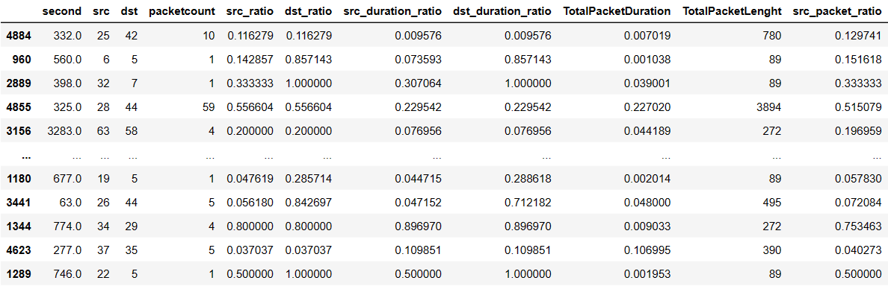
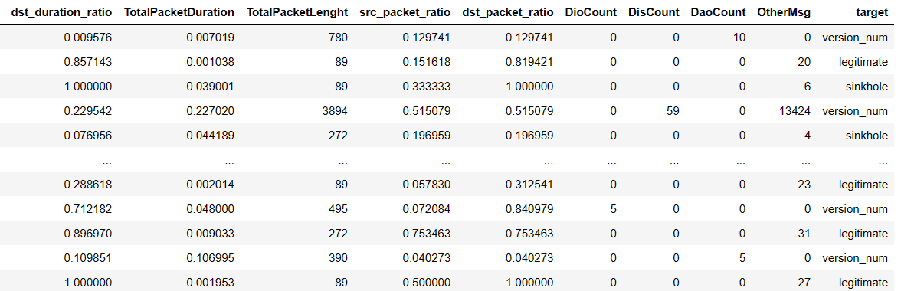
DATASET

Slide 37
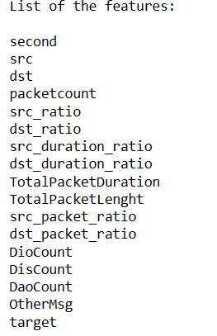
DATASET FEATURES

Slide 38
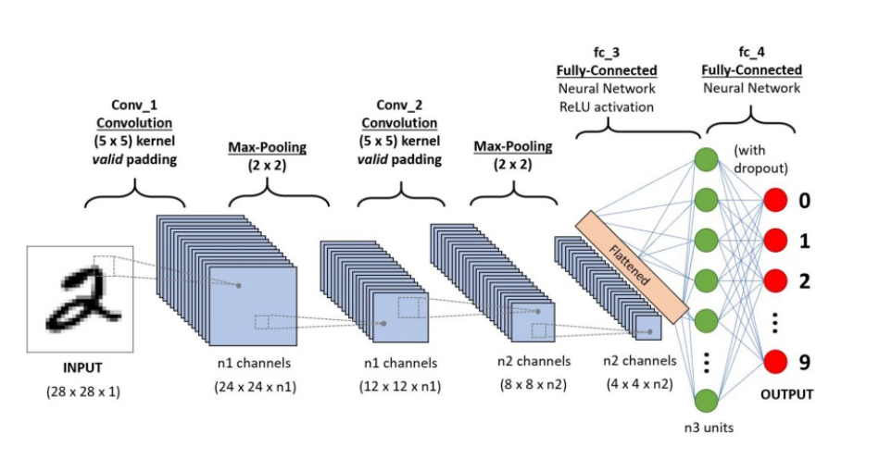
ALGORITHM
CNN-Convolutional Neural Network
A Convolutional Neural Network is a Deep Learning algorithm which can take in an input time series data, assign importance to various aspects/objects in the data and be able to differentiate one from the other.

Slide 39
DENSE HIDDEN LAYER
The input of size (None,16) to the dense layer and asking the dense layer to provide the output array of shape ( None,50) by using the units parameter as 1700, and the sequential model is using the ReLU activation function.
The input of size (None,50) to the dense layer and asking the dense layer to provide the output array of shape ( None,30) by using the units parameter as 1530, and the sequential model is using the ReLU activation function.
The input of size (None,30) to the dense layer and asking the dense layer to provide the output array of shape ( None,20) by using the units parameter as 620, and the sequential model is using the ReLU activation function.

Slide 40
FULLY CONNECTED LAYER
The final layer will reduce the vector of height twenty to a vector of four since there are four classes to predict.
This reduction is done by another matrix multiplication. Softmax is used as the classifier. It forces all four outputs of the neural network to sum up to one.
The output value will therefore represent the probability for each of the four classes. It also use adam optimizer and early stopping mechanism.

Slide 41
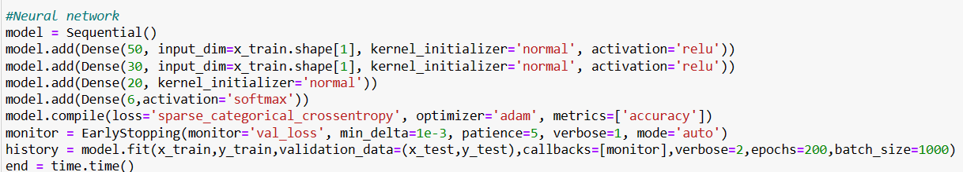
CNN MODEL

Slide 42
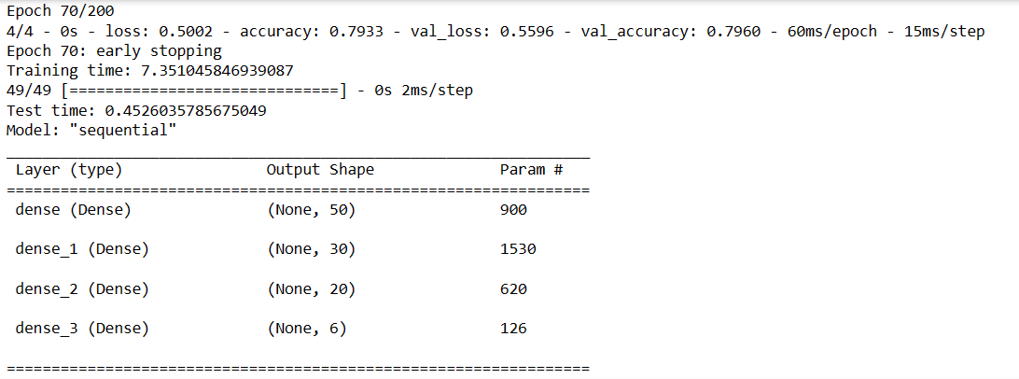
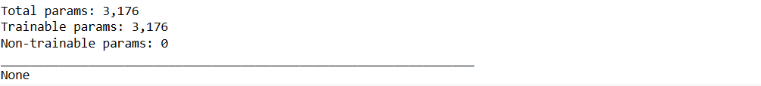
CNN MODEL SUMMARY

Slide 43
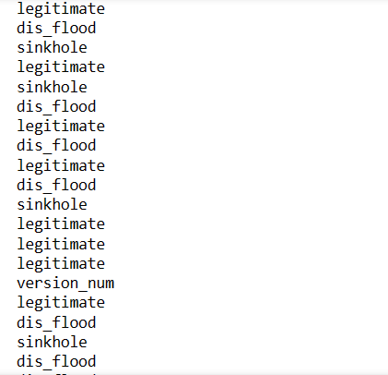
CLASSIFICATION RESULT

Slide 44
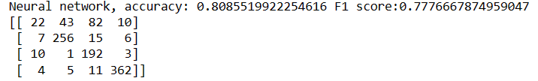
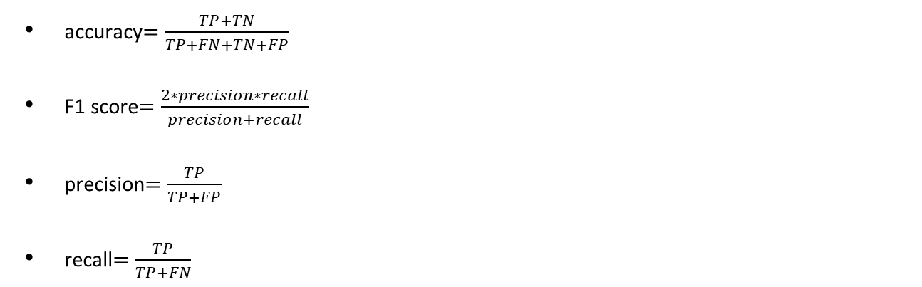
PERFORMANCE METRICS
accuracy$=\frac{TP+TN}{TP+FN+TN+FP}$
F1 score$=\frac{2∗precision∗recall}{precision+recall}$
precision$=\frac{TP}{TP+FP}$
recall$=\frac{TP}{TP+FN}$

Slide 45
CONCLUSION
In this work the data through simulating the routing protocol attacks in 6LOWPAN network connected devices was done for three different attacks and data collected.
The data was preprocessed and efficient dataset was built
Deep Learning Model was built based on One-Dimensional Convolution Neural Network (1D-CNN) methodology for the detection of normal and three different types of RPL based malicious network traffic.

Slide 46
CONCLUSION
The model make use of the deep learning methodology by employing a 1D-CNN based architecture and achieved very promising results while performing multiclass classification.
The proposed model architecture is simple and less computationally expensive.
The model achieved an overall accuracy of 77.53% with this approach.

Slide 47
REFERENCES
[1] SEMIH CAKIR , SINAN TOKLU , AND NESIBE YALCIN et al., “RPL Attack Detection and Prevention in the Internet of Things Networks Using a GRU Based Deep Learning”, IEEE ACCESS,October 6 2020.
[2] K. Janani & S. Ramamoorthy et.al., “Threat analysis model to control IoT network routing attacks through deep learning approach”, Informa UK Limited, trading as Taylor & Francis Group, 10 Dec 2022.
[3] MUSA OSMAN , JINGSHA HE, FAWAZ MAHIUOB MOHAMMED MOKBAL ,NAFEI ZHU, AND SIRAJUDDIN QURESHI et.al., “ML-LGBM: A Machine Learning Model Based on Light Gradient Boosting Machine for the Detection of Version Number Attacks in RPL-Based Networks”, IEEE ACCESS, June 7 2021.
[4] – F. Zahra, NZ Jhanjhi, Sarfraz Nawaz Brohi, Navid Ali Khan , Mehedi Masud and Mohammed A. AlZain et.al., “Rank and Wormhole Attack Detection Model for RPL-Based Internet of Things Using Machine Learning”, Sensors, 2022.
[5] Wijdan Choukri, Hanane Lamaazi, Nabil Benamaret.al., “ RPL rank attack detection using Deep Learning”, International conference on innovation abd intelligence for informatics,computing and technologies, 2020
[6] T. Winter et al., „RPL: IPv6 Routing Protocol for Low-Power and Lossy Networks” RFC 6550, March 2012.

Slide 48
REFERENCES
[7] N. Kushalnagar et al., „IPv6 over Low-Power Wireless Personal Area Networks (6LoWPANs): Overview, Assumptions, Problem Statement, and Goals”, RFC 4919, August 2007.
[8] Andrea Agiollo , Mauro Conti , Senior Member, IEEE, Pallavi Kaliyar , Tsung-Nan Lin , Senior Member, IEEE, and Luca Pajola et.al., ”DETONAR: Detection of Routing Attacks in RPL-Based IoT”, IEEE TRANSACTIONS ON NETWORK AND SERVICE MANAGEMENT, VOL. 18, NO. 2, JUNE 2021
[9] Marius Preda and Victor-Valeriu Patriciu et.al., “SIMULATING RPL ATTACKS IN 6LOWPAN FOR DETECTION PURPOSES”, IEEE, 2020
[10] Raghavendra.T , Anand M , Selvi M, Thangaramya K , Santhosh Kumar SVN,Kannan A ey.al., “An Intelligent RPL attack detection using Machine Learning-Based IDS for IoT”, 4th International Conference on Innovative Data Communication, 2022
[11] C. Cervantes, D. Poplade, M. Nogueira, and A. Santos, “Detection of sinkhole attacks for supporting secure routing on 6LoWPAN for Internet of Things,” in Proc. IFIP/IEEE Int. Symp. Integr. Netw. Manage. (IM), Ottawa, ON, Canada, 2015, pp. 606–611.
[12]F. Gara, L. B. Saad, and R. B. Ayed, “An intrusion detection system for selective forwarding attack in IPv6-based mobile WSNs,” in Proc. 13th Int. Wireless Commun. Mobile Comput. Conf., Valencia, Spain, 2017, pp. 276–281.
https://www.ietf.org/archive/id/draft-ietf-roll-rpl-13.html

Slide 49
THANK YOU!

