Slide 1

24AIM115 Ethics, Innovative Research Business & IPR 24AIM112 Molecular Biology & Basic Cellular Physiology
Team Members:
Dharshini K | CB.AI.UAIM24111
Esha R | CB.AI.UAIM24112
Harsshitha S | CB.AI.UAIM24115
Vaishnavi P | CB.AI.UAIM24149
Topic:AI-Based Predictive Model for Genetic Disease Risk Visualization
Faculties:
Mrs. Reshma Sanal
Dr. Kelath Murali Manoj
Dr. Neelesh Ashok

Slide 2
Updates
First Review | Second Review
Targeted diseases: Bipolar Disorder, Epilepsy | Targeted diseases: Bipolar disorder, Epilepsy, Parkinson’s Disease, Congenital Heart Disease
Trained a XGBoost model with 90% accuracy | Trained a XGBoost model with 96% accuracy
Frontend of the Dashboard was created which wasn’t integrated with the model or database | Frontend is integrated with the backend+model and database
Real-time predictions was not done | Real-time predictions are done
SQLite was used as Database | PostgreSQL is used for handling more complex and large-scale data with high performance
Genetic disease visualizations weren’t shown | A basic graph of genetic disease prediction is visualized in the database

Slide 3

Workflow
Model Preparation (Python : XGBoost)
Frontend Development (HTML, CSS, JS)
Performance Benchmarking
1
3
2
4
Backend Development (Python : Flask)
Visualization and Output

Slide 4
Methodology
STEP 01
DATA COLLECTION
Source: GWAS Catalog
STEP 02
DATA PREPROCESSING
Data Cleaning: Remove duplicates, fill missing value
STEP 03
MODEL DEVELOPMENT
XGBoost: Train, Tune, Validate.
Dashboard: Real-time, Risk charts, reports
STEP 04
MODEL EVALUATION
Performance Metrics: Accuracy, Precision, Recall, F1-score
STEP 05
DASHBOARD & ETHICAL CONSIDERATION
Dataset Includes: Bipolar Disorder, Epilepsy, Congenital Heart Disease and Parkinson’s Disease.
Feature Selection: Identify key genetic markers
Feature Engineering: Encode & normalize data
Selected model by performance
Ethics: Privacy, Fairness, Explainability
Attributes: riskAllele,pValue,riskFrequency,OR-value,beta,map_genes,efoTraits

Slide 5

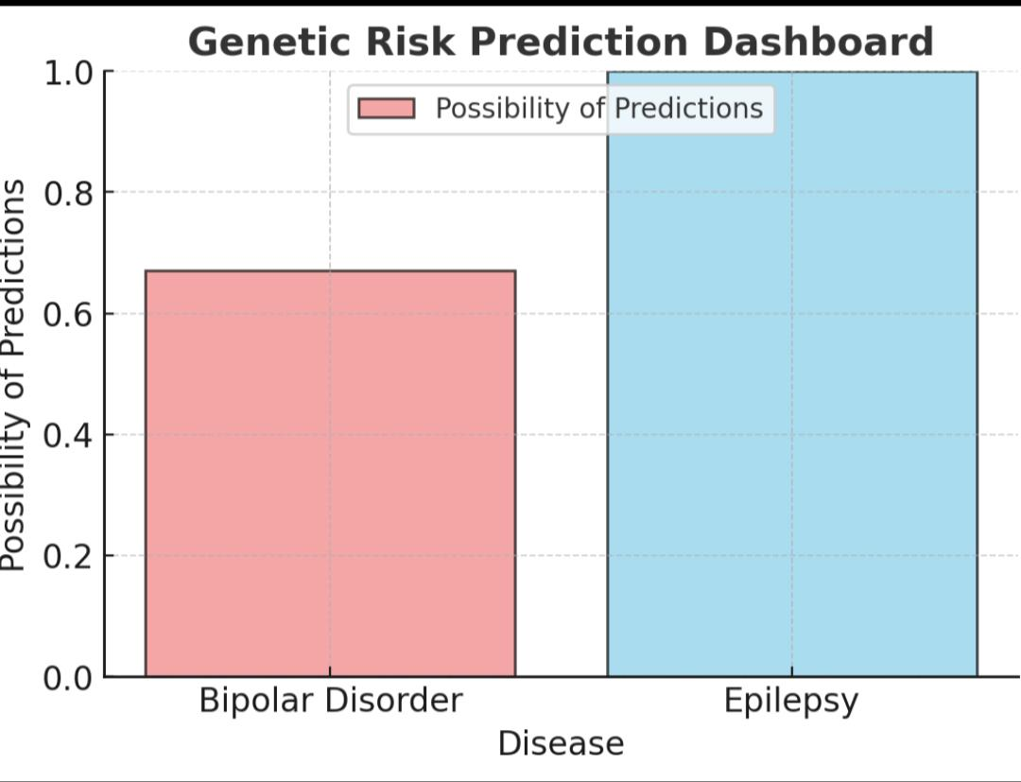
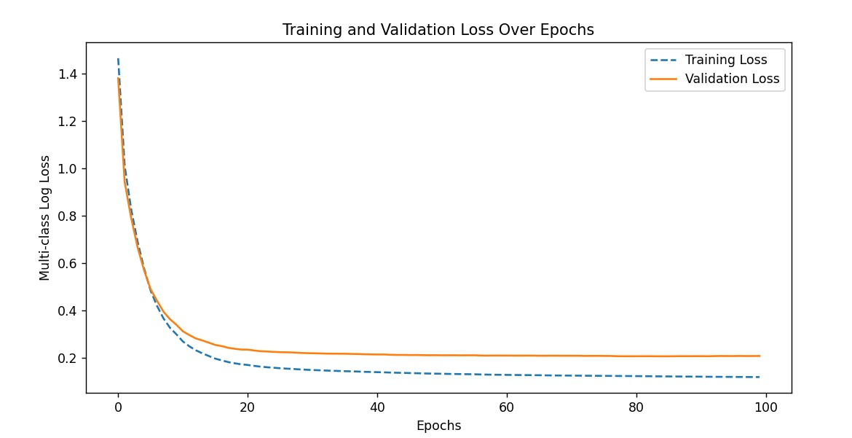
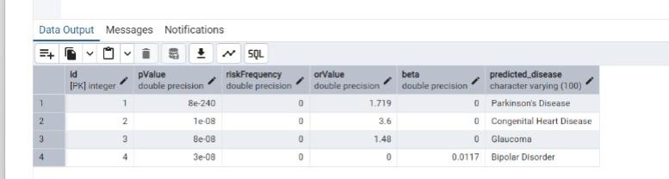
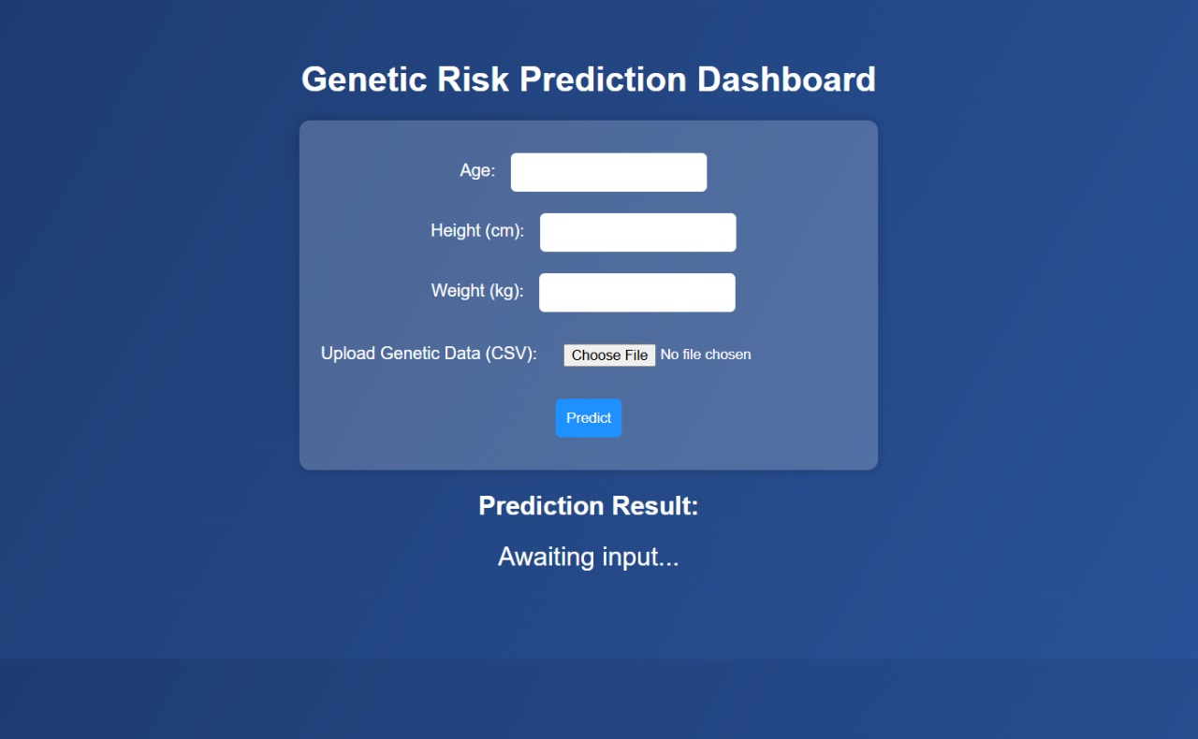
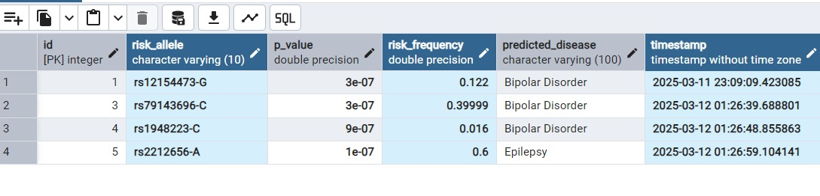
OUTPUT

Slide 6
Ethics (WHO guidelines)
Ethical Principles in Genetic Research
Respect for Autonomy – Upholding individual’s right to self-determination while protecting vulnerable populations.
Beneficence – Maximizing health benefits from genetic research for individuals and families.
Non-Maleficence – Minimizing risks and ensuring genetic interventions do no harm.
Justice – Ensuring fair distribution of genetic research benefits and healthcare resources.

Slide 7
Innovation
EEG-based XAI models now detect bipolar disorder via beta/gamma band analysis (92% accuracy) using Hjorth parameters. [7]
Wearable gait sensors predict Parkinson’s progression using step variability and speech rhythm data (30% trial efficiency boost).[8]
Federated learning enables epilepsy prediction across hospitals without raw data sharing (15% accuracy rise).[7]
TSC2 gene analysis combined with tuber count predicts epilepsy risk in tuberous sclerosis (73% accuracy).[8]
SHAP-integrated dashboards visualize disease risk drivers like TSC2 variants or ECG anomalies in real-time.[8]
Multi-disease comorbidity models link autonomic dysfunction markers (e.g., vomiting episodes) to CHD-epilepsy risks.[7]

Slide 8
Existing Patented Models
1. Health and medical history visualization and prediction using machine-learning and artificial intelligence models[3]
2. Artificial intelligence system for genetic analysis[4]
Inventor : Min Sang Kim, Samuel Kim, Mijeong BAN, In Gu LEE
Inventor: Glenn F. Osborne, Simon S.M. Chin, Paul McDonald, Scott Schneider
U.S. Pat. No. 7,062,076 (from U.S. application Ser. No. 09/650,005 filed August 28, 2000) claims priority under 35 U.S.C. §119(e) to U.S. Provisional Application Ser. No. 60/151,258 filed August 27, 1999
Application PCT/US2023/022100 (filed by Cipherome, Inc.) on
May 12, 2023. Publication WO2023220411A1 was released on November 16,
2023.U.S. Provisional Application No. 63/341,942 on
May 13, 2022, and U.S. Application No. 18/316,130 on May 11, 2023, are incorporated herein in their entirety.
Integrating patient records, the system provides an interactive visualization interface on client devices.
Professionals select input categories to generate clear, intuitive timelines.
Machine learning process and predict the patient’s potential health risk and highlights key periods, while event simulation updates records and delivers analytics on protocol deviations and dosage recommendations.
An optical scanner captures gene expression data from patient samples. ​
Data is securely transmitted to a central server for analysis. ​
A rate algorithm compares profiles with clinical data to diagnose conditions and predict adverse reactions. ​
Real-time treatment recommendations update records, supported by secure remote access and order management
Nucleic acid array hybridization and proteomics array

Slide 9
Expert system for classification and prediction of genetic diseases [5]
Inventor: Roland Eils
Patent Number 10,636,516 (US10636516B2). This patent was filed on July 15, 2019, and granted on May 18, 2021.
Relates to a proprietary expert system, in particular a data mining system, for classification and prediction of genetic diseases according to clinical and/or molecular genetic parameters.
Adapted to assist the clinician in assessment of prognosis and therapy recommendation.
Data mining system consists of machine learning approaches (artificial neural networks, decision tree/rule induction method, Bayesian Belief Networks).
4. Method and system for fast access to advanced visualization of medical scans using a dedicated web portal [6]
Inventor: Kovey Kavalan
Patent Number 10,930,397 (US10930397B2) on February 23, 2021. European patent, EP2438570B1, was granted on March 15, 2017.
Designed to receive patient data, generate a patient profile with physiological status, assessment, and treatment evaluations through automated analysis.
This info is updated in real-time and accessible via client devices, allowing healthcare professionals to readily input and access patient data.
This streamlined approach simplifies complex data, making it user-friendly for healthcare providers

Slide 10
Intellectual Property Rights
The paper outlines that it is published under the Creative Commons Attribution License, which allows for unrestricted use, distribution, and reproduction in any medium, provided that the original work is properly cited [1].
The paper highlights that, while the authors maintain certain rights, they have granted the public the ability to use the research freely, as long as proper attribution is given. There are no conflicts of interest declared by the authors regarding the publication of this work [2].

Slide 11
References:
[1] Ghazal, Taher M., et al. "Supervised machine learning empowered multifactorial genetic inheritance disorder prediction." Computational Intelligence and Neuroscience 2022.1 (2022): 1051388.
[2] Raza, Ali, et al. "Predicting genetic disorder and types of disorder using chain classifier approach." Genes 14.1 (2022): 71.
[3]Osborne, G. F., Chin, S. S. M., McDonald, P., & Schneider. Artificial intelligence system for genetic analysis (U.S. Pat. No. 7,062,076, from U.S. application Ser. No. 09/650,005 filed August 28, 2000, claiming priority to U.S. Provisional Application Ser. No. 60/151,258 filed August 27, 1999). U.S. Patent and Trademark Office.
[4]Kim, M. S., Kim, S., Ban, M., & Lee, I. G. Application PCT/US2023/022100 (filed by Cipherome, Inc.) on May 12, 2023; Publication WO2023220411A1 released on November 16, 2023. U.S. Provisional Application No. 63/341,942 (May 13, 2022) and U.S. Application No. 18/316,130 (May 11, 2023) are incorporated herein in their entirety.
[5] Roland Elis, Slonim DK, Tamayo P, Huard C. "Expert system for classification and prediction of genetic diseases". Science 286(5439): 531-537, 2021.
[6] Kovalan, K. (2021). Method and system for fast access to advanced visualization of medical scans using a dedicated web portal (U.S. Patent No. 10,930,397). U.S. Patent and Trademark Office.
[7] Islam, M. S., Hussain, I., Rahman, M. M., Park, S. J., & Hossain, M. A. (2022). Explainable Artificial Intelligence Model for Stroke Prediction genomic sequence. Sensors, 22(24), 9859. https://doi.org/10.3390/s22249859
[8] Shang S, Shi Y, Zhang Y, Liu M, Zhang H, Wang P, Zhuang L. Artificial intelligence for brain disease diagnosis using electroencephalogram signals. J Zhejiang Univ Sci B. 2024 Oct 15;25(10):914-940. doi: 10.1631/jzus.B2400103. PMID: 39420525; PMCID: PMC11494159.

Slide 12
Thank You !

