Slide 1

Dharshini K. CB.AI.UAIM24111 Esha R. CB.AI.UAIM24112 Harsshitha S. CB.AI.UAIM24115 Vaishnavi P. CB.AI.UAIM24149
Team Members:
24AIM112 Molecular Biology & Basic Cellular Physiology
&
24AIM115 Ethics, Innovative Research Business & IPR
Faculties:
Mrs. Reshma Sanal
Dr. Kelath Murali Manoj
Dr. Neelesh Ashok
Topic : AI-Based Predictive Model for Genetic Disease
Risk Visualization
1

Slide 2

Overview of our project
Model Preparation (Python : XGBoost)
Visualization and Output
Backend Development (Python : Flask)
Performance Benchmarking
1
3
5
2
4
Data Inputs
Frontend Development (HTML, CSS, JS)

Slide 3
Key Genetic Risk Indicators:
Risk Allele: A specific variant of a gene associated with an increased likelihood of developing a particular disease.
Risk Frequency: The proportion of individuals in a population who carry the risk allele.
P-Value: A statistical measure indicating the probability that the observed association occurred by chance; a lower value suggests higher significance.
Odds Ratio (OR): A measure of the strength of association between the risk allele and the disease; values greater than 1 indicate increased risk.

Slide 4
Methodology
STEP 01
DATA COLLECTION
Source: GWAS Catalog
STEP 02
DATA PREPROCESSING
Data Cleaning: Remove duplicates, fill missing value
STEP 03
MODEL DEVELOPMENT
XGBoost: Train, Tune, Validate.
Dashboard: Real-time, Risk charts, reports
STEP 04
MODEL EVALUATION
Performance Metrics: Accuracy, Precision, Recall, F1-score
STEP 05
DASHBOARD & ETHICAL CONSIDERATION
Dataset Includes: Bipolar Disorder, Epilepsy, Congenital Heart Disease and Parkinson’s Disease.
Feature Selection: Identify key genetic markers
Feature Engineering: Encode & normalize data
Selected model by performance
Ethics: Privacy, Fairness, Explainability
Attributes: riskAllele,pValue,riskFrequency,OR-value,beta,map_genes,efoTraits

Slide 5
Ethics (WHO guidelines)
Ethical Principles in Genetic Research
Respect for Autonomy – Upholding individual’s right to self-determination while protecting vulnerable populations.
Beneficence – Maximizing health benefits from genetic research for individuals and families.
Non-Maleficence – Minimizing risks and ensuring genetic interventions do no harm.
Justice – Ensuring fair distribution of genetic research benefits and healthcare resources.

Slide 6
Innovation
EEG-based XAI models now detect bipolar disorder via beta/gamma band analysis (92% accuracy) using Hjorth parameters. [7]
Wearable gait sensors predict Parkinson’s progression using step variability and speech rhythm data (30% trial efficiency boost).[8]
Federated learning enables epilepsy prediction across hospitals without raw data sharing (15% accuracy rise).[7]
TSC2 gene analysis combined with tuber count predicts epilepsy risk in tuberous sclerosis (73% accuracy).[8]
SHAP-integrated dashboards visualize disease risk drivers like TSC2 variants or ECG anomalies in real-time.[8]
Multi-disease comorbidity models link autonomic dysfunction markers (e.g., vomiting episodes) to CHD-epilepsy risks.[7]

Slide 7
Literature Review:
STUDY | OBJECTIVE | METHODOLOGY | KEY FINDINGS | LIMITATIONS
Genome-wide polygenic scores for common diseases identify individuals with risk equivalent to monogenic mutations[1] | Identify individuals at high risk for common diseases using polygenic risk scores (PRS) | Developed PRS using GWAS data and machine learning on millions of variants | PRS can identify individuals with >3x disease risk, similar to rare monogenic mutations | Tested mainly in European ancestry; limited generalizability
A machine learning model for disease risk prediction by integrating genetic and non-genetic factors [2] | Integrates genetic and non-genetic factors for disease risk prediction | Developed PRSIMD model using posterior regularization and Mendelian Randomization on UK Biobank data | PRSIMD outperformed other PRS methods, ~24% AUROC increase for CAD and T2D | Limited to CAD and T2D, UK Biobank only, self-reported data bias

Slide 8
STUDY | OBJECTIVE | METHODOLOGY | KEY FINDINGS | LIMITATIONS
Supervised Machine Learning Empowered Multifactorial Genetic Inheritance Disorder Prediction[3] | Predict cancer, dementia, diabetes using ML | SVM, KNN on Kaggle dataset (2067 patients, 32 features) | SVM/KNN: 92.8% accuracy. SVM > KNN. Early prediction aids prognosis | 3 diseases, single dataset, limited features, lacks clinical validation
Ethics of artificial intelligence in prenatal and pediatric genomic medicine[4] | Examine ethical issues of AI in prenatal/pediatric genomics | Ethical analysis: prenatal sequencing, rapid sequencing for kids, reanalysis of genomic data | AI aids disease classification, improves diagnosis, efficiency | Early tech stage, transparency concerns, bias, accountability challenges

Slide 9
Abbreviations :
GWAS – Genome-Wide Association Study
PRSIMD – Polygenic Risk Score Integrated with Mendelian Randomization and posterior regularization (specific model name)
AUROC – Area Under the Receiver Operating Characteristic curve
CAD – Coronary Artery Disease
T2D – Type 2 Diabetes
ML: Machine Learning
SVM: Support Machine Vector
KNN: K-Nearest Neighbours

Slide 10
Existing Patented Models
1. Health and medical history visualization and prediction using machine-learning and artificial intelligence models[5]
2. Machine learning platform for generating risk models [6]
Inventors: Jared Michael , Sahar Victoria
Patent Application WO2022087478A1, filed by October 22, 2021, published on April 28, 2022, under PCT/US2021/05631 with priority from US17/303,398 dated May 27, 2021.
Inventor : Min Sang Kim, Samuel Kim, Mijeong BAN, In Gu LEE
Application PCT/US2023/022100 (filed by Cipherome, Inc.) on
May 12, 2023. Publication WO2023220411A1 was released on November 16,
2023.U.S. Provisional Application No. 63/341,942 on
May 13, 2022, and U.S. Application No. 18/316,130 on May 11, 2023, are incorporated herein in their entirety.
Introduces a machine learning platform to generate polygenic risk score (PRS) models for predicting individual risk of phenotypes or conditions based on genetic data.
Utilizes GWAS summary statistics to identify genetic variants (SNPs) associated with phenotypes.
Uses penalized regression methods (e.g., elastic net) to weight and combine multiple PRS models into a composite risk score.
Automates model training, validation (e.g., cross-validation), and individualized risk reporting through a user-friendly interface called the "PRS Machine."
Integrating patient records, the system provides an interactive visualization interface on client devices.
Professionals select input categories to generate clear, intuitive timelines.
Machine learning process and predict the patient’s potential health risk and highlights key periods, while event simulation updates records and delivers analytics on protocol deviations and dosage recommendations.

Slide 11
Expert system for classification and prediction of genetic diseases [7]
Inventor: Roland Eils
Patent Number 10,636,516 (US10636516B2). This patent was filed on July 15, 2019, and granted on May 18, 2021.
Relates to a proprietary expert system, in particular a data mining system, for classification and prediction of genetic diseases according to clinical and/or molecular genetic parameters.
Adapted to assist the clinician in assessment of prognosis and therapy recommendation.
Data mining system consists of machine learning approaches (artificial neural networks, decision tree/rule induction method, Bayesian Belief Networks).
4. Method and system for fast access to advanced visualization of medical scans using a dedicated web portal [8]
Inventor: Kovey Kavalan
Patent Number US10930397B2, filed by AI Visualize Inc. on December 20, 2019, published on February 23, 2021, with priority to US16/722,986 dated December 20, 2019. Application US16/722,986 was published as US20200126668A1 on April 23, 2020.
Designed to receive patient data, generate a patient profile with physiological status, assessment, and treatment evaluations through automated analysis.
This info is updated in real-time and accessible via client devices, allowing healthcare professionals to readily input and access patient data.
This streamlined approach simplifies complex data, making it user-friendly for healthcare providers

Slide 12
Intellectual Property Rights
The paper outlines that it is published under the Creative Commons Attribution License, which allows for unrestricted use, distribution, and reproduction in any medium, provided that the original work is properly cited [3].

Slide 13
Future Scopes:
Making AI's Decisions Understandable: We plan to use tools like SHAP or LIME so doctors and users can actually see why the AI made a certain prediction. It builds more trust, especially in healthcare.
Tracking Health Over Time: By using smarter models like RNNs or Transformers, we could forecast how a person’s disease risk might change in the future based on their lifestyle and past health data.

Slide 14
References:
[1] Khera, A. V., Chaffin, M., Aragam, K. G., Haas, M. E., Roselli, C., Choi, S. H., ... & Kathiresan, S. (2018). Genome-wide polygenic scores for common diseases identify individuals with risk equivalent to monogenic mutations. Nature genetics, 50(9), 1219-1224.
[2] Xu, Y., Wang, C., Li, Z., Cai, Y., Young, O., Lyu, A., & Zhang, L. (2022, December). A machine learning model for disease risk prediction by integrating genetic and non-genetic factors. In 2022 IEEE International Conference on Bioinformatics and Biomedicine (BIBM) (pp. 868-871). IEEE.
[3] Ghazal, T. M., Al Hamadi, H., Umar Nasir, M., Gollapalli, M., Zubair, M., Adnan Khan, M., & Yeob Yeun, C. (2022). Supervised machine learning empowered multifactorial genetic inheritance disorder prediction. Computational Intelligence and Neuroscience, 2022(1), 1051388.
[4] Coghlan, S., Gyngell, C., & Vears, D. F. (2024). Ethics of artificial intelligence in prenatal and pediatric genomic medicine. Journal of Community Genetics, 15(1), 13-24.
[5]Osborne, G. F., Chin, S. S. M., McDonald, P., & Schneider. Artificial intelligence system for genetic analysis (U.S. Pat. No. 7,062,076, from U.S. application Ser. No. 09/650,005 filed August 28, 2000, claiming priority to U.S. Provisional Application Ser. No. 60/151,258 filed August 27, 1999). U.S. Patent and Trademark Office.
[4]Kim, M. S., Kim, S., Ban, M., & Lee, I. G. Application PCT/US2023/022100 (filed by Cipherome, Inc.) on May 12, 2023; Publication WO2023220411A1 released on November 16, 2023. U.S. Provisional Application No. 63/341,942 (May 13, 2022) and U.S. Application No. 18/316,130 (May 11, 2023) are incorporated herein in their entirety.
[6] Jared Michael O'Connell, Sahar Victoria Mozaffari, Wei Wang, Suyash S. Shringarpure, Adam Auton, Jingchunzi Shi Patent Application WO2022087478A1, filed by October 22, 2021, published on April 28, 2022, under PCT/US2021/056341 with priority from US17/303,398 dated May 27, 2021.
[7] Roland Elis, Slonim DK, Tamayo P, Huard C. "Expert system for classification and prediction of genetic diseases". Science 286(5439): 531-537, 2021.
[8] Kovalan, K. (2021). Method and system for fast access to advanced visualization of medical scans using a dedicated web portal (U.S. Patent No. 10,930,397). U.S. Patent and Trademark Office.

Slide 15
Thank You !

Slide 16

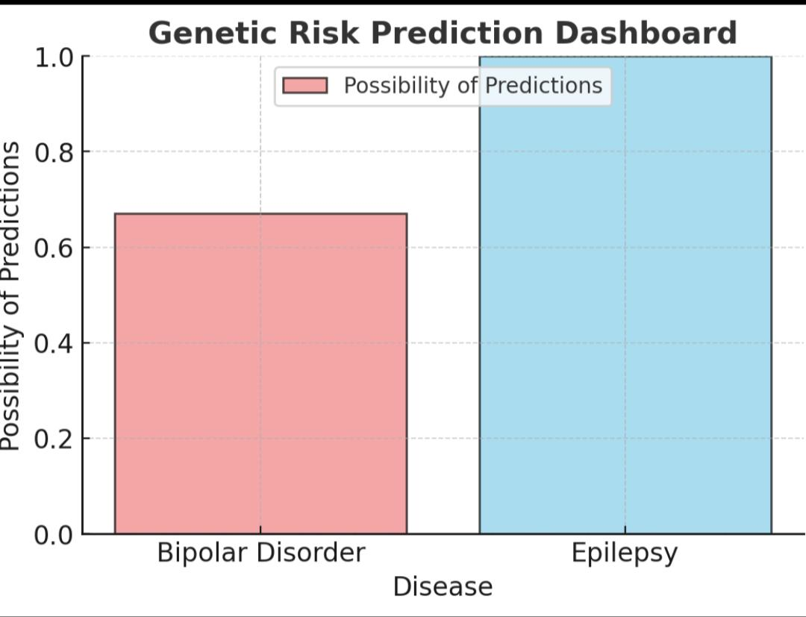
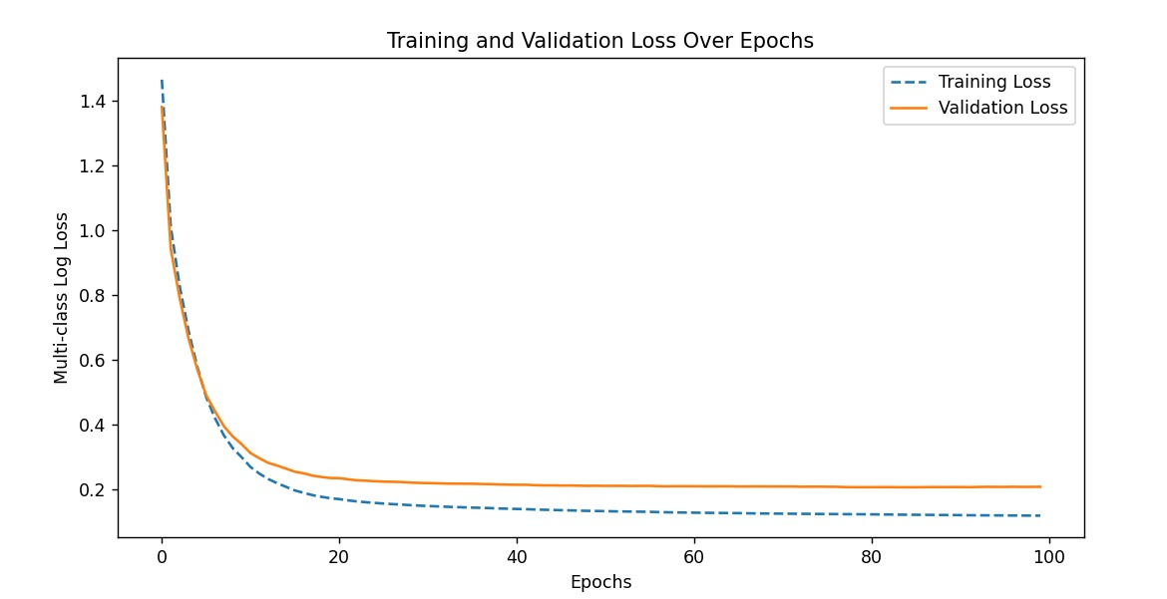
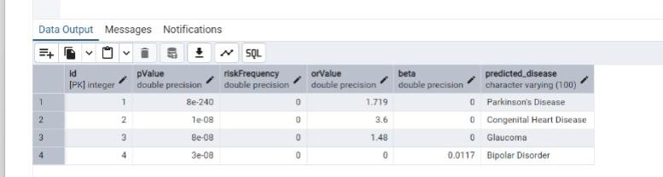
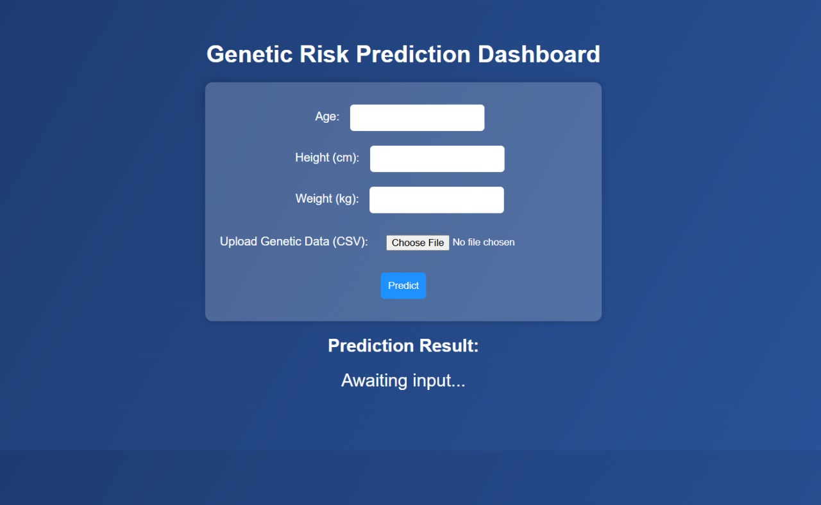
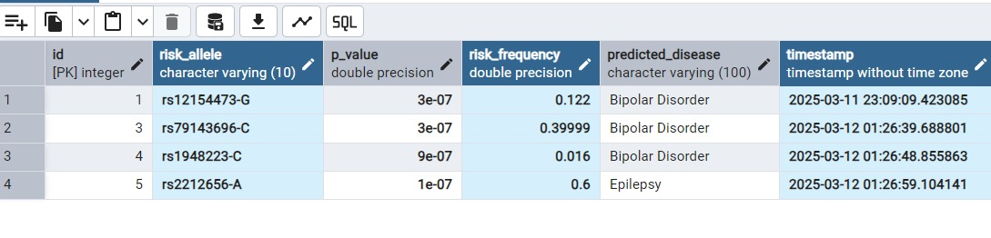
OUTPUT

