Slide 1

Topic : Quantum-Assisted Framework for Secure File Transfer using MFA
23MAT112 Mathematics for Intelligent Systems 2
24AIM111 Introduction to data structures & algorithms
Team 2
Team members: ​ Dharshini K. CB.AI.U4AIM24111 ​ Esha R. CB.AI.U4AIM24112 ​ Harsshitha S. CB.AI.U4AIM24115 ​ Vaishnavi P. CB.AI.U4AIM24149
Faculties:
Dr. S. Manimaran
Dr. Prem Jagadeesan
1

Slide 2
Problem Statement:
Modern secure communications face threats from quantum attacks, potentially breaking classical encryption. A need exists for secure file transfer, especially in sensitive areas like naval communications, to prevent third-party access.

Slide 3
Objectives:
Developed a hybrid cryptographic framework combining AES-256 and BB84 QKD for secure file transfer.
Implemented PBKDF2-HMAC-SHA256 hashing and TOTP-based MFA for strong authentication.
Used QRNG for AES-256 key generation and AES-256-CBC for quantum-resistant encryption.
Simulated the BB84 protocol to enable secure quantum key exchange.
Maintained audit logs in PostgreSQL for transparency and Verification.
Built a React.js frontend for an intuitive user experience.
Analyzed entropy and performance to validate security strength.

Slide 4
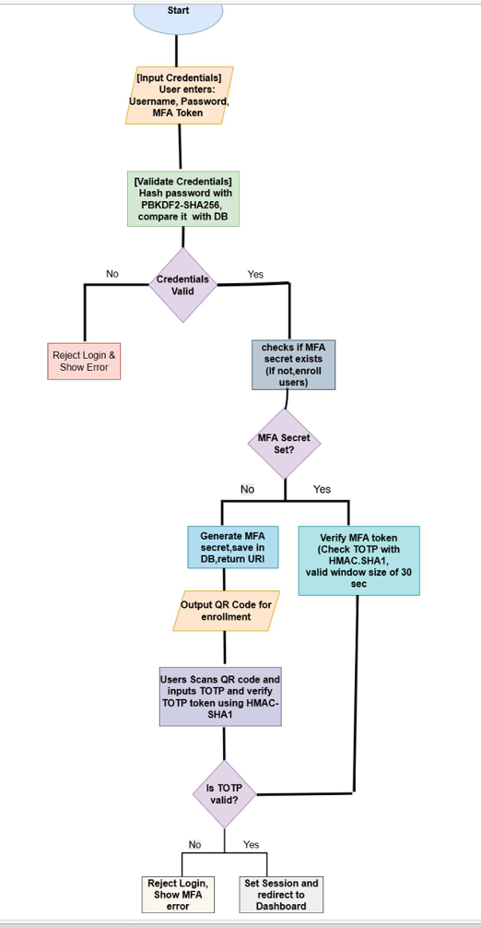
Methodology

Slide 5
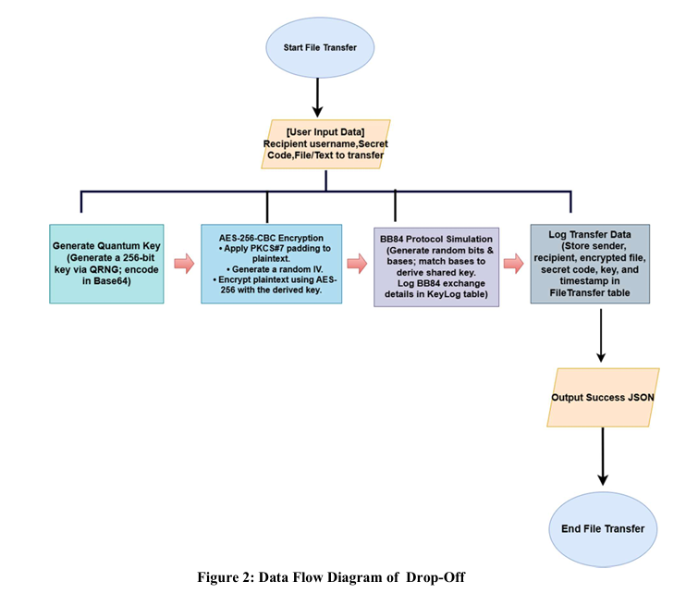
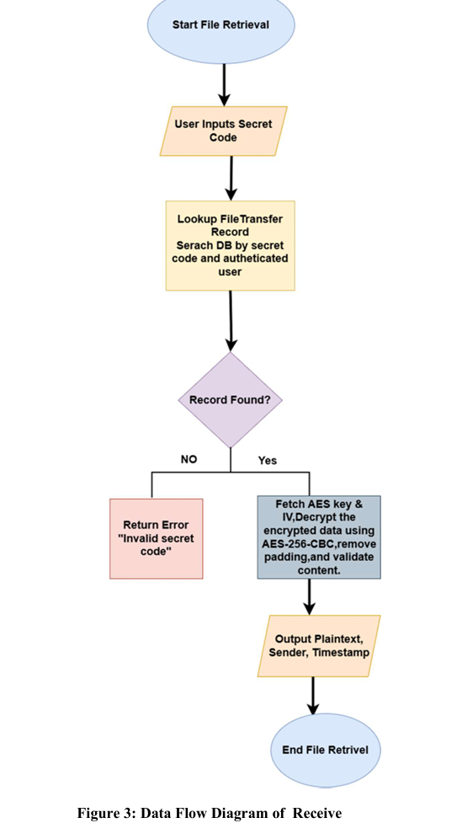

Slide 6
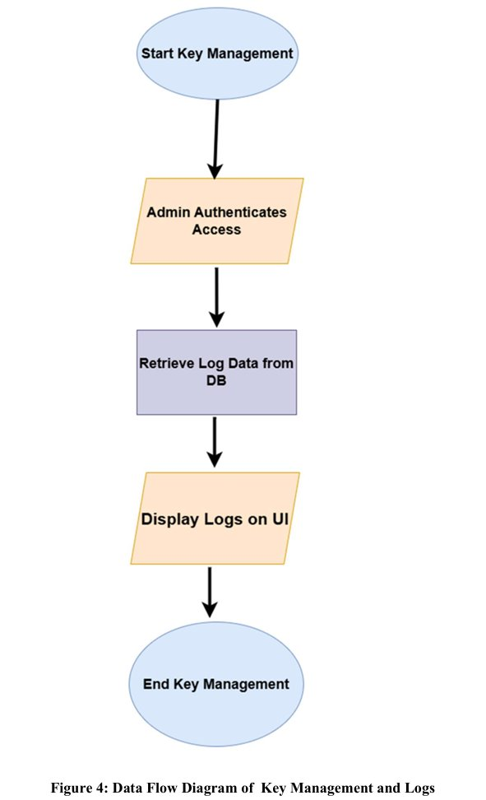

Slide 7
AES-256
The file is encrypted using AES-256, it is a symmetric 256-bit key encryption algorithm
It performs 14 rounds for each block data, AES Round Function is given by State= SubBytes, ShiftRows, Mixcolumns ,AddRoundKey – OR operation
State = Plaintext ⊕ InitialKey
Thereby converts the plain text into cipher text by Cipher Block Chaining (CBC)
After the final round the state becomes the ciphertext.

Slide 8
PBKDF2-SHA256 (Password-Based Key Derivation 2)
Used for secure conversion of passwords into cryptographic keys
The password entered by the user is compared to the stored hash in PostgreSQL database.
Where, salt- random value; c- Iteration count; dk_len- Desired length of derived key
Compatible with classical cryptographic standards.
DerivedKey=PBKDF2(Password, Salt, c, dk_len)

Slide 9
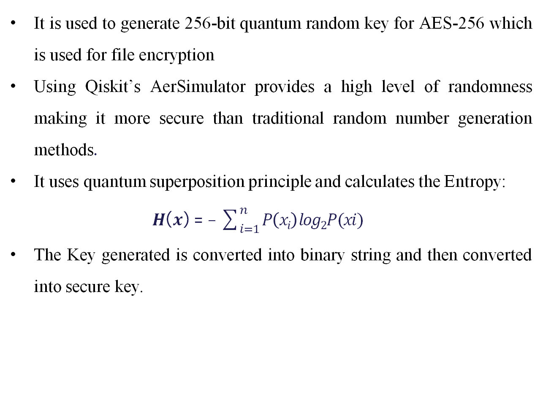
QRNG
It is used to generate 256-bit quantum random key for AES-256 which is used for file encryption
Using Qiskit’s AerSimulator provides a high level of randomness making it more secure than traditional random number generation methods.
It uses quantum superposition principle and calculates the Entropy:
𝑯(𝒙) = − $\sum_{i=1}^{n}{P\left(xi\right)log2P(xi) }$
The Key generated is converted into binary string and then converted into secure key.

Slide 10
BB84
Used to simulate a secure exchange by random generation of bits (0s and 1s) and basis sting (+ = rectilinear and x= diagonal)
Random bits: B= [𝑏1,𝑏2,…, 𝑏n] , 𝑏_{i}∈ {0,1}
Random bases: Θ=[𝜃1,𝜃2,…,𝜃n], 𝜃_{i}∈{+, ×}
The matching bits of sender and receiver acts as the symmetric key for the encryption
KeyLog={ (𝑏_{i}, 𝜃_{i} , 𝜃_{i}′ 𝑚𝑎𝑡𝑐ℎ_{i} )}
Error-checking helps to detect eavesdropping
Thus, helps in secure file transfer by detecting and protecting the file from eavesdropping.

Slide 11
COMPARISON
Criteria | Quantum-Assisted Framework (BB84, QRNG, AES) | Classical Approach | Hybrid Approach | Pure-Post Quantum Cryptography
Cryptographic Foundation | Combining quantum key distribution (BB84), QRNG, and classical AES encryption | Using RSA, ECC, or other classical encryption methods [7] | Both classical (RSA or ECC) and post-quantum cryptography algorithms [6] | Lattice-based, code-based, multivariate, or hash-based algorithms approved by NIST
Key Generation | Quantum Random Number Generator (QRNG) [2] | Pseudo-random number generators (PRNGs) | May use classical or quantum random number generation [6] | Uses complex mathematical problems
Authentication | Multi-factor authentication (MFA) | Password-based, certificate-based, or basic multi-factor authentication [7] | Traditional methods with added quantum resistance layers [1] [3] | Traditional methods replaced with quantum-resistant algorithms [4]
Implementation Complexity | High | Low to moderate | Moderate [3] | Moderate to High [1][5]

Slide 12
REFERENCES
[1] Palaniswamy B. and Karati A. (2024). QPTA: Quantum-Safe Privacy-Preserving Multi-Factor Authentication Scheme for Lightweight Devices. In Proceedings of the 21st International Conference on Security and Cryptography - Volume 1: SECRYPT; ISBN 978-989-758-709-2, SciTePress, pages 804-811. DOI: 10.5220/0012835100003767
[2] Cannings, R. (2004). On the security of the BB84 quantum key distribution protocol (Master's thesis, University of Calgary, Calgary, Canada). Retrieved from https://prism.ucalgary.ca. doi:10.11575/PRISM/19009
[3] Trzcisnki, Andrew, Sreya Vaidyanathan, Ariel Higuchi and Amritha Jayanti. “Technology Primer: Post-Quantum Cryptography.” Edited by Barak, Boaz, Lily Chen, Jack Hidary and Vinod Vaikuntanathan. Belfer Center for Science and International Affairs, Harvard Kennedy School, June 23, 2023
[4] Murray, H., Malone, D. (2021). Quantum Multi-factor Authentication. In: Saracino, A., Mori, P. (eds) Emerging Technologies for Authorization and Authentication. ETAA 2021. Lecture Notes in Computer Science(), vol 13136. Springer, Cham. https://doi.org/10.1007/978-3-030-93747-8_4
[5] P. Nema and M. J. Nene, "Qubits based mutual authentication protocol," Security and Privacy, vol. 5, no. 3, e203, May/Jun. 2022, doi: 10.1002/spy2.203.
[6] Preparing for the Quantum Leap with Hybrid Certificates. https://securityboulevard.com/2024/07/preparing-for-the-quantum-leap-with-hybrid-certificates Accessed April 17, 2025.
[7] What is secure filesharing?. https://www.blackberry.com/us/en/glossary/secure-file-sharing. Accessed April 17, 2025.

Slide 13
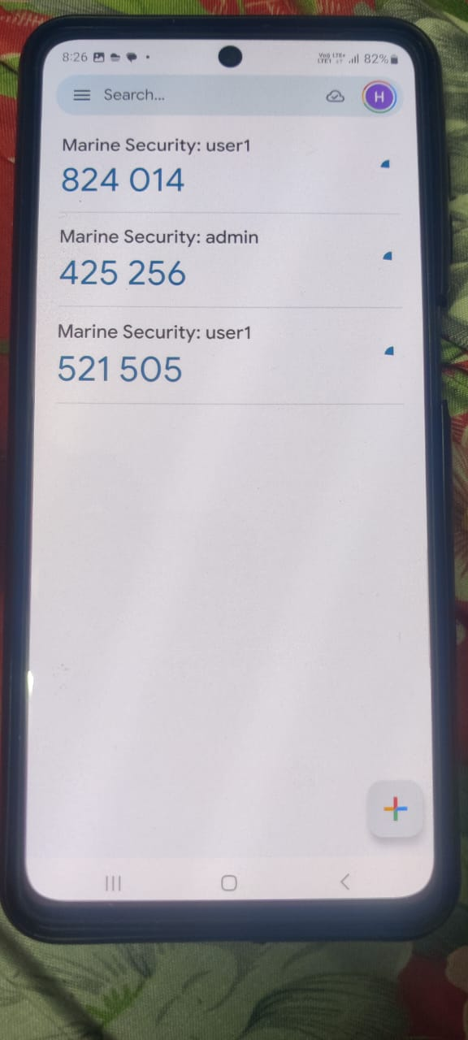
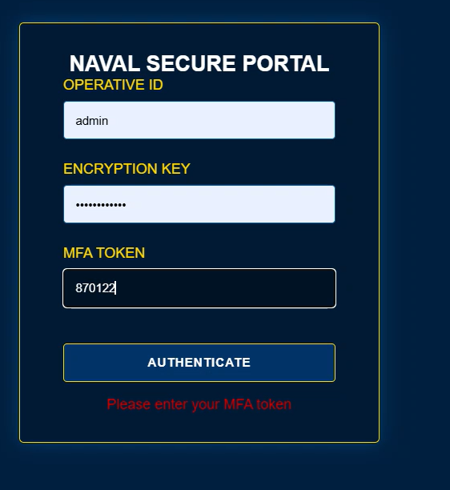
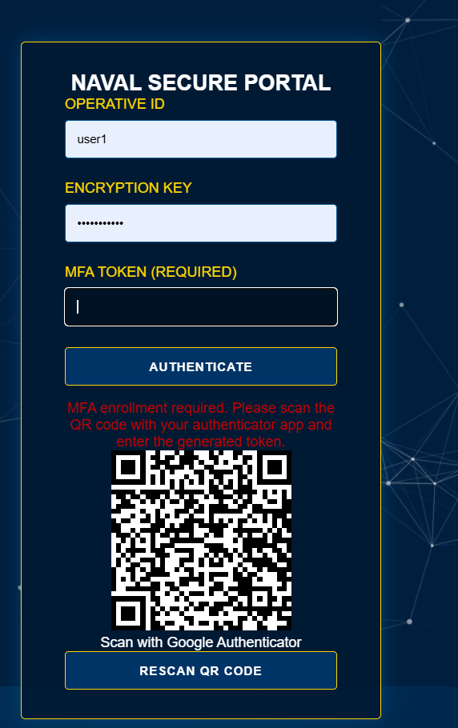
RESULTS

Slide 14
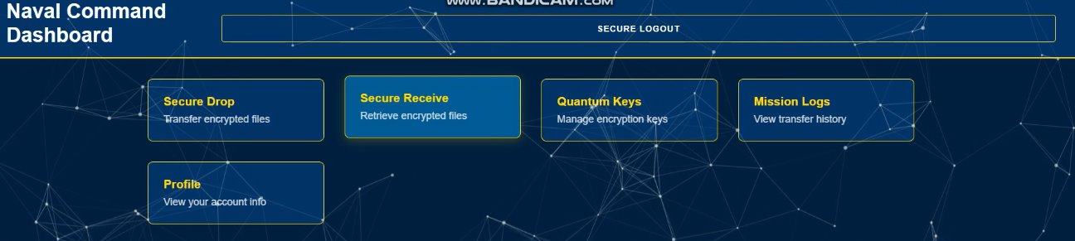
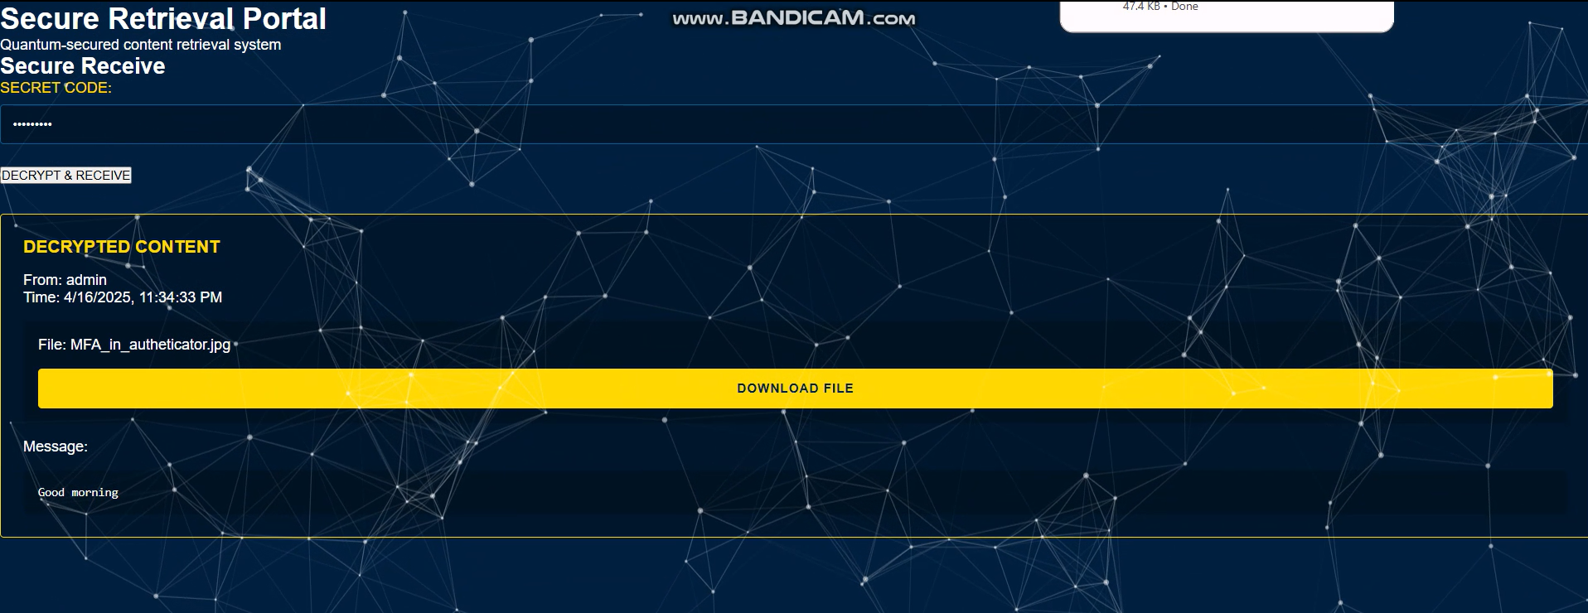

Slide 15
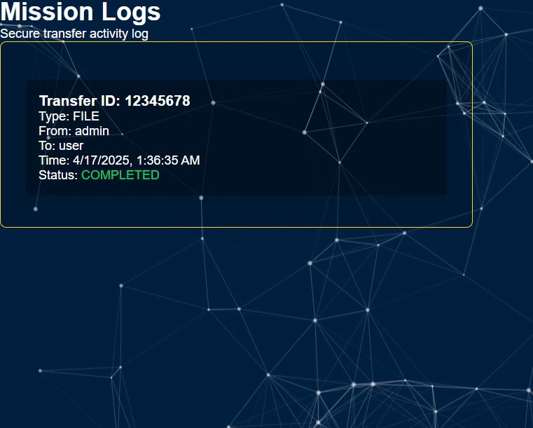
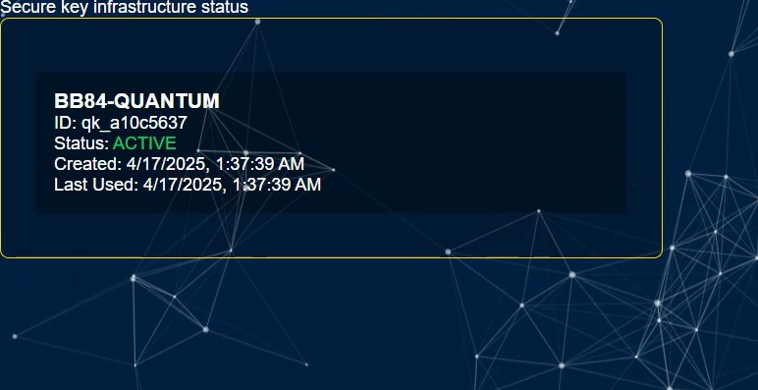

Slide 16
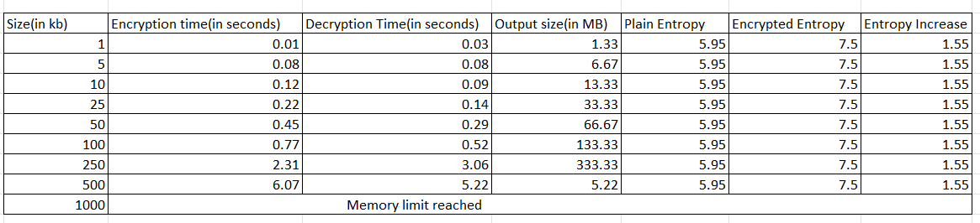
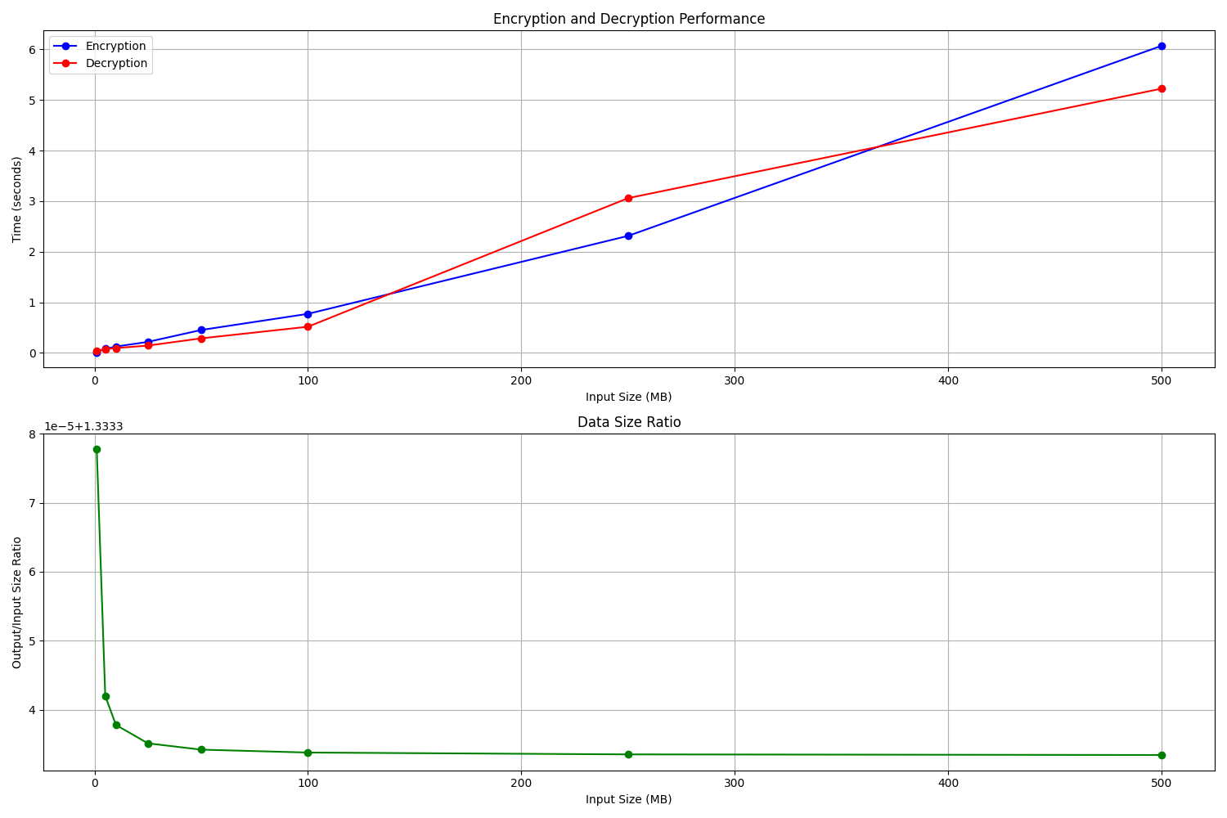

Slide 17
Thank you!
17

