Slide 1
Department
of
Computer Science & Engineering

Slide 2

Minor Project Topic
SMART LEARNING WEBSITE
Project Guide:
Ms. Manisha Kadam
Team Members:
Esha Jawade
Harsh Khathod
Darshan Paliwal
Aditya Bhgate

Slide 3

Technology Used
1.Frontend: HTML, CSS, and JavaScript.
2.Backend: Node.js(JavaScript), Python(Django or Flask), PHP, MySQL.
3.Android: Java Android Studio IDE.
4. Animation Creation: Adobe After Effects, Blender & AI.

Slide 4
Problem Statement
How can we make learning math fun and engaging for young minds on our smart learning website?"

Slide 5
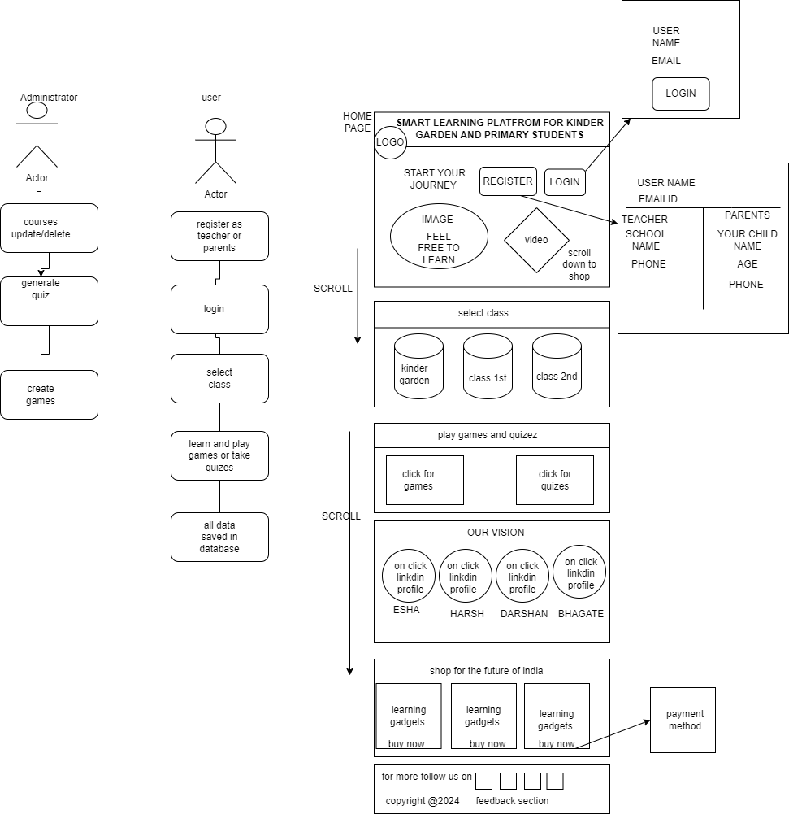
Use Case Diagram

Slide 6
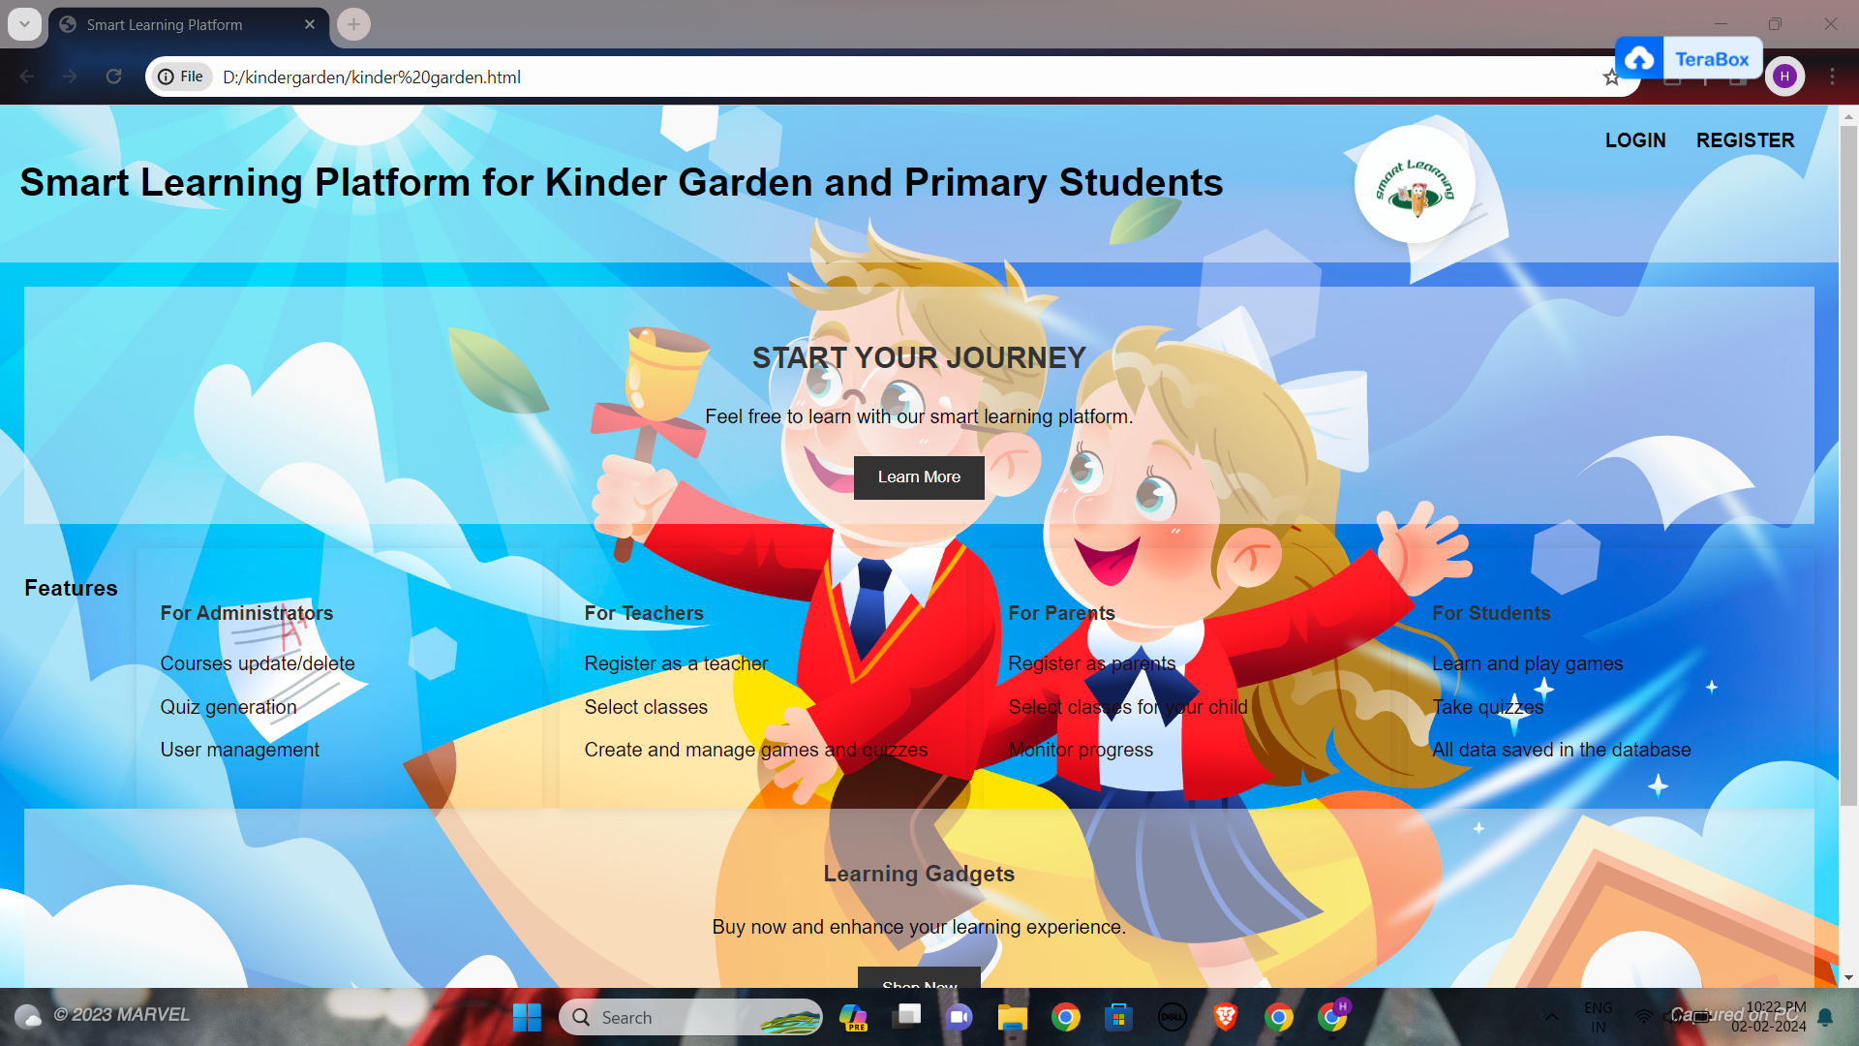
Implementation Till now

Slide 7
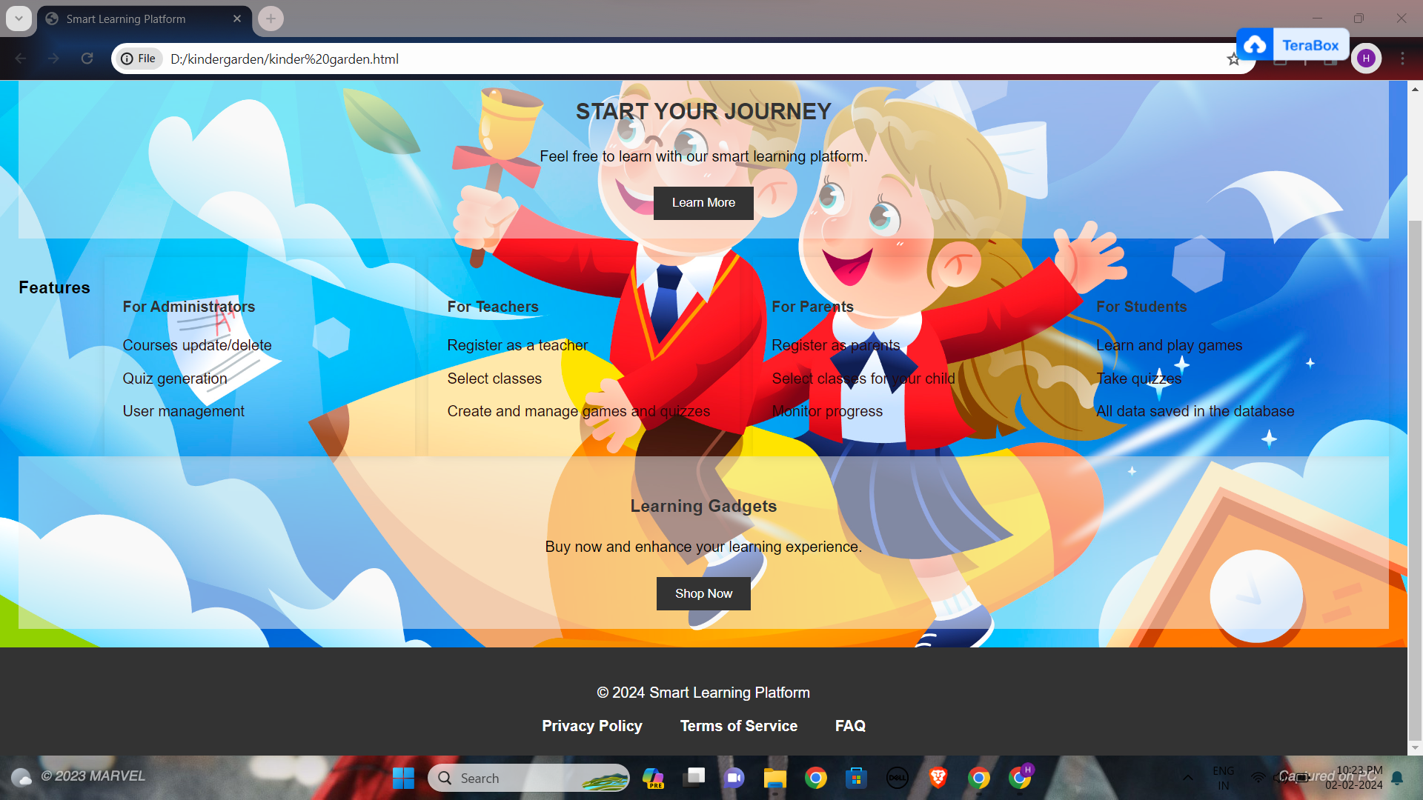

Slide 8
Thank You

