Slide 1

PERSONALIZED MEDICINE AND
CELL-BASED THERAPIES

Slide 2
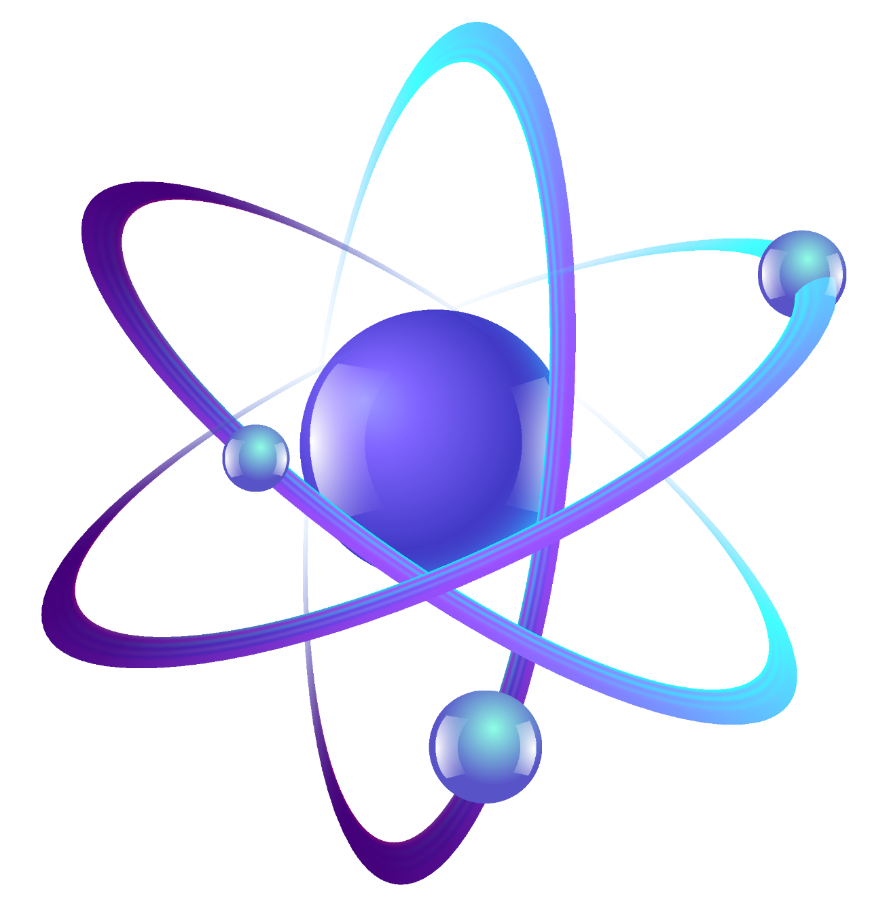
TABLE OF CONTENT
IMRANA MUMTAZ
Introduction to Personalized medicine
4P’s of Personalized medicine
ESHA ZAMAN
Car-T Cell therapy
Autologous Stem-Cell therapies
ARIBAH IMTENAN
3D Bioprinting
Future perspective

Slide 3
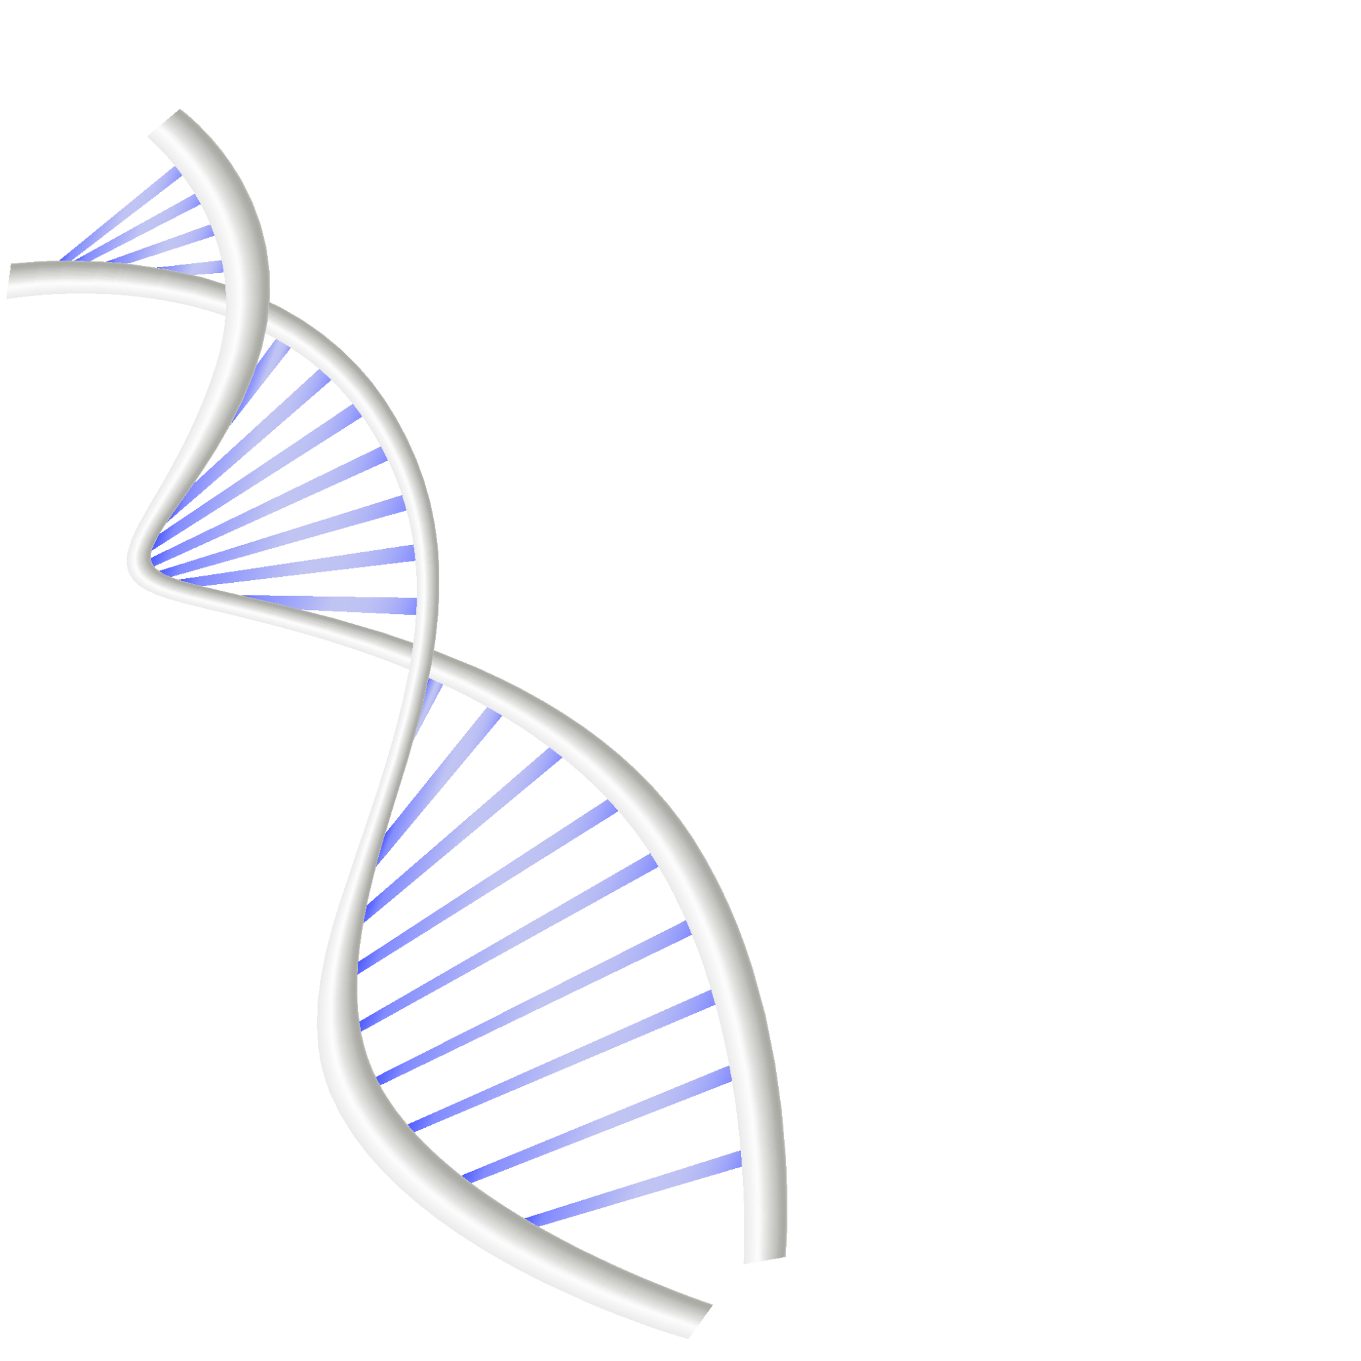
02
CELL BASED THERAPIES
Esha Zaman

Slide 4

What if we could reprogram a patient’s own immune cells to find and destroy their cancer with amazing precision?
THIS IS NOT JUST A DREAM!!

Slide 5
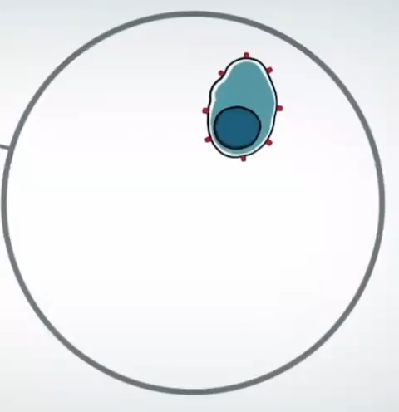

CAR T CELLS THERAPY

Slide 6
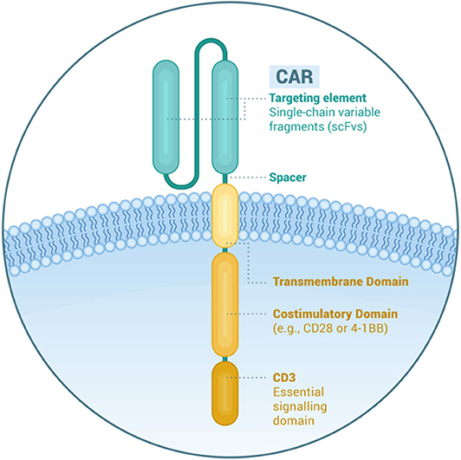
CAR T CELLS THERAPY
CAR T cell therapy uses a patient’s own immune cells to target and destroy cancer cells
CAR stands for Chimeric Antigen Receptor, a specially engineered receptor that is added to T cells to help them better recognize and attack cancer cells
Simplistically, a CAR is comprised of an:
Extracellular domain derived from antibody
Short linker between heavy and light chain
Transmembrane domain
Intracellular T cell signaling domain
Second- and third-generation constructs have one or two costimulatory signaling domains

Slide 7
ADMINISTRATION OF CAR T CELLS
Collection of Patient's Own Blood Cells
Introducing CAR Genes
Expanding CAR T Cells
Activation of T Cells Outside the Body
Infusion of CAR T Cells
BEFORE
10-21 DAYS
Lymphodepleting chemotherapy to:
Reduce T Cell Numbers
Create Space for CAR T Cells
Boost Expansion Signals

Slide 8
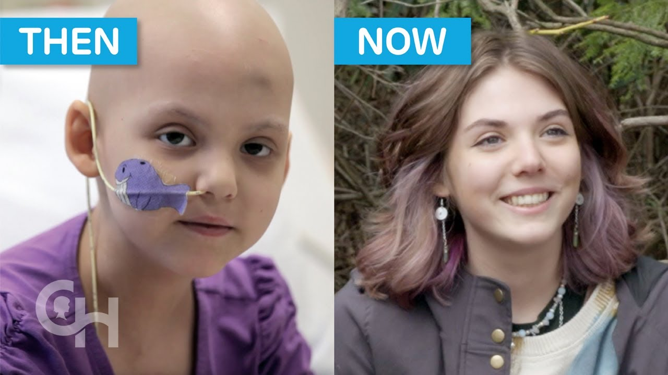
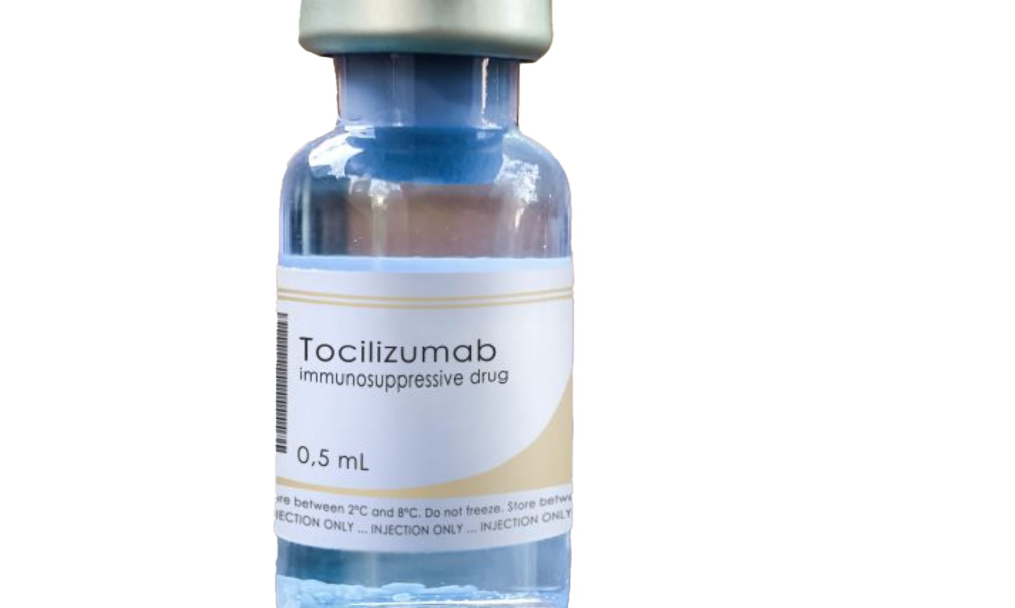
FIRST PEDIATRIC PATIENT TO RECEIVE CAR T-CELL THERAPY
Emily’s CAR T journey began in march 2012
It has been 12 years since Emily was declared cancer-free

Slide 9
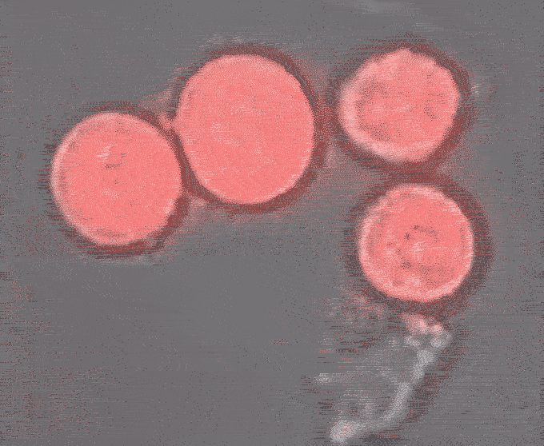
LIMITATIONS
Difficulty in producing CAR T cells for every patient who needs them
Relapse remains a concern, often occurring within a year of treatment
Neurotoxicity
B cell aplasia: destruction of normal B cells in addition to cancerous ones
Cytokine release syndrome
Notes:
https://www.embryo-science.com/post/cytokine-release-syndrome-in-car-t-cell-treated-patients-linked-to-exploding-cancer-cells

Slide 10
Did you know that over 50% of organ transplants fail due to immune rejection?
“Imagine if we could eliminate this risk entirely.”

Slide 11
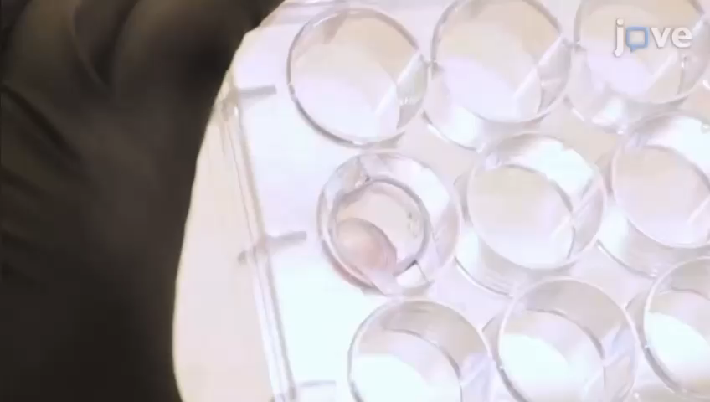
AUTOLOGOUS STEM CELL THERAPIES

Slide 12
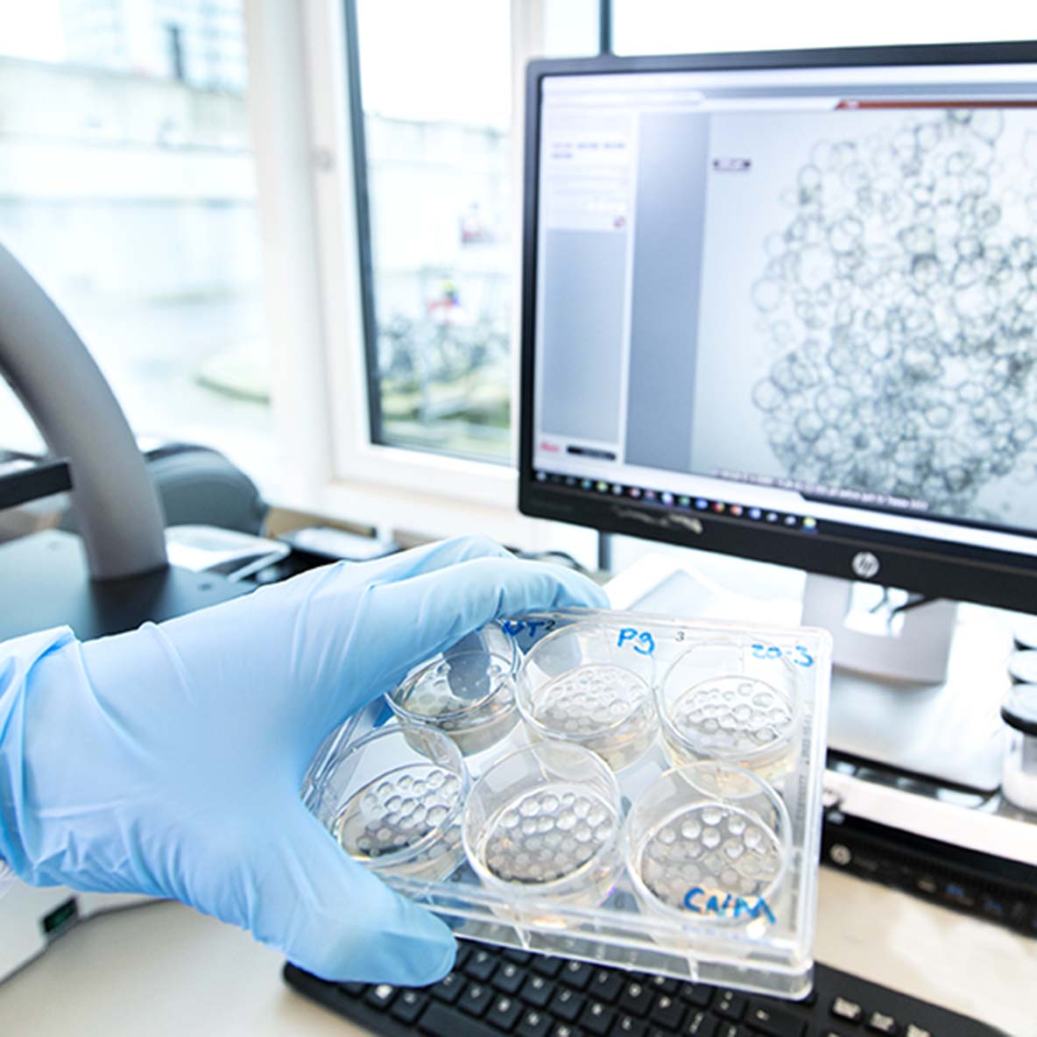
AUTOLOGOUS STEM CELL THERAPIES
Stem cells are unique cells with the ability to renew themselves and differentiate into various cell types.
Autologous stem cell therapy, uses a patient’s own cells, significantly reducing the risk of rejection and improving treatment outcomes.
Advantages of Autologous Stem Cell Therapy are:
Reduced Risk of Rejection
Personalized Treatment
Fewer Side Effects
Can be used for:
Orthopedic Injuries
Hematological Conditions
Cardiovascular Diseases

Slide 13
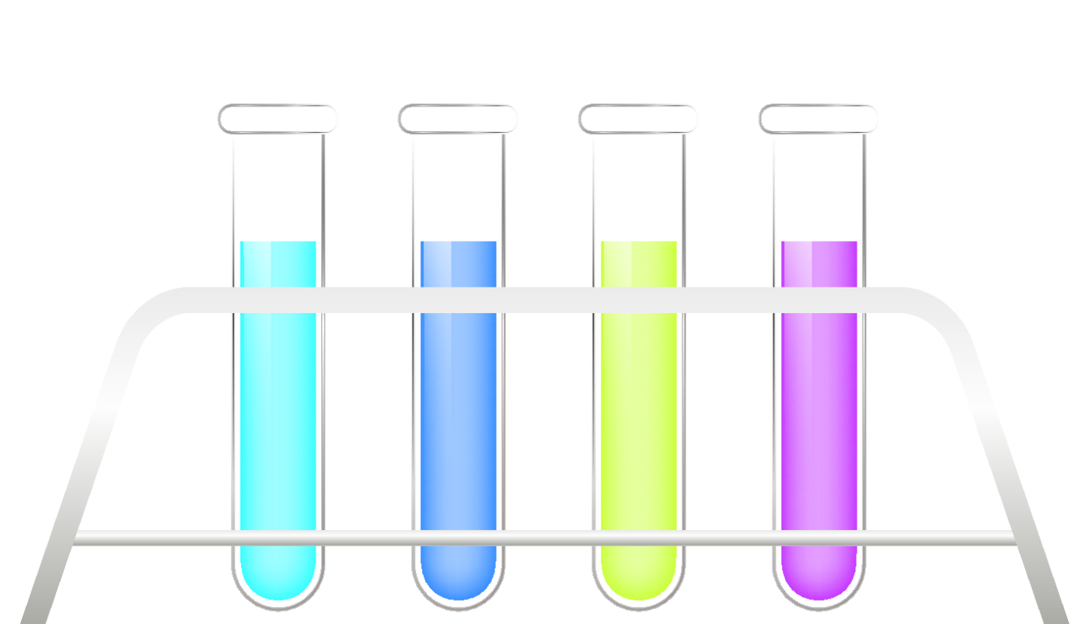
Autologous Stem Cell Therapy for Knee Cartilage Repair
Patient Evaluation
Cell Harvesting
Cell Processing
Reintroduction
Post-Treatment Care

Slide 14
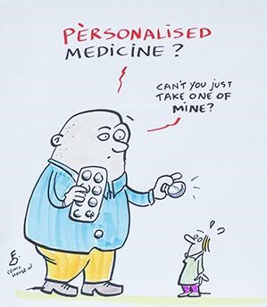
THANKS
DO YOU HAVE ANY QUESTIONS?
Please keep this slide for attribution

