Slide 1



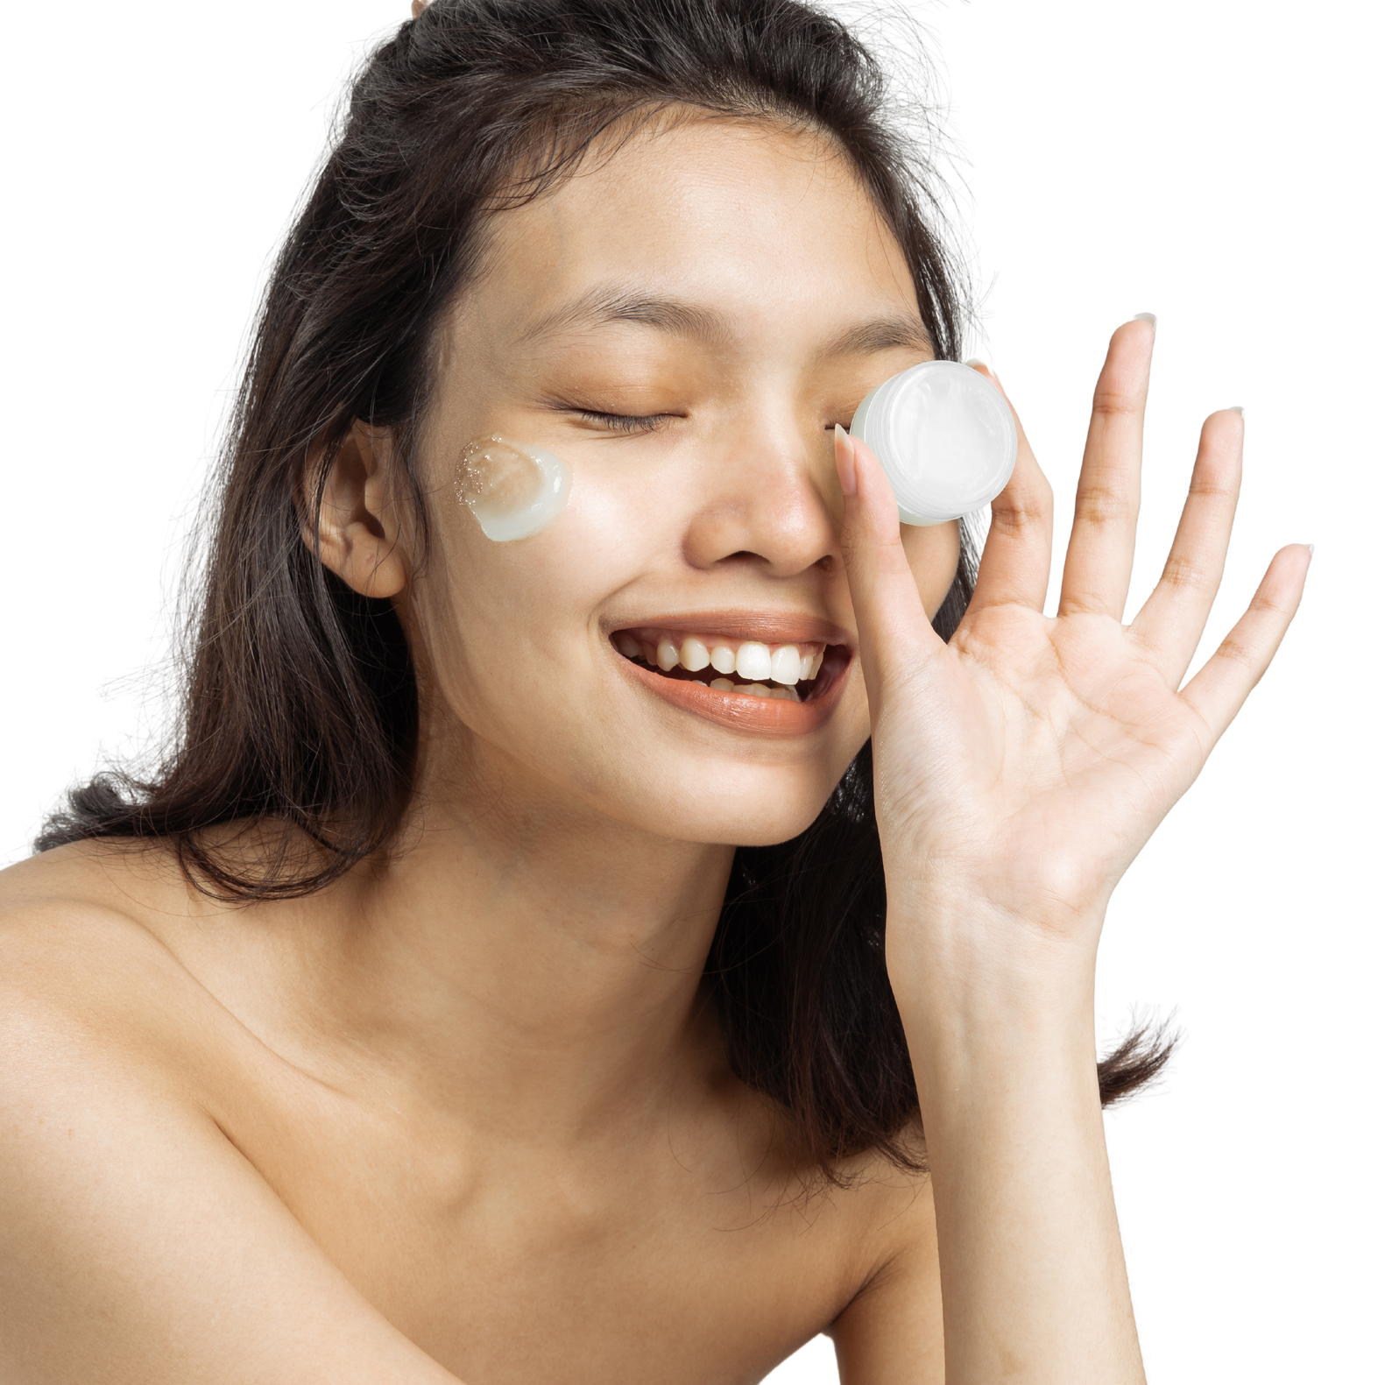

Nanotechnology in cosmetics
DBS BIOTECHNOLOGY
5TH SEMESTER

Slide 2


03
ESHA ZAMAN
Delivery system for each cosmetic target
Nano based Sunscreens
Nano based topical acne treatment

Slide 3

Delivery system for each cosmetic target
DDS
CDS
HDS
FDS

Slide 4
DDS
CDS
HDS
FDS

Slide 5
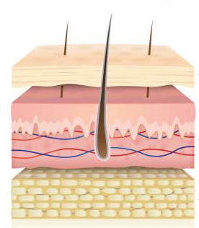
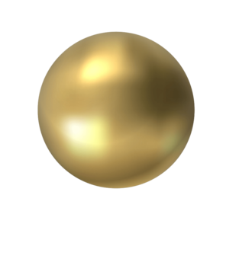

DDS-DEEP DELIVERY SYSTEM
is capable of penetrating the innermost skin layers and selectively delivering the active ingredient

Slide 6
DDS
CDS
HDS
FDS

Slide 7
CDS
DDS
HDS
FDS

Slide 8
CDS- CORNEUM DELIVERY SYSTEM
Minimizing the penetration of the active ingredient and concentrating it on the outermost skin layers

Slide 9
CDS
DDS
HDS
FDS

Slide 10
HDS
DDS
CDS
FDS

Slide 11
HDS-HAIR DELIVERY SYSTEM
NP adhere themselves to the hair stem and progressively deliver the active ingredients they contain to the hair cuticle for its part

Slide 12
HDS
DDS
CDS
FDS

Slide 13
FDS
DDS
CDS
HDS

Slide 14




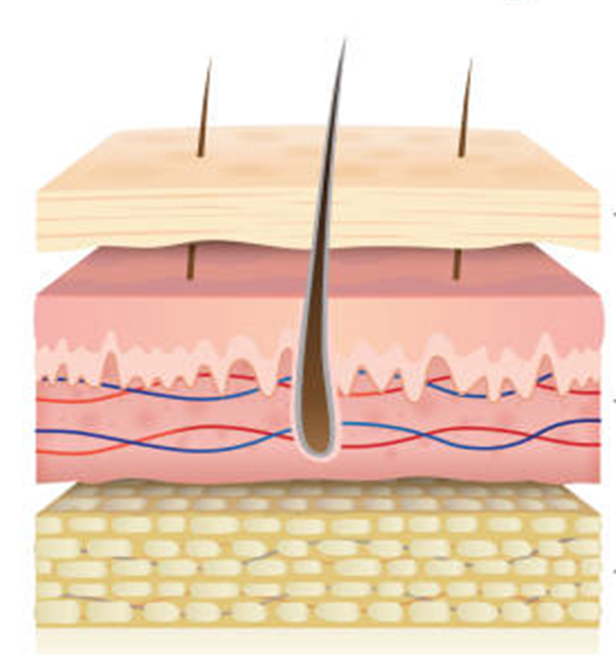

FDS- FOLLICULAR DELIVERY SYSTEM
selectively Vehicles the active ingredients to the hair bulb and the sebaceous glands

Slide 15




Can you guess what I’m going to talk about next?
I'm Rain, and I'll be sharing with you our business plan.
Follow us at @reallygreatsite to learn more.

Slide 16


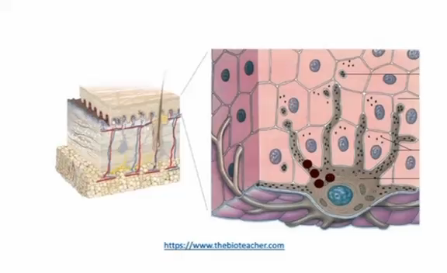

Why we need sunscreens?
1
The skin's natural defense mechanisms, such as melanin production, which prevents the penetration of UV radiation into the deeper skin layers, decreasing the release of ROS and skin photosensitization, are insufficient for an effective skin protection. In addition, melanin indirectly scavenges reactive oxygenated species (ROS) formed during the UV-inducing oxidative stress on the skin.
The amounts of melanin in the skin depend on the phenotype. In most phenotypes, endogenous melanin is not enough for full protection, especially in the summertime.
Therefore, the use of topical sunscreens and additional forms of protection is essential to prevent health issues.
2
3

Slide 17

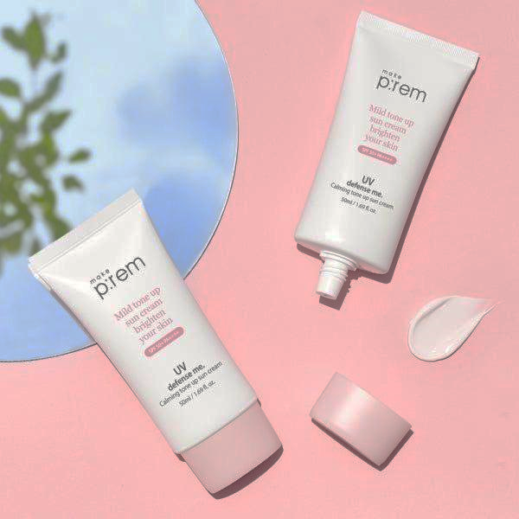
Sunscreens
1
UV filters can be chemical or physical
A suitable alternative to chemical filters is the use of physical UV filters (zinc oxide [ZnO] and titanium dioxide [TiO2]). But, they result in white cast on skin.
A way to overcome this problem is to decrease its particle size and/or incorporate these filters in nanoparticles
But titanium dioxide and zinc oxide nanoparticles were shown to trigger the formation of free radicals upon exposure to UV rays
To overcome this, nanoparticles were coated with materials that almost completely block the release of free radicals.
2
3
4
5

Slide 18
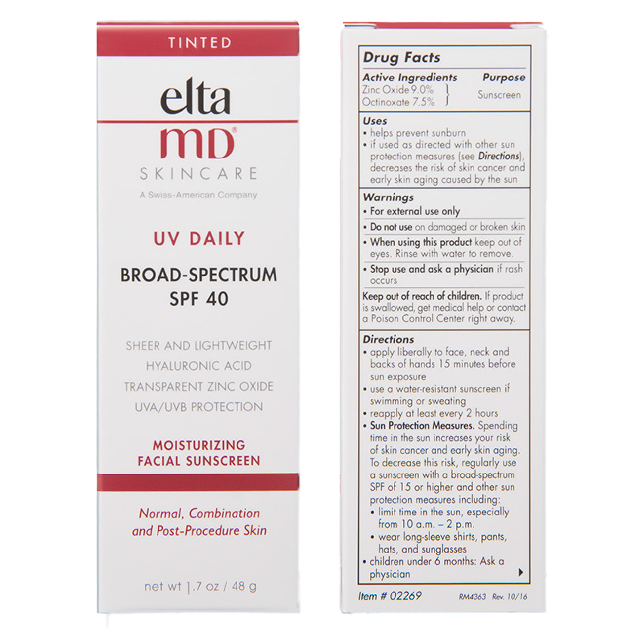
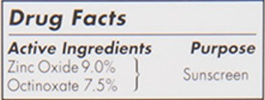
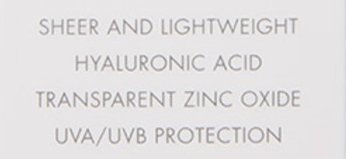

Slide 19


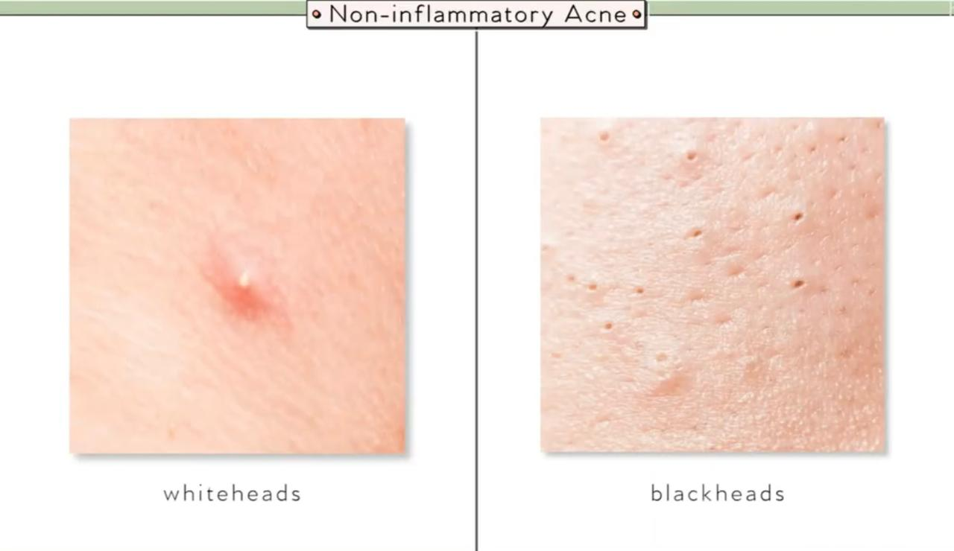
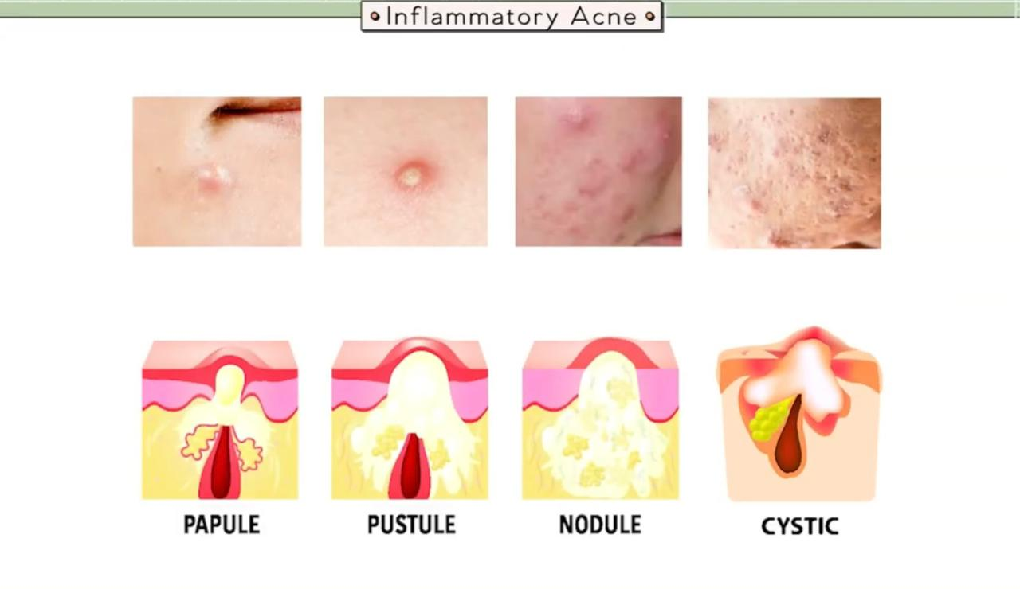

ACNE
1
Acne vulgaris is one of the most commonly observed skin diseases, affecting young adults (11–30 years). It can cause permanent physical scarring.
Often associated with acne-related bacteria such as Propionibacterium acnes, Staphylococcus epidermidis, Staphylococcus aureus
There are two types of acne that you can get, inflammatory and non-inflammatory acne
Non-inflammatory: on the surface of the skin
Inflammatory: is from the deeper layers of the skin
2
3

Slide 20


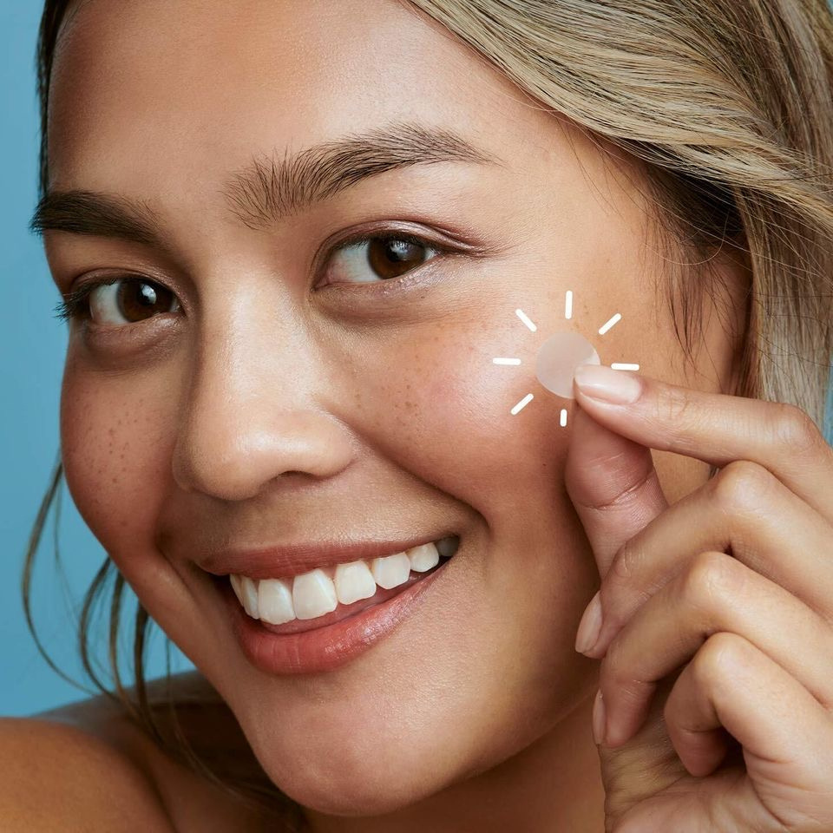


Slide 21
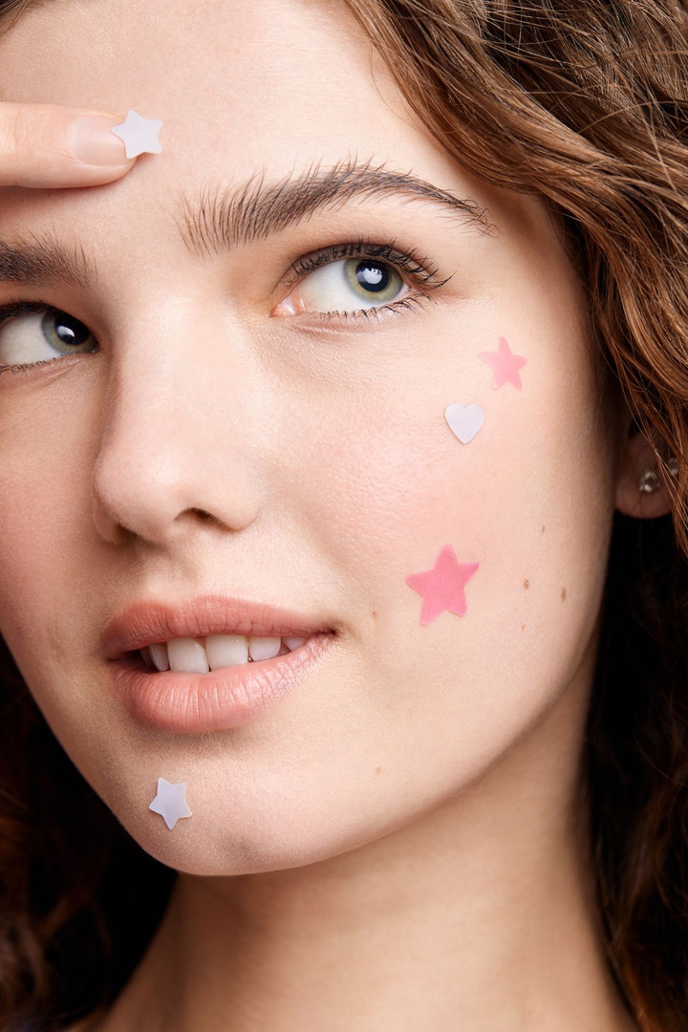

Slide 22
PIMPLE PATCHES

Slide 23
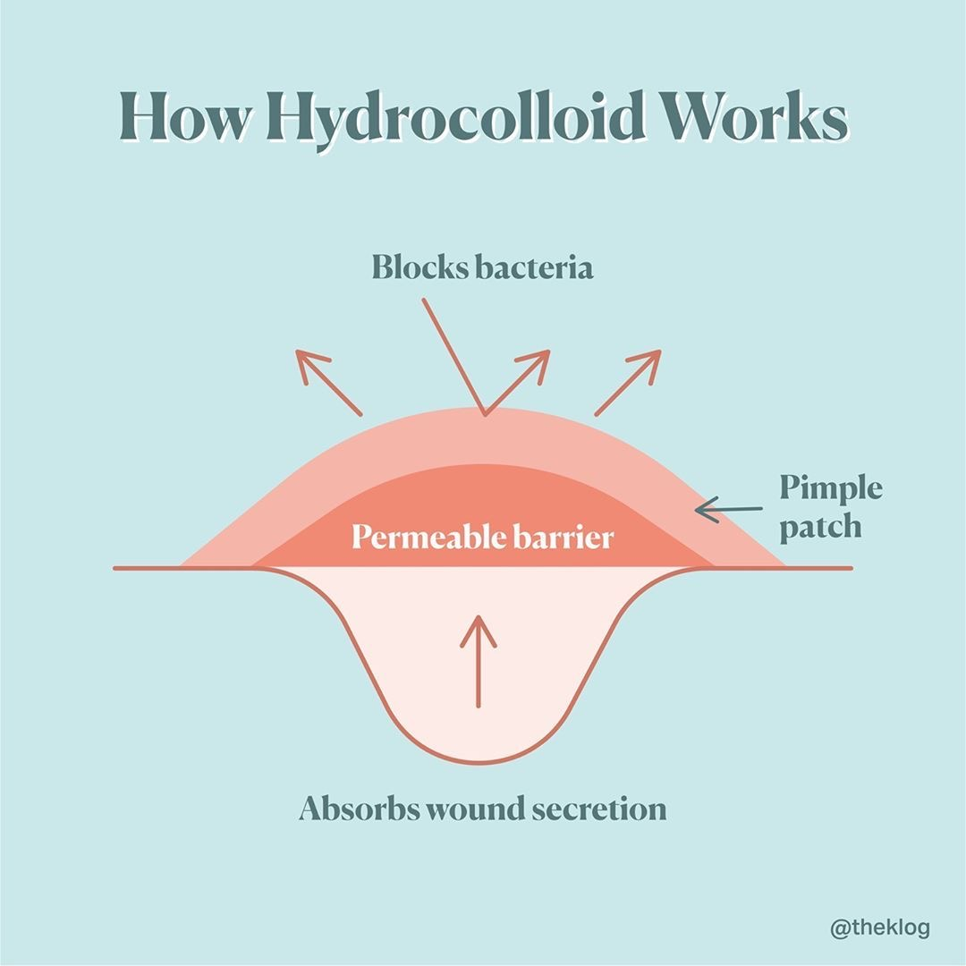

Slide 24

ACNE PATCH BASE ON NANOMATERIAL GELATIN/CHITOSAN BILAYER WITH CENTELLA ASIATICA
Making gelatin and chitosan NP solution
Lyophilization of Centella asiatica (CA) to obtain dry plant extract
Cytotoxicity Assay of CA on Human skin fibroblasts
Screening of CA for antibacterial activity by disk diffusion analysis
Bilayer GC patch's composition analysis by FTIR
Morphological Characterization of the Patches
Making of Mono and Bilayer Patches
Preparation of Gelatin/Chitosan Solution Loaded with PA/CA Extracts
Water Retention Assay of patches
Antibacterial Activity Assay of patches
Conduction of skin irritation test on rabbits
Notes:
Kuo, C. W., Chiu, Y. F., Wu, M. H., Li, M. H., Wu, C. N., Chen, W. S., & Huang, C. H. (2021). Gelatin/chitosan bilayer patches loaded with cortex Phellodendron amurense/Centella asiatica extracts for anti-acne application. Polymers, 13(4), 579.

Slide 25

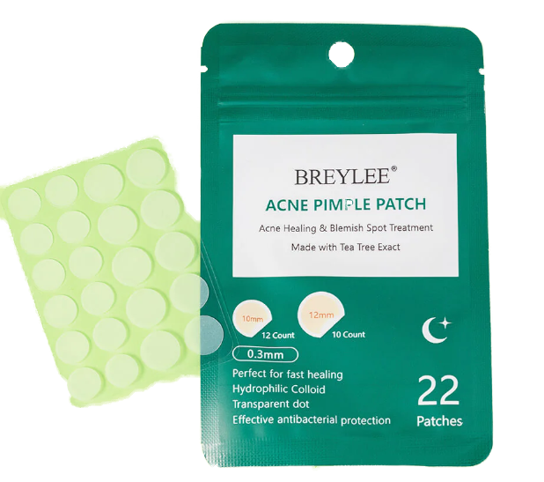

Slide 26

References
Office, P. REGULATION (EC) No 1223/2009 OF THE EUROPEAN PARLIAMENT AND OF THE COUNCIL of 30 November 2009 on cosmetic products. 2009 12/18/09, 4:01:41 AM 12/17/09, 8:09:27 AM]; Available from: https://health.ec.europa.eu/system/files/201611/cosmetic_1223_2009_regulation_en_0.pdf.
Dubey, S.K., et al., Emerging trends of nanotechnology in advanced cosmetics. Colloids Surf B Biointerfaces, 2022. 214: p. 112440.
Colomban, P., Raman spectroscopy of copper nanoparticle-containing glass matrices: Ancient red stained-glass windows. Journal of Raman Spectroscopy 40(12):1949 - 1955, May 2009.
Berube, D.M., Project on emerging nanotechnologies - Consumer product inventory evaluated. Nanotechnology Law and Business 7(2):152-163, June 2010.
https://breylee.com/products/acne-pimple-patch-for-night
https://www.sciencedirect.com/science/article/abs/pii/S2468519421002895
https://www.mdpi.com/1660-4601/17/17/6088
https://www.ncbi.nlm.nih.gov/pmc/articles/PMC7279536/
Saldaw, A., Ananda, L. T., Hafis, M. R., Wafa, S., & Rizkita, A. D. (2023, April). Systematic review: Natural Acne Patch Base On Nanomaterial Gelatin/Chitosan Bilayer from Mulberry Extract. In Proceeding International Conference on Religion, Science and Education (Vol. 2, pp. 711-714).
https://www.researchgate.net/publication/359151917_Nanotechnology_in_Cosmetics_and_Cosmeceuticals-A_Review_of_Latest_Advancements
Kuo, C. W., Chiu, Y. F., Wu, M. H., Li, M. H., Wu, C. N., Chen, W. S., & Huang, C. H. (2021). Gelatin/chitosan bilayer patches loaded with cortex Phellodendron amurense/Centella asiatica extracts for anti-acne application. Polymers, 13(4), 579.
Nanotechnology: Where Dermatology Meets Science Fiction: https://www.youtube.com/watch?v=zu499ocrEHo
https://chaileedo.com/koreas-kolmar-to-develop-first-gold-nano-sunscreen-product/
https://www.cosmeticsdesign.com/Article/2007/10/11/TRI-K-launches-nano-emulsion-in-a-gel
https://www.linkedin.com/feed/update/urn:li:activity:7163510384291749888/

Slide 27
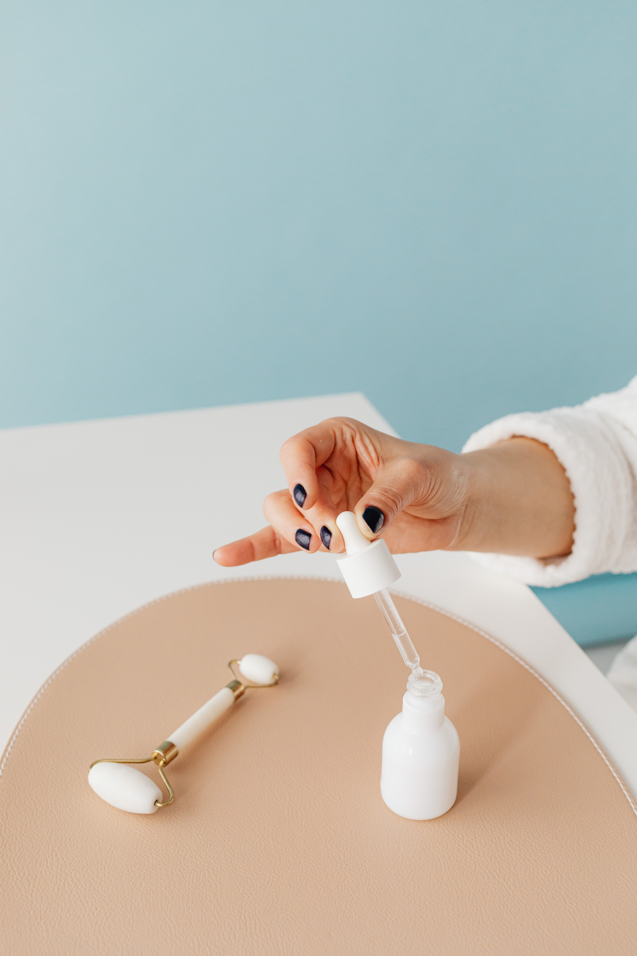




Thank
you

