Slide 1
MAKEYOUROWNTRIP agent
CAPSTONE PROJECT
Presented By : Esha Mogha
College Name & Department : Rajkiya Engineering College, Kannauj & Computer Science & Engineering

Slide 2
OUTLINE
Problem Statement
Technology used
Wow factor
End users
Result
Conclusion
Future scope
IBM Certifications
Github Link

Slide 3
Problem Statement
Travelers often face challenges in planning trips due to fragmented information, time-consuming research, budget constraints, and the difficulty of finding experiences that align with their interests. Manual planning across platforms is inefficient and lacks personalization.
Proposed Solution: The project builds customizable AI agents by integrating IBM watsonx.ai with LangGraph in a secure, API-driven pipeline. Agents are configured with tools and graph-based logic to handle natural language queries and perform tasks. Real-time inferencing is powered by foundation language models, all orchestrated within an interactive Jupyter Notebook. This setup enables rapid prototyping and scalable deployment of intelligent, workflow-aware assistants.

Slide 4
Technology used
Model: Granite 3-3-8B Instruction Model – IBM's state-of-the-art large language model optimized for instruction-following tasks, used to generate intelligent and context-aware travel suggestions.
Platform: IBM Cloud – Used for securely deploying and integrating the AI services.
Natural Language Processing (NLP): Powers user intent recognition, preference parsing, and conversational interaction.
Agentic AI Framework: Enables dynamic, interactive, task-driven travel planning and itinerary generation

Slide 5
IBM cloud services used
IBM watsonx.ai Studio: Core environment for building, deploying, and managing the Travel Agentic AI using the Granite 3-3-8B Instruction Model.
watsonx.ai Runtime: Executes real-time AI workflows, enabling dynamic, contextual travel recommendations.
IBM Cloud Identity & Access Management (IAM): Ensures secure authentication and access to cloud services through personal API keys.
watsonx.ai Prompt Lab & Agent Lab: Used to prototype, fine-tune, and manage prompt engineering and agentic task flows effectively.
IBM Cloud Deployment Services: Facilitates scalable and secure deployment of the AI system on IBM Cloud infrastructure.
External Tools Integrated via API: Google, DuckDuckGo, WebCrawler, Wikipedia, and Weather APIs integrated for real-time information retrieval and travel data enrichment.

Slide 6
Wow factors
Graph-Based Agent Logic – LangGraph enables visual, flexible agent workflows for smarter decision-making.
Enterprise-Grade Security – Built on IBM Cloud, ensuring trusted, secure handling of data and API access.
Scalable Foundation Model – Granite 3-3-8B handles complex, multi-step queries with ease and precision.
Interactive Notebook Experience – Fully executable in Jupyter for quick prototyping and testing.
Multi-Tool Integration – Agents can be equipped with various tools (e.g., web search, calendar, location) to enhance functionality.

Slide 7
End users
Business Analysts – Interact with AI agents to generate insights, reports, and automated recommendations.
Customer Support Teams – Use conversational agents to handle queries, bookings, and task automation.
Developers & Engineers – Build, test, and scale agent-based systems using IBM’s foundation models and APIs.
Educators & Students – Learn and teach AI concepts through hands-on experimentation with agent workflows.
Operations Teams – Automate routine processes and streamline decision-making using intelligent agents.

Slide 8
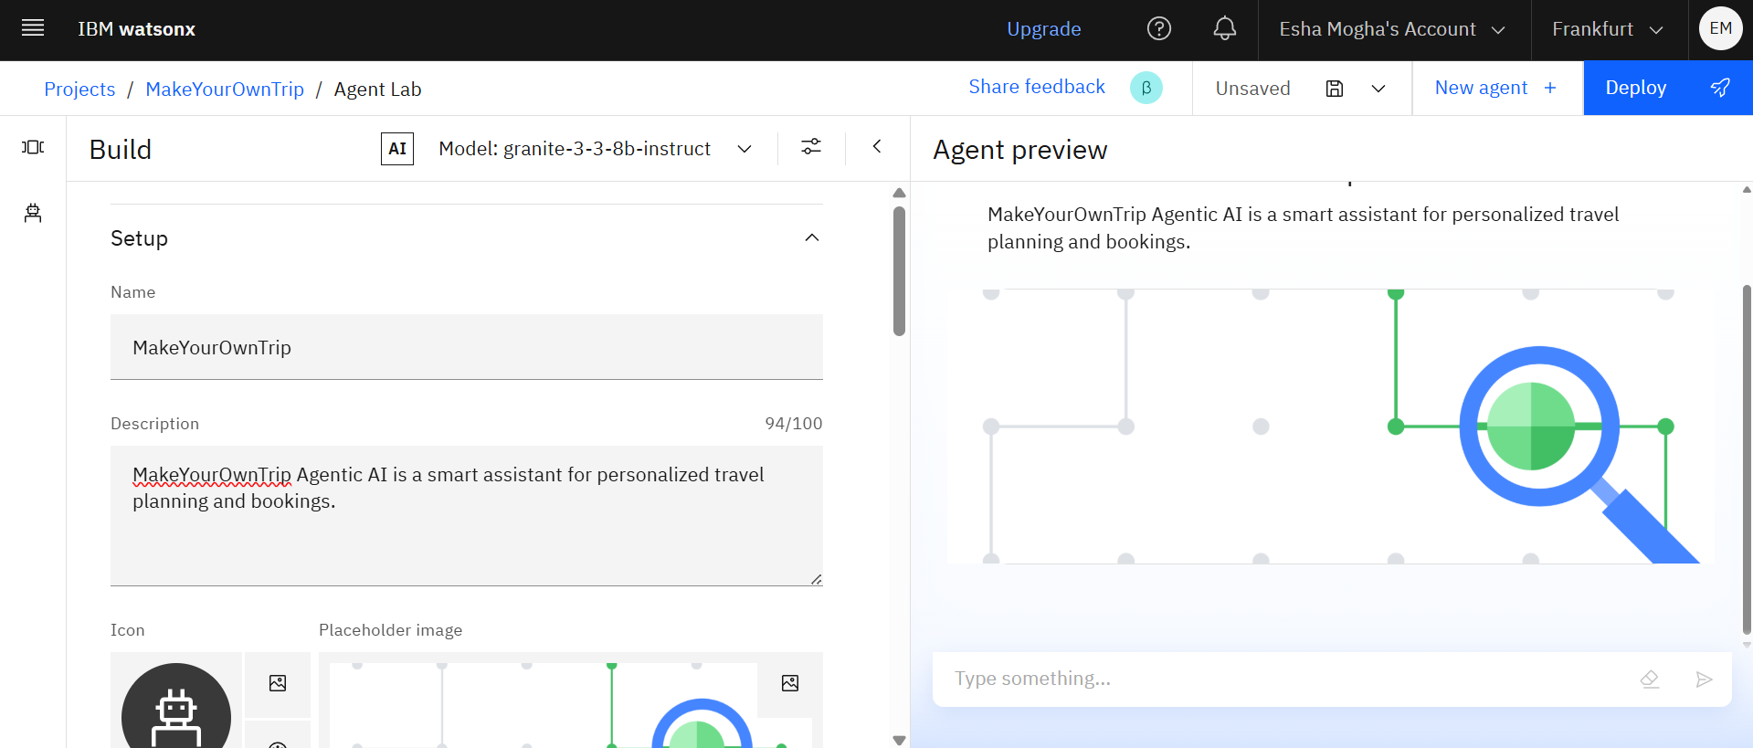
Results

Slide 9
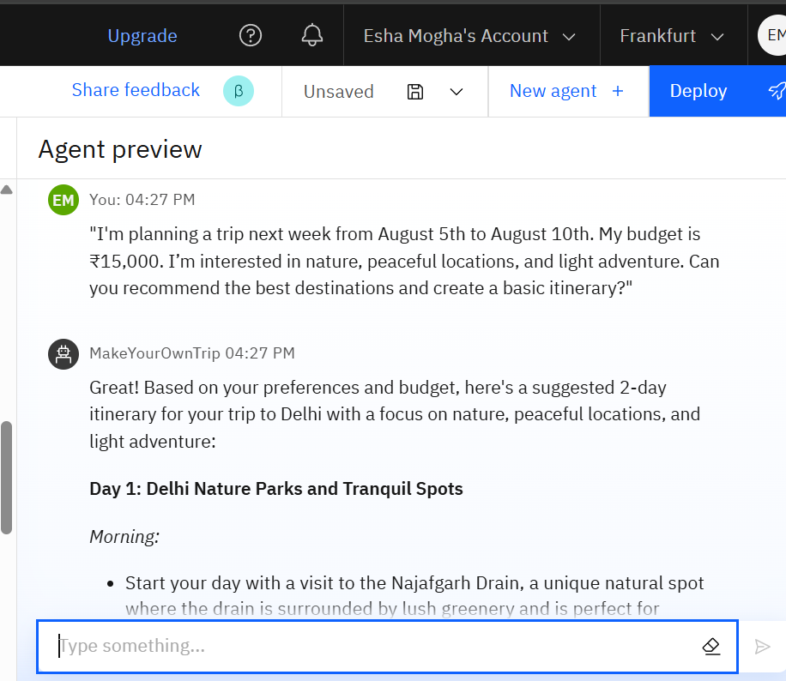
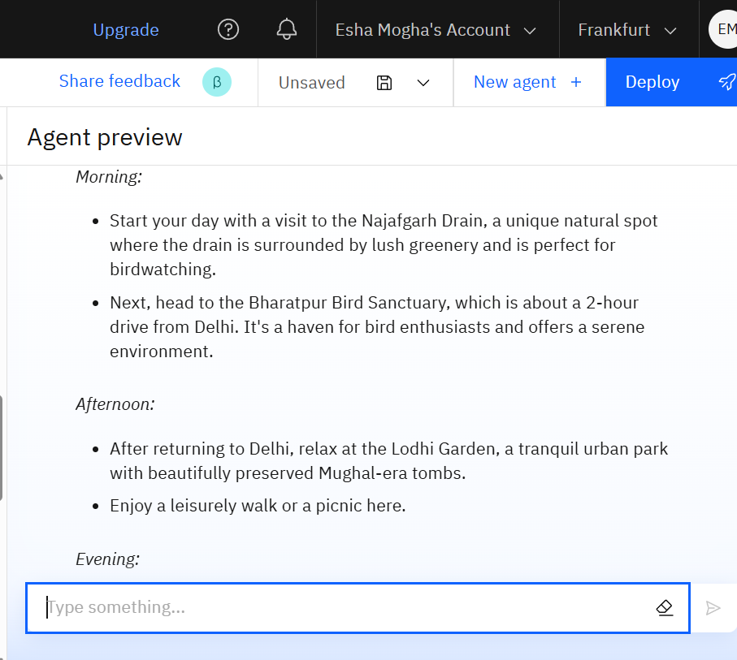
Results

Slide 10
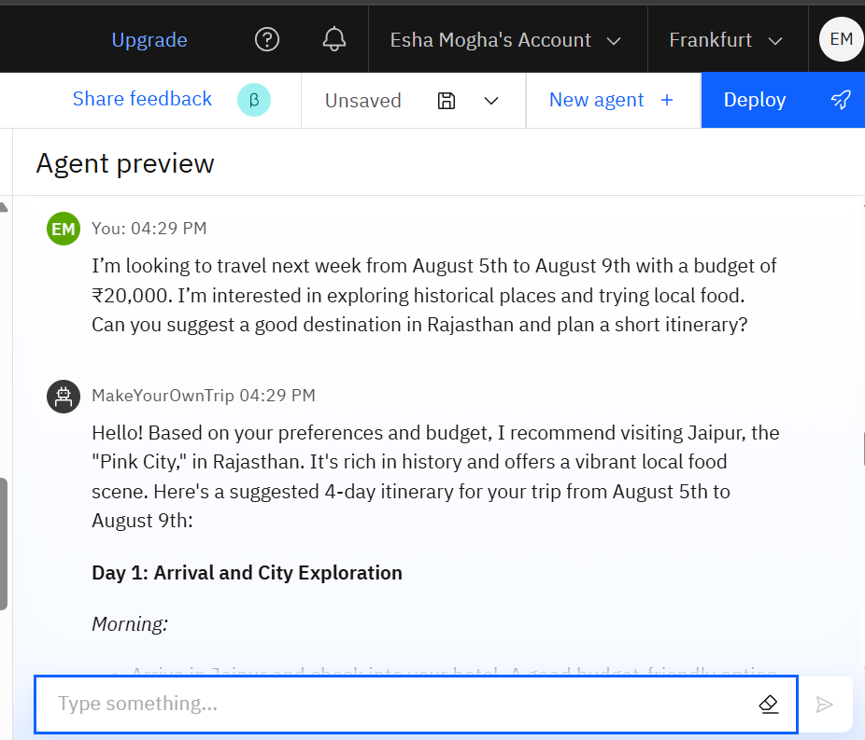
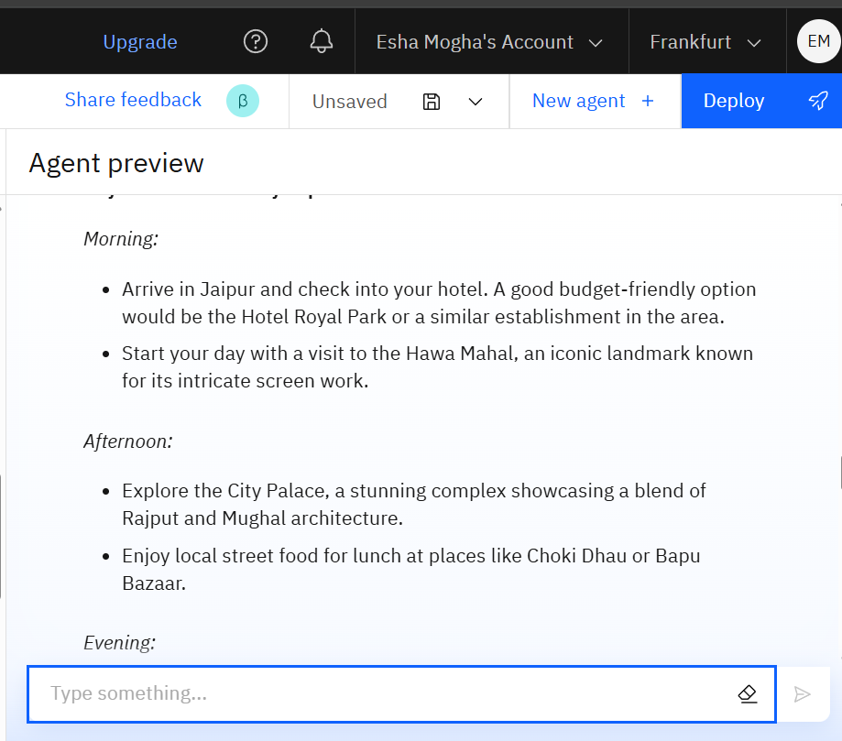
Results

Slide 11
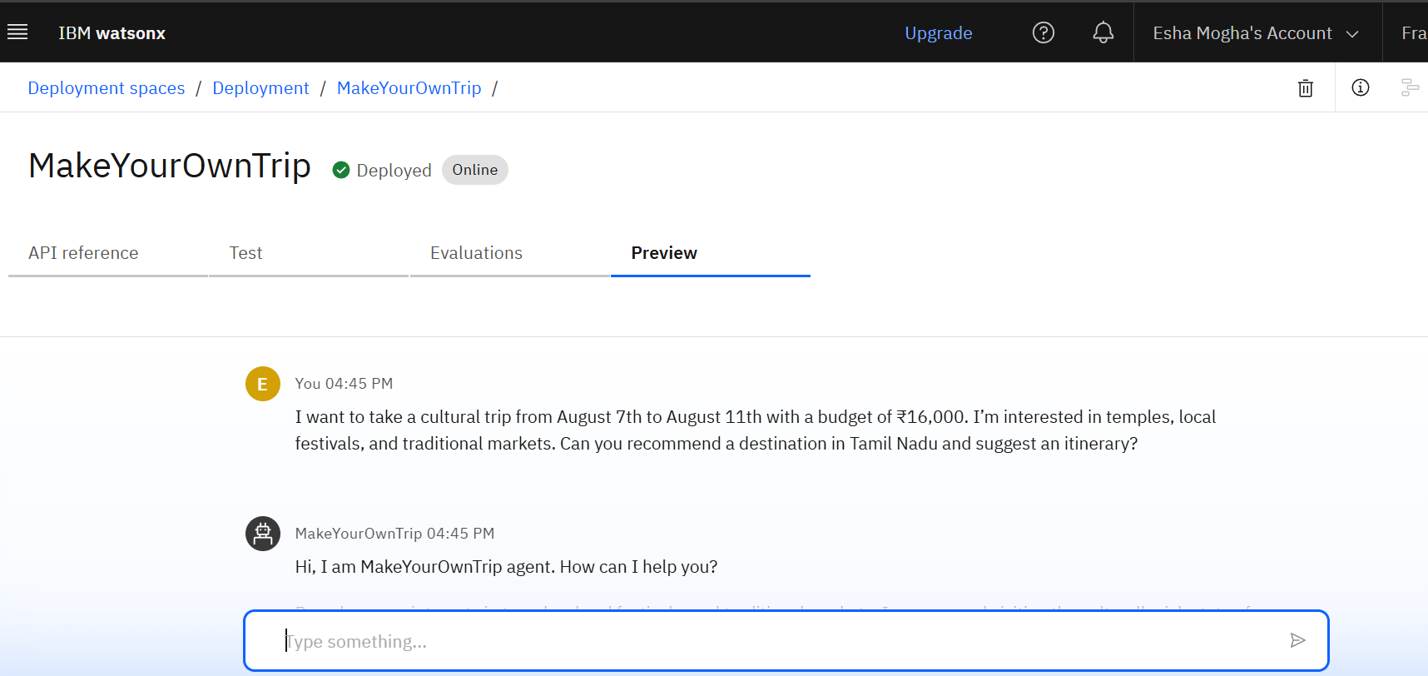
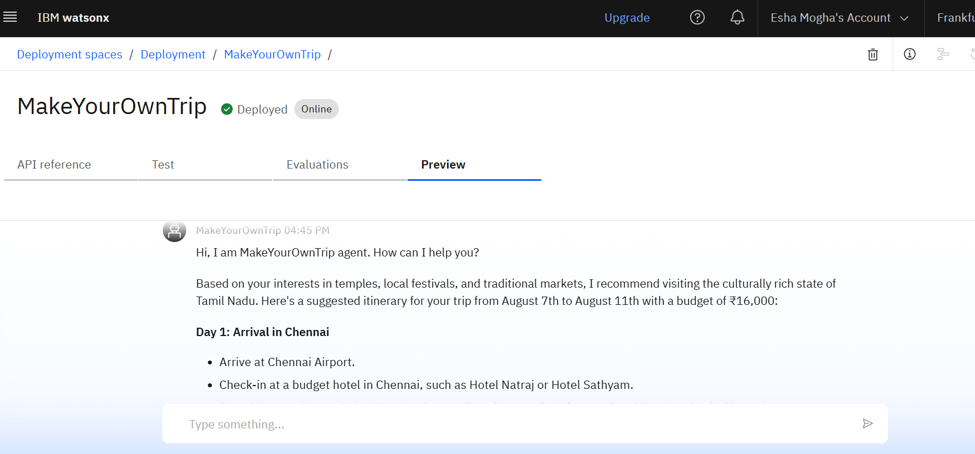
Results
Deployed AI Agent

Slide 12
Conclusion
The agent provides personalized travel recommendations based on user preferences, budget, and travel dates.
It automates time-consuming tasks like itinerary creation, activity suggestions, and weather-based planning.
By integrating real-time data from various sources, it enhances the accuracy and relevance of travel plans.
Users benefit from a seamless, conversational experience without needing to browse multiple platforms.
The system improves overall travel planning efficiency, offering a smart, user-friendly solution for modern travelers.

Slide 13
Future scope
Multilingual Support
Voice Interaction
Group Travel Planning
Booking Integration
Smart Budget Optimization

Slide 14
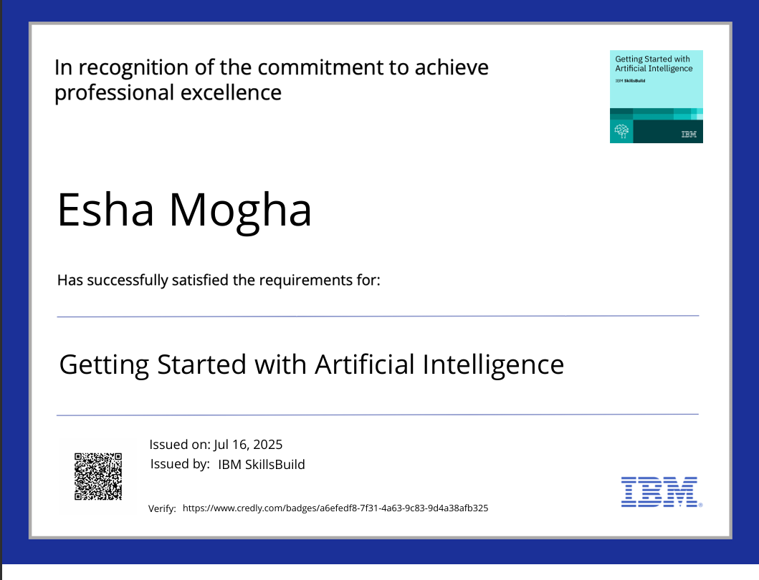
IBM Certifications

Slide 15
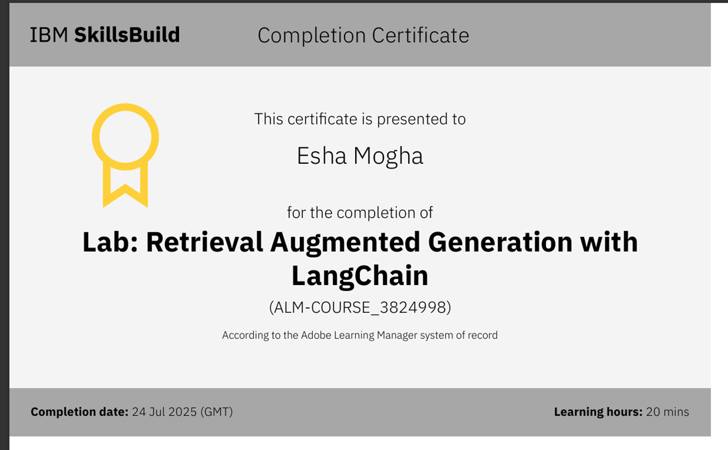

Slide 16
GitHub Link
Github Link : https://github.com/Esha0903/MakeYourOwnTrip-Agentic-Ai

Slide 17
THANK YOU

