Slide 1

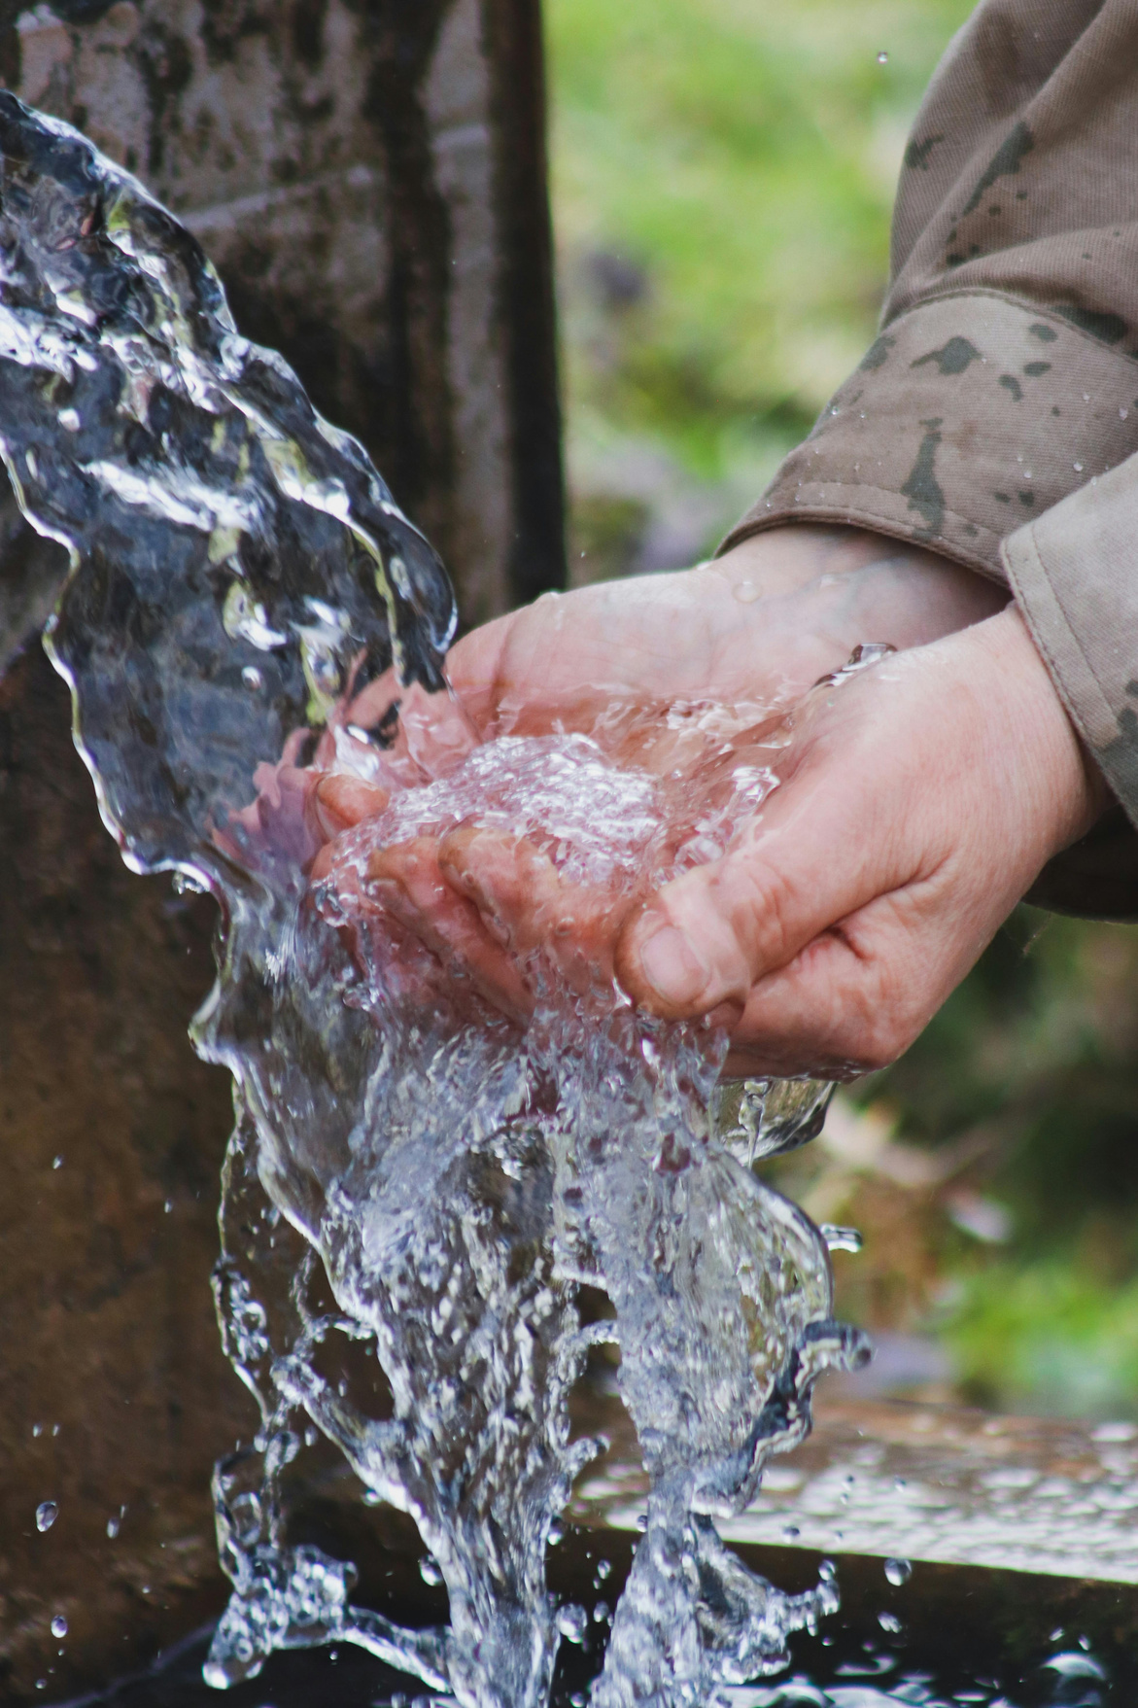
HOUSEHOLD WATER CONSUMPTION PREDICTION
Presented by:
Yuti Parmar : SDDS059A
Esha Rasam : SDDS067A

Slide 2

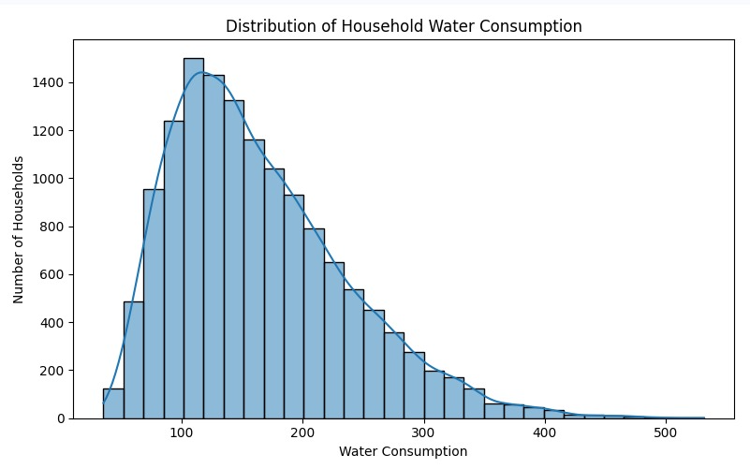
INTRODUCTION
  Water consumption varies between households depending on different conditions.
  Factors such as number of residents, temperature, humidity, guests and appliance usage can affect water usage.
  Many households do not track how much water they consume each day, which can lead to unnecessary usage and wastage.
  Machine learning can identify patterns in historical household data and use them for prediction.
PROBLEM STATEMENT
To predict household water consumption using household, environmental and time-related factors through machine learning.
WATER CONSUMPTION DISTRIBUTION

Slide 3
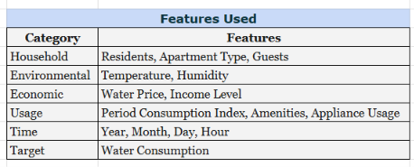
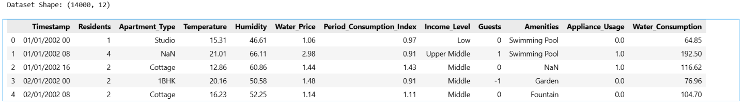
Dataset & Features
  Dataset Type: Household Water Consumption Dataset
  Total Records: 14,000
  Input Features: 14
  Target Variable: Water_Consumption
  Training Data: 11,200 records (80%)
  Testing Data: 2,800 records (20%)
Dataset Source: Kaggle — Household Water Consumption Dataset

Slide 4

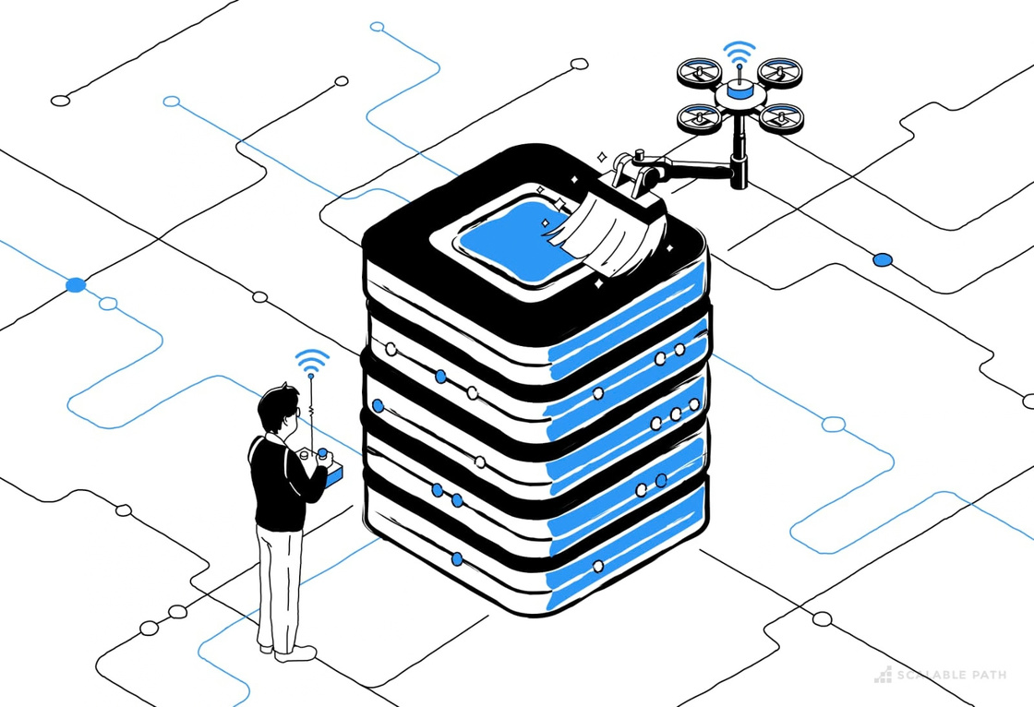
DATA PREPROCESSING & METHODOLOGY
Data Preprocessing
  Checked and cleaned the dataset.
  Handled missing and invalid values.
  Converted Timestamp into Year, Month, Day and Hour.
  Filled numerical missing values using Median.
  Filled categorical missing values using Unknown.
  Applied One-Hot Encoding to categorical features.
  Split data into 80% training and 20% testing.
Models Tested:
  Linear Regression
  Decision Tree Regression
  Random Forest Regression
Train-Test Split:
80% Training (11,200) | 20% Testing (2,800)
METHODOLOGY
Dataset → Data Cleaning → Missing Value Handling → Feature Processing → One-Hot Encoding → Train-Test Split → Model Training → Model Evaluation → Prediction

Slide 5
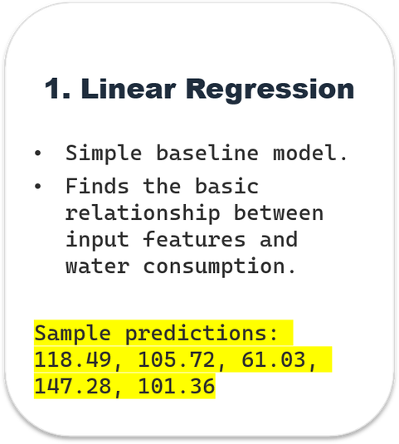
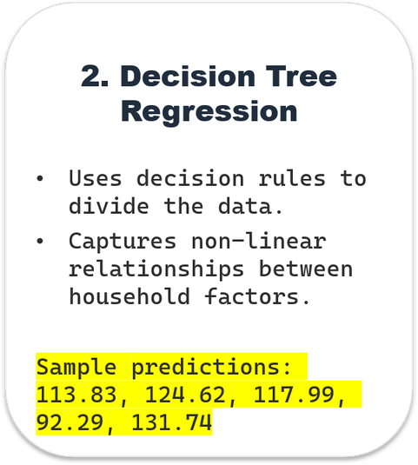
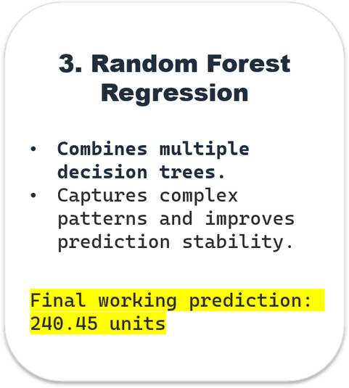
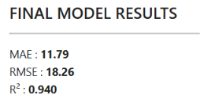
Machine Learning Models
2. Decision Tree
Regression
3. Random Forest
Regression
1. Linear Regression
Our Final Random Forest output:

Slide 6
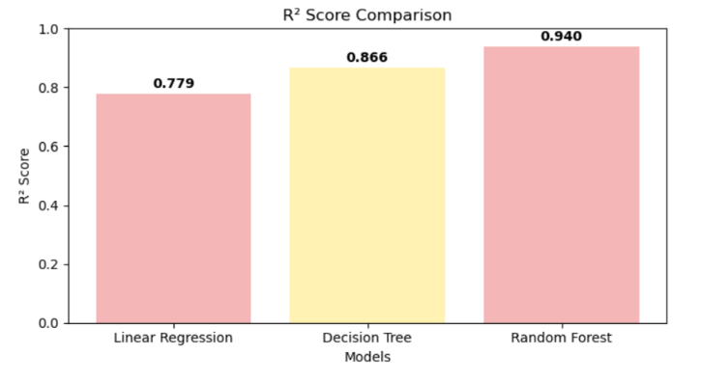
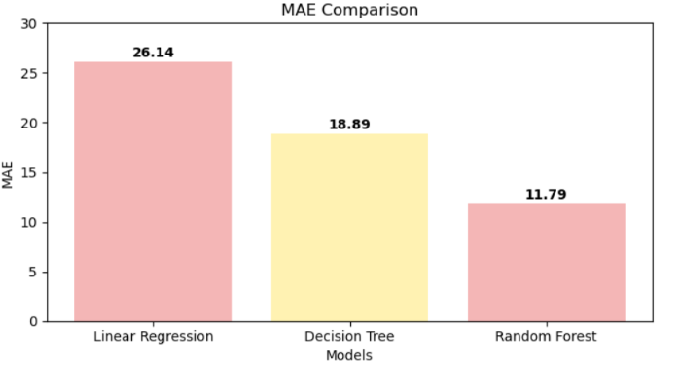
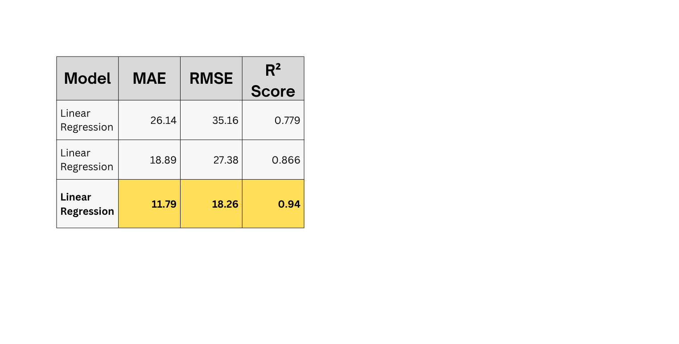
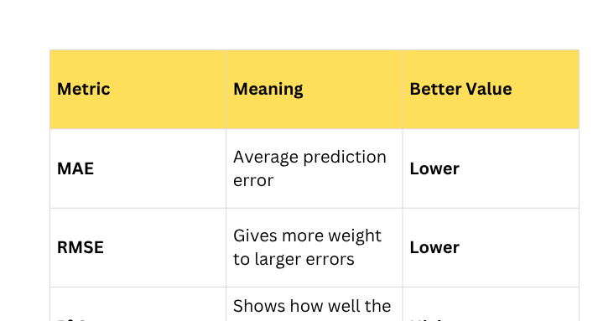
Evaluation & Metrics
Model Performance Comparison
Random Forest achieved the lowest MAE and RMSE and the highest R² score among the three models.
MAE and RMSE measure prediction error, while R² describes how much variation in the target is explained by the model.
Evaluation Metrics
MAE Comparison
Lower MAE = lower error. Random Forest: 11.79.
R² Score Comparison
Higher R² = better fit. Random Forest: 0.940.

Slide 7

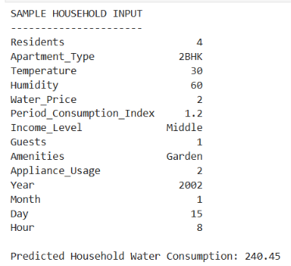
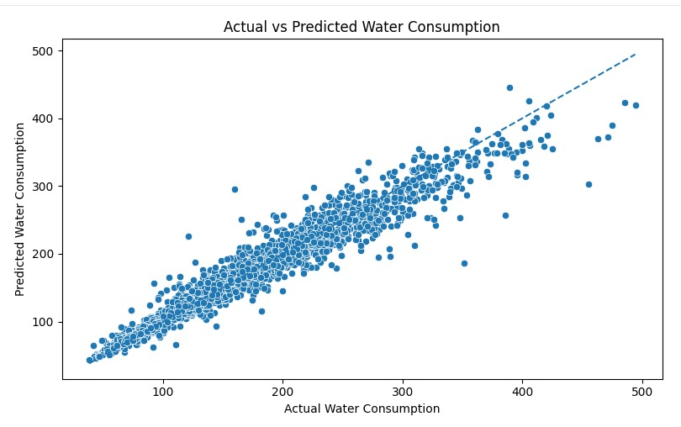
Prediction, Conclusion & Future scope
Prediction
  Final model: Random Forest Regression
  Sample predicted water consumption: 240.45 units
  Prediction is generated using household, environmental, economic, and usage-related features.
Future Scope
  Use real-time smart-meter/IoT data.
  Include larger and more diverse datasets.
  Add more weather and seasonal information.
  Develop a web/mobile dashboard for consumption monitoring.
  Explore advanced models such as LSTM and other time-series methods.
Sample Household Input & Prediction
Conclusion
Three regression models were compared: Linear Regression, Decision Tree, and Random Forest.
Random Forest achieved the best test performance:
MAE = 11.79 | RMSE = 18.26 | R² = 0.940
The project demonstrates that ML can be used to predict household water consumption from multiple input features.

Slide 8
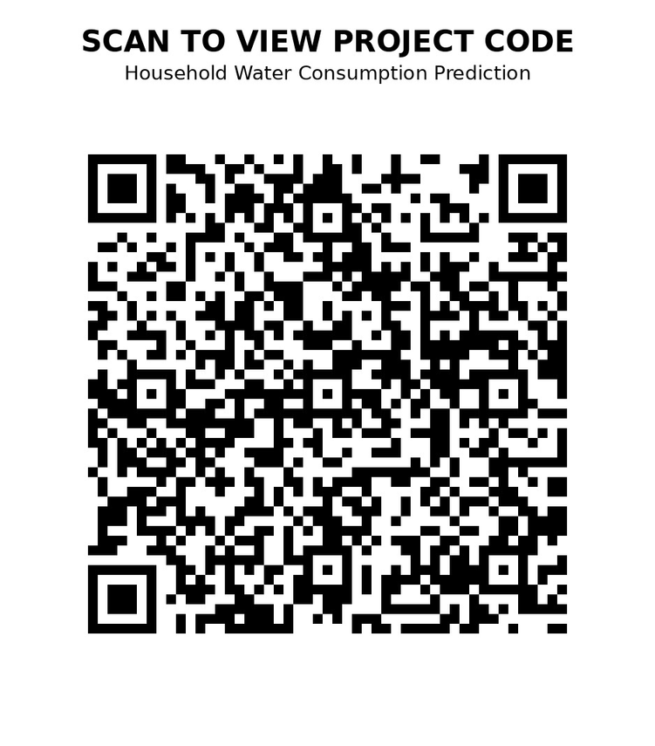
Thank you
For your Attention
Scan the QR code to access our GitHub project repository…
References
  GitHub – Household Water Consumption Pattern
  Scikit-learn Documentation
  Pandas Documentation
  NumPy Documentation
  Matplotlib Documentation
EVERY DROP
COUNTS !!

