Slide 1
E-COMMERCE DATA ENGINEERING & AGENTIC AI PLATFORM
End-to-End Medallion Data Engineering Pipeline + 9-Agent Autonomous AI Engine
DEVELOPER: Student Project | TECH STACK: PostgreSQL • Apache Airflow • Gemini AI • Streamlit • Docker

Slide 2
1. Business Problem vs. My Solution
Why this platform was built and what business value it delivers.
❌ THE BUSINESS PROBLEM
1. Raw Data Messiness: E-Commerce stores process thousands of daily orders. Raw data is scattered across files with missing values, invalid dates, and currency errors. 2. Delay & Reliance on Engineers: Whenever managers need answers (e.g. 'What were sales in California?'), they must wait days for data engineers to write custom database code. 3. Lack of Actionable Insights: Static spreadsheets show numbers, but fail to explain WHY sales dropped or WHAT management should do next.
✅ MY INTEGRATED SOLUTION
1. Automated Medallion Pipeline (Layer 1): A 3-tier pipeline (Bronze → Silver → Gold) powered by PostgreSQL and Airflow that automatically cleans data, tracks location history (SCD2), and builds Star Schema tables. 2. Autonomous Agentic AI Layer (Layer 2): A team of 9 specialized AI agents connected to the Gold database that turns natural English questions into instant SQL queries, Plotly charts, and business recommendations! 3. Zero Dependency on Data Teams: Managers get instant answers in seconds!

Slide 3
2. Data Engineering: Medallion Architecture
Refining raw incoming data into pure, analytics-ready Star Schema tables.
1. RAW SOURCES
CSV, JSON, APIs Orders, Customers, Sellers & Products
2. BRONZE LAYER
Raw Storage 🟫 Append-Only Ingestion Batch Run Auditing
3. SILVER LAYER
Cleaned & Standard 🥈 ISO Dates, Currency Cast SCD Type 2 History
4. GOLD LAYER
Star Schema 🥇 Fact & Dimension Tables Revenue Marts
➔
➔
➔
MEDALLION PIPELINE BREAKDOWN & RESPONSIBILITIES
• Bronze Layer (🟫 Raw Feeds): Stores raw incoming customer and seller transaction feeds without modification. Tracks ingestion batch IDs & load timestamps. • Silver Layer (🥈 Cleaned & Standardized): Fixes invalid date formats, converts currency strings into NUMERIC types, eliminates duplicate rows, translates category names into English, and maintains historical SCD Type 2 tracking for customer/seller locations. • Gold Layer (🥇 Analytics Star Schema): Fully optimized dimensional Star Schema (gold.fact_sales, gold.dim_customer, gold.dim_product, gold.dim_seller, gold.dim_date, gold.revenue_mart) designed for instant OLAP business queries.

Slide 4
3. Historical Tracking (SCD) & Data Quality Rules
Ensuring point-in-time revenue accuracy and enforcing data validation.
🔄 SLOWLY CHANGING DIMENSIONS (SCD)
SCD Type 1 (Overwrite): • Target: gold.dim_product • Used for basic product updates (weight, size category) where history isn't needed. • SQL: ON CONFLICT (product_id) DO UPDATE SET... SCD Type 2 (Historical Versioning): • Target: gold.dim_customer & gold.dim_seller • Tracks relocations across cities/states. • Mechanism: Expire old record (is_current = FALSE, end_date = NOW()) and INSERT new record version (is_current = TRUE). • Guarantees past sales stay credited to original regions!
🛡️ DATA QUALITY & METADATA AUDITING
1. Primary Key Non-Null Validation: Enforces non-null rules on customer_id, order_id, and product_id before processing. 2. Range & Value Constraints: Prices, freight fees, and payment values must be strictly > $0.00. 3. Referential Integrity Check: Fact sales records must resolve strictly to active dimension surrogate keys. 4. Metadata Audit Log: Tracks all runs in metadata.pipeline_runs, failed records in metadata.dq_results, and watermarks.

Slide 5
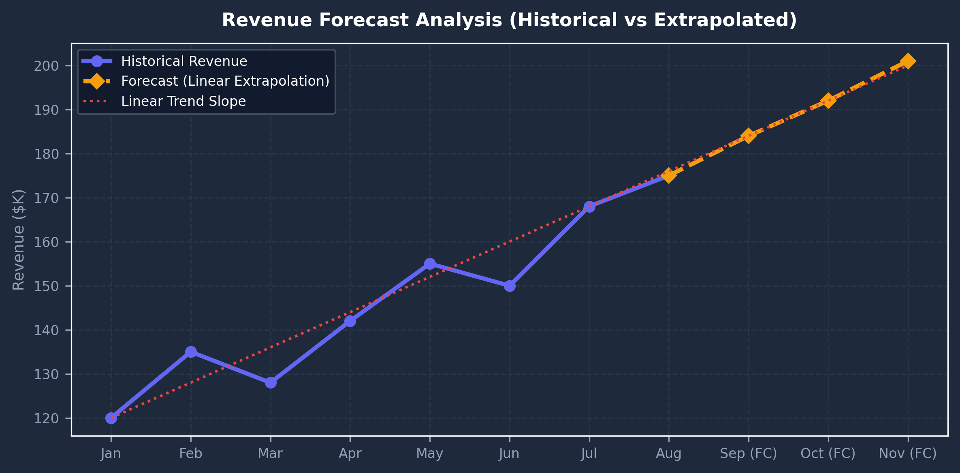
4. Data Science & ML Engine
Regression trends, moving averages, Z-score anomaly detection, and linear forecasting.
🧠 STATISTICAL & ML CAPABILITIES
1. Linear Trend Regression: Computes regression slopes on monthly revenue time-series to determine whether sales trajectories are increasing or decreasing. 2. Z-Score Anomaly Detection: Calculates statistical Z-scores across monthly revenue. Months where |Z| > 2.0 are flagged as revenue anomalies. 3. Revenue Forecasting: Extrapolates sales for 1 to 12 months ahead using linear regression extrapolation (numpy.polyfit). 4. 3-Period Moving Average: Smooths short-term fluctuations to reveal underlying growth.

Slide 6
5. Agentic AI System: 9 Specialist Agents
A team of autonomous AI agents collaborating to answer complex business questions.
Agent Name | Primary Role & Focus | Technical Mechanism / Output
🤖 Auto Router | Intent Router & Pipeline Manager | Analyzes user query and selects optimal agent sequence
📊 Data Agent | Database & SQL Expert | Generates safe SELECT queries on Gold Star Schema tables
🧠 ML Agent | Statistician & Trend Analyst | Calculates regression slopes & Z-score revenue anomalies
🔮 Forecast Agent | Predictor & Trend Extrapolator | Extrapolates sales for future 1-12 months with Plotly lines
💡 Insight Agent | Business Analyst | Transforms raw query data into 2-4 sentence evidence-backed insights
🎯 Action Agent | Management Consultant | Recommends specific operational actions with business rationale
📋 Report Agent | Executive Assistant | Summarizes full dashboard metrics into executive overviews
⚙️ Pipeline Agent | Data Engineer Audit Agent | Queries metadata.pipeline_runs & dq_results for execution health
💬 General Agent | Technical Advisor | Answers tech-stack questions on Airflow, Postgres, and Docker

Slide 7
6. Multi-Agent Orchestration Flow
Autonomous intent classification, sequential agent chaining, and context forwarding.
1. USER QUESTION
Asks: 'Why did profit drop?'
2. AUTO ROUTER 🤖
Routes to Data+Insight+Action
3. DATA AGENT 📊
Executes safe Gold SQL
4. INSIGHT AGENT 💡
Explains 12% category drop
5. ACTION AGENT 🎯
Recommends promo bundles
➔
➔
➔
➔
HOW CONTEXT FORWARDING WORKS BETWEEN AGENTS
1. User Question → Auto Router analyzes intent and selects agent sequence (e.g. ['data', 'insight', 'action']). 2. Data Agent executes safe SQL against Gold schema → Passes query results as context to Insight Agent. 3. Insight Agent derives evidence-backed business insights → Passes insight as context to Action Agent. 4. Action Agent formulates specific management recommendations → Streamlit UI renders formatted response cards.

Slide 8
7. Case Study: Answering a Complex Question
Step-by-step execution trace when a user asks a complex multi-part question.
💬 User Question: 'Why did profit decrease and what should management focus on?'
STEP 1: Auto Router 🤖
Analyzes query intent → Selects agent execution chain: Data Agent 📊 → Insight Agent 💡 → Action Agent 🎯
STEP 2: Data Agent 📊
Inspects Gold schema → Generates SELECT query → Executes safely → Retrieves revenue totals ($1.8M total sales).
STEP 3: Insight Agent 💡
Analyzes category numbers → Identifies: 'Category X sales declined by 12% MoM due to an 18% spike in regional freight costs.'
STEP 4: Action Agent 🎯
Formulates recommendation: 'Action: Renegotiate regional freight contracts and bundle Category X items with high-margin products.'

Slide 9
8. Presentation Layer & UI Features
Streamlit presentation layer with single-pane-of-glass executive controls.
🧠 AI ANALYST CHATBOT TAB
• Interactive Chat Prompt: Ask questions in plain English. • 8 Suggested Prompt Chips: Clickable buttons ('Total sales?', 'Sales forecast?') for single-click answers. • Clear Chat Button: Reset conversation anytime. • Live Status Badges: Top-right green badges showing live status for Gemini (🟢), Database (🟢), and Pipeline (🟢). • Agent Pipeline Display: Shows active agent execution chain (e.g. Data → Insight → Action). • Visual Output: Generates Plotly charts, data tables, insight cards, and recommended action boxes.
📊 4 EXECUTIVE DASHBOARD PAGES
1. Overview Page: 6 KPI cards (Total Revenue, Orders, Customers, Products, AOV, Growth MoM) + Filter selects for Category, Region & Date. 2. Pipeline Monitor: Visual Medallion architecture flow + run logs from metadata.pipeline_runs. 3. Data Quality Page: Audit reports showing passed vs failed rules & failure distribution graphs. 4. ML Insights Page: Moving average lines, Z-score anomaly threshold graphs & MoM growth breakdown.

Slide 10
9. Project Evaluation Summary & Live Demo
100% operational, fully verified, and ready for live presentation.
⭐ KEY PROJECT HIGHLIGHTS
• End-to-End Pipeline: Raw data ingested, cleansed in Silver, and modeled into Gold Star Schema (3,938 records). • Historical Accuracy: Fully supports SCD Type 1 & Type 2 location history. • Robust Data Quality: Great Expectations rules & execution tracking. • Autonomous Multi-Agent AI: 9 specialized AI agents collaborating. • SQL Security: Enforces strict read-only query validator (blocks DROP, DELETE, etc.). • Rate-Limit Protection: Fast pattern fallbacks ensure instant answers (< 1 second).
🚀 LIVE EVALUATION DEMO URLS
1. Streamlit Application & AI Chatbot: URL: http://localhost:8501 Status: 100% Connected & Ready (All Badges Green 🟢) 2. Apache Airflow Pipeline Orchestration: URL: http://localhost:8080 User: admin / Password: admin123 DAGs: 01_bronze_ingestion, 02_silver_transform, 03_gold_aggregation 3. Comprehensive PDF Report & GitHub Repo: GitHub: https://github.com/Eshaan4/E-COMMERCE-DATA-ENGINEERING-AGENTIC-AI-PLATFORM.git

