Slide 1
Findings
Draft

Slide 2
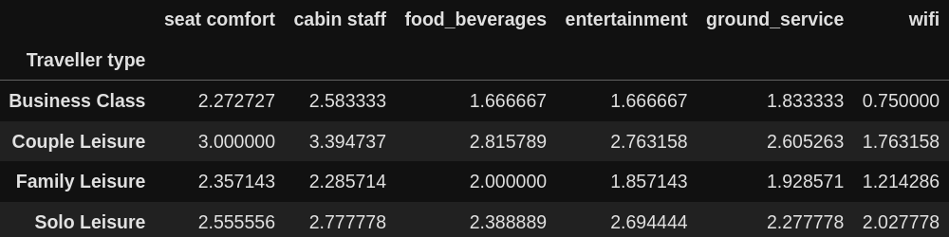
Average rating per traveller type

Slide 3
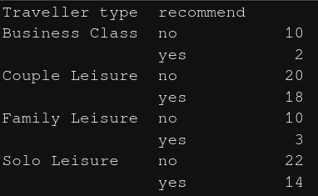
Recommendations per traveller type

Slide 4
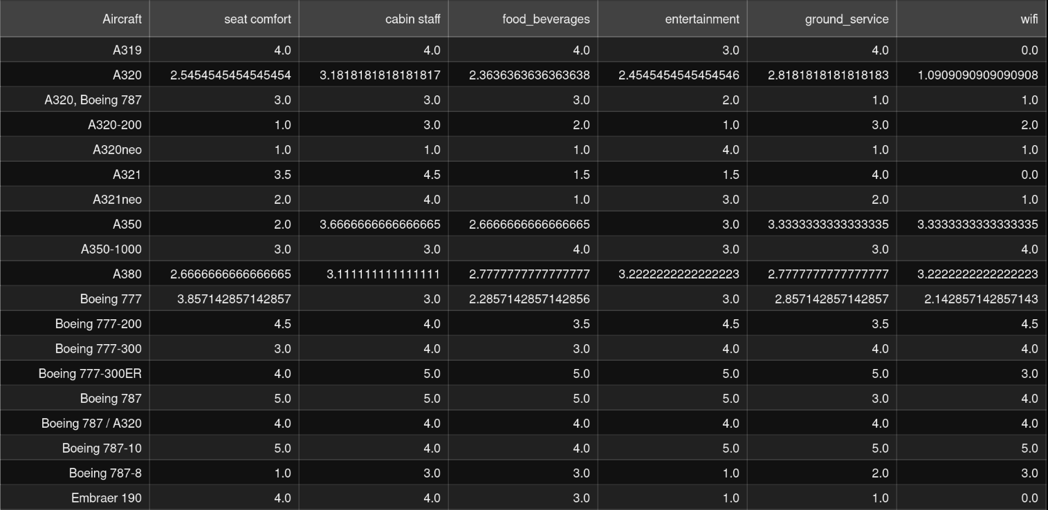
Average rating per aircraft

Slide 5
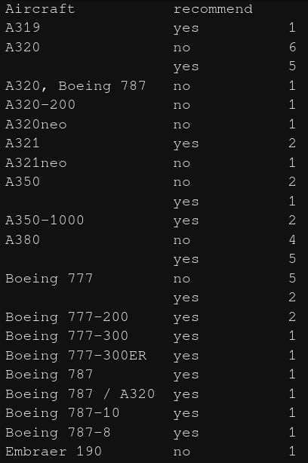
Recommendation per aircraft

