Slide 1
Category review: Chips
June 2020
Retail Analytics
Brand note: If client logo is not required, use alternate title page layout right click slide thumbnail > Layout > Title

Slide 2
Notes:
To view Privacy video explaining how important data privacy is to Quantium, please click here: https://www.youtube.com/watch?v=Zq1QDAkoRzU
or here Q:\Company Reference\Brand & Design\Brand videos\Q Privacy.mp4
At Quantium, we believe that data is the behavioural footprint of humanity and that it has to be treated with the utmost care and responsibility.
Histories, attitudes, indeed lives are stored within it in ways that aren’t always apparent – and that’s what makes its potential so powerful.
To work with it responsibly, sensitively, we set ourselves the highest data privacy protection and governance standards.
We have spent 17 years perfecting privacy-by-design and secure-by-design principles. Central to this is not holding any personally identifiable information about people –
we neither receive it, and put the necessary protections in place to be unable to decipher it.
Every aspect of handling data is safeguarded: from its de-identification, to its encryption – data security is paramount and of the highest grade.
We pride ourselves on gaining the trust of iconic organisations around the world through years of securely working with their data,
and in turn the trust that builds with their stakeholders.

Slide 3
Executive summary
01
Task 1
- Sales are highest for: Budget older families, mainstream young singles/coupl
02
Task 2
Trial | Control
77 | 233
86 | 155
88 | 237
- Trial had a significant impact of the trial stores, compared to control stor

Slide 4
01
Category

Slide 5
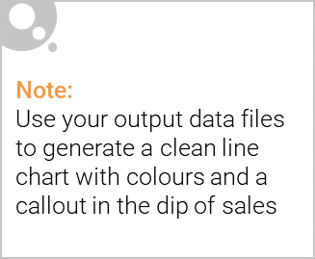
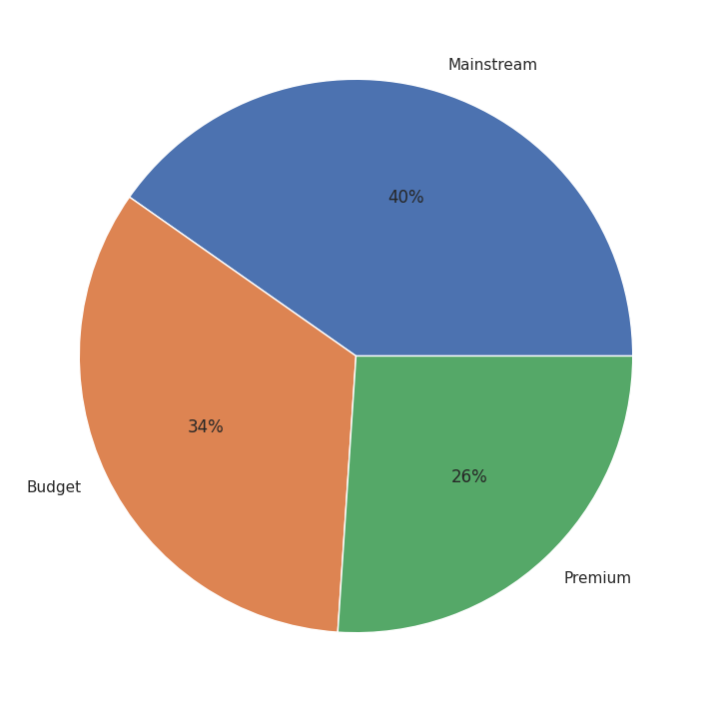
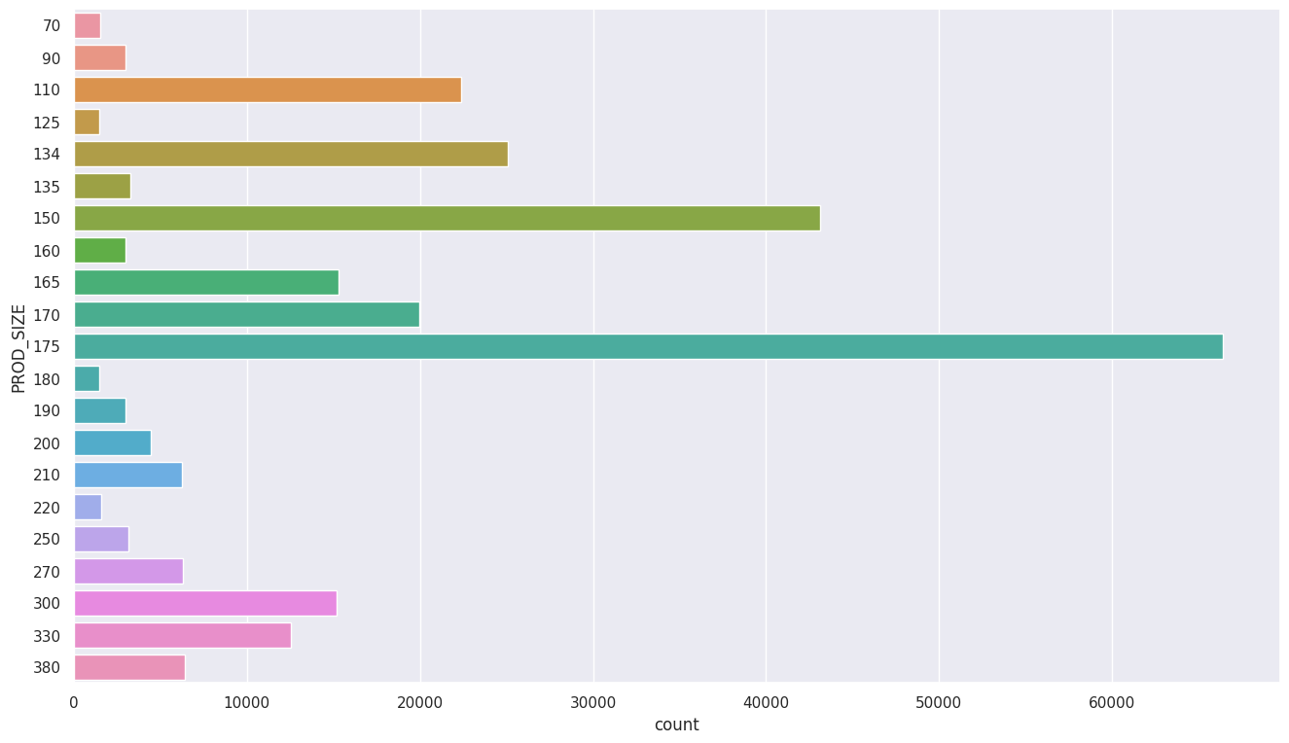
40 % customers are Mainstream, followed by 34% Budget customers and 26% Premium customers
Most bought pack size is 175g

Slide 6
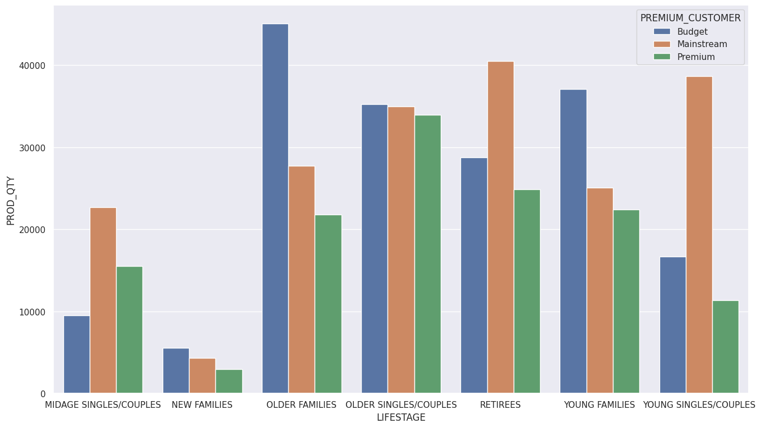
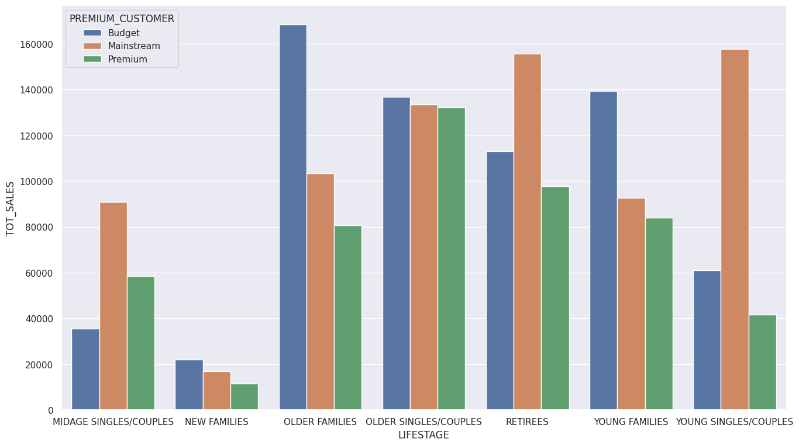
Most quantity is bought by Budget older families, mainstream retirees and young couples/singles
Similar trend for sales as well.

Slide 7
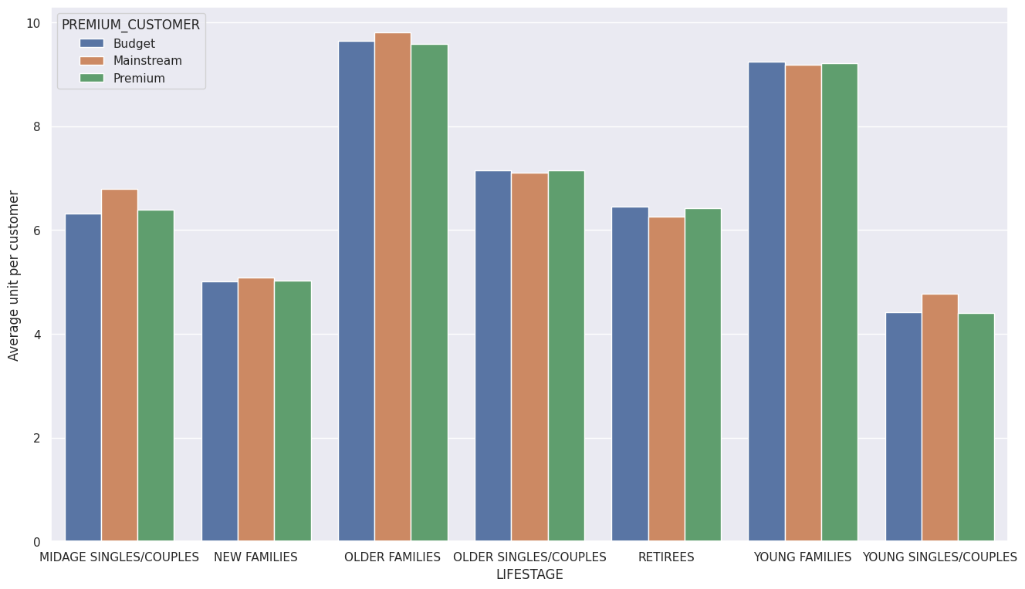
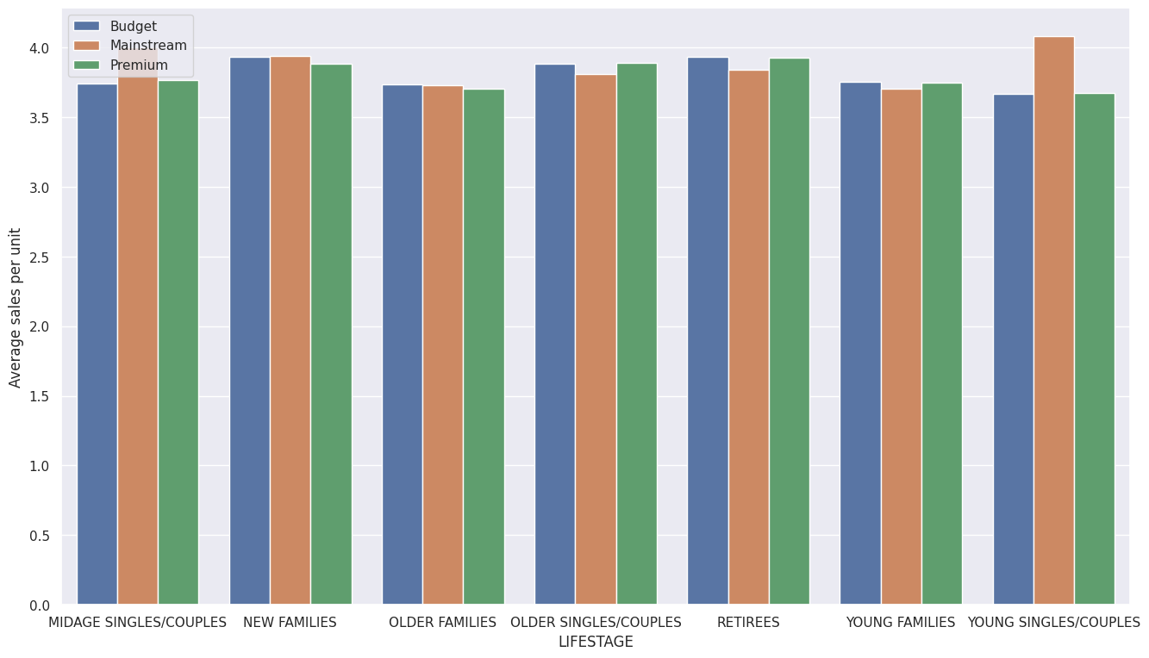
Old and young families buy more per customer
Mainstream midage and young singles/couples are more willing to pay more per pack.

Slide 8
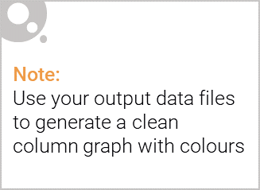
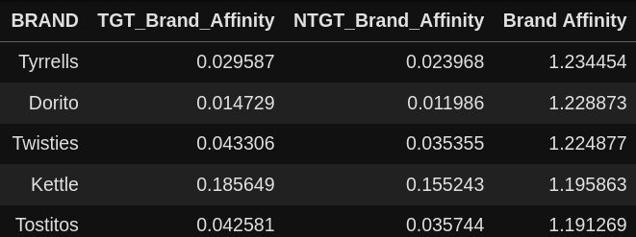
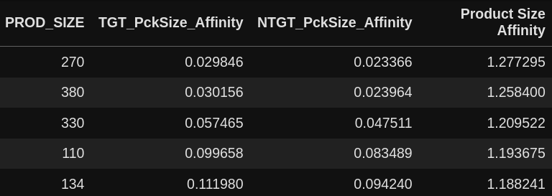
Targetting Mainstream young couples / singles
Mainstream young couples / singles are more likely to buy chips from Tyrrells compared to other brands.
More likely to buy chips of size 270 g, Twisties is the only brand that offers this size.

Slide 9
02
Trial store performance

Slide 10
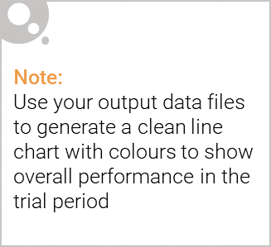
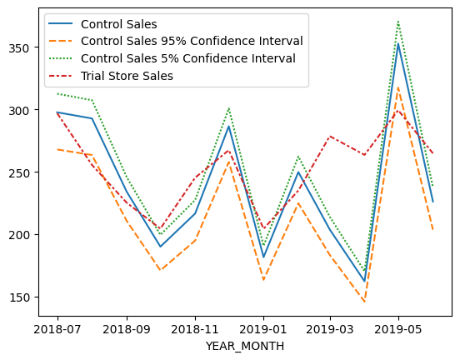
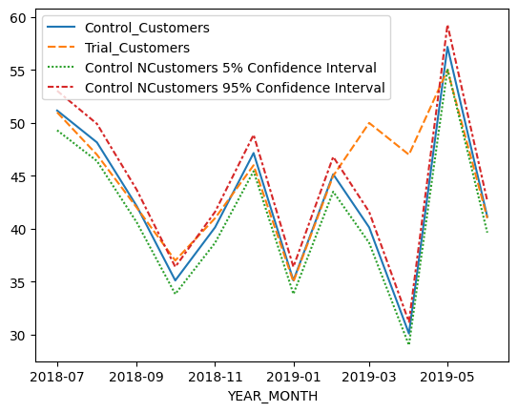
Trial store: 77
Control store: 233

