Slide 1
Onion Routing and Encrypted Communications
By Eshaan Prakash (0303204p)
COMP 3343 FA01 Data Comm & Comp Networks

Slide 2
Introduction to onion routing and encrypted communication
Onion Routing?
Significance in CyberSecurity
Encrypted Communication

Slide 3
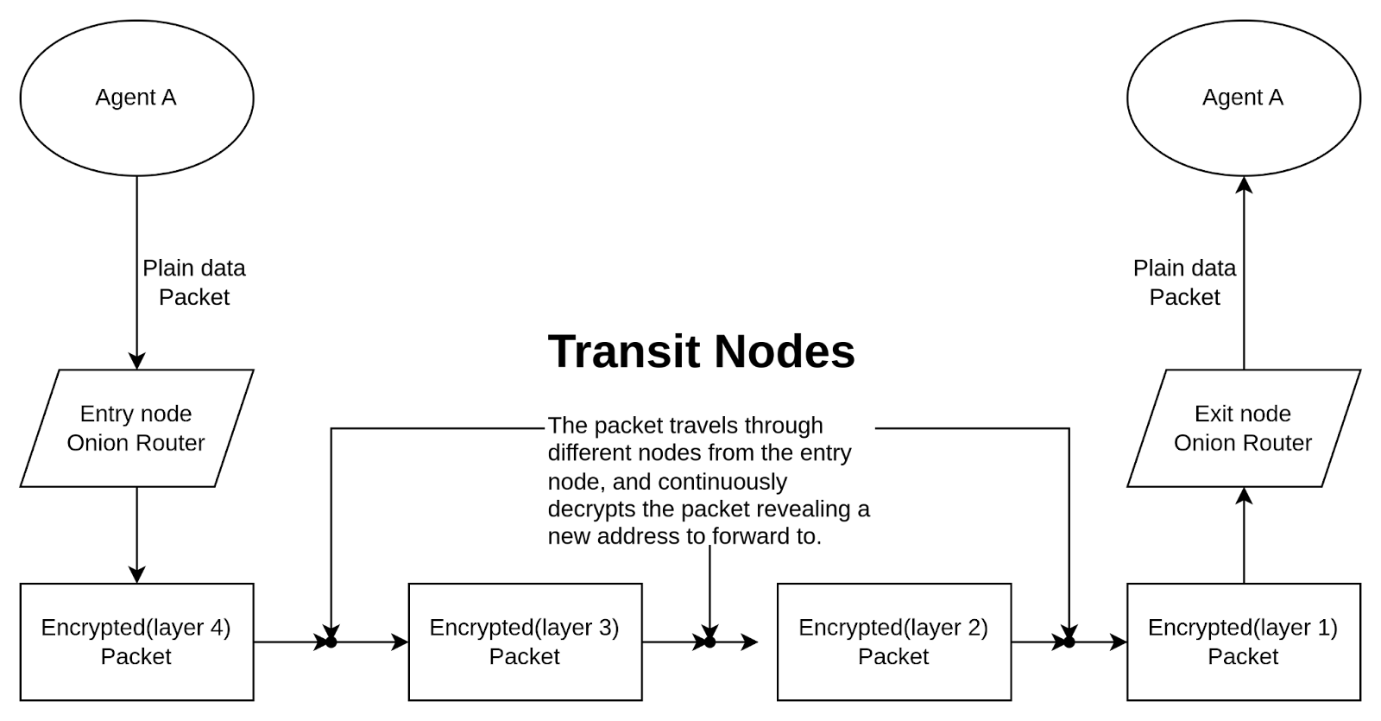
Behind the Scenes

Slide 4
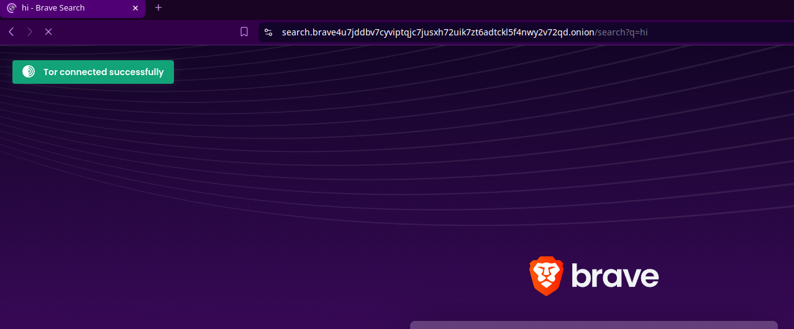
Onion Services

Slide 5
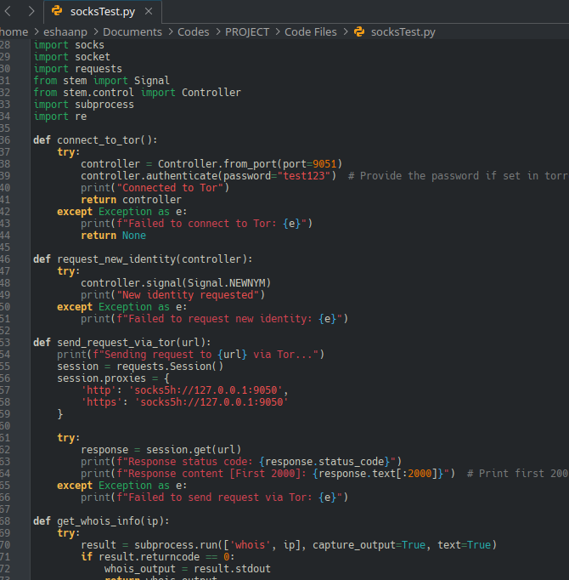
Implementation case 1: socksTest

Slide 6
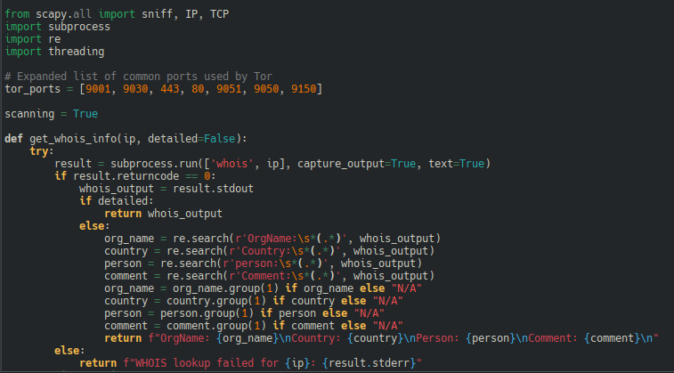
Implementation case 2: torPortScan

Slide 7
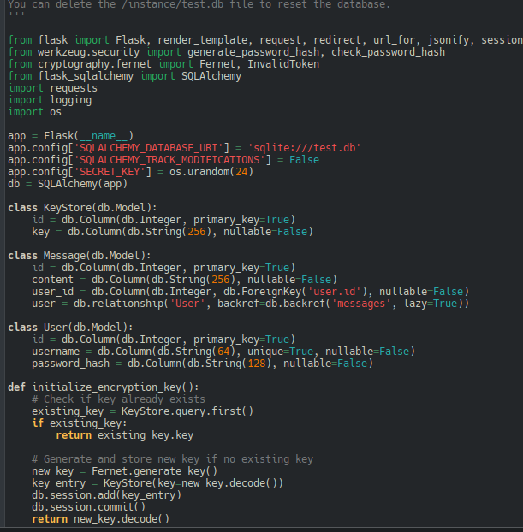
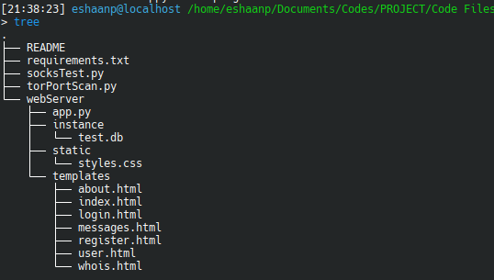
Implementation case 3: app.py

Slide 8
Comparisons
• Tor:
◦ Best for anonymous web browsing and accessing .onion services.
◦ Optimized for low-latency applications like browsing and messaging.
• I2P (Invisible Internet Project):
◦ Focuses on peer-to-peer communication within a decentralized network.
◦ Works better for internal services and file sharing; not primarily for web browsing.
• Freenet:
◦ Emphasizes anonymous file storage and distribution.
◦ Designed for persistent data availability rather than real-time communication.
• Key Differences:
◦ Tor: Public internet gateway; best for browsing.
◦ I2P: Internal communications; focuses on decentralization.
◦ Freenet: Data publishing and archival; resistant to takedowns.

Slide 9
Conclusion
Importance of Encrypted Networks:
Helps keep personal data safe and protect against surveillance.
Provide a haven for free speech and sensitive communications.
Onion Routing’s Role:
Balances privacy, security, and anonymity.
Enables safe interaction in situations requiring confidentiality.
Applications:
Tor can be applied in your day to day applications in many ways as showcased.
It will help provide anonymity and privacy in development.

Slide 10
Thank you!
By Eshaan Prakash (0303204p)
COMP 3343 FA01 Data Comm & Comp Networks

