Slide 1
Secure DATA HIDING IN IMAGES USING STEGANOGRAPHY
CAPSTONE PROJECT
Presented By
Student Name : ESHAAN SANDHU
College Name & Department : DEPARTMENT OF CSE, PUNJABI UNIVERSITY PATIALA

Slide 2
OUTLINE
Problem Statement
Technology used
Wow factor
End users
Result
Conclusion
Git-hub Link
Future scope

Slide 3
Problem Statement
The proliferation of digital images as a common medium of communication presents a unique opportunity for covert data transfer. While steganography offers this potential, existing methods often struggle to balance capacity, security, and imperceptibility. Many techniques are vulnerable to sophisticated steganalysis, lack sufficient payload capacity for practical applications, or introduce noticeable artifacts that betray the presence of hidden data. Furthermore, ensuring the robust and secure extraction of the embedded information remains a challenge.

Slide 4
Technology used
Platform Used :
Visual Studio Code
Libraries Used:
cv2
tkinter
os
pillow
shutil
cyptography
numpy

Slide 5
Wow factors
User-Friendly Interface : Experience seamless data hiding with intuitive Graphical User Interface (GUI). No complex commands, just point-and-click simplicity.
Ironclad Password Protection : Your secrets are safe. I employed a robust SHA-256 hashing algorithm to securely store your password, ensuring impenetrable protection against unauthorized access.
Blazing Fast Performance : Get results in a flash! Highly efficient algorithms ensure rapid data embedding and extraction, saving you valuable time.
PNG Power : Preserve image quality and maximize data capacity. Its support for PNG images, with their lossless compression, guarantees pristine image integrity and ample space for your hidden information.

Slide 6
End users
Journalist
Activist and Human Right Advocates
Everyday Users
Companies
Government Organizations
Healthcare Providers
Cybersecurity Experts
Forensic Investigators

Slide 7
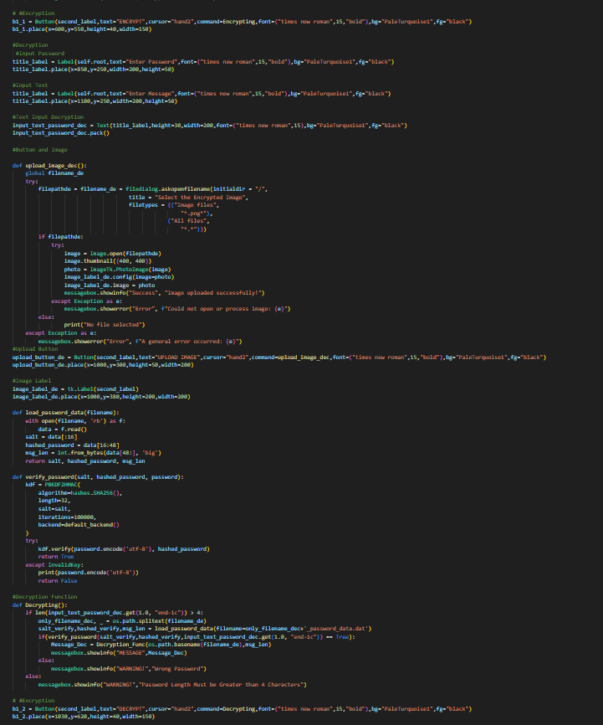
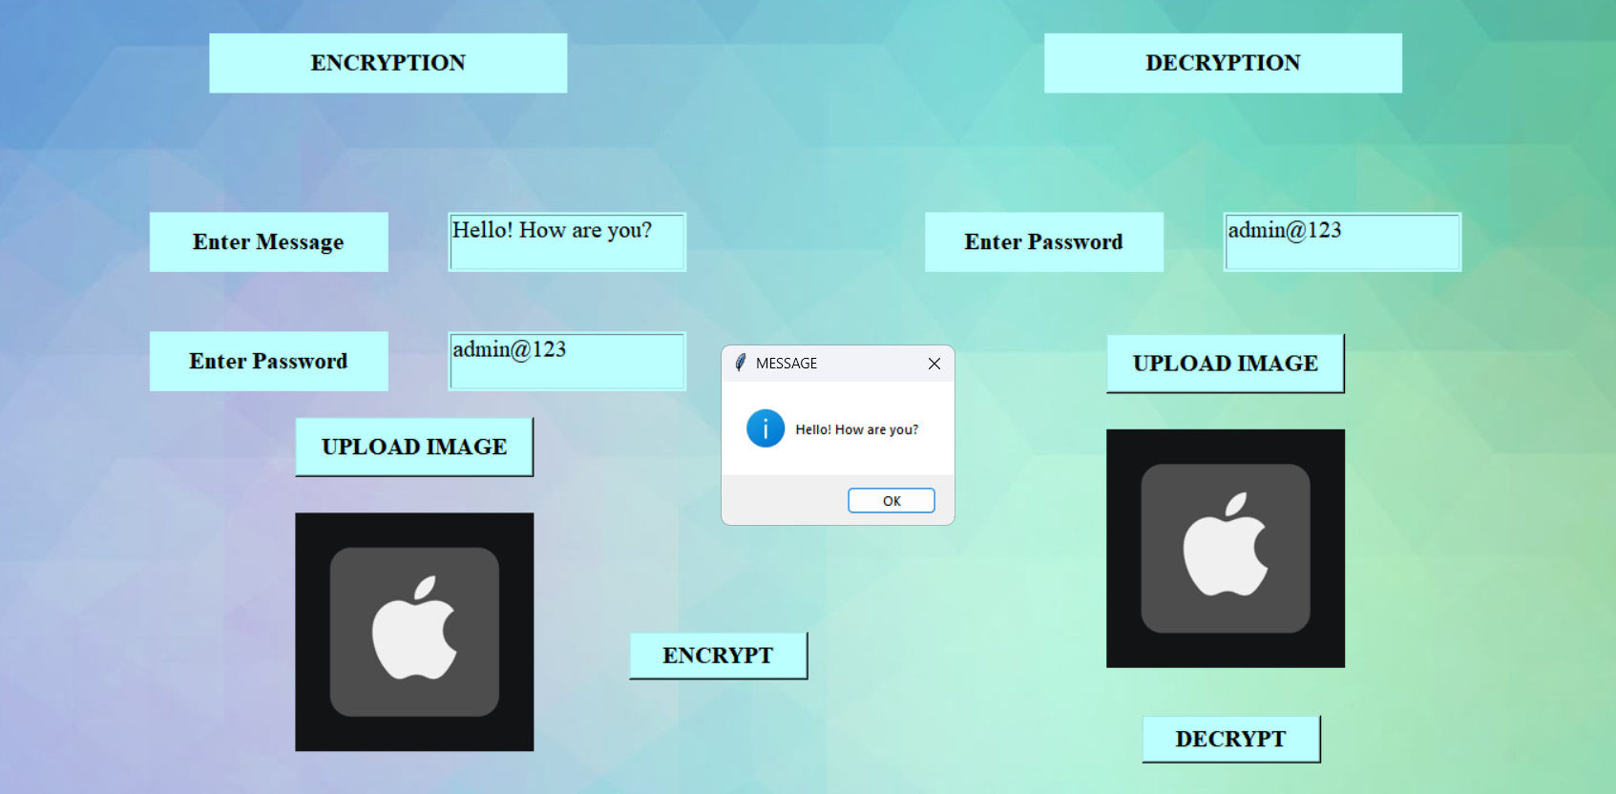
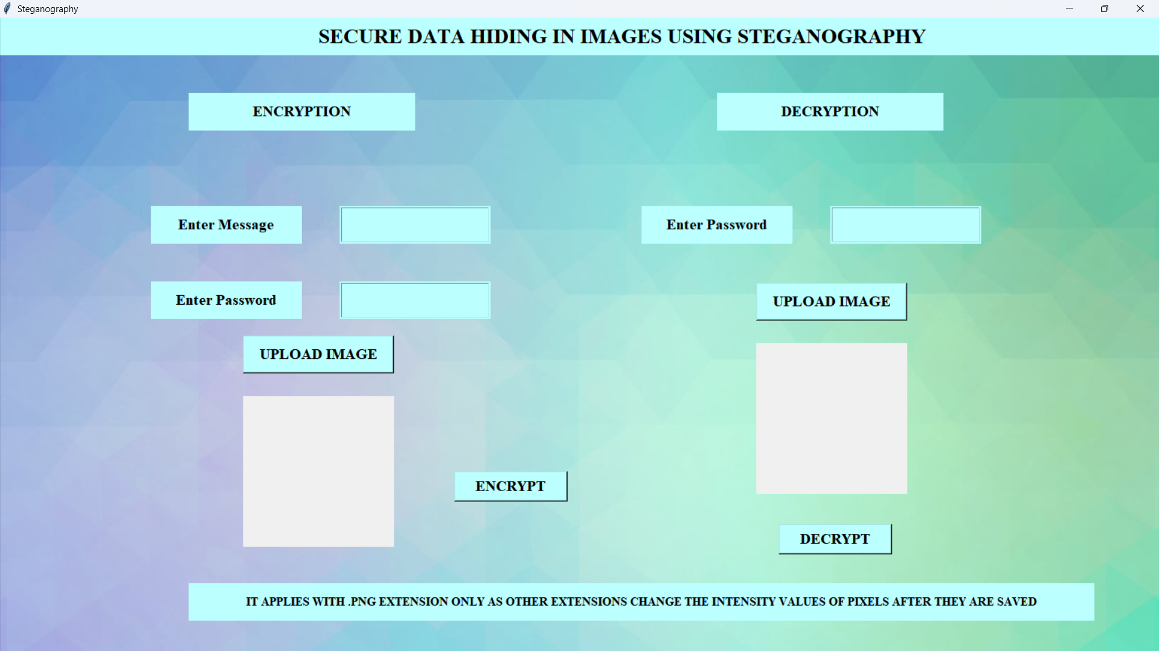
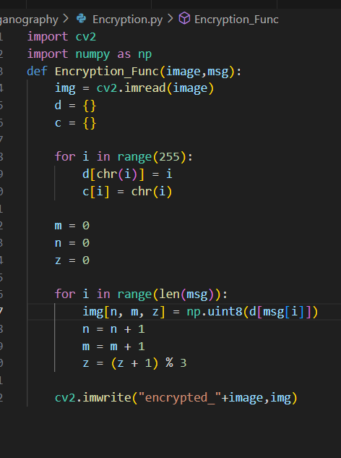
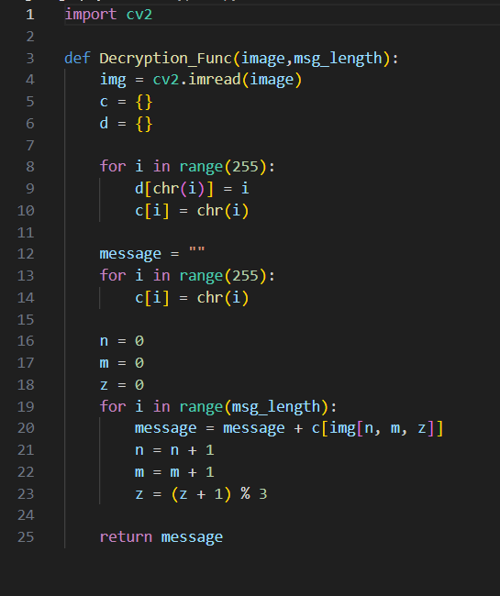
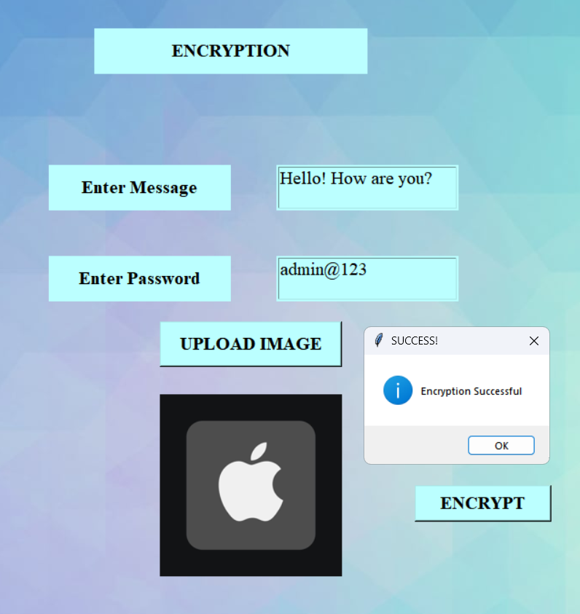
Results

Slide 8
Conclusion
This project has been successfully developed using a robust and user-friendly system for secure data hiding within digital images using steganography. By implementing a graphical user interface (GUI), the process of embedding and extracting hidden information is made accessible and intuitive for users of all technical levels. The incorporation of SHA-256 hashing ensures the secure storage of user passwords, safeguarding against unauthorized access. Furthermore, the choice of the PNG image format, with its lossless compression, guarantees that image quality is preserved throughout the steganographic process, maximizing both data capacity and visual integrity. The comprehensive design of the application provides all necessary options for secure data hiding in a single, readily available package, streamlining the process and promoting its wider adoption for secure and covert communication. This work contributes to the field of steganography by offering a practical and secure solution for protecting sensitive information in the digital age.

Slide 9
GitHub Link
https://github.com/EshaanSandhu/Eshaan_Cryptography.git

Slide 10
Future scope(optional)
Enhanced Security: Explore and implement more advanced steganographic techniques to further
enhance the security and undetectability of hidden data, such as incorporating adaptive steganography
or exploring methods resistant to more sophisticated steganalysis attacks.
Expanded File Support: Extend support to other image formats (e.g., JPEG, TIFF) and potentially other
media types (audio, video) to increase the versatility and applicability of the steganography tool.

Slide 11
THANK YOU

