Slide 1



L
LearnBridge
Free for every student, everywhere
Expert education in any subject —
free, in your language.
Talent is universal. Access isn't.
Quality education is gatekept by geography, wealth, and language. LearnBridge removes all three barriers at once.
learnbridge.app · Product Overview

Slide 2


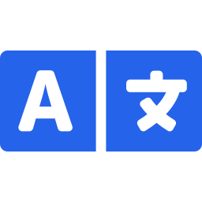
THE PROBLEM
Opportunity isn't equal
Where you're born, what your family earns, and the language you speak still decide the quality of education you can reach. Three barriers, stacked on top of each other.
Geography
Wealth
Language
Expert teachers cluster in a handful of cities. Rural and remote students are simply out of range.
Quality tutoring and elite schooling sit behind fees most families can't pay.
The best material exists in a few dominant languages — leaving billions reading a translation, if anything.
LearnBridge
02

Slide 3



WHAT IS LEARNBRIDGE
Free, expert education — matched to your exact problem
LearnBridge is a web platform where any student, anywhere, describes their confusion in their own language and gets matched to expert video courses with an AI tutor beside them. Students pay nothing. The whole thing is funded by corporate sponsors and the teachers get paid per lesson.
Students pay nothing
Sponsors fund content
Teachers get paid
100% free to learn. No paywall, no subscription, no signup required to search.
Companies fund courses by subject — for brand reach in emerging markets and CSR mandates.
Educators earn per lesson delivered, so great teaching scales without charging students.
LearnBridge
03

Slide 4
HOW IT WORKS
From confusion to certificate
1
Ask in any language
2
AI matches you
3
Learn by video
Type what you're stuck on into one search bar — Hindi, French, German, English, anything.
Claude detects your language, subject, concept and level, then returns the 3 best courses.
Open a course and watch real embedded lessons from world-class educators, inline.
4
Think with a tutor
5
Earn a certificate
6
Meet a human tutor
A Socratic AI tutor asks guiding questions in your language — it never just hands over answers.
Finish the course and get a shareable certificate of completion.
Optionally connect to a live human tutor matched to your subject.
LearnBridge
04

Slide 5
THE MATCHING ENGINE
Type your confusion in any language
This is the heart of the product. The student's raw text goes to Claude, which identifies the language, subject, concept and difficulty, then returns the three best-matched courses with a reason — never defaulting to one subject.
Same search bar, four languages, four subjects:
“मुझे photosynthesis समझाओ”
Hindi → Biology · Photosynthesis
“Why does gravity work?”
DETECTED
English → Physics · Gravitation
language French
subject Biology
concept DNA & genetics
level Beginner
matched 3 courses + reason
“Qu'est-ce que l'ADN ?”
French → Biology · Genetics
“Erkläre die Pythagoras-Formel”
German → Mathematics · Geometry
LearnBridge
05

Slide 6



THE AI TUTOR
A tutor that never gives you the answer
Socratic Tutor
Asks, never tells
Guiding questions and hints lead students to discover the answer themselves.
What's the derivative of x²?
Good — let's get there together. What does a derivative measure about a curve at a point?
Anchored to the lesson
Stays tied to the exact material on the page — no wandering, no spoilers.
The slope?
Replies in your language
Exactly. So what changes as x grows?
Responds in whatever language the student writes in, every time.
LearnBridge
06

Slide 7
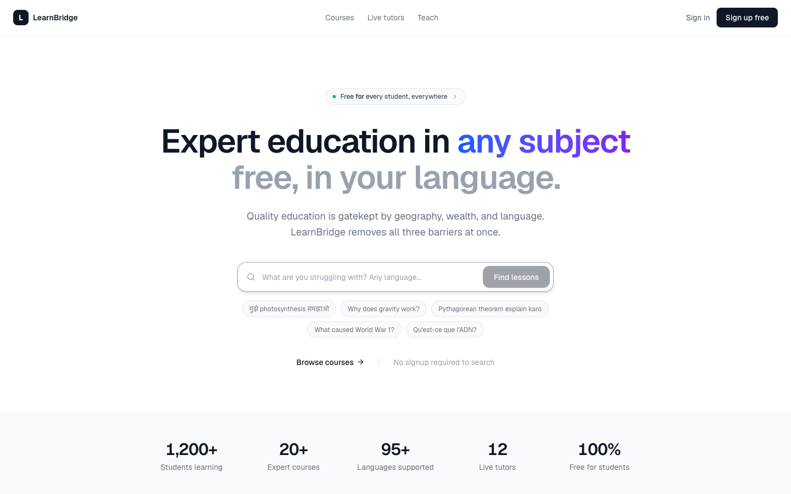

SEE IT LIVE
A real, funded product — not a prototype
Multilingual search front and center
One bar, any language, no signup required to start.
Mission stated, not buried
“Quality education is gatekept by geography, wealth, and language.”
Live the moment you land
Suggested queries in Hindi, French and more invite a first try.
LearnBridge
07

Slide 8
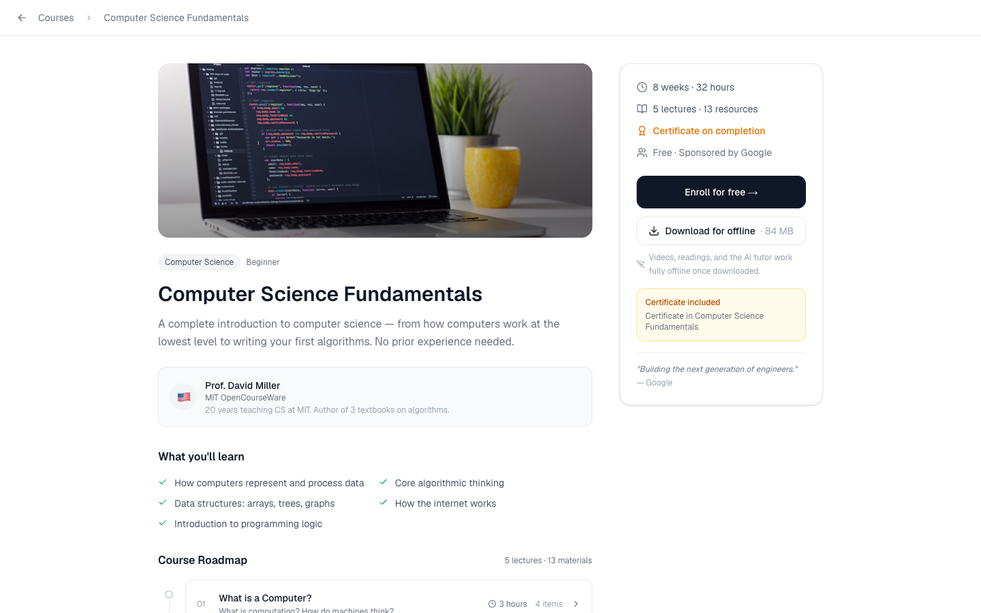


THE COURSE EXPERIENCE
Real lessons, a certificate, and offline-ready
Embedded video lessons
Real courses from CS50, 3Blue1Brown, MIT, CrashCourse and more.
Certificate on completion
A shareable credential when a student finishes the course.
Visible sponsor badge
Every course shows who funds it — e.g. “Sponsored by Google.”
Download for offline
Lessons and the AI tutor work fully offline once downloaded.
LearnBridge
08

Slide 9


THE BUSINESS MODEL
Sponsors fund the classroom
Students never pay. Companies sponsor courses by subject category — gaining brand reach in fast-growing emerging markets, meeting CSR and education mandates, and receiving anonymized student-impact metrics.
Google
SAP
Siemens
Bayer
Deutsche Bank
UNICEF
McKinsey
Bosch
Brand reach
CSR mandates
Impact metrics
Visibility with the next billion learners in emerging markets.
A measurable, credible way to fund education at scale.
Reach and engagement reported back by subject category.
LearnBridge
09

Slide 10

BUILT FOR EVERYONE
Download once. Learn offline. Even the AI tutor.
Courses download in one tap
Downloaded
Save a course once on a connection — then learn with no data afterward.
CS Fundamentals
The tutor runs on-device
Biology Basics
The Socratic tutor keeps working offline, so guidance never depends on a signal.
Math for Everyone
Designed for the last mile
Built for rural and low-connectivity learners who are usually left out.
Tutor available offline
LearnBridge
10

Slide 11
BY THE NUMBERS
Built to reach the unreached
1,200+
20+
95+
12
100%
students learning
expert courses
languages supported
live human tutors
free for students
Numbers reflect the platform's launch targets and current catalog.
LearnBridge
11

Slide 12
THE CATALOG
20 expert courses across 16 subjects
From computer science to public health — taught by a deliberately global faculty. Diverse teachers aren't a footnote; they're the mission made visible.
Computer Science
Mathematics
Biology
Physics
Chemistry
Data Science
Economics
Psychology
Philosophy
History
Public Health
Environmental Sci.
Creative Writing
Business
Art & Culture
Languages
A few of the faculty:
Dr. Amara Osei
Prof. Priya Sharma
Prof. David Miller
Dr. Angela Yu
University of Nairobi
IIT Bombay
MIT OpenCourseWare
App Brewery, London
LearnBridge
12

Slide 13


A 14-year-old in rural Africa deserves the same education as an elite school student.
Talent is universal. Access isn't. LearnBridge exists to close that gap.
L
LearnBridge
learnbridge-eshaank08s-projects.vercel.app

