Slide 1
SUPERSTORE
Name : Eshaan Michael
Contact: 7893744128
A comprehensive overview of Superstore's sales performance across regions, time periods, product categories, and customer segments, to help business stakeholders make informed decisions based on profitability, growth, and order trends.

Slide 2
DATASET OVERVIEW
• Source: Kaggle – Global Superstore Dataset
• Rows: ~10,000 records
• Columns: 21 fields
• Time Period: 2014 to 2017
• Industry: Retail (Office Supplies, Technology, Furniture)
• Key Fields Used:
– Order Date, Sales, Profit, Discount
– Category, Sub-Category, Segment, Region
– Customer Name, Product Name

Slide 3
KPI’S
• Total Sales– Total revenue generated from all orders
• Total Profit – Earnings after subtracting discounts and costs
• Profit Margin – Profit as a percentage of total sales
• Total Orders – Number of unique orders placed
• Average Discount – Average discount given across all sales
• Total Customers – Number of unique customers in the dataset

Slide 4
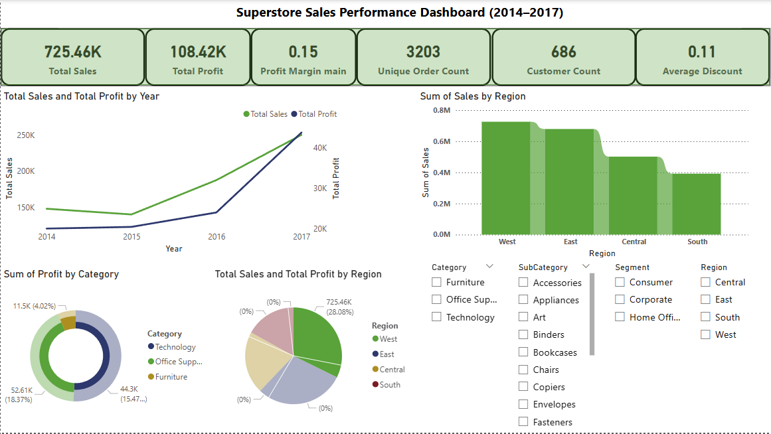
This Power BI dashboard summarizes key performance metrics across time, region, category, and customer segments. Users can interact through filters to gain deeper insights

Slide 5
Key Insight’s
• 📈 Sales and Profit steadily increased from 2014 to 2017, with the highest growth in 2017.
• 🌍 The West region generated the highest sales, while the South had the lowest performance.
• 💡 Technology category contributed the most to total profit, despite fewer orders compared to Office Supplies.
• 🛍️ The Consumer segment accounted for the majority of orders and revenue.
• 📉 Average discount across all sales is ~16%, potentially impacting profit margins.
• 📦 Sub-Categories like Phones and Chairs are top performers, while Tables show low profitability.

Slide 6
CONCLUSIONS:
• Overall business performance is improving year-over-year, with 2017 being the best-performing year.
• The West region and Consumer segment are key contributors to revenue growth.
• Technology products, especially Phones, are highly profitable.
• High average discount (~16%) may be negatively affecting profit margins.
• Certain categories (e.g., Tables) show consistently low profitability.

Slide 7
RECOMMENDATIONS:
• Focus marketing efforts on high-profit segments like Technology and Phones.
• Review and optimize discount strategies to improve margin without reducing sales volume.
• Explore performance in underperforming categories (like Tables) to identify root causes.
• Consider investing more in regions like West and improving strategies in South.
• Continue tracking KPIs quarterly to monitor profit and category-level trends.

Slide 8
LIMITATIONS AND FUTRE WORK:
• Dataset limited to U.S. sales only — no international data considered.
• Data covers only 4 years (2014–2017), which may not reflect long-term trends.
• Profit and cost breakdown is aggregated — no detailed cost structures.
• External factors (like marketing campaigns, economic conditions) are not included.
• Incorporate real-time or more recent data for ongoing performance tracking.
• Add customer-level metrics (e.g., lifetime value, return rate).
• Introduce forecasting (e.g., future sales trends using machine learning).
• Build additional dashboards (e.g., Product-Level Deep Dive, Region-Level Insights).
• Integrate Power BI with SQL or cloud sources for automation.

