Slide 1
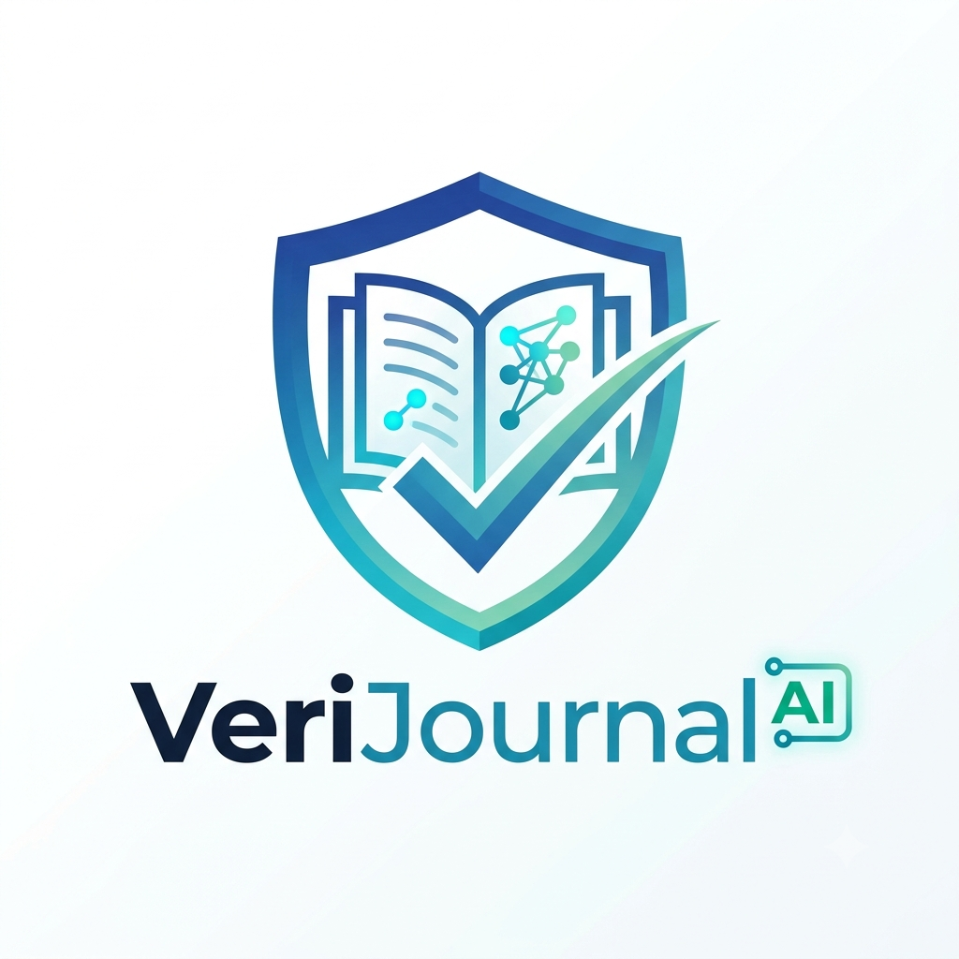
VeriJournal AI
Personal Truth & Fact-Checking Journal
Author: Esha Khare

Slide 2
THE REAL WORLD PROBLEM
Viral Fake News
Rumors and deepfakes travel 6x faster than real news, spreading panic in minutes.
Fact-checkers take days to respond, leaving everyday people confused and misled.
🎬 [PLAY VIDEO HERE]
Insert your merged AI problem video here:
1. Family phone alert panic
2. Empty supermarket shelves
3. Researcher tab burnout

Slide 3
Meet VeriJournal AI
A smart, private journal that verifies news and builds critical thinking.

Slide 4
FEATURE 01
Smart Chat Journal
Chat directly with Gemini AI to ask questions about your news and get honest answers.
Every answer is tied to real facts — with zero made-up information.

Slide 5
FEATURE 02
Private & Secure
Your personal investigations and notes stay 100% private and protected.
Built with bank-grade security: no leaked passwords, no tracking, and no selling your data.

Slide 6
FEATURE 03
Real Search Proof
Searches the live web and official databases to prove if a claim is true or false.
Shows clear word-for-word quotes from trusted journalists instead of confusing percentages.

Slide 7
FEATURE 04
Story Timeline
Tracks when a story began and catches old photos being reused as breaking news.
Unmasks recycled crisis images by uncovering the exact date they first appeared online.

Slide 8
LIVE DEMO & ROADMAP
Future Scope
1. Browser Extension
Check any tweet or article with one click.
2. Deepfake Detection
Scans video frames to catch AI face-swaps.
3. News Bias
Spots political spin and emotional wording.
🎥 [LIVE DEMO VIDEO]
Insert your screen recording here:
• Paste a link or photo
• Watch the fast safety check
• Inspect proof quotes and photos
• Adjust your belief slider

Slide 9
Thank You!
Reclaiming Truth with VeriJournal AI
Author: Esha Khare

