Slide 1
Film Studio
Management System
Eshal Hussain 24F-0597 · Ezza Bilal 24F-0603
Oracle 11g · C# WinForms · EERD-Driven Design

Slide 2
Introduction
What is this Project?
A comprehensive Film Studio Management System built on Oracle 11g and C# WinForms, designed to manage all aspects of movie production.
The system tracks directors, actors, crew members, shooting locations, scenes, schedules, cast roles, and contracts in a fully normalized relational database.
Built on an EERD-driven design, the database enforces referential integrity through foreign keys, triggers, and stored procedures
Key Highlights
10
Normalized Tables with full FK constraints
7
Database Views for role-based data access
7
Triggers for audit logging & validation
6
Stored Procedures for CRUD operations
2
Functions for budget & booking queries
4
Role-based access (Admin/Director/Actor/Crew)

Slide 3
Database Tables & Attributes
10 TABLES
director
movie
director_id · full_name · dob · nationality · biography
movie_id · title · release_year · genre · rating · budget · status · director_id
actor
crew_member
actor_id · full_name · dob · nationality · contact
crew_id · full_name · department · specialization
shooting_location
cast_role
location_id · name · address · location_type · country · daily_rate
role_id · movie_id · actor_id · character_name · role_type · billing_order
contract
scene
contract_id · movie_id · party_id · party_type · signed_date · expiry_date · total_value
scene_id · movie_id · location_id · scene_no · description · duration · status
crew_assignment
schedule
assignment_id · movie_id · crew_id · job_title · start_date · end_date
schedule_id · movie_id · scene_id · location_id · shoot_date · start_time · end_time · status

Slide 4
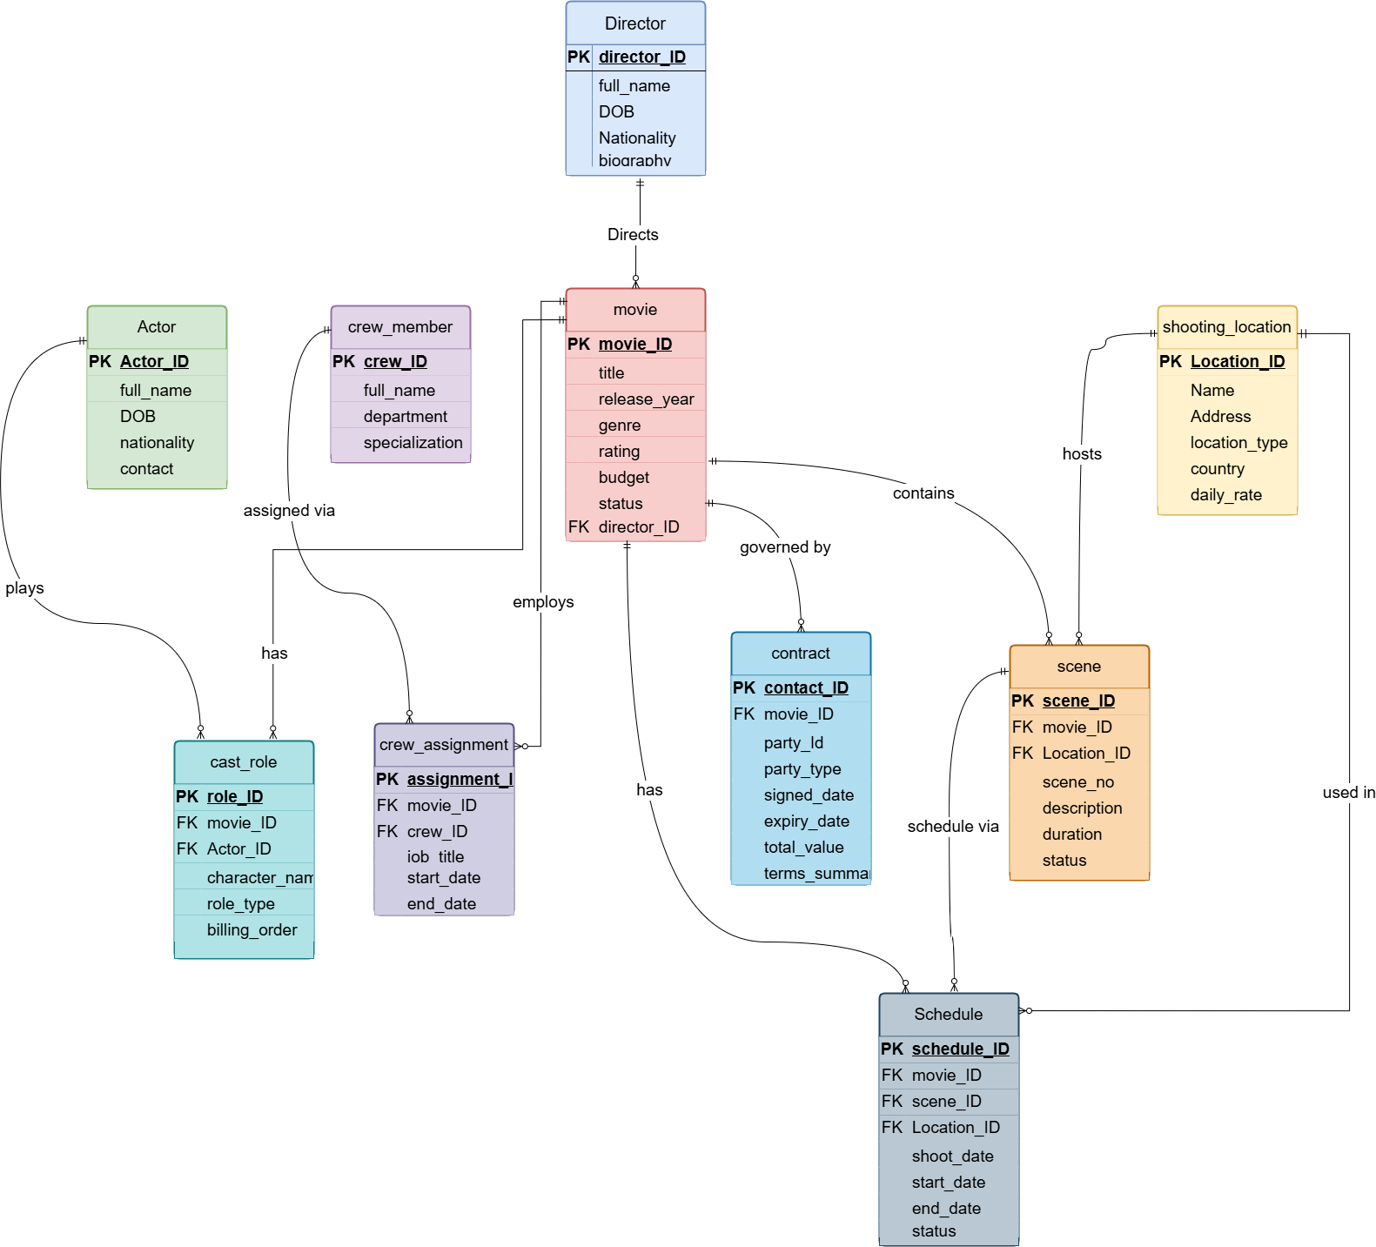
Enhanced Entity-Relationship Diagram (EERD)

Slide 5
Entity Relationships
Entity A
Entity B
Cardinality
Description
DIRECTOR
MOVIE
One director can direct multiple movies
1 : M
MOVIE
CAST_ROLE
A movie has many cast roles (junction with actors)
1 : M
ACTOR
CAST_ROLE
An actor can be cast in many movies through cast_role
1 : M
MOVIE
CREW_ASSIGNMENT
A movie employs multiple crew members via assignment
1 : M
CREW
CREW_ASSIGNMENT
A crew member can be assigned to multiple movies
1 : M
MOVIE
CONTRACT
A movie has many contracts (Actor, Crew, Director)
1 : M
MOVIE
SCENE
A movie is composed of many scenes
1 : M
LOCATION
SCENE
A location can be the setting of many scenes
1 : M
SCENE
SCHEDULE
Each scene appears in one or more schedule entries
1 : M

Slide 6
Data Fetching Techniques · Subqueries & Joins
SUBQUERIES
JOINS
Movies above average budget
INNER JOIN — Movies & Directors
WHERE budget > (SELECT AVG(budget) FROM movie)
movie m JOIN director d ON m.director_id = d.director_id
Actors NOT in any contract
INNER JOIN — Cast, Movie & Contract
WHERE actor_id NOT IN (SELECT party_id FROM contract ...)
movie m JOIN cast_role cr JOIN actor a JOIN contract c
Highest daily-rate location
LEFT JOIN — Uncast Actors
WHERE daily_rate = (SELECT MAX(daily_rate) FROM ...)
actor a LEFT JOIN cast_role cr ON a.actor_id = cr.actor_id
Multi-lead movies (HAVING)
LEFT JOIN — Location Usage Count
GROUP BY movie_id HAVING COUNT(*) > 1
shooting_location sl LEFT JOIN scene sc ON ...
Sci-Fi genre actors
Multi-JOIN — Crew Roster & Duration
WHERE actor_id IN (SELECT ... WHERE genre='Sci-Fi')
crew_member cm JOIN crew_assignment ca JOIN movie m
Crew on highest-budget film
FULL OUTER JOIN — Scene vs Schedule
WHERE movie_id = (SELECT movie_id WHERE budget=MAX)
scene sc FULL OUTER JOIN schedule sch ON ...

Slide 7
Data Fetching Techniques · Views & Triggers
VIEWS (7 Views)
TRIGGERS (7 Triggers)
vw_movie_overview
trg_set_release_year
BEFORE UPDATE
Movie details with director name & nationality
Auto-sets release_year when status → Released
vw_full_cast
trg_protect_director
BEFORE DELETE
Complete cast, character names & billing order
Blocks deletion of directors with active movies
vw_active_schedule
trg_high_value_contract
AFTER INSERT
Scheduled & In-Progress shoots with locations
Logs contracts exceeding PKR 10 million
vw_movie_financials
trg_movie_status_audit
AFTER UPDATE
Budget vs contract expenses & remaining funds
Audits every production phase change
vw_location_utilization
trg_prevent_location_overlap
BEFORE INSERT
Scenes shot per location + estimated cost
Prevents double-booking a shooting location
vw_director_portfolio
trg_check_crew_dates
Director's movie count & total managed budget
BEFORE INSERT
Enforces start_date < end_date on assignments
vw_daily_call_sheet
trg_check_positive_budget
BEFORE INSERT
Daily shoot schedule: call time & wrap time
Rejects non-positive movie budgets

Slide 8
Data Fetching Techniques · Stored Procedures & Functions
STORED PROCEDURES (6)
FUNCTIONS & CORRELATED SUBQUERIES
proc_get_cast
func_get_remaining_budget
fn
(p_movie_id)
Returns budget minus total contracts for a movie
Prints full cast list using a cursor
proc_assign_crew
func_location_booked_days
fn
(movie_id, crew_id, job, dates)
Counts distinct booked days for a location
Dynamically assigns crew to a movie
proc_movie_summary
CORRELATED SUBQUERIES (5)
(p_movie_id)
Most expensive contract per movie
Dashboard: title, budget, cast, scenes
WHERE total_value = (SELECT MAX FROM contract WHERE movie_id = ...)
proc_delay_production
(movie_id, delay_days)
Actor contracts > 20% of budget
Shifts all schedule dates + marks Postponed
WHERE (SELECT SUM WHERE party_type='Actor') > budget * 0.20
proc_terminate_crew
(crew_id, movie_id)
Scenes longer than avg per movie
Sets crew end_date to SYSDATE (early exit)
proc_estimate_location_costs
WHERE duration > (SELECT AVG FROM scene WHERE movie_id=sc.movie_id)
(p_movie_id)
Actors paid above average contract
Calculates location costs from schedule
WHERE total_value > (SELECT AVG FROM contract WHERE type='Actor')

Slide 9
System Working — How Data Flows
👤
🎬
📝
⚡
💾
Login
→
Dashboard
→
CRUD Ops
→
Triggers
→
Oracle DB
app_user table
Role-based auth
Views & Queries
Role-filtered
INSERT / UPDATE
DELETE / SELECT
Auto-fire on DML
Audit + Validate
11g · Sequences
FK Constraints
Role-Based Access Control
Admin
Director
Actor
Crew
Full CRUD on all tables
Manage users, view all reports
Manage own movies, assign crew
View schedules & budgets
View cast roles & contracts
Accept/review assignments
View assignments & schedules
Read-only access to movies
Database Layer Architecture
Auto-Connect Strategy
WinForms UI (C#)
→
DatabaseHelper.cs
→
Oracle ODP.NET → DB
Tries: Ports 1521/1522 · SIDs xe, XE, orcl Session: userId, partyId, role stored in DatabaseHelper.SetSession() Pool: Min 1 · Max 10 connections

Slide 10
Thank You
Film Studio Management System
Eshal Hussain 24F-0597 · Ezza Bilal 24F-0603

