Slide 1
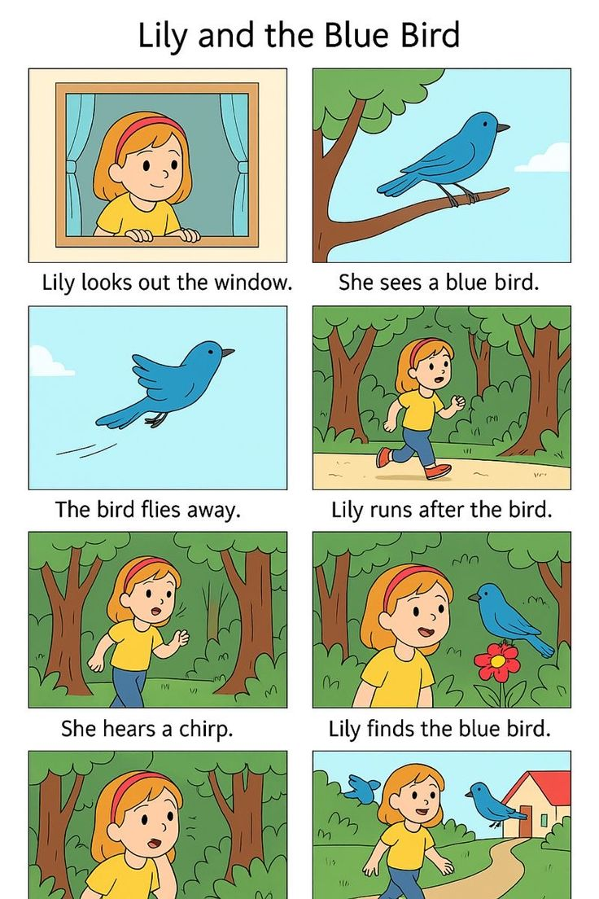
Lily looks outside the window

Slide 2
She sees a blue bird

Slide 3

The bird flies away

Slide 4
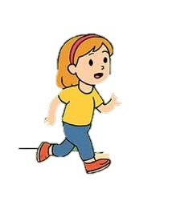
Lily rans after the bird

Slide 5
She hears a chirp

Slide 6
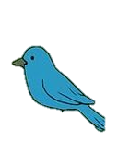
Suddenly she found the blue bird

Slide 7

Happy ending

