Slide 1

Machine Learning with MUSE Astro Data: Self-Supervised Region Mapping and Zero-Shot Spectral Classification of the Irradiated Herbig-Haro Jet HH399
Eshan Kumar Jain | 25252963 | MSc Data Science & Analytics, Maynooth University
Supervisor: Prof. Rozenn Dahyot | Collaborator: Prof. Emma Whelan
VLT/MUSE cube (ESO 60.A-9322(A)) + 9 archival FEROS spectra | Three self-supervised models
Notes:
Title slide, borrowed from the project overview deck.

Slide 2
The Object: HH399 Inside the Trifid Nebula
TERMINOLOGY 1 OF 2
Trifid Nebula (M20): a star-forming region in Sagittarius. Its gas is ionised by a massive O7.5 star, which floods the whole neighbourhood with ultraviolet light.
Herbig-Haro (HH) object: the glowing knots and bow shocks formed where a jet from a newborn star slams into the gas around it.
HH399: the HH jet sitting inside M20. Most catalogued HH objects sit somewhere quiet, so they glow purely from their own internal shocks.
Irradiated jet: HH399 does not get that luxury. It is close enough to the O7.5 star to also be lit from outside, so its light is a blend of internal shock excitation and external photoionisation.
external UV
O7.5 star
HH399 jet
young star
internal shocks
So the line ratios measured across HH399 are a mix of two excitation mechanisms, not shock physics alone. No single clean rule holds everywhere in the field.
Notes:
Two terms here: the Trifid Nebula is the environment, HH399 is the jet. The word that matters is irradiated.

Slide 3
Emission Lines: How Gas Is Read From Light
TERMINOLOGY 2 OF 2
An emission line is a spike of light at one exact wavelength, produced by one specific ion. Its strength depends on how hot, how dense and how hard-irradiated the gas is. A spaxel is one spatial pixel of the cube, and it carries a full spectrum of its own.
Hα 6563 Å
[N II] 6583 Å
[S II] 6716 / 6731 Å
[O III] 5007 Å
Hydrogen recombination. The brightest line in the cube and a direct tracer of how much ionised gas is present.
Collisionally excited, so it needs harder conditions. It rises sharply where gas has been shock-heated.
A doublet. The ratio of its two components reads electron density rather than excitation mechanism.
A high-ionisation line, treated as evidence of fast shocks above roughly 100 km/s.
Line ratio = the actual diagnostic
Why it matters for this project
Dividing one line map by another cancels out brightness, distance and exposure depth, leaving behind the physics. This is the BPT tradition (Baldwin, Phillips & Terlevich 1981).
Every model in this project is unsupervised. These ratio maps are the only independent, physically motivated check any of them gets.
Notes:
Four diagnostic lines, one derived quantity. The ratio is the thing, not the raw flux.

Slide 4
The Problem
Scale
Blended physics
No ground truth
The cube holds 96,093 usable spectra. The standard method is to compare emission-line ratios by hand, spaxel by spaxel, and judge the structure by eye. That does not scale, and it bakes in the analyst's own expectations about where the jet should be.
HH399's emission mixes internal shock excitation with external photoionisation from the O7.5 star. A rule calibrated on a quiet HH object cannot simply be assumed to hold across this whole field.
Nobody has gone through the HH399 cube and labelled every spaxel as jet, diffuse gas or point source. There is no accuracy figure to report for region mapping, and no labels to train on.
THE QUESTION: can a model with no labels, no rules and no physics built into it rediscover the same jet-versus-background boundary that astronomers draw by hand?
If it can, that boundary is more likely to be real structure in HH399 than an artefact of how any one method was set up.
Notes:
Scale, blended physics, and no labels. Those three together are what make the ML framing worth trying.

Slide 5
Objectives
FIVE TARGETS, EACH WITH ITS OWN SUCCESS METRIC
1
Physical baseline
Continuum-subtracted line and line-ratio maps for every spaxel, so every later model has an independent check to be judged against. Measured by signal-to-noise-masked coverage of the jet.
2
Self-supervised region mapping (Model 1)
Learn spectral-spatial embeddings that recover jet, diffuse background and point sources with no labels of any kind. Measured by ARI on synthetic data, retrieval accuracy and agreement with the baseline.
3
Zero-shot classification (Model 2)
Classify real spectra against plain-English class prompts, with no fixed classifier head, on both a generic benchmark and the project's own FEROS targets. Measured by accuracy and confusion matrices.
4
Multi-modal fusion (Model 3)
Combine the MUSE cube and the FEROS spectra in one shared model without forcing them onto a common wavelength grid. Measured by ARI, qualitative checks and FEROS accuracy.
5
Honest evaluation
Where a model fails, diagnose the cause rather than reporting only the favourable numbers.
Notes:
Objective 5 is a real objective here, not a disclaimer.

Slide 6
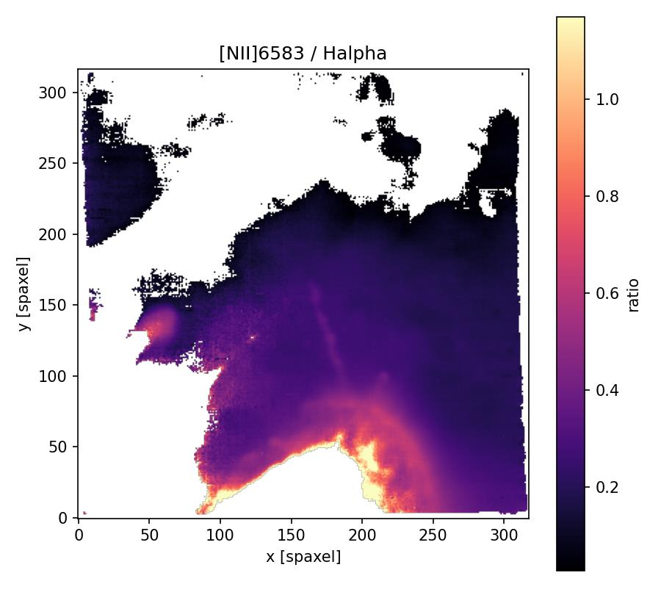
What Astronomers Build by Hand: The Line-Ratio Map
OBJECTIVE 1 — THE PHYSICAL BASELINE
Method: take the flux in a narrow window around each line's rest wavelength, subtract a local continuum estimated from windows either side, mask every spaxel below signal-to-noise 3, then divide pairs of maps.
Sub-pixel refinement: each line's true centre drifts slightly from where physics predicts, so the peak is snapped with a parabolic fit before any flux is integrated.
Coverage: 84.5% of spaxels at Hα S/N ≥ 3, giving 96,093 valid spaxels.
Median [N II]/Hα = 0.22, median [S II]/Hα = 0.08.
[S II] 6716/6731 = 1.20, consistent with a low-density regime.
[N II] 6583 / Hα across the cube. The bright ridge from lower-left to upper-right is the shock-excited jet.
This hand-built ridge is the answer key. Not because it is perfect, but because it is the one trusted, physically understood result the learned models can be checked against.
Notes:
This is the baseline every later slide refers back to.

Slide 7
Dataset 1: The VLT/MUSE Integral-Field Cube
THE MAIN DATASET — STRUCTURE DISCOVERY
MUSE is an integral-field unit on ESO's Very Large Telescope. Instead of one spectrum through a slit, it records a full optical spectrum at every spatial pixel across the field, so the data is a 3D cube: two sky axes plus one wavelength axis.
Provenance
Spatial
Spectral
ESO programme 60.A-9322(A), the 2014 MUSE science-verification run. 2.9 GB on disk.
The full HH399 jet plus surrounding nebula. 96,093 valid spaxels after masking.
Roughly 3,681 wavelength points per spaxel. Medium resolution, air wavelengths.
Handled with
Role in the project
Limitation
mpdaf, the package the MUSE instrument team publishes. It understands the DATA/STAT pair, the WCS and the air convention natively.
Unsupervised structure discovery. Every region map in this project comes from this cube.
Medium spectral resolution. Fine line profiles of individual stars are not recoverable from it.
One object, one field, 96,093 spectra, zero labels. That combination is what makes a self-supervised approach the natural fit.
Notes:
Cube gives spatial context. That is what Model 1 exploits.

Slide 8
Dataset 2: Nine Archival FEROS Spectra
THE SECOND DATASET — REAL CLASSIFICATION TARGETS
FEROS is a fibre-fed echelle spectrograph. Each exposure is a single pointing with no spatial structure at all, but with very fine spectral sampling.
Nine archival exposures are used, covering the system that irradiates HH399: the stars HD164492B, HD164492C and HD164514, plus nebular gas in the NGC 6514 H II region.
Roughly 189,626 wavelength points per exposure, about 50 times the cube's sampling.
Role: the real-world classification target for Models 2 and 3, replacing a generic SDSS-only evaluation with one specific to this physical system.
They are also the project's differentiator. A labmate's thesis already works from the same cube, so tying this work to HH399's own irradiating stars keeps it distinct.
The mismatch, side by side
MUSE
FEROS
Spatial
96,093 spaxels
none
Wavelength pts
3,681
~189,626
Resolution
medium
~50x MUSE
Target
whole jet
9 exposures
No shared wavelength grid and no shared spatial dimension. Forcing both onto one grid would destroy information, which is exactly the problem Model 3 exists to solve.
Notes:
Nine spectra is small, and that is stated openly. They are real, and they are specific to HH399.

Slide 9
Background: What a CLIP-Style Model Does
THE IDEA BEHIND MODELS 1 AND 2 (RADFORD ET AL. 2021)
Two encoders are trained side by side, one per data type. Each produces a vector in one shared embedding space.
The training signal is the pairing itself: things that belong together should land close, everything else in the batch should land far apart. No class labels are needed.
The loss is symmetric InfoNCE. In a batch of N pairs, each item has to pick its true partner out of all N candidates, and the score is averaged over both directions.
After training, classification is just a nearest-neighbour lookup in that space, which is why new classes can be added by writing a new sentence instead of retraining a head.
Encoder A
true pair pulled together
e.g. a spectrum
shared
embedding
space
Encoder B
e.g. a patch or a sentence
everything else pushed apart
Model 1 pairs a spectrum with the image patch around it, so it needs no labels at all. Model 2 pairs a spectrum with a short text description, which is what makes zero-shot classification possible.
Notes:
CLIP explained once here so Models 1 and 2 do not need to re-explain it.

Slide 10
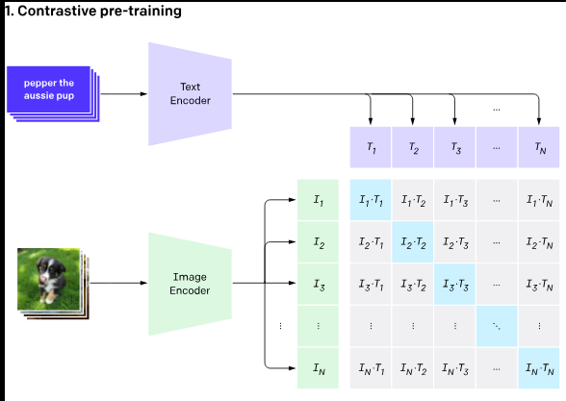
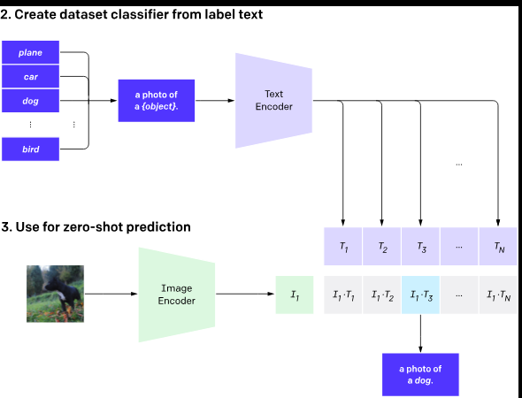
CLIP MODEL

Slide 11
Model 1: Self-Supervised Spectral-Spatial Region Mapping
OBJECTIVE 2 — NO LABELS ANYWHERE
Goal: learn an embedding space in which a spaxel's spectrum and its own spatial neighbourhood land close together, and everything else in the batch lands further away. Clustering that space should then recover physically sensible regions the model was never told to look for.
The pair
Spectrum encoder
Patch encoder
A spaxel's own spectrum (3,681 points) and the 7x7 image patch centred on it, carrying 6 channels: Hα, [N II], both [S II] lines, [O III], and a broadband white-light map.
1D CNN. Three convolution blocks, kernel width 9 (wide enough to see a full emission line), then global average pooling to a 64-d vector.
2D CNN. Two convolution blocks over the 6-channel patch, then global average pooling to a 64-d vector.
Training
Region map
Evaluation metrics
Both vectors are projected to 32-d and trained with symmetric InfoNCE for 15 epochs over all 96,093 spaxels. Batches are built so no two entries are accidental near-duplicates.
KMeans is run on the trained 64-d embeddings at K=3 and K=4. The cluster labels become the region map.
Adjusted Rand Index on synthetic planted data; batch top-1 retrieval accuracy in both directions; qualitative overlay against the [N II]/Hα baseline.
Notes:
Global pooling is deliberate: the same encoder handles short synthetic spectra and full real ones unchanged.

Slide 12
Model 1: How It Works
MECHANISM, END TO END
Spectrum
1D CNN
Projection
3,681 points
3 conv blocks → 64-d
→ 32-d, L2-norm
Symmetric InfoNCE
MUSE cube
96,093 spaxels
each spectrum must find its own patch, and each patch its own spectrum
Patch 7 x 7
2D CNN
Projection
6 channels
2 conv blocks → 64-d
→ 32-d, L2-norm
Compare
Region map
KMeans, K = 3
Trained embeddings
vs [N II]/Hα map
jet / diffuse / points
no labels used
96,093 x 64-d
Nothing in this diagram is ever told where the jet is. The only supervision is the fact that a spectrum and its own neighbourhood belong together.
Notes:
Two towers, one loss, then plain KMeans on the learned space.

Slide 13
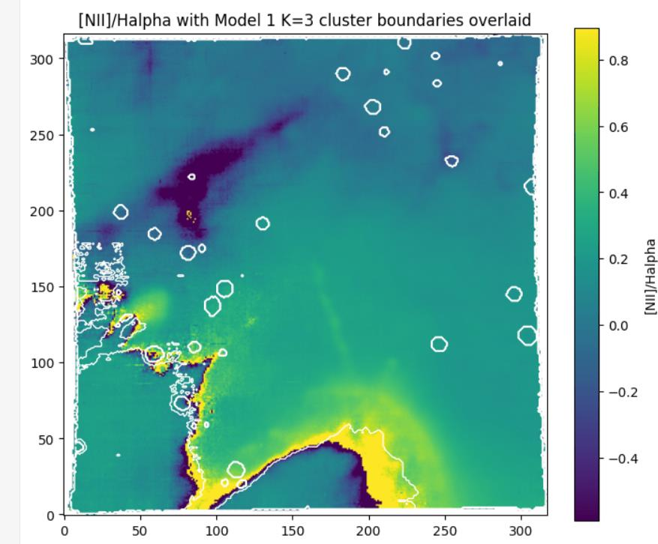
Model 1: What Came Out
OBJECTIVE 2 — RESULTS, INCLUDING THE WEAK ONE
Synthetic ARI 1.000. This confirms the training loop and loss are wired correctly, and nothing more, since the planted classes were designed to be trivially separable.
Real-cube training loss fell from 5.19 to 1.63 over 15 epochs.
K=3 clusters: 80,303 spaxels of diffuse background, 12,974 in a jet-ridge-shaped cluster, and 1,470 scattered circular regions that cross-check against the white-light continuum map as real point sources.
The jet cluster sits almost exactly on the high [N II]/Hα band from the baseline. K=4 splits the background along a smooth curved boundary, which looks like real sub-structure rather than noise.
Model 1's K=3 cluster boundary (white contour) drawn on the hand-built [N II]/Hα map. The model never saw that map.
Notes:
Strong qualitative result, weak retrieval number, both stated.

Slide 14
Model 2: Zero-Shot Classification From Plain English
OBJECTIVE 3 — SPECTRA MATCHED TO SENTENCES
Goal: classify a spectrum against a small set of natural-language descriptions without ever training a fixed classifier head, so a new class can be added by writing a new sentence instead of retraining.
Spectrum encoder
Why that change
Text encoder
Model 1's backbone with one deliberate change: it pools into 8 coarse positional bins instead of one global value, so the network keeps track of where along the spectrum a feature sits.
An earlier version copied straight from Model 1 confused a blue-end feature with a red-end one 100% of the time. Global pooling discards position by design, and position is exactly what separates these classes.
A TF-IDF vectoriser feeding a small MLP. Deliberately simple: a component that can be explained line by line, given the vocabulary is only a handful of short sentences.
Training data
Prediction
Evaluation metrics
90 real SDSS spectra, 30 each of STAR, GALAXY and QSO, de-redshifted to rest frame using each object's own pipeline redshift and resampled onto a fixed 2,048-point grid. 72/18 stratified split.
Embed the spectrum, embed each candidate class sentence, and pick the class whose sentence embedding is closest. No softmax over fixed classes anywhere.
Accuracy and a confusion matrix on the held-out SDSS test set, then zero-shot accuracy on the 9 FEROS exposures as stellar versus nebular.
Notes:
The FEROS half is the test that actually matters for this thesis.

Slide 15
Model 2: How It Works
MECHANISM, END TO END
Spectrum
1D CNN
Projection
SDSS or FEROS, rest frame
pooled to 8 positional bins
→ 32-d, L2-norm
Cosine similarity
argmax
spectrum vs every class sentence
predicted class
Class prompt
TF-IDF + MLP
Projection
“an optical spectrum of a star …”
text encoder
→ 32-d, L2-norm
Training signal
The weak link, in advance
A K-way cross-entropy against the fixed set of class-sentence embeddings, recomputed every step because the text encoder is trainable.
Only words that appear in the training sentences ever receive gradient. Any word the model has not been trained on stays at its random starting value.
Notes:
Note the asymmetry: the spectrum side sees thousands of examples, the text side sees three sentences.

Slide 16
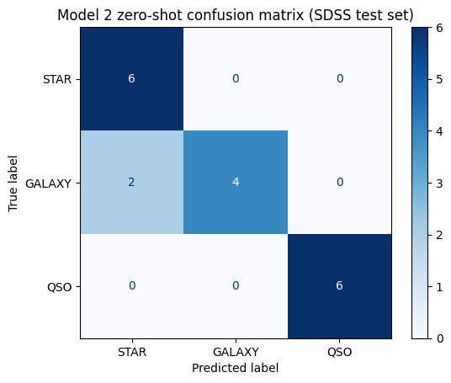
Model 2: 0.889 on SDSS, 0.000 on FEROS
OBJECTIVE 5 — THE FAILURE, DIAGNOSED
SDSS: 0.889. STAR 6/6 and QSO 6/6, with only 2 of 6 GALAXY spectra called STAR. That is a physically sensible confusion: a galaxy spectrum is a stellar continuum plus narrow emission lines, and at low emission-line contribution it can resemble a pure star.
FEROS: 0.000, but inverted, not random.
Every true stellar spectrum scored positive on both class similarities and every true nebular spectrum scored negative on both. The spectrum encoder separated the two physical classes cleanly. Only the label assignment was backwards.
Why the accuracy is exactly zero
The text MLP only ever received gradient for words appearing in the three SDSS training sentences. FEROS-only vocabulary such as “hot”, “young” and “HII” sat at random initialisation, and that noise was enough to flip which side of an otherwise-correct boundary each label landed on.
SDSS test set. Every error is a GALAXY called STAR, none in the other direction, and no QSO confusion at all.
The useful finding: the spectral representation generalised across instruments even though the text side did not. A pretrained sentence encoder is the direct fix, scoped but not implemented here.
Notes:
A perfectly inverted score is more informative than a random one. That is the whole point of this slide.

Slide 17
Background: AION-1 in Short
THE IDEA BEHIND MODEL 3 (PARKER ET AL. 2025)
AION-1 is an omnimodal foundation model for astronomy, trained across five surveys (Legacy Survey, HSC, SDSS, DESI and Gaia) covering more than 200 million stars, galaxies and quasars.
Stage one: modality-specific tokenizers. Each data type, whether image, spectrum or catalogue value, is converted into the same kind of token by its own small encoder.
Stage two: one shared transformer backbone trained by masked modelling, predicting held-out tokens within and across modalities. No contrastive pairing at all.
Released at 300M to 3.1B parameters, with a frozen encoder that transfers to many downstream tasks without retraining.
Modality A
Own tokenizer per modality
One shared transformer, masked modelling
Modality B
Modality C
Why it fits here: tokenize first, then fuse. That sidesteps the 50x resolution gap between MUSE and FEROS instead of resampling both onto one grid. Model 3 is a small single-object version of this idea, not a reproduction of AION-1.
Notes:
Billion-parameter pretraining was never in reach. Only the two structural ideas carry over.

Slide 18
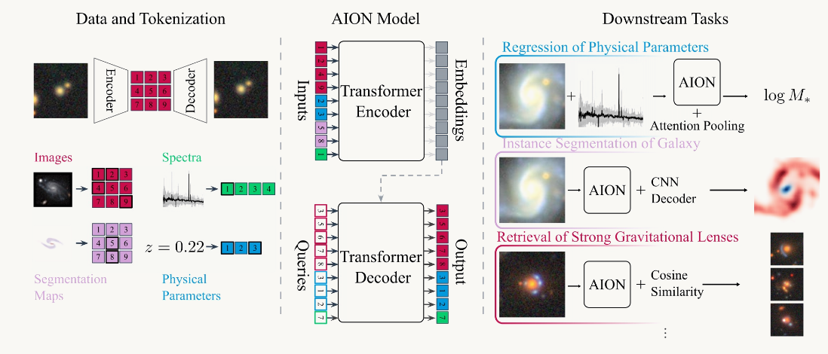
AION-1 model

Slide 19
Model 3: Shared Transformer — How It Works
OBJECTIVE 4 — FUSING TWO INSTRUMENTS, NO CONTRASTIVE LOSS
MUSE spectrum
MUSE tokenizer
3,681 points
pool to 48 bins
48 tokens x 64-d
Mask 15% of bins
Shared transformer
FEROS spectrum
FEROS tokenizer
plus a learned positional embedding per bin index
replaced by a learned mask token
3 layers, 4 heads
~189,626 points
pool to 48 bins
No text tower
KMeans K=3 / FEROS classification
Learned embeddings
Reconstruction head → MSE on masked bins only
and no contrastive loss anywhere
Because the transformer only ever sees learned tokens, bin 10 of 48 can mean a different stretch of Ångströms in each instrument without breaking anything. Metrics: synthetic ARI, masked-reconstruction MSE, cluster overlay against the baseline, and leave-one-out accuracy on FEROS.
Notes:
Scoring only the masked positions is what stops the model trivially copying its input.

Slide 20
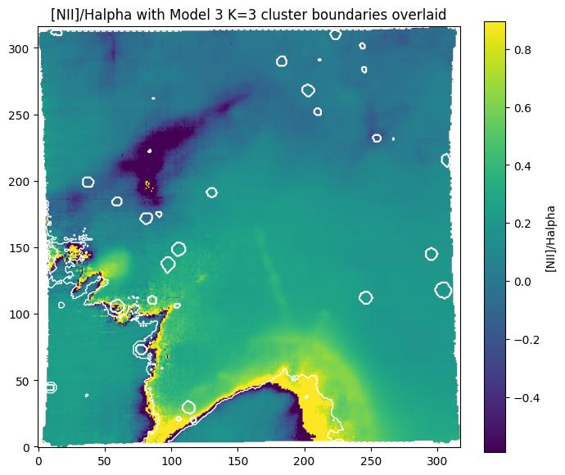
Model 3: Independent Confirmation, and the FEROS Fix
OBJECTIVES 4 AND 5 — RESULTS
Synthetic ARI 0.997, the same sanity-check role as Model 1's.
Trained on all 96,093 real-cube spaxels for 10 epochs. Masked-reconstruction MSE fell from 0.00598 to 0.00001.
K=3 clusters: 81,606 diffuse, 13,341 in the jet ridge, 1,146 point-source-like.
That boundary tracks the same high [N II]/Hα band as the baseline and as Model 1, despite sharing no architecture, loss function or training objective with Model 1.
FEROS: the shared backbone was fine-tuned on the 9 exposures and evaluated by leave-one-out nearest-centroid classification. Accuracy 0.889, missing only one HD164492B exposure.
Why the FEROS result improved
Two caveats, stated
Model 2's failure traced to an untrained-vocabulary text encoder. Model 3 has no text tower to fail that way, which is exactly the design argument for building it.
Leave-one-out is not a strictly fair comparison with Model 2's genuinely unseen test. And the jet cluster's mean spectrum shows a large negative dip at Hα, cause unconfirmed.
Model 3's K=3 boundary on the same [N II]/Hα map. Compare it with Model 1's contour two slides back.
Notes:
The convergence between Models 1 and 3 is the headline. The FEROS number is the traceable answer to Model 2.

Slide 21
Conclusion
WHAT THE PROJECT ESTABLISHED
The strongest result is not any single accuracy score.
Learned embeddings, trained with no labels at all, recover the same jet, diffuse background and point-source structure that line-ratio diagnostics identify by hand.
Model 1 and Model 3 share no code, no loss function and no training assumptions, yet both landed on the same jet boundary that decades-old line-ratio practice predicts should be there. Agreement from three independent directions is stronger evidence than any one of them alone.
Model 2 reached 0.889 on SDSS and failed on the FEROS targets in a specific, traceable way. That diagnosis is what motivated Model 3's design, and Model 3 answered it with 0.889 on the same 9 spectra.
The FEROS spectra worked as the intended differentiator, tying the project to HH399's own irradiating system rather than to the cube alone.
Limits kept in view: Model 1's near-chance retrieval, two unexplained spectral dips, and the fact that this is a single-object study.
Notes:
Objective 5 in practice: the weak results are on this slide too.

Slide 22
What Can Be Done Next
FUTURE WORK
Fix the text encoder
Close the retrieval gap
Chase the Hα anomaly
Replace Model 2's TF-IDF and MLP with a pretrained sentence transformer, then re-run the FEROS test to check whether the spectral representation alone was always sufficient.
Investigate Model 1's chance-level retrieval with harder in-batch negative sampling or a larger batch size, to see whether it is a training-signal problem rather than a representational one.
Re-run K=3 with a different random seed and check whether the same dip reappears, which separates a per-spaxel artefact from a property of that particular clustering split.
Generalise beyond HH399
Scale Model 3 upward
Apply the same baseline-plus-two-models pipeline to a second MUSE-observed HH jet, to test whether the convergence result is a property of the method or of this object.
Add more MUSE-observed jets as additional objects the shared backbone trains across, moving one step closer to AION-1's actual many-objects-at-once regime.
Thank you
Notes:
Six directions, ordered from the cheapest fix to the largest scaling step.

