Slide 1

MUSE Data & Astronomy Research
Exploring the Multi-Unit Spectroscopic Explorer, FITS data format, and two cutting-edge research papers — from young stellar jets to AI foundation models.

Slide 2

What is MUSE?
MUSE (Multi-Unit Spectroscopic Explorer) is an instrument on ESO's Very Large Telescope in Chile. It's an Integral Field Unit (IFU) — unlike a normal camera (2D image) or spectrograph (one spectrum), MUSE captures a spectrum at every pixel simultaneously across a 1×1 arcminute field of view.
X Position
Y Position
Spatial axis
Spatial axis
Wavelength
Spectrum at each pixel

Slide 3
MUSE Key Specifications
4000–9000Å
~3000
100K
Wavelength Range
Resolution Elements
Pixels per Element
Full optical light coverage
Across the field of view
Spectral info per resolution element
This creates a powerful 3D data cube: extract images at any wavelength, or spectra from any location in the field.

Slide 4

What is FITS Format?
FITS (Flexible Image Transport System) is the standard file format in astronomy. MUSE data cubes are stored as .fits files.
Images
Data Cubes
Tables
Headers
2D pixel arrays
3D: x, y, wavelength
Star catalogues & measurements
Metadata: telescope, date, coordinates, exposure time

Slide 5


Research Paper 1: The Th 28 Jet
Th 28 (Sz 102) is a Classical T Tauri Star — a young, pre-main-sequence star in the Lupus 3 cloud, ~160 parsecs away. It drives a bipolar jet (HH 228), ejecting gas in two opposite directions.
Jets remove mass and angular momentum from the star-disk system — understanding them reveals how stars like our Sun form.

Slide 6
MUSE Analysis of Th 28
01
02
Spectro-Imaging
PV Diagrams
Extracted jet images in Hα, [S II], [O III], [N II] at specific velocity ranges — revealing blue-shifted (toward us) vs. red-shifted (away) gas.
Position-Velocity slices through the data cube showing how velocity changes along the jet.
03
04
Knot Identification
Jet Width & Precession
Found 6 new knots (shocked gas clumps), some only visible after Lucy-Richardson deconvolution.
Measured jet opening angle via Gaussian fitting; detected point-symmetric wiggle — a signature of jet precession.

Slide 7
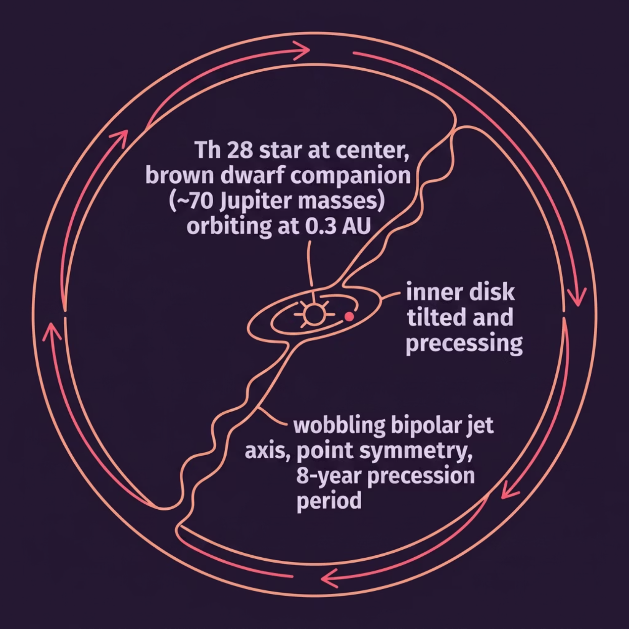


Why Does the Jet Precess?
The jet axis slowly rotates — like a spinning top — with a period of ~8 years. The proposed cause: a brown dwarf companion (~70 Jupiter masses) orbiting Th 28 at just ~0.3 AU, forcing the inner disk to precess and dragging the jet with it.
This connects to the broader question of jet launching: what does jet morphology tell us about the star-disk system?

Slide 8

Research Paper 2: AION-1
AION-1 (Parker et al. 2025) is a foundation model for astronomy — like GPT, but built to process 39 types of astronomical data: images, spectra, and scalar measurements, all in one unified model.
The Problem
Traditional analyses use separate, instrument-specific models — no cross-modal reasoning.
The Solution
An omnimodal architecture integrating all data types within a single transformer system.

Slide 9

AION-1 Architecture & Variants
Two-Stage Design
Model Variants
Universal Tokenization
AION-B
300M params
Images (MagViT+FSQ), spectra (ConvNeXt-V2+LFQ), and scalars (CDF-mapped) → common discrete token space.
AION-L
800M params
AION-XL
3.1B params
Multimodal Masked Modeling
Transformer encoder-decoder trained to reconstruct masked tokens, learning cross-modal relationships.

Slide 10

Key Concepts
Precession
The slow rotation of a jet's axis — like a spinning top wobbling. In Th 28, caused by a companion's gravitational tug on the disk.
Red & Blue Shift
Motion stretches (red) or compresses (blue) light wavelengths. MUSE uses this to map which jet regions move toward or away from us.
Flux
The amount of light energy received per unit area per unit time — a measure of brightness at a given wavelength.

