Slide 1
🛍️
AvengersShop • E-COMMERCE PLATFORM
AI Shopping Assistant Chatbot
Stack: Python (FastAPI + SQLAlchemy) | Focus: E-commerce AI
A conversational, function-calling AI chatbot that turns a 250-product catalog into a grounded, personalized shopping experience.
FastAPI
SQLAlchemy
OpenAI Function Calling
SQLite

Slide 2
PROBLEM STATEMENT
Shoppers Need Guidance, Not Just Filters
Shoppers on an e-commerce site often need guidance — comparing products, understanding specs, or getting recommendations — but static filters and search bars don't hold a conversation. This project builds a conversational shopping assistant that finds products, compares options, answers spec questions, and gives personalized suggestions, grounded strictly in real product data.
🔍
Catalogs are too big to browse
💬
Search doesn't understand intent
250 products across 12 categories — filters alone can't answer “which laptop is best for editing under $1200?”
Keyword search can't parse natural language, compare items, or answer spec-level questions.
🎯
No real personalization
⚠️
Chatbots hallucinate
Generic listings ignore what a shopper has already viewed or bought.
Generic LLM bots invent prices and specs, so shoppers stop trusting them.
AI SHOPPING ASSISTANT CHATBOT
2

Slide 3
THE SOLUTION
A Grounded, Conversational Assistant
DemoShop pairs a full storefront with an assistant that uses OpenAI function calling to query the live product database directly — every price, spec and recommendation is fetched from real data.
WORKING FLOW
•
Understand Intent: Parse the user's message to detect intent (search, compare, ask spec, recommend).
•
Personalize: Factor in the user's browsing/purchase history for recommendations.
•
Fetch Data: Query the product database/catalog for relevant items matching the intent.
•
Clarify When Needed: If the request is ambiguous (e.g. budget/size not given), ask a follow-up question.
•
Ground Response: Pass the fetched product data + user message to the model to generate a natural reply.
•
Respond & Continue: Return the answer and keep conversation context for follow-up turns.
“Grounded, not generated” — every assistant reply is backed by a live SQL lookup; zero hallucinated prices or specs.
AI SHOPPING ASSISTANT CHATBOT
3

Slide 4
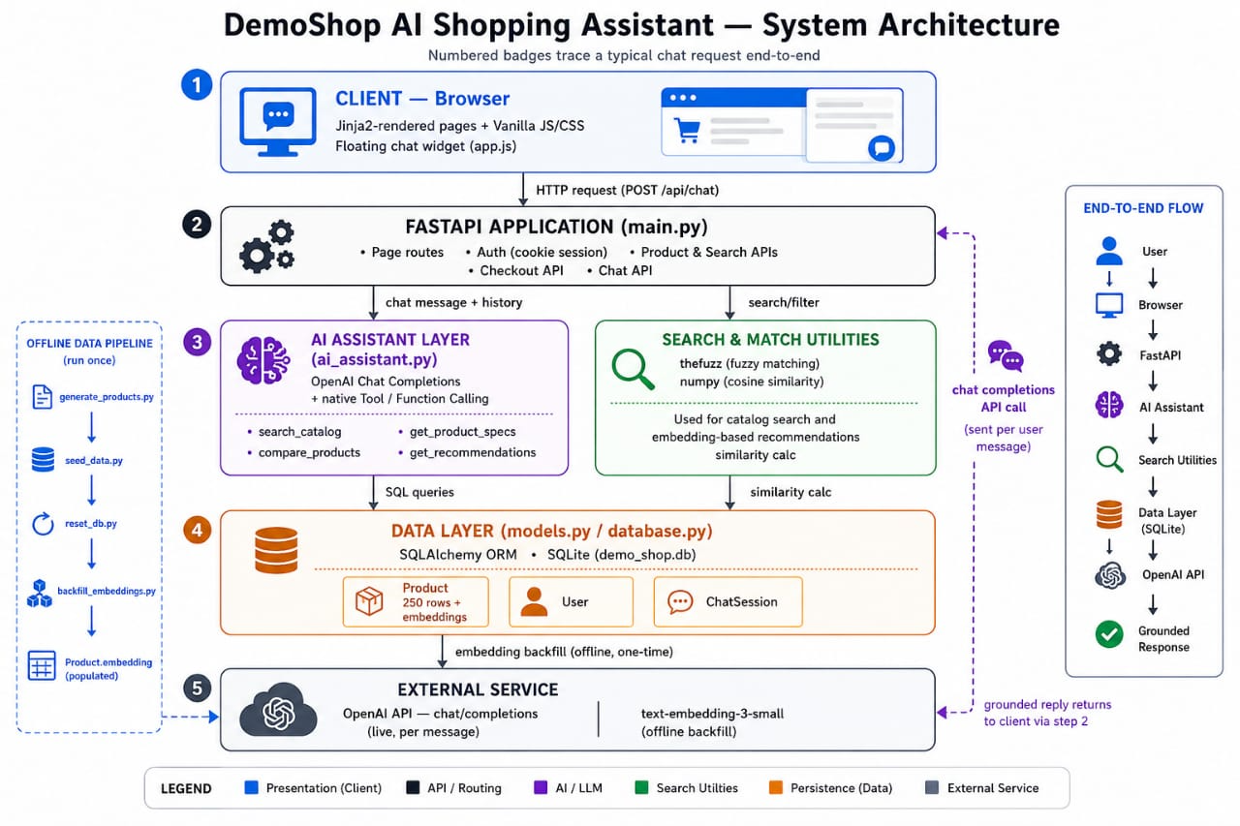
UNDER THE HOOD
Technical Architecture
🧩
FRONTEND
HTML / Vanilla CSS / JS
DATABASE STRUCTURE
Dark, professional Bootstrap-style UI
▼
Users — authentication, browsing & purchase history (JSON)
⚙️
BACKEND
FastAPI
Async Python API layer & request routing
Products — 250 items — name, category, brand, price, specs (JSON)
▼
💬
AI LAYER
OpenAI API — Tool / Function Calling
ChatSessions — full multi-turn conversation history (JSON)
Interprets intent, invokes catalog tools
▼
🗄️
DATA LAYER
SQLAlchemy ORM + SQLite
250-product catalog, users, chat history
AI SHOPPING ASSISTANT CHATBOT
4

Slide 5
FUNCTION CALLING & GROUNDING LOGIC
How the AI Works
01
02
03
04
💬
🔀
🔍
✅
User Asks
Model Selects a Tool
Tool Queries Live DB
Answer Is Grounded
→
→
→
“Compare the two best wireless headphones under $100.”
OpenAI function calling picks search_catalog / compare_products / get_product_specs.
FastAPI executes the call against SQLAlchemy — real rows, real prices.
The model replies using only the returned data — nothing fabricated.
🛡️
Grounding Principle: The model never answers from its own memory of products. Every specification, price, or comparison is fetched from SQLite at the moment of the question — multi-turn memory keeps the conversation coherent without ever letting the model “guess.”
AI SHOPPING ASSISTANT CHATBOT
5

Slide 6
BROWSING, RECOMMENDATIONS & CHECKOUT
Personalization & User Flow
1
2
3
4
5
👤
👁️
📈
🛒
💳
Sign In
Browse & Chat
Get Recommended
Add to Cart
Checkout
→
→
→
→
User authenticates; profile & history load.
Activity and AI questions are tracked live.
Engine blends browsing + purchase history.
Chosen products move into the cart.
Mock payment gateway completes the order.
🗄️
Personalization Signal: Every product view and past order is written back to the database in real time, so the recommendation engine and the AI assistant are always reasoning over the shopper's current behavior — not a stale snapshot.
AI SHOPPING ASSISTANT CHATBOT
6

Slide 7
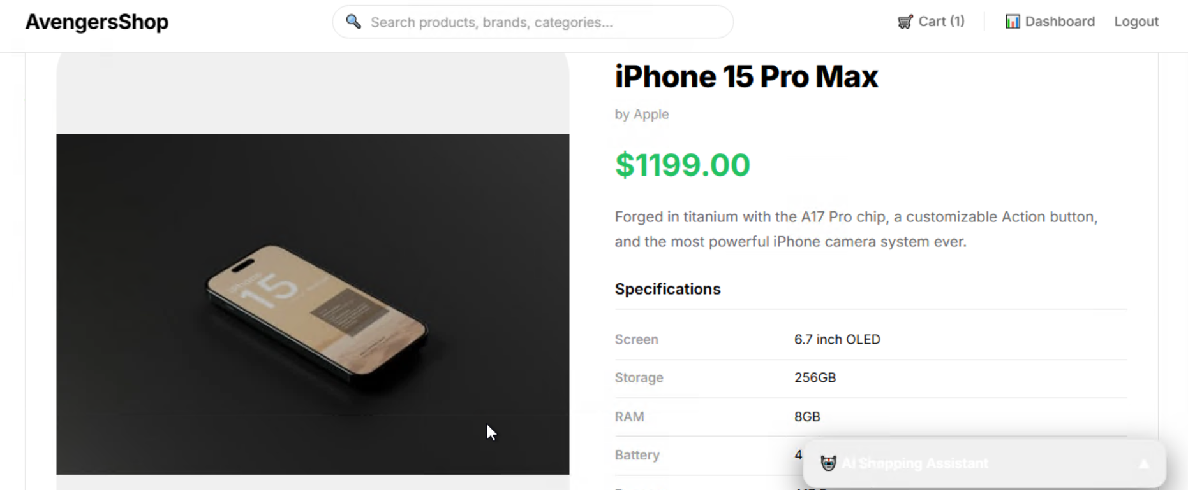
ACTUAL WORKING — LIVE APP
Grounded Product Data, End to End
Real specs, not guesses
The product page (and the assistant's get_product_specs tool) both read the exact same SQLite row — screen size, storage, RAM, battery, processor.
Exact live pricing
Prices shown to the shopper are identical to what the assistant quotes in chat — single source of truth.
Related-product logic reused
“You may also like” and the assistant's recommendation tool both query by category, keeping suggestions consistent everywhere.
AI SHOPPING ASSISTANT CHATBOT
8

Slide 8
CONCLUSION & FUTURE SCOPE
A Grounded, Personal Shopping Experience
This project pairs a full FastAPI + SQLAlchemy backend with OpenAI function calling to deliver a shopping assistant that is conversational, personalized, and always factually grounded in real product data.
WHAT'S NEXT
🎙️
🔗
💳
📈
Voice & Multi-Language
Vector Search / RAG
Real Payment Integration
Analytics Dashboard
Voice input and localized conversations for a broader audience.
Embedding-based retrieval for deeper semantic product matching.
Replace the mock gateway with a live provider (Stripe/Razorpay).
Admin insights into chat trends, conversions, and inventory gaps.
Thank You — Questions & Discussion
AI SHOPPING ASSISTANT CHATBOT
9

