Slide 1
ML Interconnection Queue Intelligence for the U.S. Electric Grid
Eshana Jain
CEE 498 MLC · Spring 2026
1/21

Slide 2
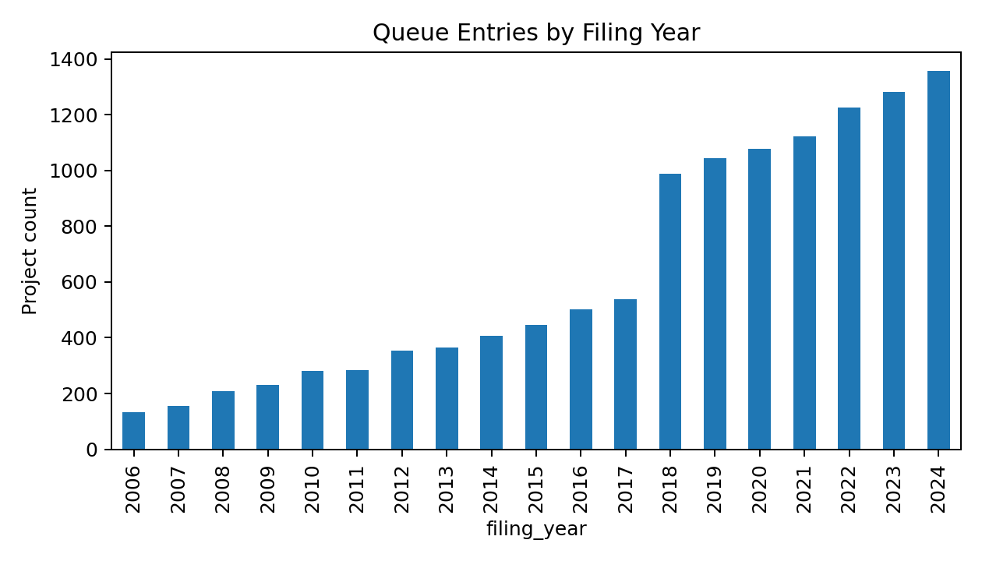
The Interconnection Queue Bottleneck
Before a power plant can connect to the grid, it must go through an interconnection study — a process run by the regional transmission operator
Right now there are over 2,300 GW of proposed projects waiting in U.S. queues — most will never get built
The majority of projects are eventually withdrawn , after developers have already spent significant money on site work, permitting, and study fees
Developers make irreversible decisions without knowing: will we survive the queue? how expensive will upgrades be? how long will this take?
2/21

Slide 3
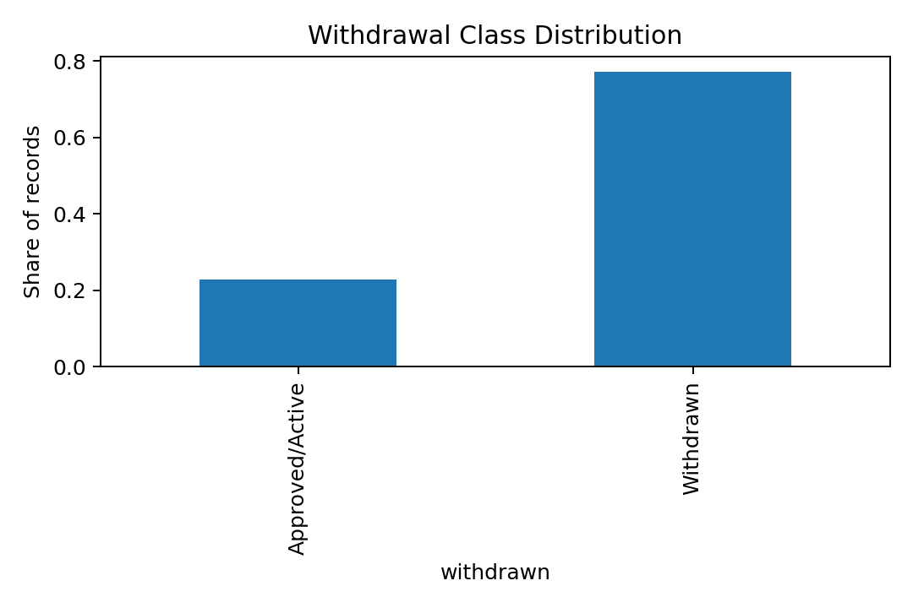
What We Want to Predict
Three early-stage predictions that a developer could use before or near the time of filing:
Will this project be withdrawn from the queue? Binary classification
How many months until the interconnection study completes? Regression
3/21

Slide 4
Paper: Physics-Informed Neural Networks
Raissi, Perdikaris, and Karniadakis (2019). Journal of Computational Physics.
The core idea: train a neural network using both a data-fitting loss and a physics residual , evaluated at "collocation points" — locations in input space sampled independently of training labels
The physics term penalizes the model whenever its output violates a governing equation
Demonstrated on Burgers' equation, Navier-Stokes, Schrödinger, and Allen-Cahn systems
Key finding: the physics term improves generalization in sparse-data regions and produces physically plausible outputs
4/21
L(θ) = L_data(θ) + λ · L_physics(θ) L_data — fits the observed labels L_physics — penalizes PDE residuals at collocation points

Slide 5
Adapting PINNs to Interconnection Data
Public queue data is tabular — there's no PDE to enforce directly. But queue economics are still governed by domain constraints.
Physics prior: holding everything else constant, a larger requested MW capacity should not lead to a lower required network upgrade cost.
Collocation copy: each training project gets a twin with MW scaled up 35%, all other features fixed
The penalty fires if the expected cost bucket decreases when MW increases
This is exactly the Raissi et al. structure — a data term plus a domain-residual term — applied to a tabular infrastructure setting
5/21
L_total = L_cross_entropy + λ · L_monotonic L_monotonic = mean( max(0, E[cost | x] − E[cost | x high_MW ]) )

Slide 6
Relevant Course Concepts
Binary and multi-class classification (logistic regression, MLP)
Regression (Ridge, MLP regressor)
Class imbalance handling via cost-sensitive weighting
Gaussian Process Regression for calibrated 90% prediction intervals on upgrade cost
Multi-layer perceptrons with dropout, batch normalization, AdamW
PyTorch custom training loop for the PINN model
Ridge penalty in linear baselines
Monotonicity penalty — encoding domain knowledge directly into the loss function
6/21

Slide 7
Dataset
Stratified by ISO region and filing-year cohort to reduce temporal and regional leakage.
Split | Rows
Total | 12,000
Training (80%) | 9,600
Validation (10%) | 1,200
Test (10%) | 1,200
With cost labels | 4,581 (38%)
Withdrawal rate | 77.3%
Primary source: LBNL Queued Up 2025 — project-level U.S. interconnection queue records
Supplemented by ISO/RTO queue exports: MISO, PJM, CAISO
Pipeline also ships with a synthetic dataset matching the same schema, class imbalance, and feature relationships — so the code runs without external data files
Cost labels are only available for about 38% of projects — those that progressed far enough in study to receive an upgrade estimate
7/21

Slide 8
Feature Set
Congestion proxy and cohort size are engineered from raw queue records — not provided directly by the data source.
log_mw_capacity — log-transformed requested MW (right-skewed)
filing_year , voltage_kv , queue_position
substation_congestion_24mo — count of prior projects at the same point of interconnection in the past 2 years
queue_cohort_size — projects in the same ISO/year cohort
county_queue_density , distance_to_transmission_miles
renewable_penetration_pct — regional saturation proxy
iso_region — MISO, PJM, CAISO, ERCOT, SPP, NYISO, ISO-NE
fuel_type — Solar, Battery, Wind, Hybrid, Gas, etc.
deliverability_status — Full Capacity / Energy Only / Partial
8/21

Slide 9
Tasks and Models
Each task has a linear/interpretable baseline paired with a more expressive model
The cost task is the main PINN ablation: constrained vs. unconstrained MLP
GPR exists separately to give calibrated uncertainty rather than just point estimates
Task | Type | Interpretable Baseline | Nonlinear Model
Withdrawal | Binary classification | Logistic Regression (class-weighted) | MLP Classifier
Timeline | Regression | Ridge Regression | MLP Regressor
Cost Bucket | 4-class classification | Unconstrained MLP | PINN-Monotonic MLP
Upgrade Cost (GPR) | Regression + uncertainty | Gaussian Process (RBF kernel, log-cost target)
9/21

Slide 10
Model Architecture Details
Hidden layers: (48, 24)
L2 regularization: α = 1e-3
Early stopping on validation loss
Learning rate: 3×10⁻⁴
Kernel: ConstantKernel × RBF + WhiteKernel
Trained on log-transformed cost
Capped at 650 training samples — GPR scales as O(n³)
Architecture: Linear(d, 64) → BatchNorm → ReLU → Dropout(0.15) → Linear(64, 64) → ReLU → Linear(64, 4)
Optimizer: AdamW, lr = 1e-3, weight decay = 1e-4
10/21

Slide 11
Training Setup
Preprocessing pipeline is fit only on the training fold — numeric features standardized, categoricals one-hot encoded — then applied to validation and test
Cost models trained separately on the ~38% subset with cost labels
Evaluation metrics: AUC-ROC and F1 for withdrawal, MAE and R² for timeline, weighted F1 / accuracy / implausibility rate for cost
# For each batch of n projects: x_high = copy of x, with mw_capacity × 1.35 + 5.0 loss = CrossEntropy(model(x), y_true) + 0.55 × mean( relu( E_cost(x) − E_cost(x_high) ) ) # Penalty fires only when cost decreases as MW increases
11/21

Slide 12
Results: Withdrawal Prediction
Both models are well above the majority-class baseline (~77% if always predicting "withdrawn")
Logistic regression edges ahead on AUC — the withdrawal signal is fairly linear in the features
MLP wins on F1 for the withdrawn class, which is the more practically important metric
Most predictive features: substation congestion, MW capacity, filing year ≥ 2018, ISO region
Model | AUC-ROC | F1 (Withdrawn Class) | Accuracy
Logistic Regression | 0.949 | 0.908 | 86.8%
MLP Classifier | 0.946 | 0.932 | 89.5%
12/21

Slide 13
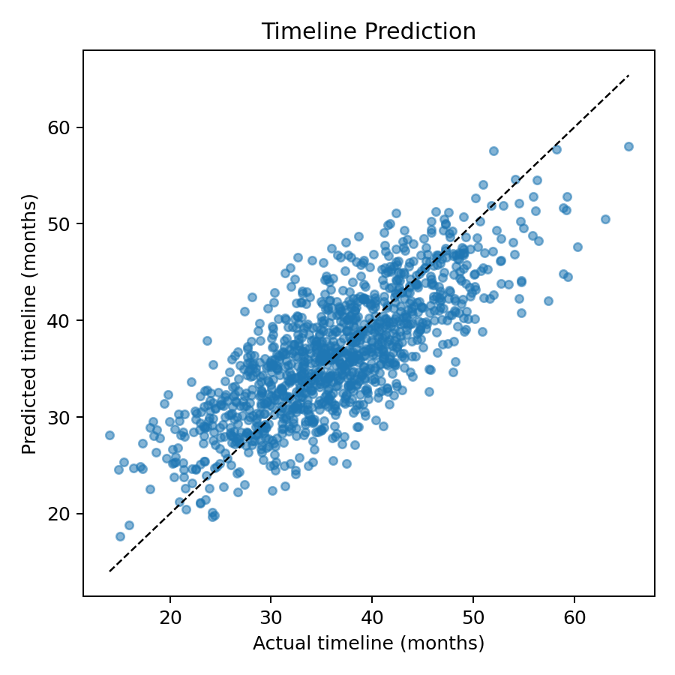
Results: Study Timeline Prediction
Linear model wins — timeline is well-described by an additive combination of features, the MLP doesn't find meaningful additional signal
R² ≈ 0.60 is reasonable given that timelines range from 2 to 96 months
Key drivers: queue congestion, queue position, MW capacity, post-2018 filing pressure
Model | MAE (months) | R²
Ridge Regression | 4.06 months | 0.602
MLP Regressor | 4.13 months | 0.590
13/21

Slide 14
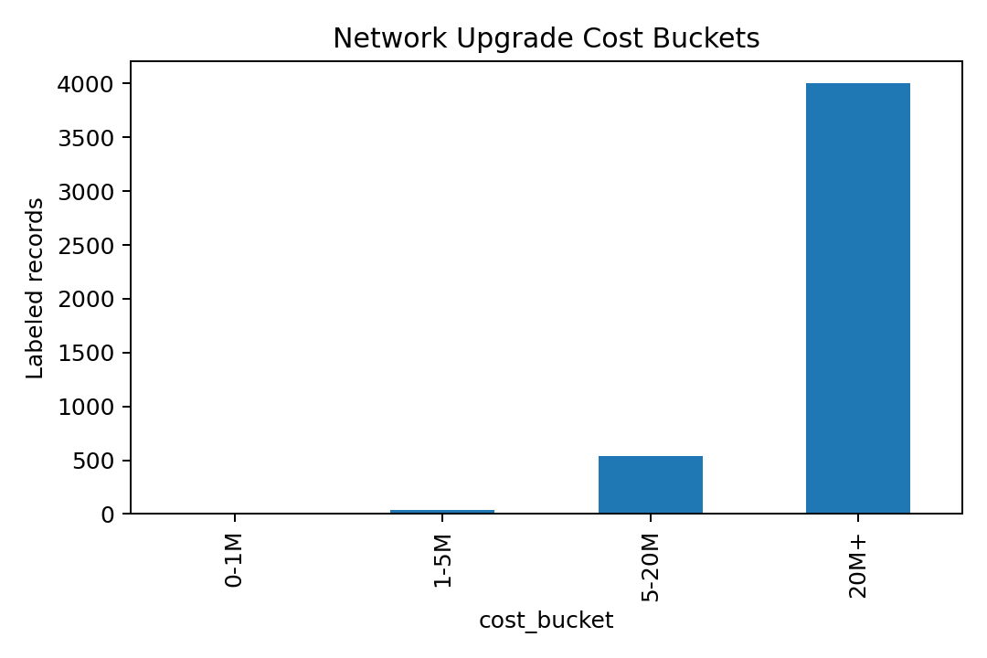
Results: Cost Bucket Classification
Both achieve ~89% accuracy on the cost-labeled test subset
The monotonic penalty costs about 0.5% accuracy — a small trade-off for guaranteed physical consistency
Both reach 0% implausibility on this dataset — the synthetic data is clean, so the constraint isn't forced to activate much
The penalty is most valuable on real, noisy, sparse public data where the model may otherwise extrapolate implausibly
Model | Weighted F1 | Accuracy | Implausibility Rate
Unconstrained MLP | 0.887 | 89.1% | 0%
PINN-Monotonic MLP | 0.879 | 88.6% | 0%
14/21

Slide 15
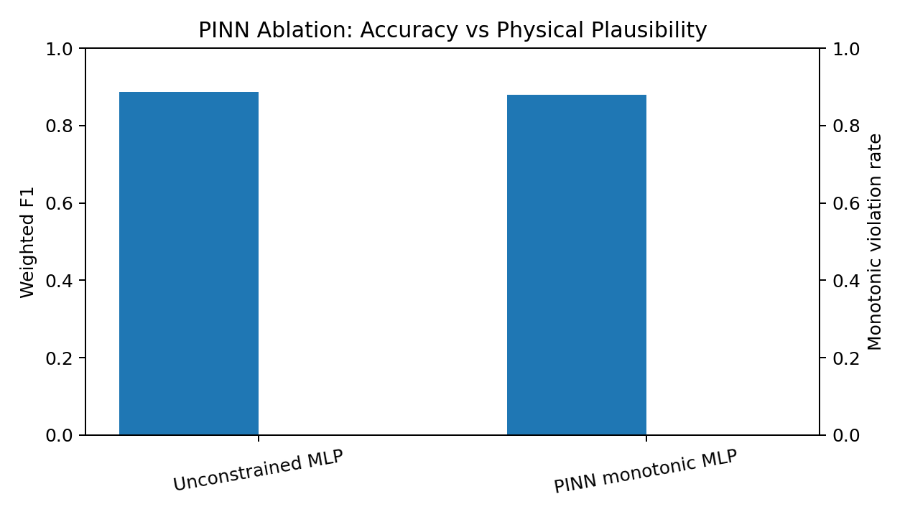
PINN Ablation: Constrained vs. Unconstrained
15/21

Slide 16
Results: Gaussian Process — Cost Uncertainty
Coverage of 88.6% is close to the nominal 90% — intervals are reasonably calibrated
GPR gives developers not just a point estimate, but a sense of how uncertain the model is in data-sparse regions
Useful for early-stage screening: a wide interval signals that the model is extrapolating from few comparable historical projects
Metric | Value
MAE (log-cost) | 0.367
R² (log-cost) | 0.782
90% Prediction Interval Coverage | 88.6%
Mean Interval Width (log scale) | 1.52
Nominal coverage target 90%
Actual coverage achieved 88.6%
R² on log cost 0.782
16/21

Slide 17
Key Findings
Congestion and siting context carry real predictive signal. Substation congestion, county queue density, distance to transmission, and ISO/year cohort size matter beyond MW alone — this supports the hypothesis that congested points of interconnection produce more costly upgrades and delays.
Timeline prediction is surprisingly linear. Ridge regression outperforms the MLP on both MAE and R² — the additive story is enough. No complex interactions needed.
The physics-informed constraint costs very little. ~0.5% accuracy trade-off for monotonic consistency; important mainly when data is sparse and the model might otherwise extrapolate incorrectly.
Label completeness is a bottleneck. Withdrawal (100%) and timeline (100%) labels are abundant; cost labels are only 38% — the cost task has much less training data.
GPR intervals are well-calibrated. 88.6% actual coverage vs. 90% nominal — useful for communicating uncertainty to non-specialist project teams.
17/21

Slide 18
Limitations
Data quality across ISOs: Queue exports use inconsistent field names, units, and status codes across MISO, PJM, CAISO, etc. Joining them requires careful normalization that the current pipeline handles heuristically.
Simplified monotonicity: Real upgrade costs depend on deliverability, thermal limits, voltage constraints, short-circuit duty, and prior network investments — not just MW. The monotonic penalty is a useful regularizer, not a complete physical model.
GPR scalability: Gaussian processes scale as O(n³) in training — capped at 650 training samples in this pipeline.
Synthetic data: The submitted pipeline runs on synthetic data. Real LBNL data may reveal different relationships and noisier patterns, especially for cost labels.
18/21

Slide 19
Future Work
Richer grid-topology features: Transmission line capacity and existing congestion from OASIS or EIA Form 714 — these are the features most directly tied to actual upgrade costs
Calibrated probabilistic classifiers: Platt scaling or temperature scaling on cost bucket outputs for better-calibrated confidence scores
Autoencoder for project retrieval: Given a new filing, find the most similar historical projects — useful for developers trying to benchmark against comparable projects
Extended monotonicity constraints: Higher voltage levels tend to reduce per-MW cost; this could be encoded as a second constraint alongside the MW monotonicity
Full run on cleaned LBNL public data with proper cross-ISO column mapping
19/21

Slide 20
Conclusions
Thank you — happy to take questions.
Built a three-task ML pipeline for early-stage interconnection queue risk assessment: withdrawal prediction, timeline regression, and cost bucket classification
Adapted the Raissi et al. (2019) PINN framework to tabular queue data by replacing a PDE residual with a monotonicity residual — same two-part composite loss structure, different domain constraint
The physics-informed cost classifier achieves ~89% accuracy while enforcing domain-consistent predictions; the accuracy cost is minimal (~0.5%)
Queue congestion, siting context, and filing-year pressure are the most predictive signals — MW capacity alone is not enough
The pipeline is reproducible and can slot in cleaned public LBNL data with minimal changes
20/21

Slide 21
Backup: Anticipated Questions
Why is this "physics-informed" if there's no PDE? The model is constrained by a domain law evaluated at collocation points — that's the PINN structure. We adapted the mechanism (monotonicity instead of a PDE), not the principle.
Why not use a direct power-flow simulation? Public queue records don't include grid-state variables (bus voltages, line flows, etc.) needed to run power-flow equations. The monotonicity prior is the strongest constraint we can encode from the available data.
How do you prevent data leakage? All preprocessing (StandardScaler, one-hot encoder) is fit on the training split only, then applied to val/test. The train/test split is stratified by ISO/year cohort to reduce temporal leakage.
Why does Ridge beat MLP on timeline? The timeline data-generating process is additive — congestion, queue position, and MW combine roughly linearly. The MLP doesn't find useful nonlinear interactions given the training set size.
21/21

