Slide 1
Premature Baby Care Service

Slide 2
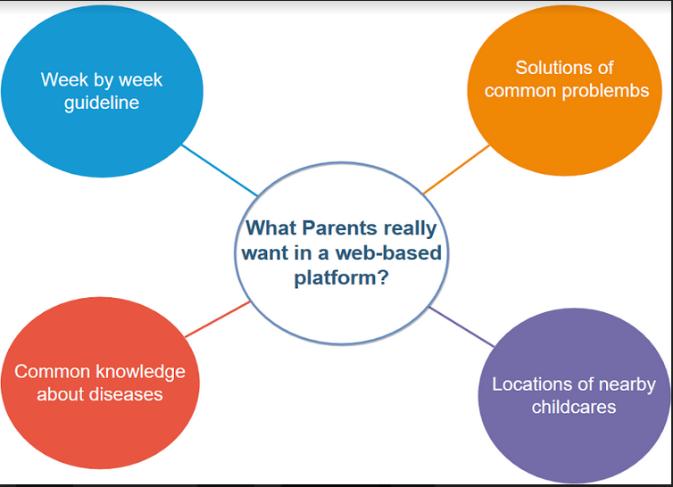
Design Implication

Slide 3
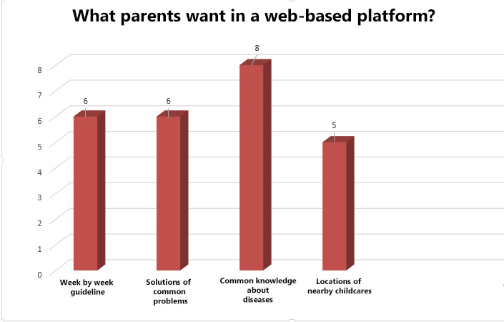
Design Implication

Slide 4
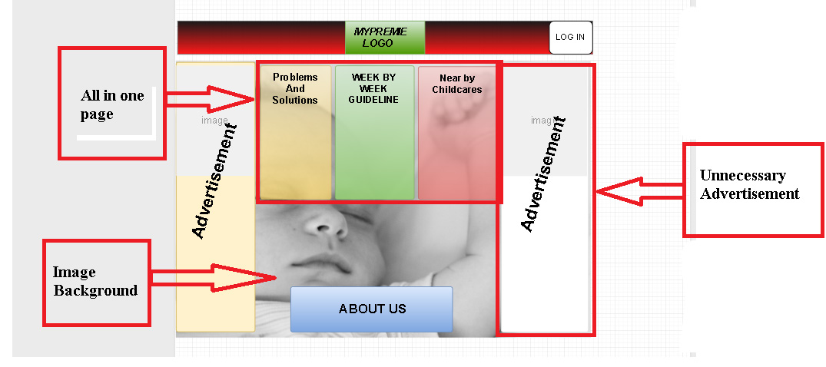
Design (Bad)

Slide 5
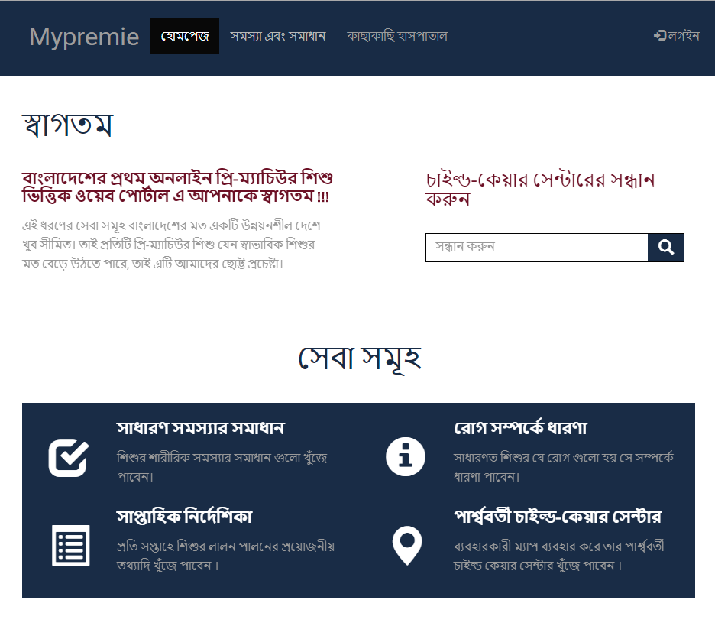
Design (Good)

Slide 6
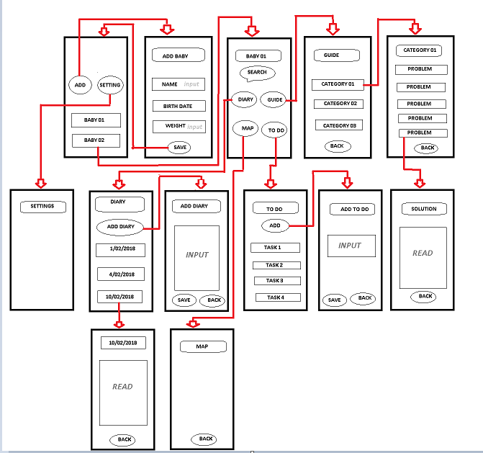
Block Diagram

