Slide 1
AtliQ Sales & CRM Assistant
AI PM CAPSTONE · ATLIQ TECHNOLOGIES
A sales memory that closes the loop — it catches every promise and client ask, tells founders what to do today, and updates the CRM when they act.
Presented by
Live prototype
Eshita Rastogi
atliq-sales-crm-assistant-eshita-rastogi.vercel.app
Notes:
Hi, I'm Eshita. This is the AtliQ Sales and CRM Assistant — an AI sales memory for AtliQ's founder-led sales team. In the next few minutes: the problem we found in AtliQ's own data, why AI is the right tool, the live prototype, how we measure success, and how it stays safe.

Slide 2
AtliQ doesn't lack leads. It lacks memory.
THE PROBLEM
$410k
0 / 40
CRM records with a next follow-up date
3 wks
FinEdge — our biggest deal — waited for a reply after compliance cleared
of known pipeline was waiting on AtliQ, not on the client, in the July 2026 snapshot.
FinEdge $95k · NovaPharma $80k · ShopSwift $55k · Meridian $45k · ClearPath $40k · AgroLink ~$37k · HealthFirst $30k · VoltEnergy $28k
2×
"Update the CRM same day" was agreed — April and July — and failed both times
AtliQ Sales & CRM Assistant · 02 · Source: capstone dataset (CRM export, 34 emails, 16 meeting notes)
Notes:
Here's the headline from AtliQ's own data. The leads are there — 40 in the CRM and more in inboxes — but about 410 thousand dollars of pipeline was waiting on an action from AtliQ, not the client. Not one of the 40 CRM records had a next follow-up date. FinEdge, the biggest deal at 95k, sat for three weeks after the client said 'compliance cleared, let's talk commercials'. And the team already tried the obvious fix twice. That's the signal that this is a structural problem, not a discipline problem.

Slide 3
The founder-seller who sells between meetings
DISCOVERY · WHO WE BUILT FOR
Thinks
Feels
KARANDEEP · CEO & FOUNDER-SELLER
"I might lose deals because I can't remember earlier points or follow up."
Overwhelmed and pressured; guilty when warm clients have to chase us.
"I answer emails on my phone between meetings and it never gets into the system. By the time I'm at a laptop it's gone."
Says
Does
"We find out what's urgent by accident." · "Half of these will go cold."
Promises on the phone, pushes CRM updates to "later", searches the inbox mid-meeting.
Composite of Bhavin, Dhaval and Karandeep · secondary user: Jay, sales exec
AtliQ Sales & CRM Assistant · 03 · Step 1: persona & empathy map
Notes:
Our persona is the founder-seller — a composite of the two founders and the CEO. They close most deals, but they sell from their phones, between meetings. The empathy map came straight from the meeting notes: they worry about losing deals, they feel guilty when warm clients chase them, and they push CRM updates to later — which never comes.

Slide 4
From "we're losing revenue" to the real root cause
DISCOVERY · 5 WHYS
Why 1
Revenue slips → follow-ups and client asks don't happen ($410k waiting on AtliQ)
Why 2
Nobody sees them coming → the CRM is out of date (0/40 follow-up dates, wrong stages, 5 leads missing)
Why 3
Context is lost → information arrives scattered and is typed in days later, if at all
Why 4
No time to update → selling happens on the phone; data entry pays nothing back, so discipline failed twice
Why 5
The CRM is built on manual entry, while the real signals live in conversations nobody has time to read back
Root cause: the signals that drive revenue — asks, promises, deadlines, revisits, cross-sells — stay buried in unstructured conversations, with no owner. The fix is a system that comes to the data, not more discipline.
AtliQ Sales & CRM Assistant · 04 · Step 1: 5 Whys & problem statement
Notes:
The 5 Whys took us below the surface complaint 'the CRM is stale'. The CRM depends on people re-typing conversations, founders sell on their phones, and the same-day rule failed twice because typing pays nothing back to the person doing it. So the root cause is structural: the real signals live in unstructured conversations and nothing turns them into owned actions. That's what makes this an AI problem.

Slide 5
Revenue leaks in five repeatable patterns
DISCOVERY · WHAT THE DATA SHOWED
01
02
03
04
05
Dropped promises
Unanswered asks
Buried deadlines
Lost deals that came back
Missing leads & duplicates
"I'll send the case study" — said, never sent.
The client asked a direct question. Nobody replied.
"By the 15th" sits inside paragraph four of an email.
"Revisit in Q3" — marked Lost, never revisited.
5 leads only in inboxes; Meridian entered twice.
ByteBridge · CloudNine · VoltEnergy
FinEdge $95k · Meridian $45k
ShopSwift 15 Jul · HealthFirst 14 Jul · NovaPharma 24 Jul
Quantia · ClearPath · Kaveri
5 missing · 1 duplicate
Every pattern is a signal hidden in text — exactly what a language model can read, and a rule-based CRM can't.
AtliQ Sales & CRM Assistant · 05 · These patterns became the eval answer key
Notes:
When we read every email and meeting note, the leaks weren't random — they fell into five patterns. Promises we made and forgot. Questions clients asked that nobody answered, including FinEdge. Deadlines buried in long emails. Lost deals where the client said 'come back in Q3' and nobody did. And leads that never made it into the CRM, or got entered twice. Every one of these is a signal hidden in text. That's the opportunity for AI — and these exact cases became our evaluation answer key.

Slide 6
10 steps, 5 pain points, where AI fits
THE OPPORTUNITY · PROCESS MAPPING
Input
New opportunity
1
2
3
4
5
6
7
8
9
10
Output
Revenue & growth
Receive
Log lead
Qualify
Discovery
Proposal
Meetings
Follow up
Negotiate
Close / lost
Grow
2 · Log lead
6 · Meetings
7 · Follow up
Organizes + Connection — capture from any note, flag duplicates
Finds + Writes — minutes, promises and dates from the recording
Plans & Recommends — ranked next best actions, draft replies
9 · Close / lost
10 · Grow
Cards we rejected
Finds + Connection — catch "revisit in Q3" on lost deals
Finds + Recommends — spot cross-sell signals in won accounts
Autonomous · Commands · Facial recognition — AI never sends, changes or decides on its own
AtliQ Sales & CRM Assistant · 06 · Step 2: Miro process board with AI cards and ethical risk cards
Notes:
On the Miro board we mapped AtliQ's sales process in ten steps, from a new opportunity to revenue won and the relationship grown. Five steps hurt the most: logging leads, meetings, follow-ups, closing or losing, and growing accounts. For each we picked the AI capability that fits: organising and connecting at lead capture, finding and writing at meetings, planning and recommending at follow-up. Just as important are the cards we rejected — nothing autonomous. AI never sends an email or changes a deal on its own.

Slide 7
"When I'm between meetings, help me know what I owe each client today — and keep the CRM true without me typing it — so no warm deal goes cold."
THE OPPORTUNITY WE CHOSE
Why AI, not another rule
AI does
AI never
The signals are written in plain language. "Revisit in Q3" or "can you send by Friday" can't be caught by a form field or a filter.
✓ Reads emails, notes and recordings
✕ Sends anything to a client
✕ Changes a stage or value on its own
✓ Pulls out asks, promises and deadlines, with the source quote
✕ Merges records or deletes data
Discipline was tried twice. The fix has to remove the typing, not ask for more of it.
✓ Ranks what to do today
✕ Invents a price, date or commitment
✓ Drafts replies and minutes
AtliQ Sales & CRM Assistant · 07 · Job to be done & scope boundary
Notes:
So the opportunity we chose is this job to be done: between meetings, tell me what I owe each client today and keep the CRM true without me typing — so no warm deal goes cold. AI is the right tool because the signals are written in plain language, and because discipline has already failed twice. Equally important is the boundary. AI reads, finds, ranks and drafts. It never sends, never changes a deal by itself, never merges records, and never invents a number.

Slide 8
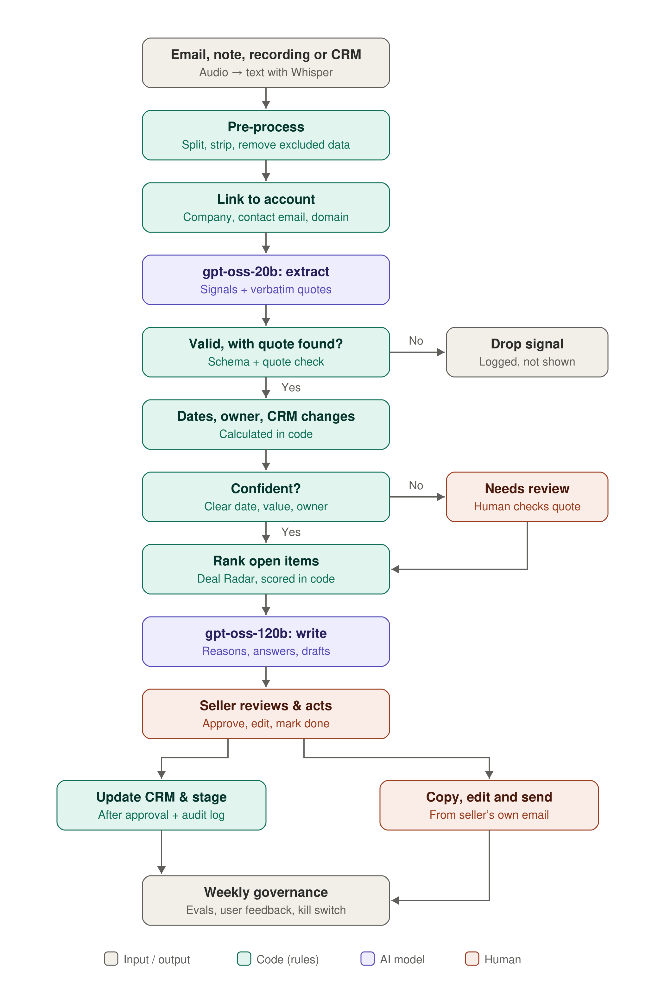
A sales memory that closes the loop
THE SOLUTION
AI reads & writes
Extracts asks, promises, dates and profiles; writes minutes and drafts. Every item carries its source quote.
Code does the maths
Due dates, ranking, quote checks and duplicate flags run in code — repeatable and testable.
Humans decide
Mark done, move stage, send, merge — one tap each, always by a person.
Groq · gpt-oss-20b & 120b · Whisper · Next.js on Vercel
AtliQ Sales & CRM Assistant · 08 · Step 3: AI PRD flow
Notes:
Here's the solution in one picture. Emails, meeting notes and recordings come in. A language model reads them and pulls out every ask, promise and deadline, each with the exact quote it came from. Then code takes over: it checks the quote really exists, works out the due date, ranks what matters today and flags duplicates. And the founder decides — one tap to mark something done, move a stage or approve a draft. AI reads and writes, code does the maths, humans decide.

Slide 9
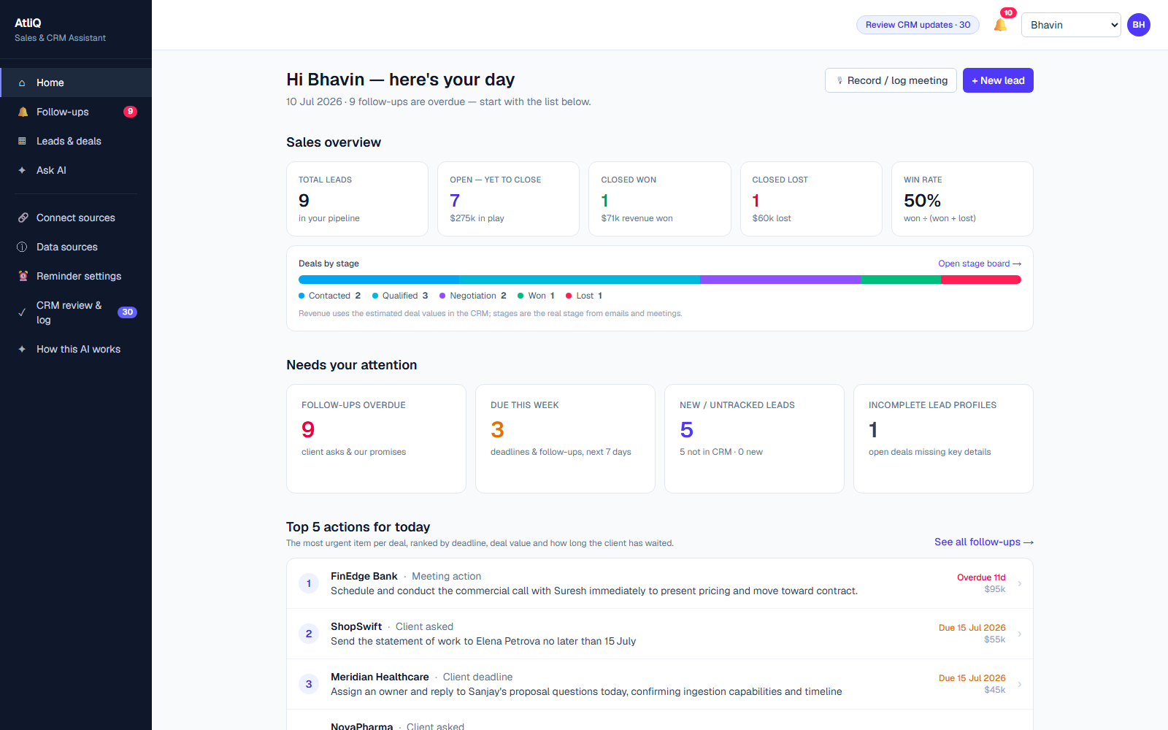
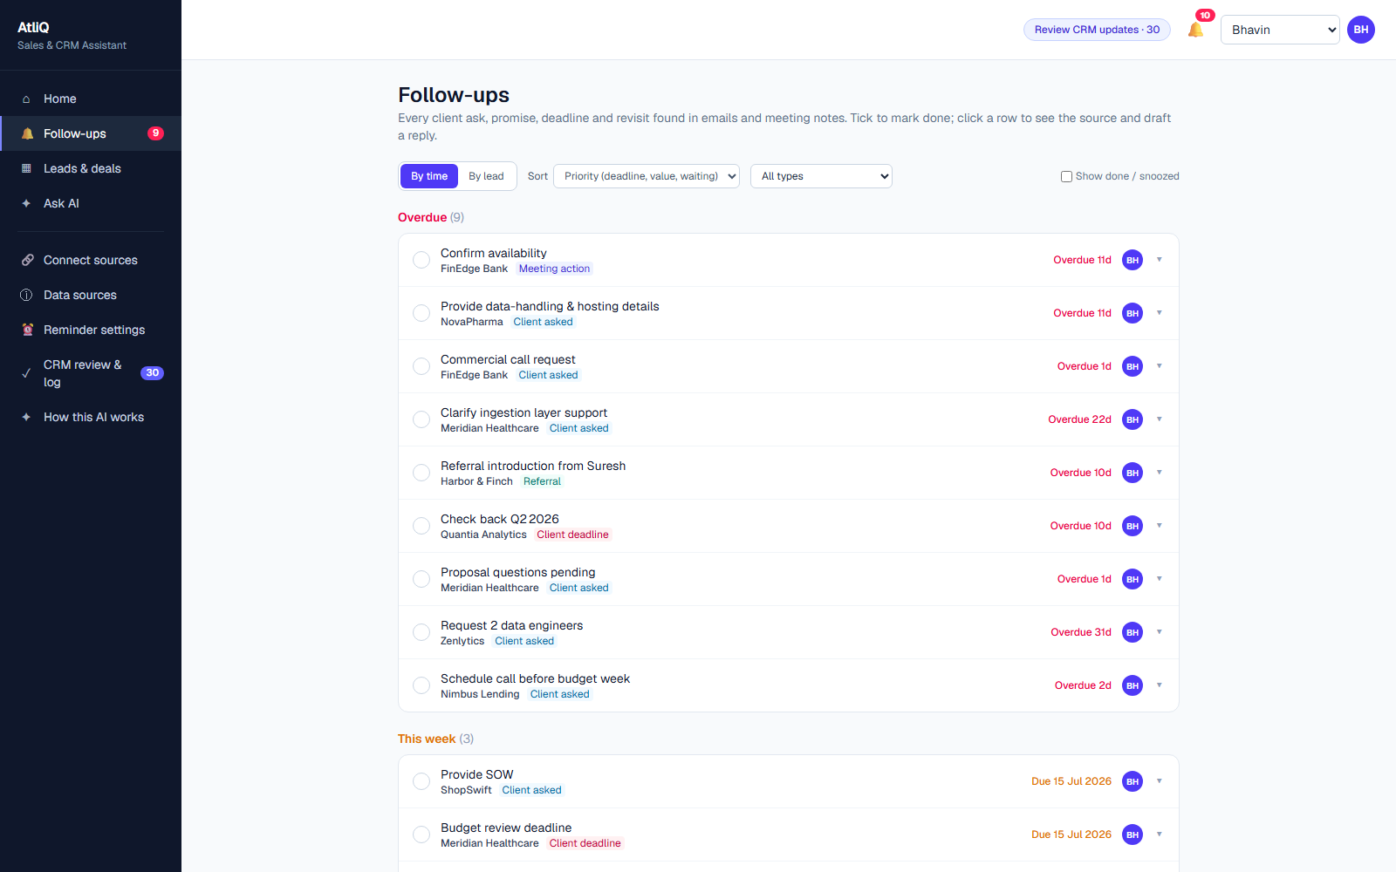
Open the app, know what to do today
WALKTHROUGH 1 · START THE DAY
Home: pipeline, overdue, due this week, new leads — then the top 5 actions, ranked.
Follow-ups: by time or by lead. Each shows the quote it came from — done, snooze or remind me.
AtliQ Sales & CRM Assistant · 09 · Live prototype
Notes:
Let's walk through the prototype. A founder opens the app between meetings. Home shows four numbers — open pipeline, overdue, due this week and new leads — and the top five things to do, ranked. FinEdge is right at the top, which is exactly where it should have been in July. The follow-ups page lists every open promise and client ask, by time or by lead, and each one shows the exact quote it came from — so you can trust it in a second.

Slide 10
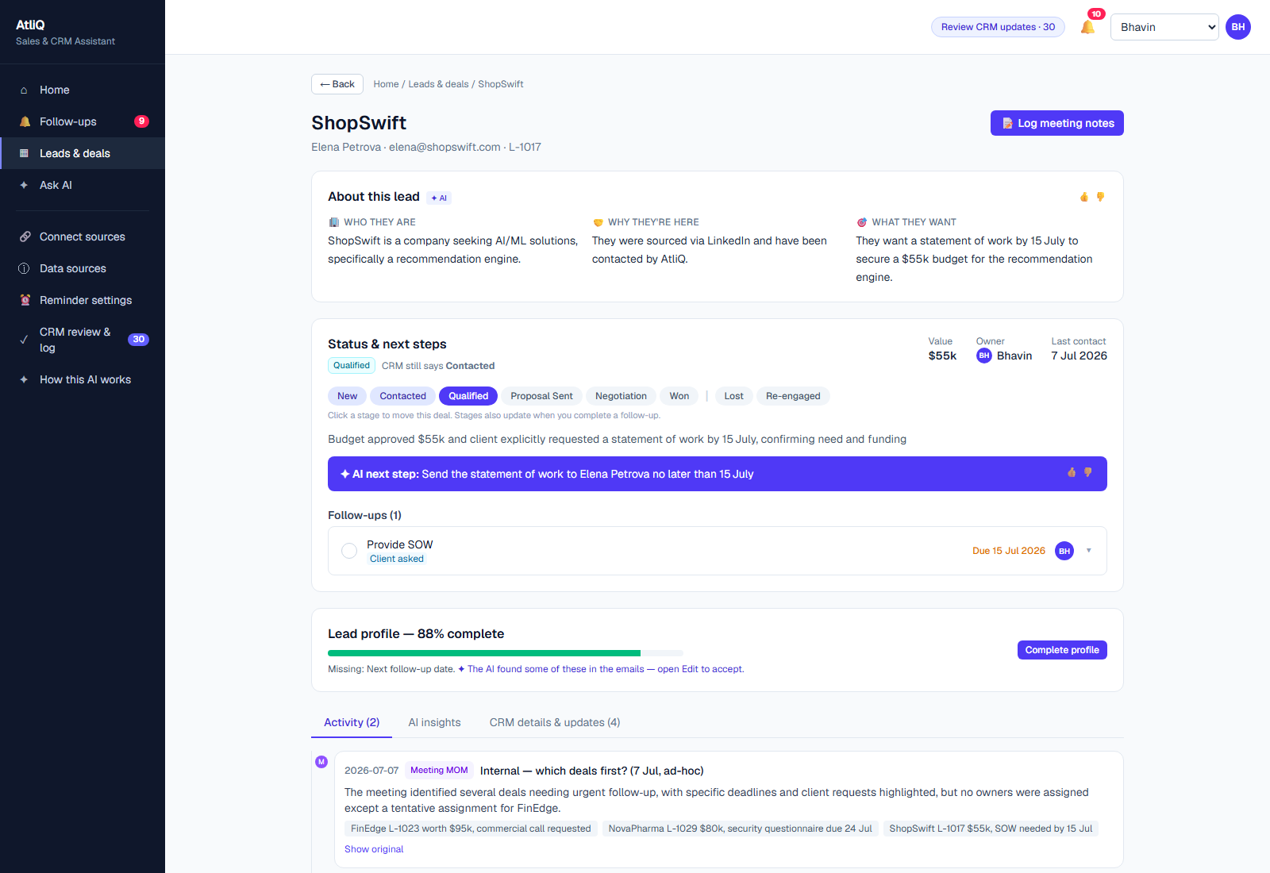
One tap closes the loop — and the CRM updates itself
WALKTHROUGH 2 · WORK A DEAL
1
ShopSwift, $55k. AI summary, who they are, and the buried ask: SOW by 15 Jul.
2
Draft the reply. AI writes it; anything it doesn't know shows as [TBD].
3
Mark done: "SOW sent". Action and date are logged; stage moves Qualified → Proposal Sent.
4
Profile completeness shows what's missing — fill it in place.
AtliQ Sales & CRM Assistant · 10 · Live prototype
Notes:
Now let's open a deal — ShopSwift, 55 thousand dollars. At the top: who they are and what they want. Then the status panel with the stage track. The AI found the ask buried in an email — send the SOW by the 15th of July. I can draft the reply; anything the AI doesn't know, like a price, shows as TBD rather than being made up. When I mark it done and type 'SOW sent', the action and date are logged and the stage moves from Qualified to Proposal Sent. That's the loop closing — the CRM stays true without anyone typing it up later.

Slide 11
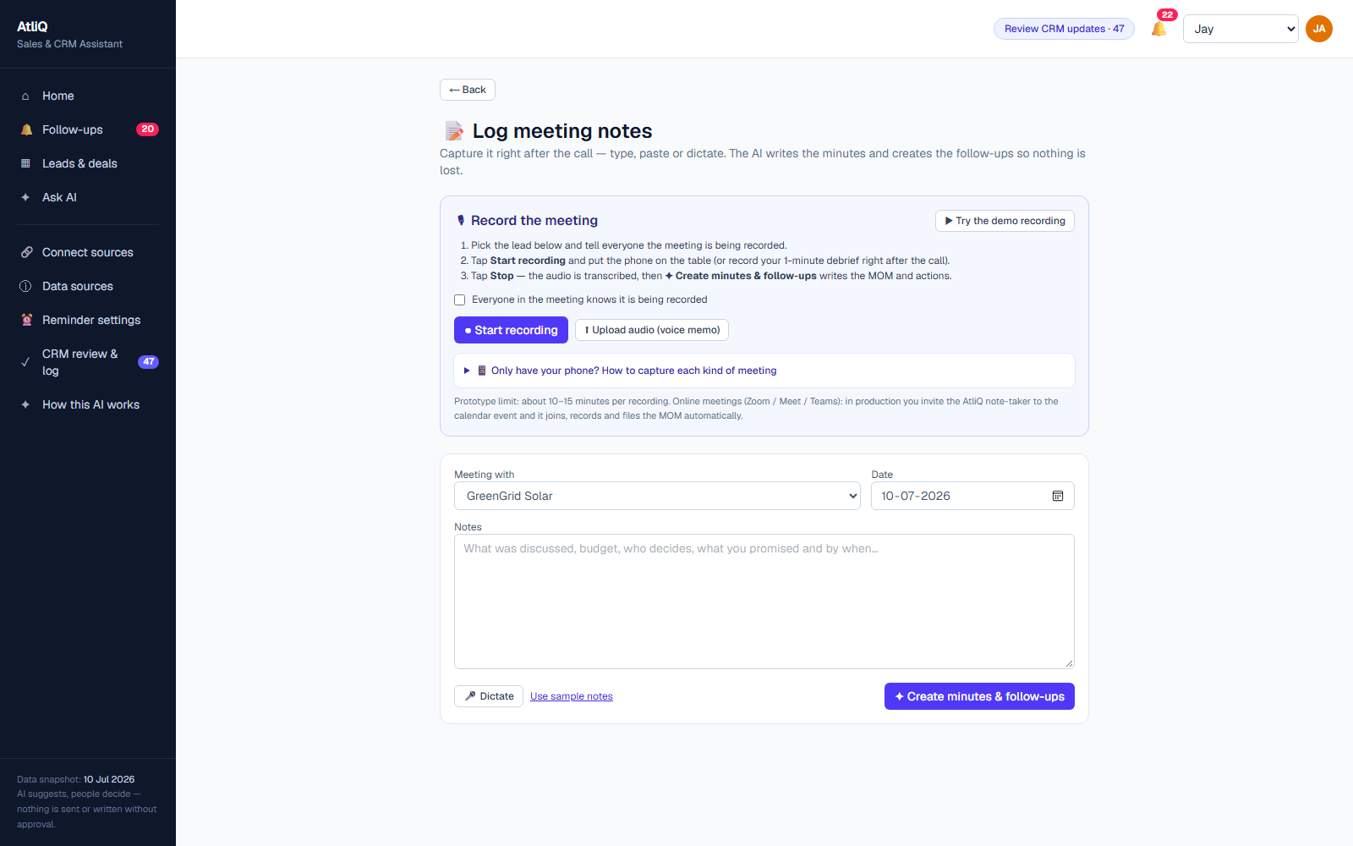
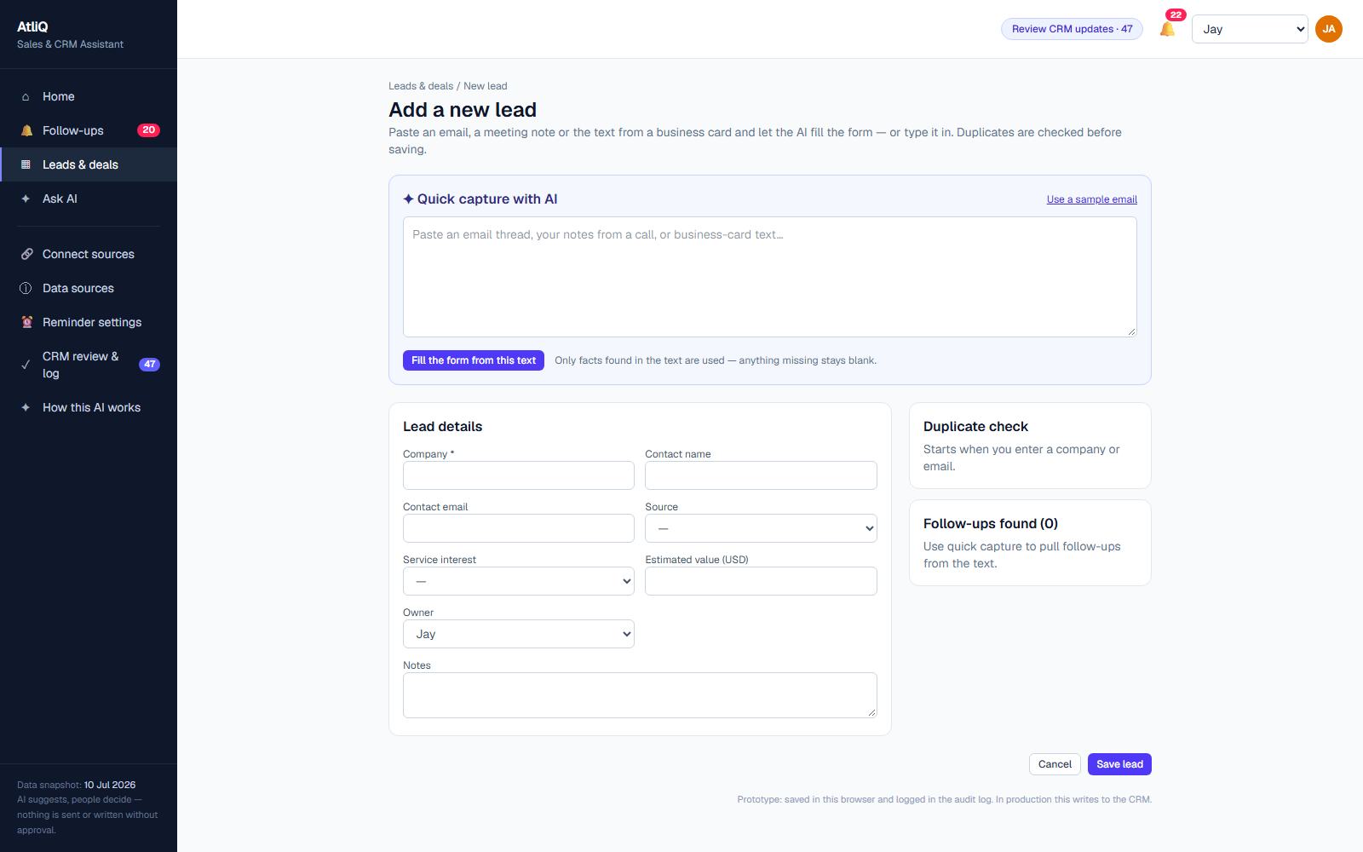
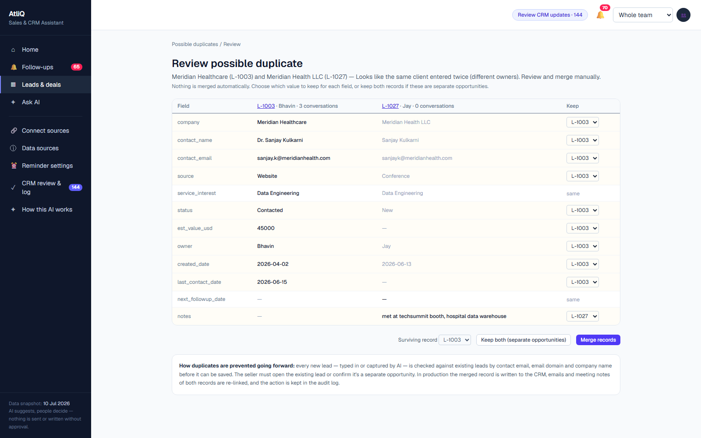
Talk, paste or record — the CRM fills itself
WALKTHROUGH 3 · CAPTURE WITHOUT TYPING
Log a meeting. Record, upload or dictate. The GreenGrid demo returns minutes, $22k and 2 follow-ups with dates.
Add a lead. Paste an email or business card; AI fills the fields and warns about likely duplicates.
Merge duplicates. Side by side; a person picks what to keep. AI flags, never merges.
AtliQ Sales & CRM Assistant · 11 · Live prototype · Whisper speech-to-text + gpt-oss
Notes:
The third flow removes the typing. After a call, the founder records or dictates a quick debrief — even on just a phone. Whisper transcribes it and the AI writes the minutes, finds the deal value and creates the follow-ups with real dates. In the GreenGrid demo that's 22 thousand dollars and two follow-ups, in seconds. New leads work the same way: paste an email or a card, and the AI fills in the fields and checks for duplicates. If there is a duplicate, like Meridian, a person merges it side by side — the AI only flags.

Slide 12
One North Star, backed by trust and safety
SUCCESS METRICS
NORTH STAR
~20%
≥60%
≥80%
≥90%
% of follow-ups done on time
→
→
→
Today (est.)
Beta
Launch
Steady state
Business
Trust & adoption
Guardrail (must hold)
Reply to client asks in < 2 business days
≥ 70% of AI suggestions accepted
0 actions taken without approval
≥ 80% 👍 on AI output
≥ 98% source quotes accurate
Pipeline review prep: 2 hrs → < 10 min
Founders open it daily
0 invented prices, dates or promises
0 clients chasing us per month
AtliQ Sales & CRM Assistant · 12 · Revenue impact is tracked by the founders, not claimed by the tool
Notes:
How do we know it works? Our North Star is the share of follow-ups done on time — because every leak we found was a follow-up that didn't happen. Today that's roughly 20 percent. We aim for 60 in beta, 80 at launch and 90 at steady state. Business metrics sit under it: replying to client asks within two business days, pipeline review prep from two hours to under ten minutes, and no clients chasing us. Trust metrics tell us if people actually use it. And the guardrail metrics must always hold: zero actions without approval and zero invented facts.

Slide 13
Tested against AtliQ's own answer key: 12 / 12 pass
PROOF · EVALUATION
30/30
124/124
5/5
What the evals caught
Hallucination: a draft invented "HL7" and a "UAT" date. Fixed with a [TBD] rule and a numbers check.
Known asks & promises found
Source quotes verified word for word
Missing leads found in inboxes
Ranking: ShopSwift first came out at #87. Reweighted → #2.
4/4
#1
Top 6
False alarm: GlobalMart was flagged as "silent" while AtliQ owed the action. Rule fixed.
Buried deadlines dated correctly
FinEdge ranked top of the list
ShopSwift #2 · Meridian #4 · HealthFirst #5 · NovaPharma #6
AtliQ Sales & CRM Assistant · 13 · scripts/eval.ts runs on every pipeline build
Notes:
We didn't just build it — we tested it against the answer key hidden in the dataset's editorial notes. All 12 checks pass: every known ask and promise found, all 124 quotes verified word for word against the source, all five missing leads found, and every buried deadline dated correctly. FinEdge ranks number one. The evals earned their keep: they caught a draft that invented details, a ranking bug that put ShopSwift at 87, and a false alarm on GlobalMart. Each was fixed and re-tested.

Slide 14
9 failure modes, each with a guardrail in the build
RISKS & GUARDRAILS
Grounding
Human control
Privacy & security
Hallucination → every item needs a verbatim quote; code drops any it can't find
Autonomous action → AI never sends, moves a stage or deletes
Prompt injection → email text is data, never instructions
Wrong merge → duplicates flagged, merged only by a person
Data exposure → API key server-side only; input size limits
Invented facts in drafts → [TBD] for unknowns; numbers checked against source
Over-trust → "✦ AI" labels, sources one tap away, 👍/👎 feedback
Recording consent → record only with the client's agreement
Wrong dates → AI quotes the phrase, code works out the date
Designed with Microsoft's 18 HAX guidelines — an in-app "How this AI works" page explains what it can and can't do.
AtliQ Sales & CRM Assistant · 14 · Full table in the AI PRD (V1.1), guardrails section
Notes:
An assistant that tells founders what to say to clients has to be trustworthy. We listed nine ways it could fail and built a guardrail for each. Grounding: nothing appears without a verbatim quote, drafts use TBD instead of guessing, and dates are calculated by code. Human control: the AI never sends, never moves a deal and never merges — a person does. And privacy: client email text is treated as data, never as instructions, the API key stays on the server, and meetings are only recorded with consent. The interface follows Microsoft's HAX guidelines, including a page that explains how the AI works.

Slide 15
$2.31 a month to protect a $410k pipeline
COST & VALUE
Monthly AI running cost (Groq)
~$391
gpt-oss-20b · extraction, capture, minutes
$0.31
saved per month vs $393.75 of founder time spent on manual follow-up tracking — 99% cheaper
gpt-oss-120b · summaries, Q&A, drafts
$1.03
New-lead capture
$0.17
Whisper · meeting transcription
$0.80
Same workload on Claude would cost about $27.76/month — still cheap, kept as the quality fallback.
Hosting · Vercel hobby tier
$0.00
Total
$2.31
AtliQ Sales & CRM Assistant · 15 · Step 4: cost estimation sheet · dataset-based volume, Groq list prices
Notes:
What does it cost? At AtliQ's real volume, about two dollars and thirty cents a month on Groq — the small model for extraction, the larger one for summaries and drafts, and Whisper for meetings. Hosting is free. Compare that with nearly 394 dollars a month of founder time spent tracking follow-ups by hand: a saving of about 391 dollars, 99 percent. Even on Claude it would be under 28 dollars. And the real value is protecting a pipeline worth 410 thousand dollars.

Slide 16
Not a chatbot on top of a CRM — a sales memory that closes the loop.
WHAT MAKES IT DIFFERENT
Next on the roadmap
Proof, not vibes
Closes the loop
Every item shows its source quote
Mark done → stage moves, CRM updates
→ Shared database & CRM write-back
→ Live Gmail / Outlook connection
→ Call-in note-taker & meeting bot
Phone-first capture
Catches what CRMs miss
Record or dictate; minutes in seconds
Lost-deal revisits, silent threads, missing leads
→ WhatsApp & push reminders
Try it live
atliq-sales-crm-assistant-eshita-rastogi.vercel.app
Evaluated
Human in control
github.com/Eshita-Rastogi/atliq-sales-crm-assistant
12/12 against the real answer key
HAX-designed; AI suggests, people decide
AtliQ Sales & CRM Assistant · 16 · Thank you — Eshita Rastogi
Notes:
To close: this is not a chatbot bolted onto a CRM. It's a sales memory that closes the loop. Every suggestion shows its proof. Acting on it updates the CRM. It works from a phone. It catches what CRMs miss — lost deals that come back, threads that went quiet, leads that never got entered. It's tested against a real answer key, and people stay in control. Next we'd connect live email, write back to the CRM and add a meeting bot. The prototype is live at the link on screen. Thank you.

