Slide 1

Basic Details of the Team
and Problem Statement
Problem Statement:
Managing money sounds simple — until it’s not. Most of us, especially students and young professionals, struggle to keep track of where our money goes. While there are apps out there, they’re either too complex, filled with ads, or don’t match the way we actually spend. We wanted to create something better — something ours. A tool that helps you budget smarter, spend wiser, and finally feel in control of your finances — without the jargon.
Team Name: BITSPIRE
Institute Name: NIT, PATNA
Theme Name: FINTECH

Slide 2

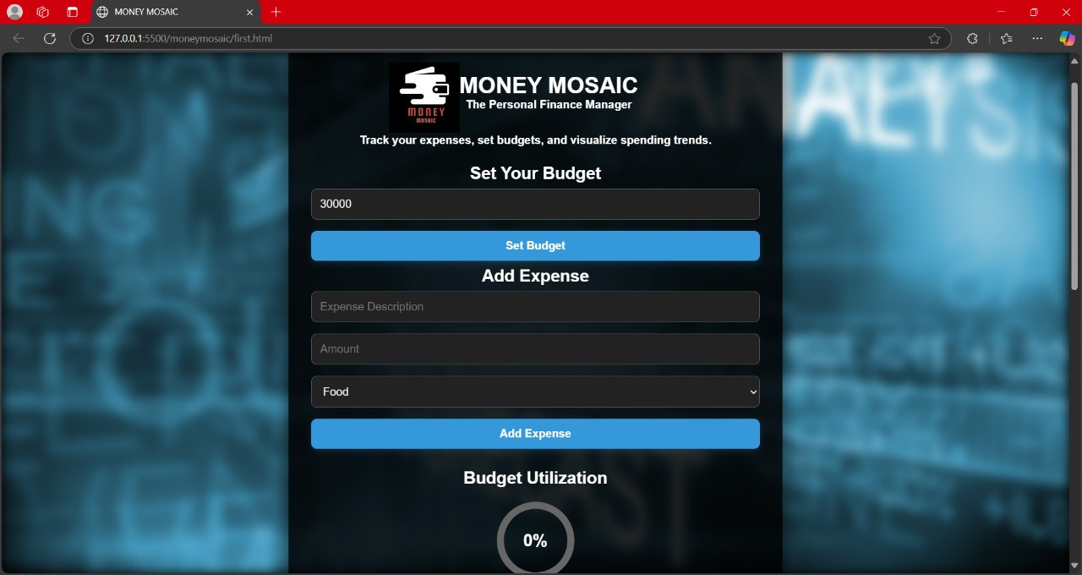
Idea/Approach Details
MONEYMOSAIC: PERSONAL FINANCE MANAGER
We’re building Money Mosaic — a simple, clean, and easy-to-use website for managing your personal finances.
Set monthly or yearly budgets.
Log your expenses by category.
Get visual charts that show how your money’s being used.
All in a lightweight and beginner-friendly interface.
Technology stack :
Frontend: HTML, JavaScript

Slide 3
Idea/Approach Details
Use Cases:
A student managing a tight monthly allowance.
A young professional trying to budget for rent, food, and fun.
Anyone looking to save better and spend more consciously.
Dependencies/ Show Stopper:
Making sure the data stays private and safe.
Creating a responsive design for all screen sizes.
Ensuring our website stays fast, even as features. grow

Slide 4
Team Member Details
Team Leader Name: Eshita Srivastava
Branch : Btech Stream : MAE Year : I
Team Member 1 Name: Ankit Mishra
Branch : Btech Stream : CSE Year : II
Team Member 2 Name: Deependra Pratap Shahi
Branch : Btech Stream : CSE Year : I
Team Member 3 Name: Satakshi Shukla
Branch : Btech Stream : CSE(IOT) Year : I

