Slide 1


Wumpus World: Logic and Strategy in an Uncertain Labyrinth
A V ESHWAR
K CHARAN VRNKATA KRISHNA
Guided By
GANESH RAMACHANDRAN
CSA0910
JAVA PROGRAMMING
192211123
192211133

Slide 2

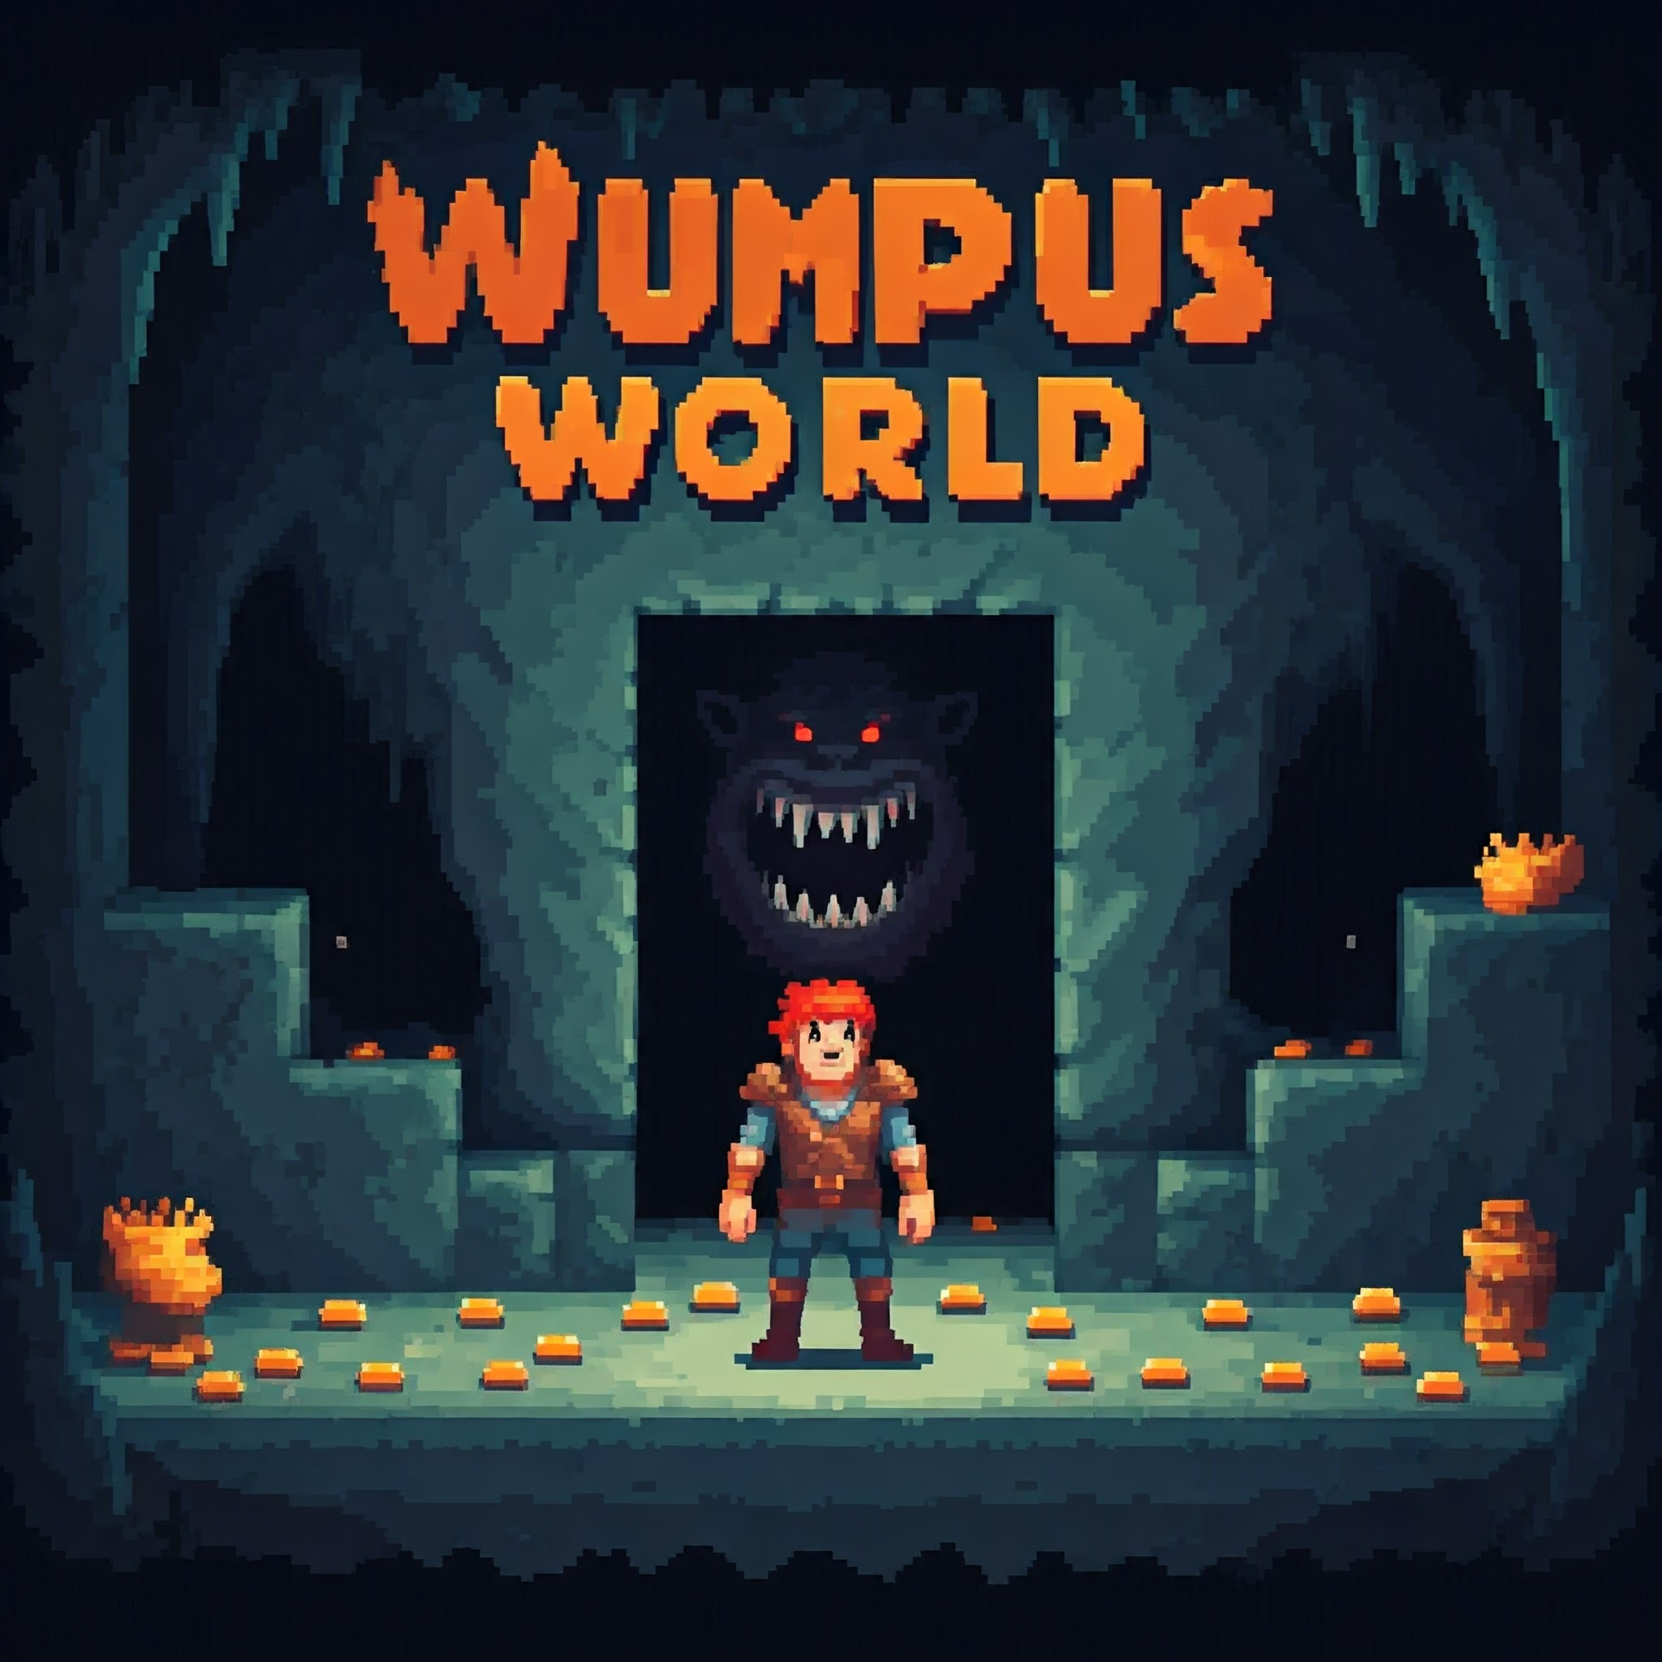
Abstract
Explores Wumpus World, a grid-based AI problem with hidden dangers
Develops logical reasoning and strategic decision-making algorithms
Investigates machine learning applications
Implements probabilistic inference for handling uncertainty
Investigates machine learning applications
Discusses real-world implications

Slide 3
Introduction
Agent must use logical reasoning to navigate with incomplete information
Implements advanced AI concepts like propositional logic and probabilistic reasoning
Strategic planning amidst unseen dangers
Visualizes agent's decision-making process in real-time
Bridging game theory and practical AI applications

Slide 4
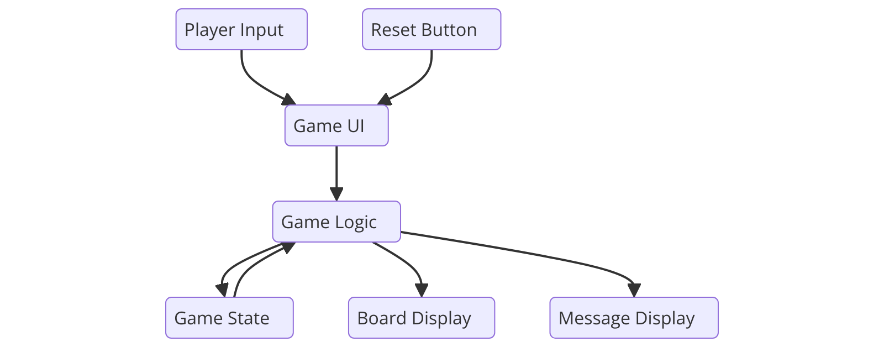
Architecture Diagram
key points describing the game structure shown in the diagram:
Player Input and Reset Button feed into the Game UI
2. Game UI communicates with Game Logic
3. Game Logic interacts with three components:
- Game State
- Board Display
- Message Display
4. The structure separates user interface, core game mechanics, and display elements
5. Arrows indicate the flow of data and control between components
6. The design allows for modular organization of game elements

Slide 5
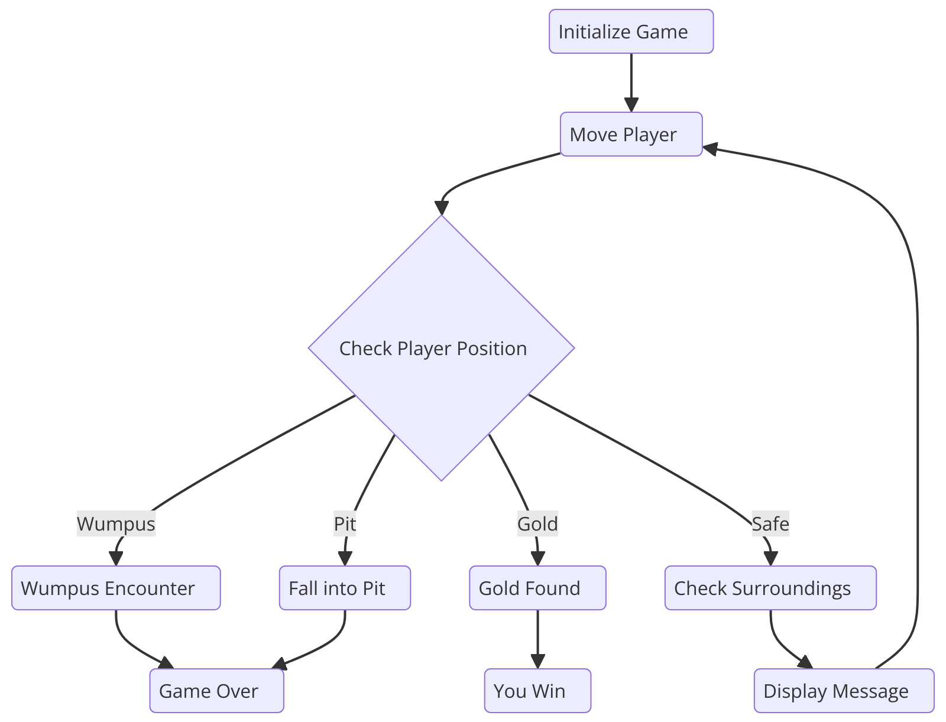
Flow Chart
1. The game starts with initialization.
2. Player movement is the core loop.
3. After each move, the player's position is checked.
4. Four possible outcomes of position check:
- Wumpus: Leads to Wumpus Encounter
- Pit: Results in falling into a pit
- Gold: Player finds gold and wins
- Safe: Surroundings are checked
5. Wumpus Encounter and falling into a pit both end the game.
6. Finding gold leads to a win condition.

Slide 6
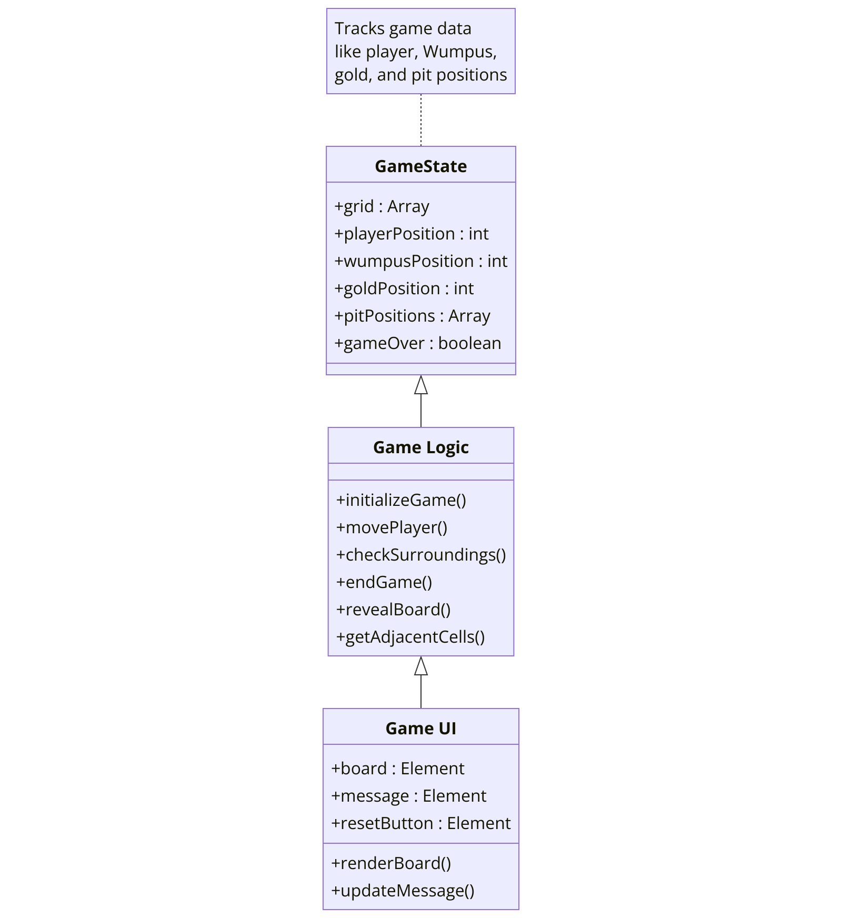
Class Diagram
GameState: Stores the current state of the game board, player, Wumpus, gold, and pit positions.Indicates whether the game is over.
GameLogic: Initializes the game by setting up the board and placing elements.Handles player movement and checks the surroundings for dangers and rewards.
Ends the game if the player wins or loses.Reveals the entire game board.Gets the adjacent cells to a given position.
GameUI: Represents the game board, messages, and a reset button.Renders the game board and updates the message displayed to the player.

Slide 7
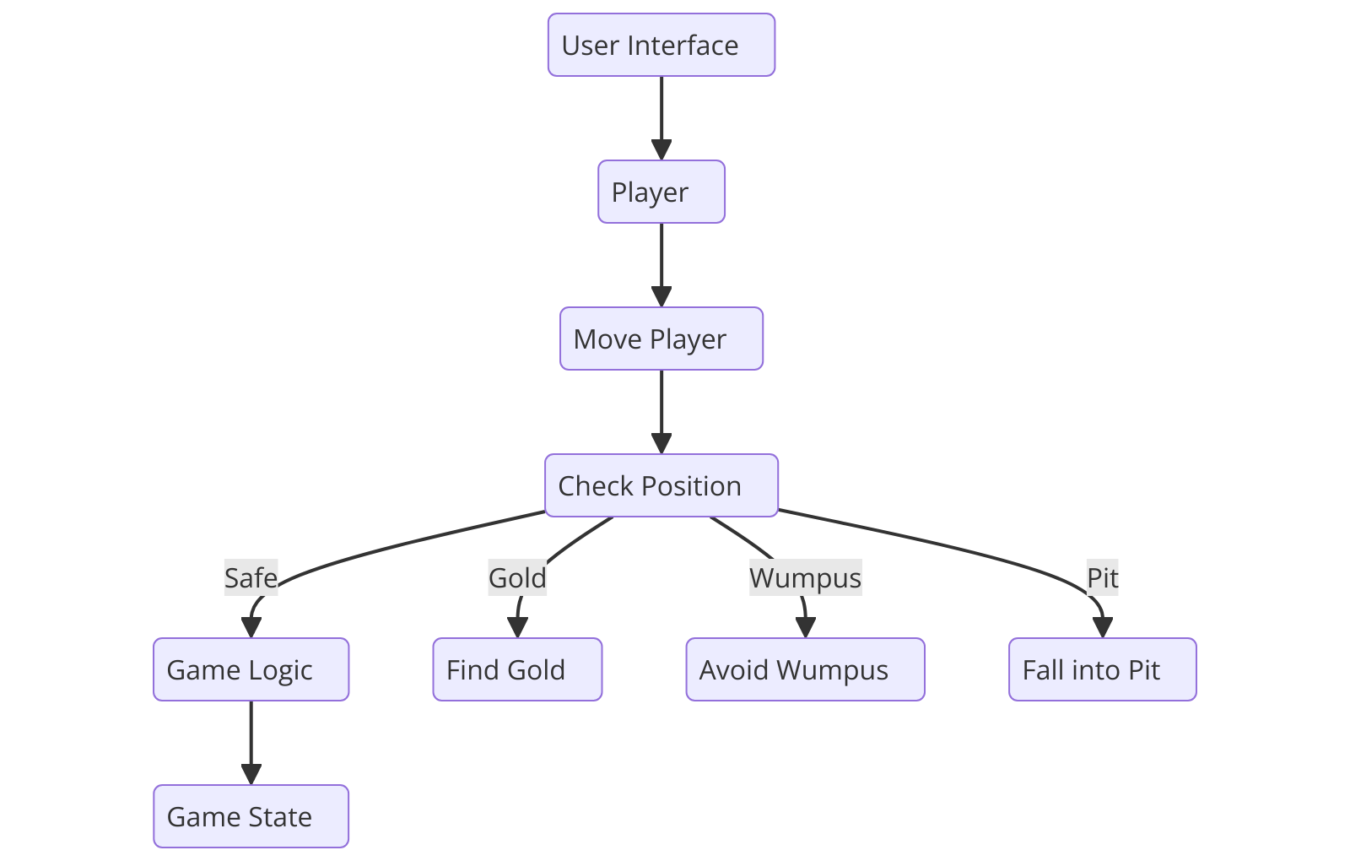
UML Chart
User Interface: Starts the game.
Player: Moves around the board.
Check Position: Determines the outcome based on the player's location.
Game State: Updates based on the outcome (win, lose, continue).
Wumpus: The game's antagonist, which moves around the board and attacks the player.
Pit: A dangerous location that can cause the player to fall and lose the game.
Gold: The objective of the game, which the player must collect to win.

Slide 8
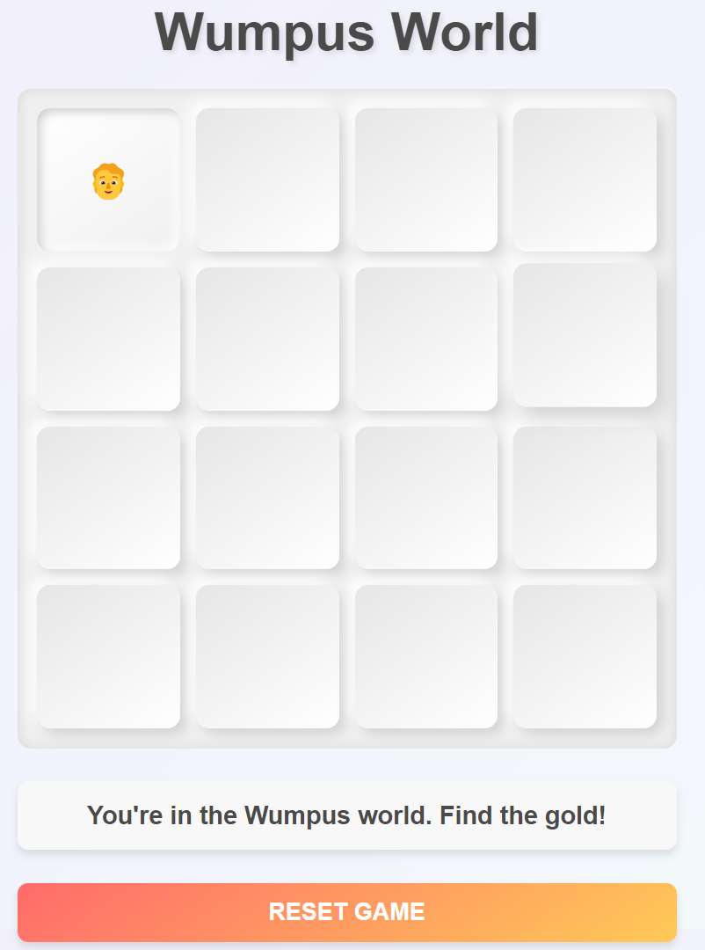

Result Screenshot
Game Interface

Slide 9
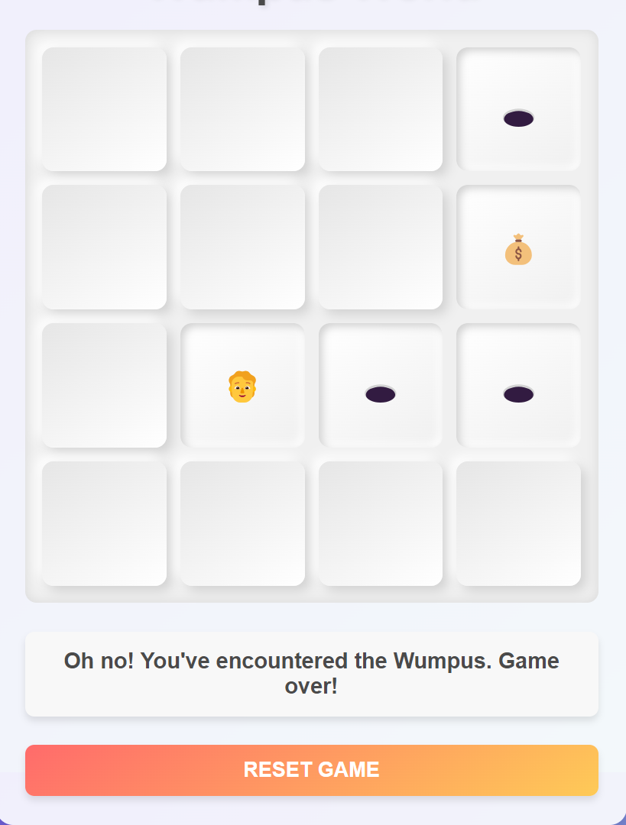
Result Screenshot
Encountered the WUMPUS !

Slide 10
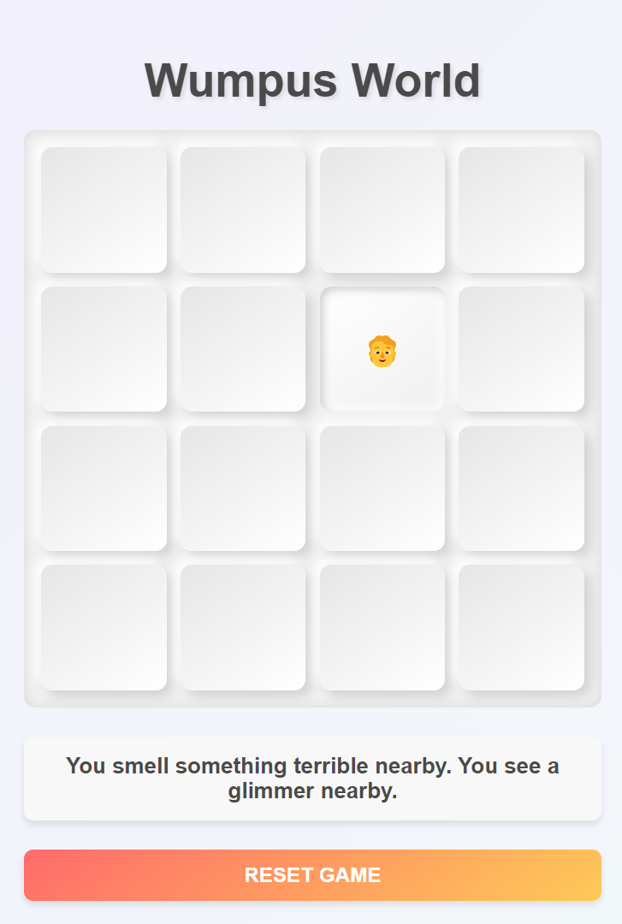
Result Screenshot
Terrible and Glimmer , Which means Both WUMPUS and GOLD are at adjacent .

Slide 11
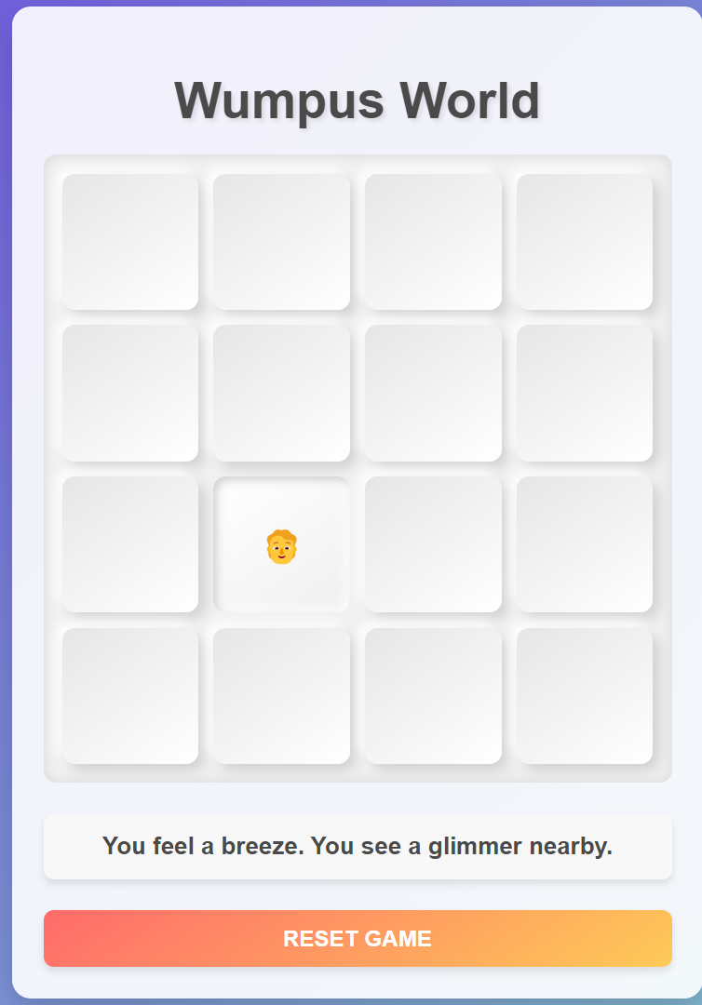
Result Screenshot
Feels Breeze and Glimmer , Which means Pits and Gold are right adjacent to the player !

Slide 12
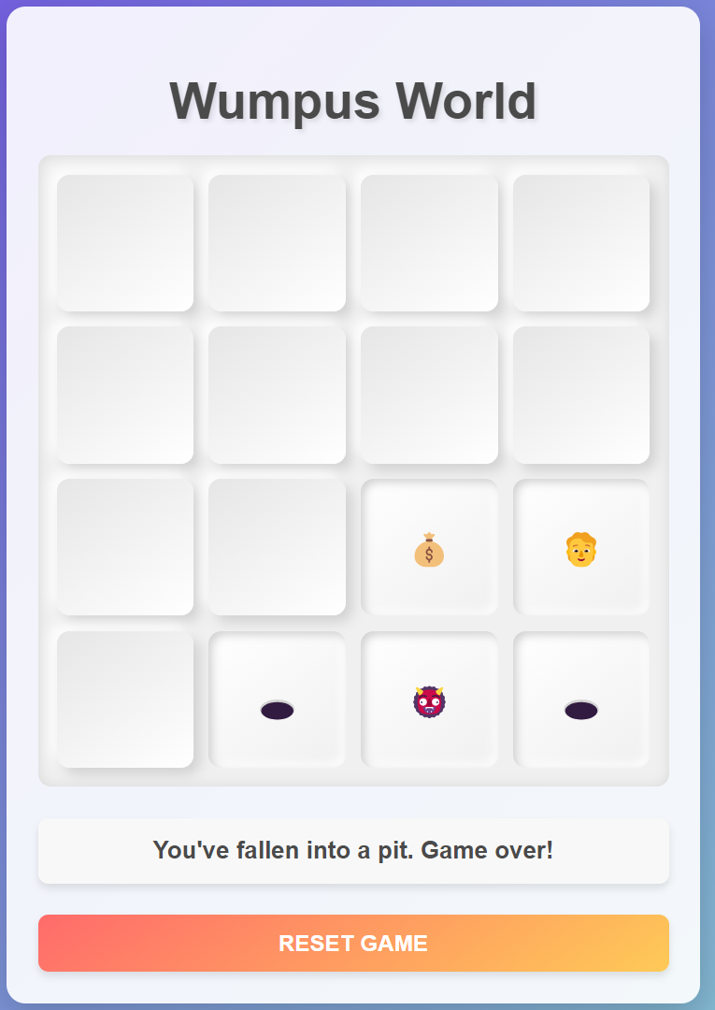
Result Screenshot
Ohh no !! Fell into a Pit !!

Slide 13
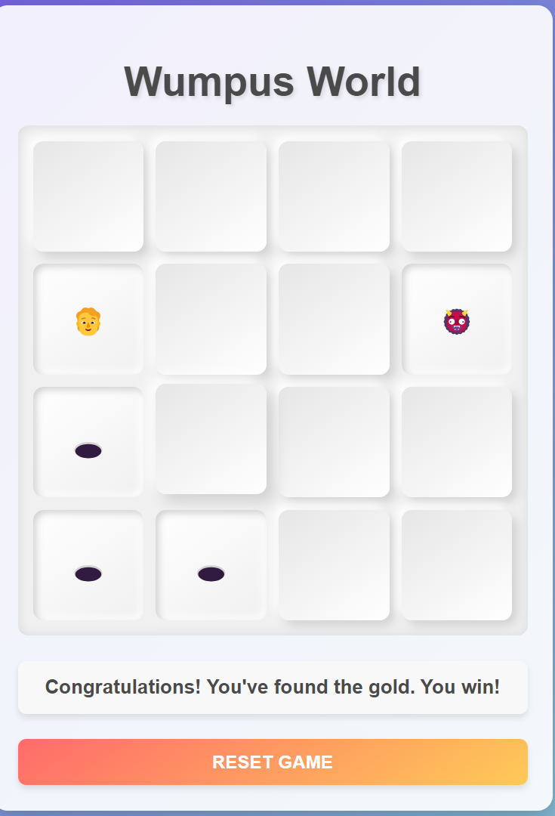
Result Screenshot
Congratulations you found the GOLD !!

Slide 14


Conclusion
This capstone project successfully developed the Wumpus World game in Java, providing a simulated environment for strategic decision-making.
The game features real-time logic and a user-friendly interface, demonstrating effective use of enterprise-level technologies.
By overcoming challenges in game logic and interface design, the project showcases the value of software development skills in creating practical applications.

