Slide 1
Handwritten Digit Recognition
By
M S Eshwar 20CSU057
Sirun 20CSU141
Shiven Arora 20CSU148
Mehul Raj Ratra 20CSU151

Slide 2
Introduction
Handwritten digit recognition is the ability of a computer to recognize the human handwritten digits from different sources like images, papers, touch screens, etc, and classify them into 10 predefined classes (0-9)

Slide 3
Problem Statement
The handwritten digit recognition is the capability of computer applications to recognize the human handwritten digits.
It is a hard task for the machine because handwritten digits are not perfect and can be made with many different shapes and sizes. It is a way to tackle this problem which uses the image of a digit and recognizes the digit present in the image.

Slide 4
Literature Survey
We referred to a research paper from S Pashine and learned about this problem.
We also referred different papers to understand various methods being used such as SVM, KNN etc.

Slide 5
Proposed Techniques
Convolutional neural network (CNN) - Convolutional neural network is a class of artificial neural network, most commonly applied to analyze visual imagery.
Support vector machine (SVM) - Support Vector Machine is a linear model for classification and regression problems
K-nearest neighbors (KNN) - K-nearest neighbors (KNN) algorithm uses 'feature similarity' to predict the values of new datapoints which will be assigned a value based on how closely it matches the points in the training set.

Slide 6
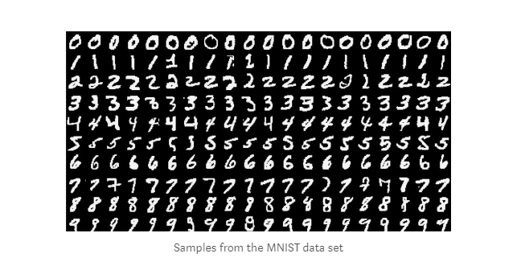
Dataset
The MNIST dataset is an acronym that stands for the Modified National Institute of Standards and Technology dataset. It is a dataset of 60,000 small square 28×28 pixel grayscale images of handwritten single digits between 0 and 9

Slide 7
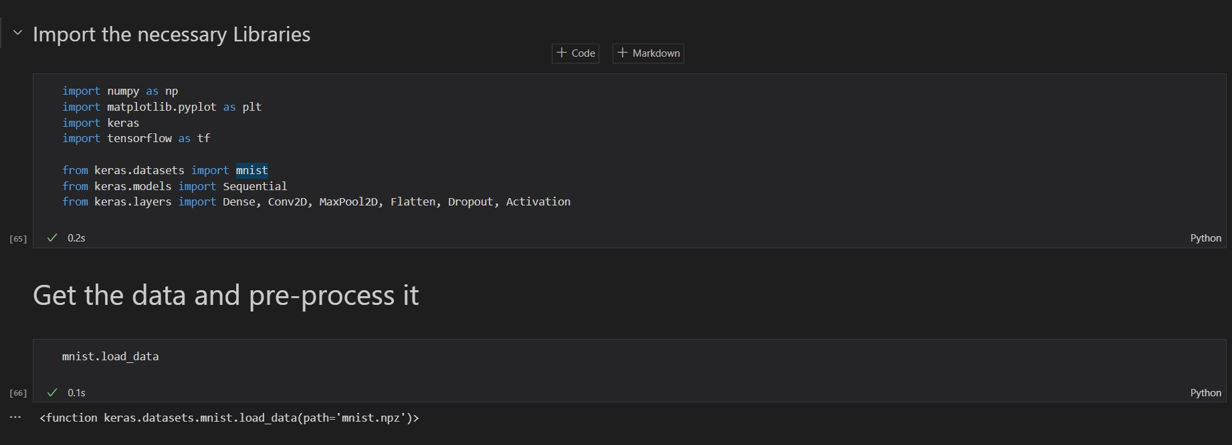
Procedure (Code)
We first import the necessary libraries such Numpy, Matplotlib, Keras, Tensorflow, Pygame
Loading the dataset

Slide 8
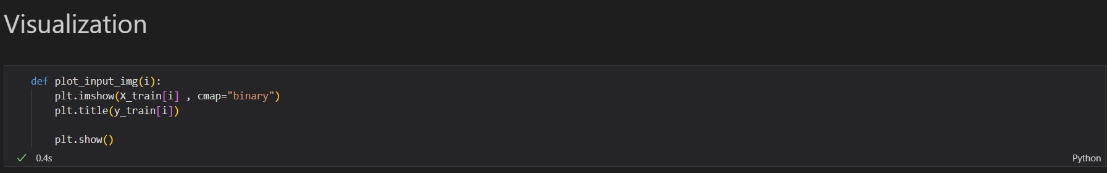
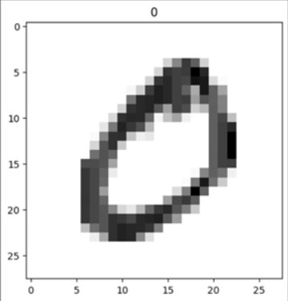
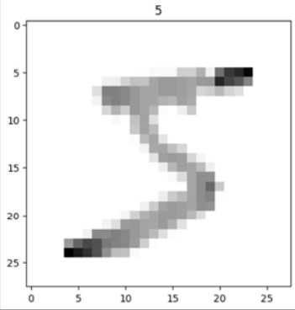
Code
Now we visualize our data and print some values

Slide 9
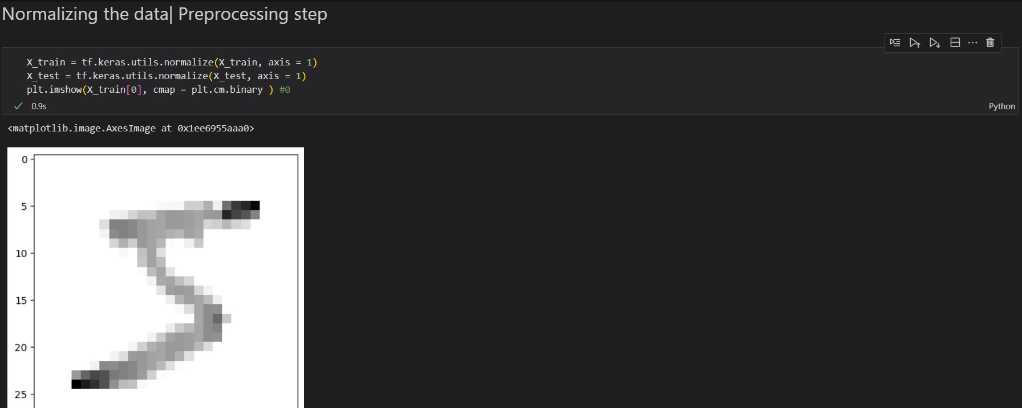
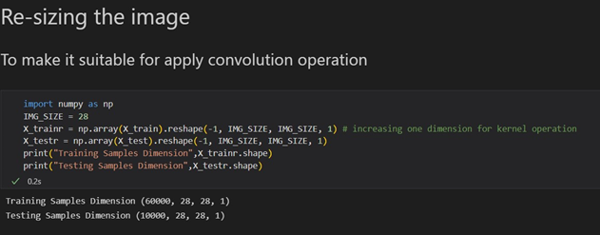
Code
Pre- Processing
Normalization
Re – Sizing the images

Slide 10
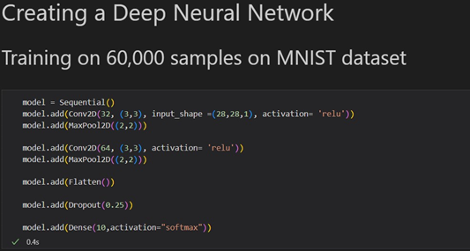
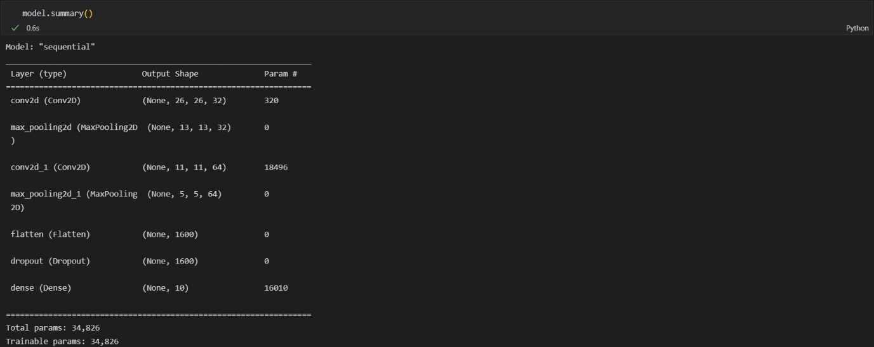
Code
Creating the model

Slide 11
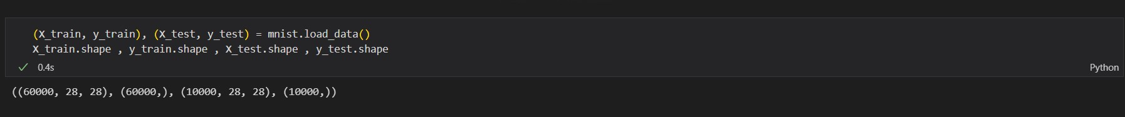
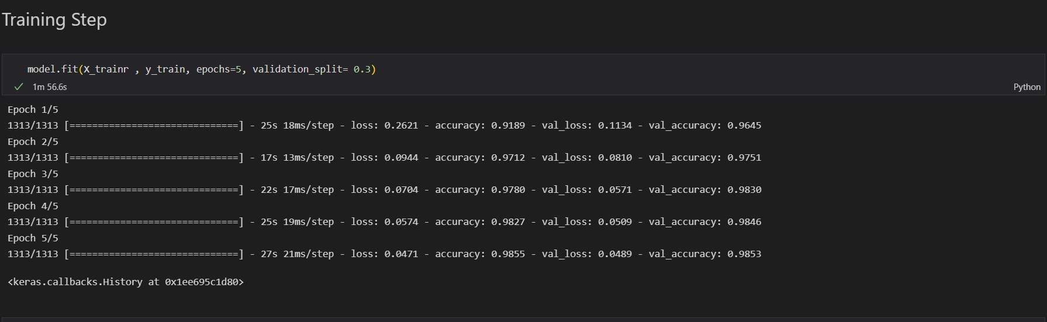
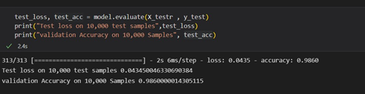
Code
Splitting the Dataset in Train and Test
Fitting the data in the model
Accuracy of the model

Slide 12
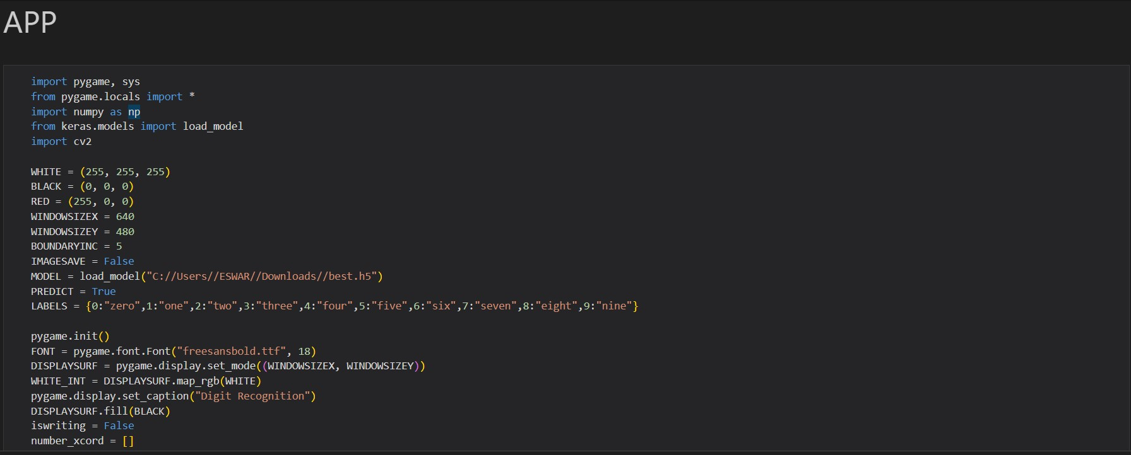
Code (Application)
We create an application to draw the digits , so that the model can recognize the digits.

Slide 13
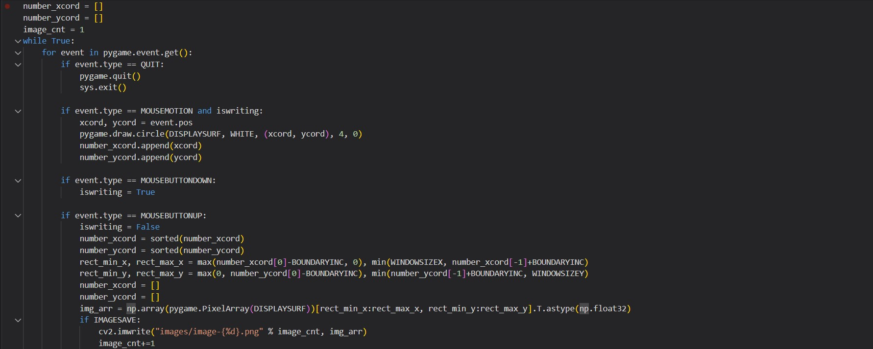
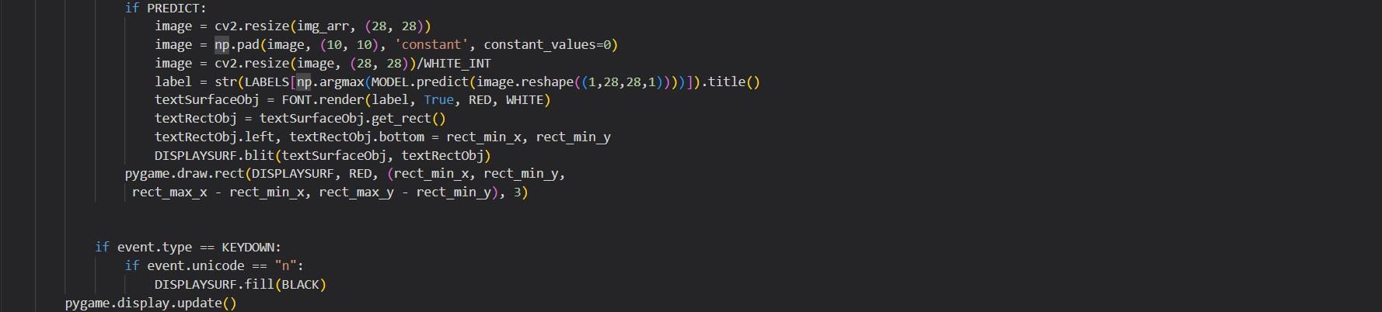
Code (Application)

Slide 14
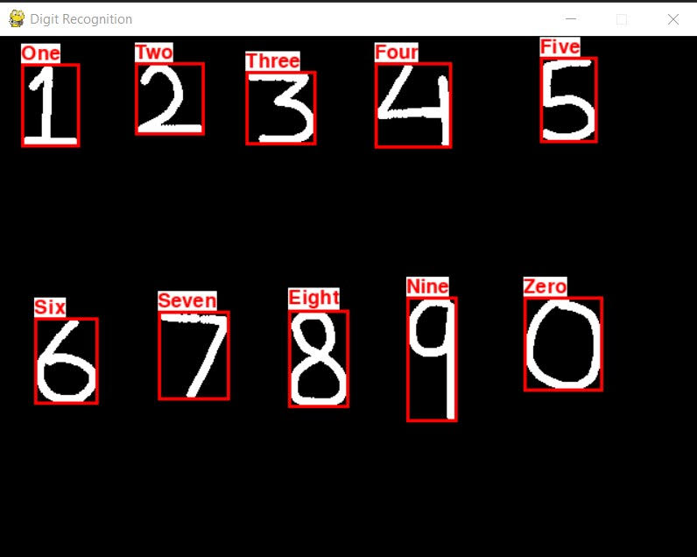
Output
The model recognizes the5 handwritten digits and display the number on top of it
Our model has an accuracy of 98.6%

Slide 15
Conclusion
The goal of a Handwriting Digit Recognition system is to convert handwritten digits into machine readable formats. The main objective of this work is to ensure effective and reliable approaches for recognition of handwritten digits and make banking operations easier and error free

Slide 16
Thank you

