Slide 1

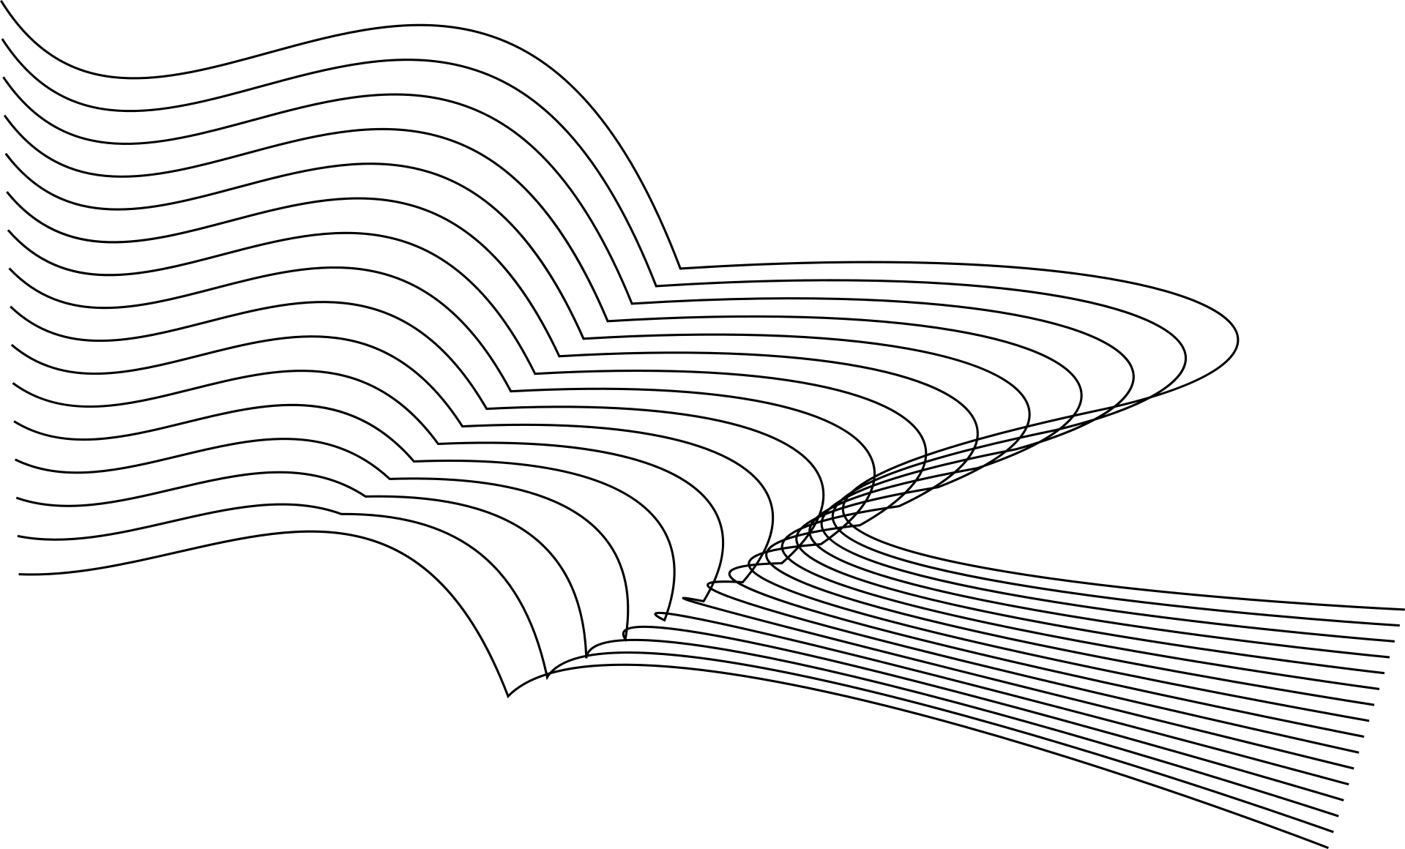
AN INTELLIGENT STROKE RISK PREDICTION AND LESION SEGMENTATION SYSTEM USING TRANSFORMER-RESNET FUSION OPTIMIZED BY AN IMPROVED SLIME MOULD ALGORITHM
Team Members
Naresh Kumar Sripada – Assistant Professor
Eshwar Nomula
Anjani Enumula
Hansika Vangari
Nagasri Pingili

Slide 2
INTRODUCTION
Stroke is one of the leading causes of death and disability worldwide.
Early detection can save lives and reduce long-term complications.
Existing systems use only clinical data or imaging data, reducing accuracy.
Our invention combines both clinical data + medical images for better prediction.
Uses Transformer + ResNet + Improved Slime Mould Algorithm for intelligent diagnosis.
01

Slide 3
OBJECTIVES
Predict stroke risk at an early stage.
Segment lesion areas accurately from medical images.
Combine multi-modal data for improved performance.
Optimize model parameters automatically.
Support hospitals and doctors in decision-making.
Reduce diagnosis time and increase accuracy.

Slide 4
STAKEHOLDER
PRIMARY USERS
BENEFICIARIES
HOSPITALS
DIAGNOSTIC CENTERS
NEUROLOGISTS
RADIOLOGISTS
TELEMEDICINE PLATFORMS
STROKE PATIENTS
ELDERLY PEOPLE
HIGH-RISK INDIVIDUALS
HEALTHCARE RESEARCHERS

Slide 5
PROGRAMMING LANGUAGES, TOOLS & SOFTWARE
PROGRAMMING LANGUAGES
SOFTWARE TOOLS
PYTHON
SQL (FOR DATA HANDLING)
JUPYTER NOTEBOOK
GOOGLE COLAB
VS CODE
POWERPOINT
LIBRARIES / FRAMEWORKS
TENSORFLOW
PYTORCH
OPENCV
NUMPY
PANDAS
MATPLOTLIB
DATASET SOURCES
PUBLIC MEDICAL DATASETS
ECHOCARDIOGRAM & CLINICAL DATA

Slide 6
PROMPTS USED TO GENERATE CODES
CONSIDER ECHONETLVH DATASET GENERATE CODE FOR THE PATENT “AN INTELLIGENT STROKE RISK PREDICTION
AND LESION SEGMENTATION SYSTEM USING TRANSFORMER-RESNET FUSION OPTIMIZED BY AN IMPROVED
SLIME MOULD ALGORITHM” ALSO GENERATE SIMULATED RESULTS

Slide 7
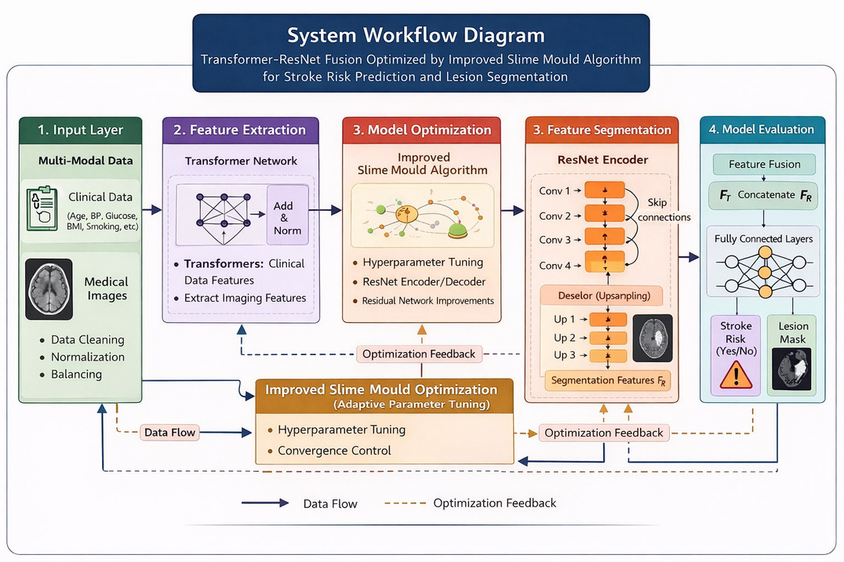
FLOWCHART OF WORKFLOW

Slide 8
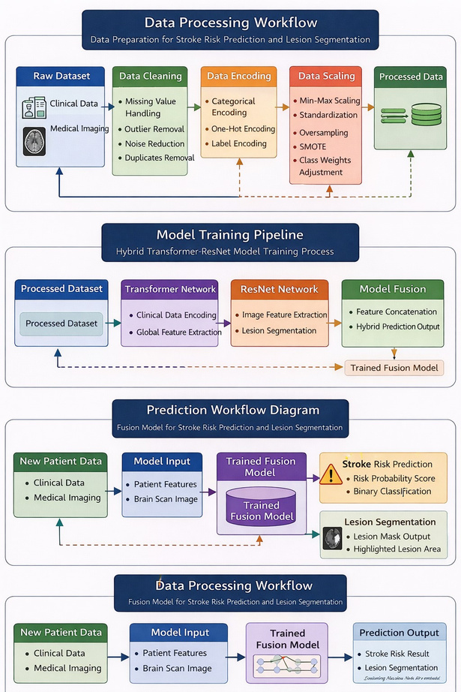

Slide 9
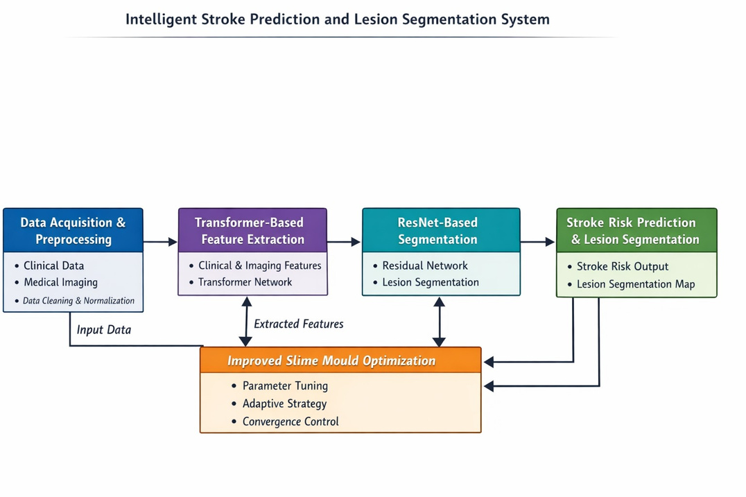

Slide 10
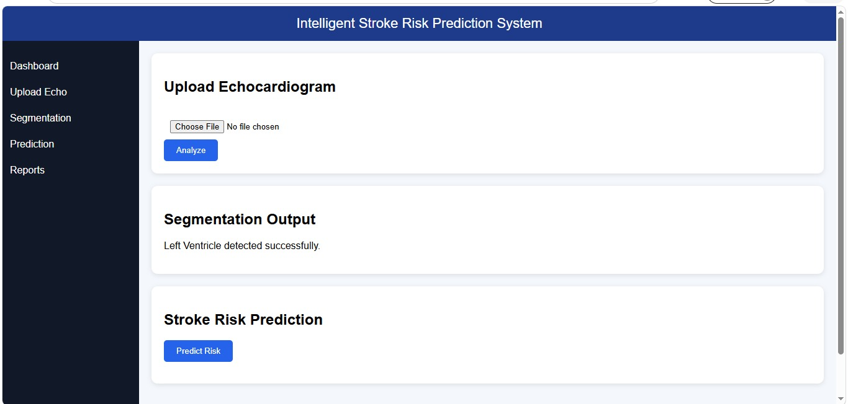
FRONT-END VIEW OF WEB/MOBILE APPLICATION
07

Slide 11
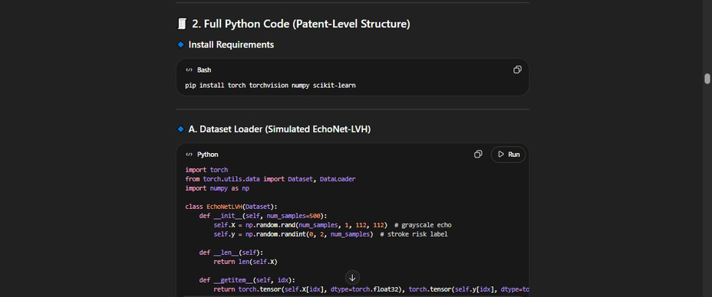
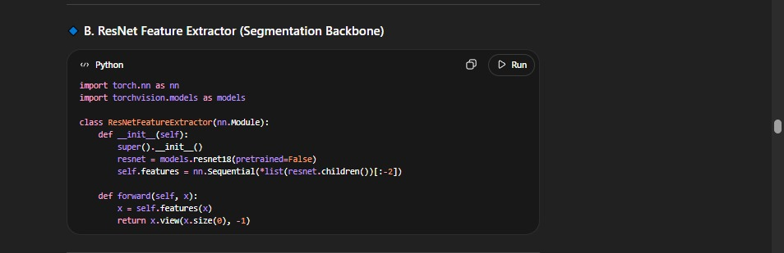
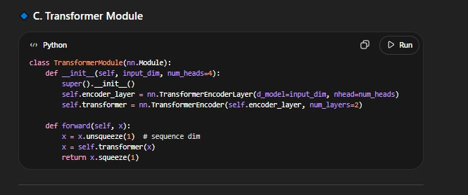
PROOF OF PROMPTS GENERATING CODES

Slide 12
REFERENCES
WHO STROKE REPORTS
TENSORFLOW OFFICIAL DOCUMENTATION
PYTORCH DOCUMENTATION
RESEARCH PAPERS ON STROKE PREDICTION
TRANSFORMER NEURAL NETWORKS PAPERS
RESNET RESEARCH PAPER
SLIME MOULD OPTIMIZATION RESEARCH PAPERS
PUBLIC MEDICAL DATASETS (KAGGLE / UCI / NIH)
09

Slide 13
THANK YOU

