Slide 1





GROUP 1 · FINAL PROJECT
INSURANCE
ANALYTICS
DASHBOARD
Business Insights | Root Cause Analysis | Client Recommendations
TECHNOLOGIES USED
SQL
Excel
Tableau
Power BI
Notes:
Cover: Insurance Analytics Dashboard. Group 1. Tools used: SQL, Excel, Tableau and Power BI.

Slide 2
Group Members
TEAM
Group 1 — the team behind the Insurance Analytics project
AP
Ashwini Swapnil Patil
RK
Ramesh Kambala
CS
Chethan Sai Kumar
PR
Prajakta Nandkumar Randhir
BP
Banavath Pradeep Naik
SS
Sudheer Sripati
Notes:
Group 1 members: Ashwini Swapnil Patil, Ramesh Kambala, Chethan Sai Kumar, Prajakta Nandkumar Randhir, Banavath Pradeep Naik, Sudheer Sripati.

Slide 3



Executive Summary
EXECUTIVE SUMMARY
A portfolio overview and a set of actions to improve retention and decision-making.
5,000
5,000
251.4M
254.56K
Total customers
Total policies
Total claim amount
Average coverage amount
MAIN SIGNAL
Active policies
The dashboard shows 33.64% active and 66.36% inactive policies. This is the clearest area to investigate first.
33.64%
POLICIES
5,000
Inactive policies
BUSINESS FOCUS
66.36%
Investigate lapse and payment reasons, validate premium growth calculations, and compare claim performance by policy type.
Notes:
Key KPIs: 5,000 customers, 5,000 policies, total claim amount 251.4M, average coverage amount 254.56K. 33.64% of policies are active and 66.36% inactive; this is the first area to investigate.

Slide 4
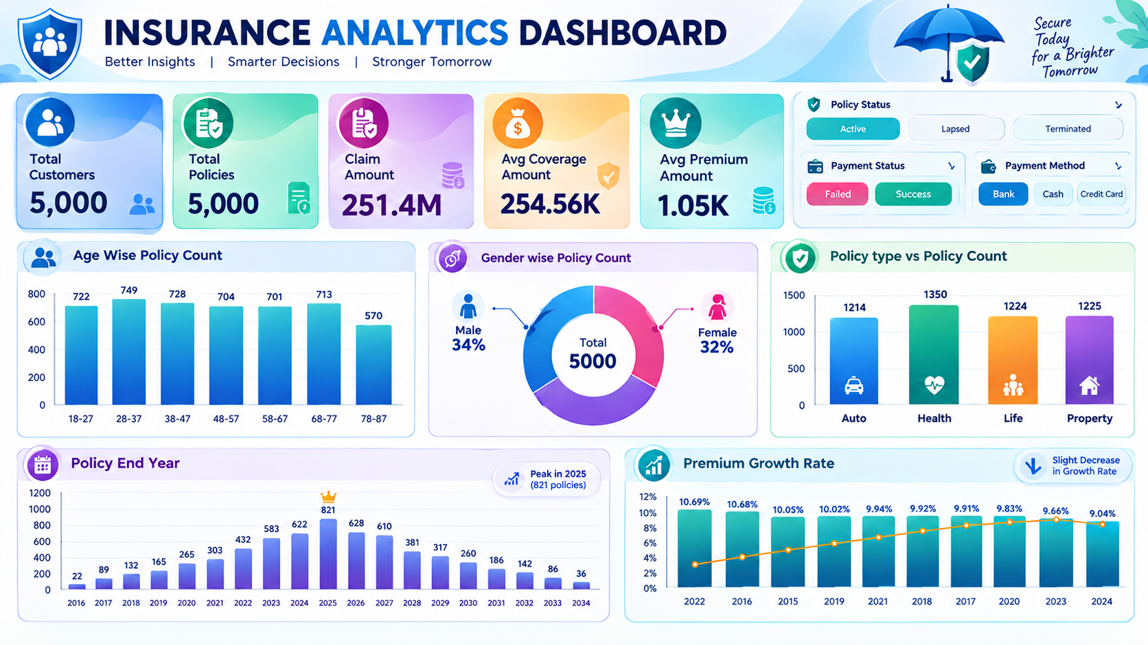
Insurance Analytics Dashboard
DASHBOARD
The dashboard snapshot used for the analysis.
WHAT IT SHOWS
KPI cards
Age, gender and policy-type views
Policy end year
Premium growth rate
Filters: policy status, payment status, payment method
Notes:
This is the actual Power BI / dashboard snapshot used for the analysis. All findings in the following slides are read from this dashboard.

Slide 5





Key Findings from the Dashboard
FINDINGS
What the current visuals indicate — observations, not proven causes.
Policy status
Policy mix
Premium growth
Auto
1,214
10.69% → 9.04%
Health
1,350
Active 33.64%
Inactive 66.36%
Life
1,224
Needs validation: displayed PGR values; check year order and calculation.
Share of policies by status
Property
1,225
Health is highest (about 1,350)
Claims
Customer segments
Payments
≈ 251.4M
Age · Gender
Success · Failed
Total claim amount; segment-level analysis is needed to interpret it.
Visuals show portfolio distribution, not retention or profitability by segment.
Both statuses are available for follow-up analysis.
Notes:
Observations from the dashboard only. Premium Growth Rate values (about 10.69% to 9.04%) still need validation of the calculation and year order. Policy type counts are as displayed on the dashboard.

Slide 6


Root Cause Analysis: What to Investigate
ROOT CAUSE ANALYSIS
Observed issue → what to investigate → business question. Causes are not yet verified.
OBSERVED ISSUE
WHAT TO INVESTIGATE
BUSINESS QUESTION
High inactive share
›
66.36% of policies are inactive; reasons not yet known
›
Lapse reasons, expiry dates, renewal history, contact outcomes
›
Why are so many policies inactive, and which can be recovered?
Payment failures
›
Failed and successful payments are both recorded
›
Failures by payment method, date, retry and policy status
›
Do payment failures contribute to lapses?
Premium growth movement
›
PGR shows 10.69% to 9.04%; year order is unclear
›
Year sorting, formula logic, new business vs renewals, policy mix
›
Is growth truly slowing, or is it a calculation issue?
Claim amount patterns
›
Total claims ≈ 251.4M; no policy-type breakdown yet
›
Claim frequency and average claim by policy type, region, period
›
Which policy types drive claim cost relative to premium?
Notes:
Four areas to investigate. These are hypotheses to test with data, not verified root causes.

Slide 7




Recommendations to the Client
RECOMMENDATIONS
Four actions to test and measure, based on the dashboard findings.
1. Improve retention
2. Reduce payment friction
Send renewal reminders before expiry; contact lapsed customers and record the reason for non-renewal.
Notify customers of failed payments, enable retries and provide clear alternative payment options.
3. Improve portfolio performance
4. Make marketing more targeted
Compare claim-to-premium ratios, average claim costs and policy counts by product before changing strategy.
Use age group, gender and policy preference alongside renewal and profitability data to design campaigns.
TRACK
MONTHLY
Renewal rate
Lapse rate
Payment success rate
Premium growth
Claim-to-premium ratio
Notes:
Recommendations: improve retention, reduce payment friction, improve portfolio performance, make marketing more targeted. Track renewal rate, lapse rate, payment success rate, premium growth and claim-to-premium ratio monthly.

Slide 8






Difficulties Faced and How I Addressed Them
CHALLENGES
Project challenges and the approach taken for each.
CHALLENGE
CHALLENGE
CHALLENGE
Data cleaning
Data import and connectivity
Data modeling
HOW I ADDRESSED IT
HOW I ADDRESSED IT
HOW I ADDRESSED IT
Standardized column names and checked formats and missing values.
Worked through Excel-to-MySQL import and connector setup issues.
Reviewed table names, columns and relationships to support reliable analysis.
CHALLENGE
CHALLENGE
CHALLENGE
KPI calculations
Dashboard design
Validation and interpretation
HOW I ADDRESSED IT
HOW I ADDRESSED IT
HOW I ADDRESSED IT
Checked formulas and field selection for counts, averages and Premium Growth Rate.
Arranged KPI cards, charts and filters for a clear visual layout.
Compared visual results with business questions and identified where more data was needed.
Notes:
Six challenges: data cleaning, import and connectivity, data modeling, KPI calculations, dashboard design, validation and interpretation.

Slide 9
Suggested Action Plan
ACTION PLAN
A four-step roadmap from validation to measured impact.
01
02
03
04
Validate data
Find drivers
Pilot actions
Measure impact
Confirm definitions for inactive policy, premium growth and claim amount.
Analyze lapse reasons, payment failures, renewal history and product-level claims.
Test renewal reminders and failed-payment follow-ups with a defined customer group.
Compare renewal, payment success, premium growth and claim metrics before and after.
SUCCESS
MEASURES
Higher renewal rate
Fewer avoidable lapses
Improved payment success
More reliable portfolio reporting
Notes:
Roadmap: validate data, find drivers, pilot actions, measure impact. Success means higher renewal rate, fewer avoidable lapses, improved payment success and more reliable portfolio reporting.

Slide 10




Conclusion
CONCLUSION
Turn dashboard
insights into
measurable action.
01
Understand the high inactive-policy share
02
Validate premium growth calculations
The first priority is to understand the high inactive-policy share. Next, validate premium growth trends and investigate claim patterns at policy-type level. Recommendations should be tested and measured using reliable source data.
03
Investigate claim patterns by policy type
04
Test recommendations and measure the results
Notes:
Four priorities: understand the inactive-policy share, validate premium growth, investigate claim patterns by policy type, and test recommendations with measurement.

Slide 11
THANK YOU
Insurance Analytics Dashboard
GROUP 1

