Slide 1
Conversational Question Answering (CoQA)
Final Presentation
Date: 05/05/2021
Course: NLP & Text Mining (CSE-635)
Professor: Dr. Rohini K Srihari
TA: Sougata Saha, Souvik Das
Team Name: Alpha-Targaryen
Rahul Patil
Eshwar N Kumar
Soumith Reddy Chinthalapally

Slide 2

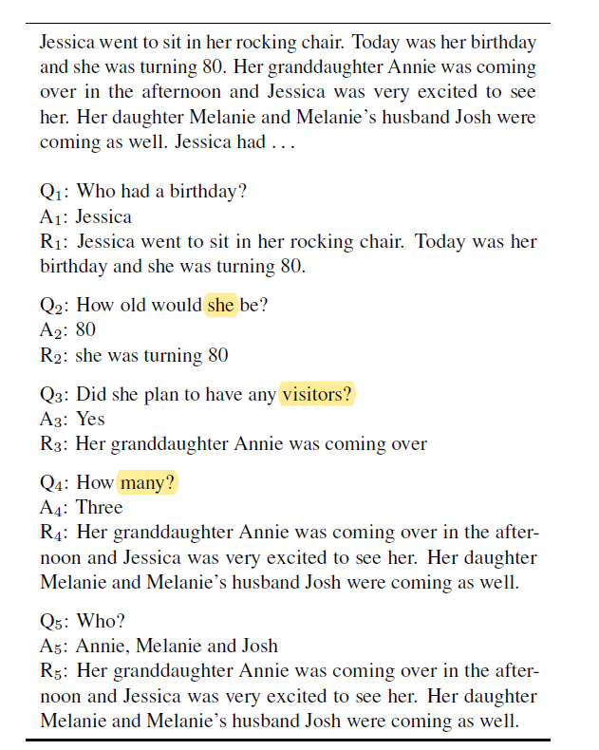
What is CoQA?
A chatbot that understands a text passage and provides natural form answers to questions asked to it in conversational format. Below are the three main project objectives/features to be implemented:
Each question after the first is dependent on the conversation history. In addition, the conversation will have two annotators in which the chatbot will act as a second annotator/answerer.
Ensure the presence of naturalness of the conversation with coreferences. The answers must be free form text which is modified version of the text span obtained from the passage(which is quoted as proof for the answer).
The conversation system must work across domains like the field of literature, medicine, science, news, etc.

Slide 3
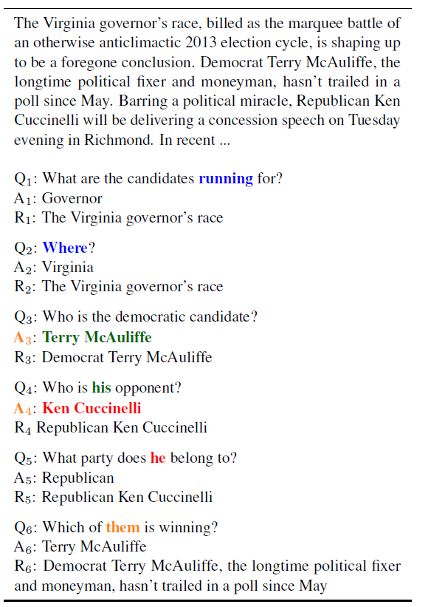
Problem Statement
A passage is given as input to a chatbot(CoQA) which must analyze the passage and provide answers to questions asked to it in the form of a conversation.
It must also provide the part of the passage from which the answer can be inferred as a rationale.

Slide 4
Literature Review
Document Reader Question Answering(DrQA)
Uses Bigram Hashing and tf-idf to efficiently return subset of articles from the Wikipedia data store. Then it uses RNN to detect answer spans – Applicable for Wikipedia articles only, no coreference and natural form in answers
A simple but effective way to implement multi-turn context with BERT for Conversational Machine Comprehension
BERT(for contextual encoding previous questions, previous answers and current question) + softmax(to find the start and end index of the answer span) – No coreference and natural form in answers
Stanford Question Answering Dataset (SQuaD)
Have all features of CoQA except that free-form nature of answers and coreferencing are absent
GraphFlow: Exploiting Conversation Flow with Graph Neural Networks for Conversational Machine Comprehension
Use Graphical Neural Network Mechanism to process the paragraph over the traditional Integration Flow(IF) mechanism. Handles the case of abstractive answers in the passage

Slide 5
Dataset
The training and test data sets are available in the official website of CoQA (https://stanfordnlp.github.io/coqa/)
Training dataset & Test dataset details:
Story, filename, file_id, source
Questions: question, turn_id
Answers: span_start, span_end, span_text, turn_id, input_text(answer)
Evaluation Methodology
Similar to evaluation methodologies used by the submissions discussed in the literature survey, the evaluation metric used for this project will also be F1 score of word overlap in each question answer pair for each individual domain such as news articles, History, Medicine, Science articles, Fiction, etc.

Slide 6
Data Preprocessing
We start by building a DataFrame for the training and validation data and normalizing the strings.
We then tokenize the words and create context ids for each word in the context. We do the same for questions and answers.
We create a vocabulary set, character set using the words in the context and the questions.
Additionally, using ID as identifier, we append question to the context based on turn IDs.
We use the same data twice, as for DrQA model, we are using the start span and end span as target variables and for Seq-to-seq model we are using the answer span and the input text as input and target variables.

Slide 7
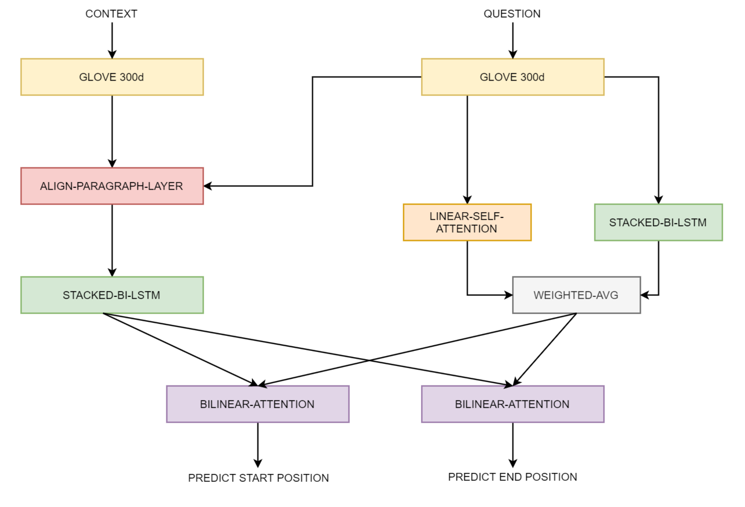
Architecture
We use a part of DrQA model, implemented by Facebook for Question Answering based on the information from Wikipedia.
Before passing the inputs to the model, we use GloVe word vectors to convert the tokens to word embeddings for the model to learn text where the words have a similar representation.
We then use aligned question embedding function on context and questions with which the attention score is calculated to capture the similarity between the paragraph and the questions. This enables the model to understand what portion of the context is more relevant to the question.

Slide 8
DRQA Continued….
The paragraph encoding is then passed to a multilayer bidirectional LSTM. This enables the model to retain the history of questions and answers while answering the present question
The output of the LSTM network is passed through attention layers. The attention layer calculates the weighted sum of the relevance of the given question to the span in the context
The output of the network is the span of tokens that are most likely to be correct
We use two attention layers separately to predict each token to be start and end tokens. Then the start and end span is chosen such that their probabilities are maximized

Slide 9
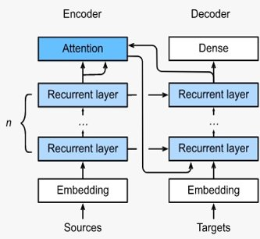
Seq-to-Seq Model
We use the Seq-to-Seq model to generate answer from the text span.
Encoder is a RNN that outputs some value for every word in input sentence. For every input word, the encoder outputs a vector and a hidden state. The hidden state is used along with the next input word.
Decoder takes the context vector as the input to the first decoder unit. Then, the output of every decoder is taken as input to the next decoder unit to produce one sentence.
Attention helps decoder to choose the right output word and to focus only on a specific range in input sequence.
Teacher Forcing: We use real target outputs as each next input instead of using decoder's guess as the next input.

Slide 10
Results
Baseline Model Result
Data Set | In Domain |  |  |  |  | Out Domain |  | Overall |  | Overall
 | Children Stories | Literature | Mid High School | News | Wikipedia | Reddit | Science | In Domain | Out Domain
Dev Data Set | 11.3 | 8.1 | 10.3 | 9.4 | 11.2 | 0.0 | 0.0 | 10.0 | 0.0 | 10.0
Final Model Result
Data Set | In Domain |  |  |  |  | Out Domain |  | Overall |  | Overall
 | Children Stories | Literature | Mid High School | News | Wikipedia | Reddit | Science | In Domain | Out Domain
Dev Data Set | 19.5 | 14.7 | 19.1 | 17.9 | 19.2 | 0.0 | 0.0 | 18.0 | 0.0 | 18.0

Slide 11
Error Analysis
We tried different hyperparameters but the one for which we got the best F1 score is with dropout rate of 0.4 with 3 hidden layers. Some findings and shortfalls are as below:
The model dropped the questions for which the span text in None or missing.
The ineffectiveness of our model to be able to generate Yes/No for the given answer span since for the input is span text from the context, and the label for training is the generated answer for the seq2seq model.
Absence of naturalness in the output of seq2seq model due to which the actual output has a greater number of words when compared to that of expected output.
The model is misinterpreting some questions and returning the closest answer to the question rather than returning what is asked.

Slide 12
Examples
Question: "Was cotton happy that she looked different than the rest of her family?",
Our Model Answer: "She often wished she looked like the rest of her family"
CoQA Answer: "no",
Question : "What color were her sisters?",
Our Model Answer: "mommy and 5 other sisters . All of her sisters were cute and fluffy , like Cotton . But she was the only white one in the bunch . The rest of her sisters were all orange"
CoQA Answer: "orange and white",
Question : "Did they want Cotton to change the color of her fur?",
Our Model Answer : "I only wanted to be more like you" . Cotton 's mommy rubbed her face on Cotton 's and said" Oh Cotton , but your fur is so pretty and special , like you . We would never want you to be any other way" . And with that , Cotton 's mommy picked her up and dropped her into a big bucket of water . When Cotton came out she was herself again . Her sisters licked her face until Cotton 's fur was all all dry . " Do n't ever do that again , Cotton !" they all cried . " Next time you might mess up that pretty white fur of yours and we would n't want that"
CoQA Answer: "no"

Slide 13
Conclusion
The model designed here works good for datasets where the emphasis is greater on the retrieval of text from the given context rather than on the generation of answers.
With more upcoming deep learning models like transformers which are trained on millions of parameters, the accuracy of the model can be greatly increased.
There can be a more precise model than a seq2seq model like Match-LSTM network or a Pointer-Generator Network which can be embedded into the layers of the main DrQA model for more precise sentence generation.
The computational requirement of deeper networks was a constraint we faced during the implementation of these models, which can be improved upon.

Slide 14
Questions & Feedback?

Slide 15
Thank You

