Slide 1
Conversational Question Answering (CoQA)
Milestone-1
Date: 3/5/2021
Course: NLP & Text Mining (CSE-635)
Professor: Dr. Rohini K Srihari
TA: Sougata Saha, Souvik Das
Team Name: Targaryen
Team Member: Eshwar N Kumar (eshwarna)

Slide 2

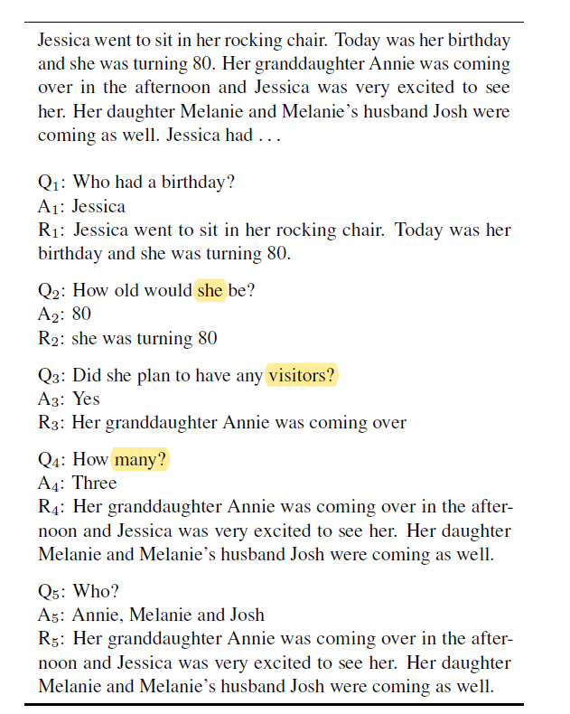
What is CoQA?
A chatbot that understands a text passage and provides natural form answers to questions asked to it in conversational format. Below are the three main project objectives/features to be implemented:
Each question after the first is dependent on the conversation history. In addition, the conversation will have two annotators in which the chatbot will act as a second annotator/answerer.
Ensure the presence of naturalness of the conversation with coreferences. The answers must be free form text which is modified version of the text span obtained from the passage(which is quoted as proof for the answer).
The conversation system must work across domains like the field of literature, medicine, science, news, etc.

Slide 3
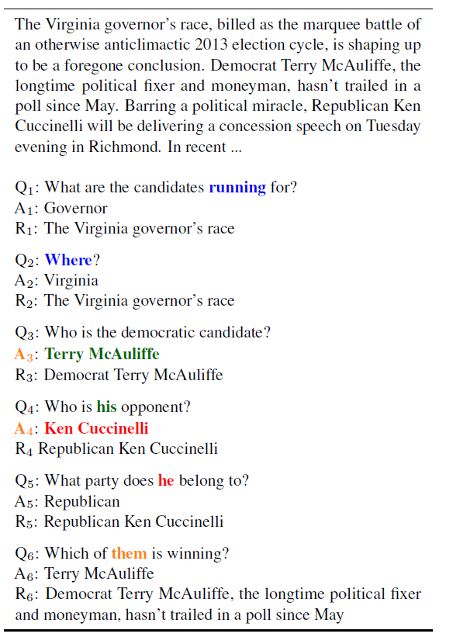
Problem Statement
A passage is given as input to a chatbot(CoQA) which must analyze the passage and provide answers to questions asked to in the form of a conversation.
It must also provide the part of the passage from which the answer can be inferred as a rationale.

Slide 4
Literature Review
Document Reader Question Answering(DrQA)
Uses Bigram Hashing and tf-idf to efficiently return subset of articles from the Wikipedia data store. Then it uses RNN to detect answer spans – Applicable for Wikipedia articles only, no coreference and natural form in answers.
A simple but effective way to implement multi-turn context with BERT for Conversational Machine Comprehension
BERT(for contextual encoding previous questions, previous answers and current question) + softmax(to find the start and end index of the answer span) – No coreference and natural form in answers.
Standford Question Answering Dataset (SQuaD)
Have all features of CoQA except that free-form nature of answers and coreferencing are absent.
GraphFlow: Exploiting Conversation Flow with Graph Neural Networks for Conversational Machine Comprehension
Use Graphical Neural Network Mechanism to process the paragraph over the traditional Integration Flow(IF) mechanism. Handles the case of abstractive answers in the passage.

Slide 5
DataSet
The training and test data sets are available in the official website of CoQA (https://stanfordnlp.github.io/coqa/)
Training dataset & Test dataset details:
Contents:
Story, filename, file_id, source
Questions: question, turn_id
Answers: span_start, span_end, span_text, turn_id, input_text(answer)

Slide 6
Evaluation Methodology
Similar to evaluation methodologies used by the submissions discussed in the literature survey, the evaluation metric used for this project will also be F1 score of word overlap in each question answer pair for each individual domain such as news articles, History, Medicine, Science articles, Fiction, etc.

Slide 7
Project Plan
Baseline Model:
The implementation of this project contains three steps as follows:
Step 1: Contextual Encoding
Use BERT to encode the relationship between the paragraph, current question, previous questions, previous answers and span-based rationale for all previous answers. (To find the relation between questions, we can also concatenate the turn id and find out the connections between questions)
BERT(Bidirectional Encoder Representations from Transformers): It is a very powerful language representation model used for producing word embeddings. It is a advanced version of word2vec. The main difference is that BERT takes the context of the word into consideration but word2vec doesn’t take it into consideration.
Paragraph is fed as input to BERT along with current question, previous questions, previous answers and span-based rationale for all previous answers.
BERT outputs the relation between the question and paragraph.

Slide 8
Step 2: Answer Span Extraction
In this step, the model predicts the start and end index of the answer to the current question in paragraph based on the concatenation of the paragraph representations encoded in step 1.
The output of step 1 is kept in the form of a row vector. To predict the start index, the row vector is passed through a BiGRU (Bidirectional Gated Recurrent Unit) whose output is then passed through a softmax function to predict the start index Is.
To predict the end index, the output of the first BiGRU is then passed through another BiGRU whose output is then passed through a softmax function to predict the end index Ie.

Slide 9
Step3: Filter the span text and add naturalness
Split the span text into chunks starting from smallest size to largest size chunk. Apply POS(Part Of Speech) and NER(Named Entity Recognition) to these chunks and find out the exact answer.
This can be done by extracting all the legal answers possible to the question in the span. Then use wordtovec to find word embeddings. Finally apply cosine similarity to find the exact answer among the legal possible answers.
To add naturalness, we can use tools like GPT2 which is an AI based text generator that can predict the next word in the sentence. We can also use it to provide answers in the form of sentences wherever needed.
Tools:
Python, TensorFlow, Numpy, sklearn, spacy(POS Tagging), Keras(BERT), TensorFlow(GPT2)
Applications:
Replacement of Customer Support (For all ecommerce, banking applications)

Slide 10
Questions & Feedback?

Slide 11
Thank You

