Slide 1

BMI APP USING FLUTTER
RNS INSTITUTE OF TECHNOLOGY
BENGALURU - 98
DEPARTMENT OF INFORMATION SCIENCE & ENGINEERING
Presentation on Internship
Candidate Name : Eshwar P V
USN: 1RN18IS043
ENMAZ Engineering Services Pvt. Ltd.
Internal Guide :
Mrs. Akshata S Bhayyar
Asst. Prof, Dept of ISE, RNSIT
External Guide
Mr. Akshay
Enmaz

Slide 2
AGENDA
Abstract
About the Company
Introduction
Requirements
System Design
Implementation
Results
Conclusion and Future Enhancements
References

Slide 3
ABSTRACT
The BMI Calculator App is a software application which avoids more manual hours that need to spend in a personally calculate and find Body Mass Index for a particular person at a single click.
In this work the main scope is to maintain the health.
The system is developed on android platform using flutter and android studio.
The BMI app gives information regarding our health when we enter the height, weight and age and we get the information whether we are underweight , overweight or perfect.

Slide 4
About the Company
Enmaz is the IT services company registered under Govt. of India, Ministry of Micro, Small & Medium Enterprises.
Enmaz has a simple yet robust solution that helps any Industry/Factory digtise their workfloor in no time.
The products offered will help in remote monitoring ,controlling and also analysing and machine parameter or process.
Their Mission is to empower their customers with necessary knowledge, skills and resources for them to succeed in their endeavors.

Slide 5
INTRODUCTION
BMI : It is a measure of body fat based on our weight in relation to the height. It is more of an indicator than a direct measurement of a person’s total body fat. As the BMI score increases, so does the person’s total body fat increases.
The purpose of the application is to allow users to calculate their BMI by entering their height and weight.
The BMI results will be displayed on the main tab along with a reference to their category class i.e, underweight, overweight or normal.
Users will be able to determine what their risk for diseases such as diabetes, hypertension and cardio vascular.

Slide 6
Requirements
Operating System : Windows 10
Developing environment : Android Studio
Tools : Flutter
Hardware Requirements
RAM : 8 GB and Above
Processor : 64 bit Processor
Graphics Card : 2 GB and above

Slide 7
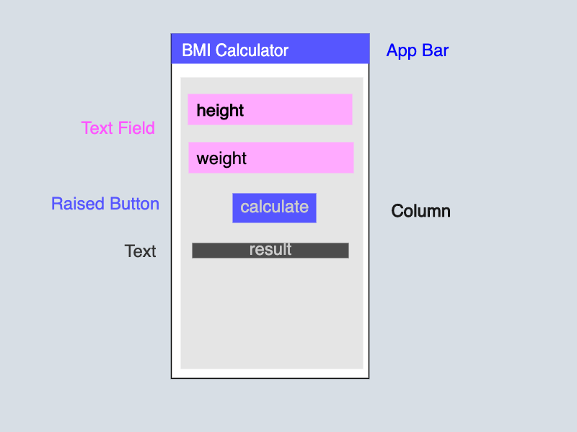
System Design
Architecture diagram
Or
Skelton of the App

Slide 8
Implementation
Step 1
Start the app by building the UI and it will be easy when split into small part so that it will be more clear.
These are the widget used in the application.
AppBar
Text
Column
Text Input
Icon
Raised Button
Let's build the basic scaffold firs then we will move into depth

Slide 9
Implementation
Step 2
To convert the skeleton to the flutter app.
return Scaffold(
appBar: AppBar(
title: Text('BMI Calculator'),
centerTitle: true,
backgroundColor: Colors.pinkAccent,
),
body: Column(
children: <Widget>[
TextField(
decoration: InputDecoration(
labelText: 'Weight in cm',
icon: Icon(Icons.trending_up),
),
),
SizedBox(height: 20),
SizedBox(height: 15),
RaisedButton(
color: Colors.pinkAccent,
child: Text(
"Calculate",
style: TextStyle(color: Colors.white),
),
onPressed: () {},
),
SizedBox(height: 15),
Text(
"Result will be here" ,
style: TextStyle(
color: Colors.redAccent,
fontSize: 19.4,
fontWeight: FontWeight.w500,
),
),
],
)

Slide 10
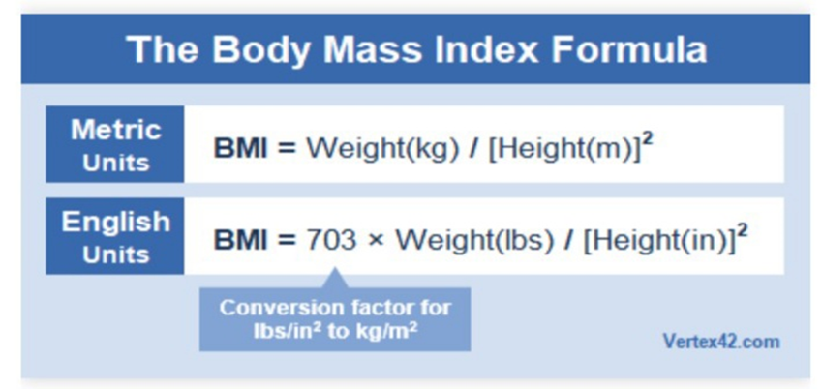
Implementation
Step 3
Bind the input controller with the weight and height field. It will help us in getting the value from the field.
Step 4

Slide 11
Implementation
Step 4
Now we will write the function to Calculator BMI and add the event with button click event. So whenever we will click on the button it will calculate the BMI.
double calculateBMI(double height, double weight){
double heightSquare = height * height;
double result = weight / heightSquare;
return result;
}
void calculateBMI(){
double height = double.parse(_heightController.text) / 100;
double weight = double.parse(_weightController.text);
double heightSquare = height * height;
double result = weight / heightSquare;
print(result);
}
Let's attach the method to the button click or press.
RaisedButton(
color: Colors.pinkAccent,
child: Text(
"Calculate",
style: TextStyle(color: Colors.white),
),
onPressed: calculateBMI,
),

Slide 12
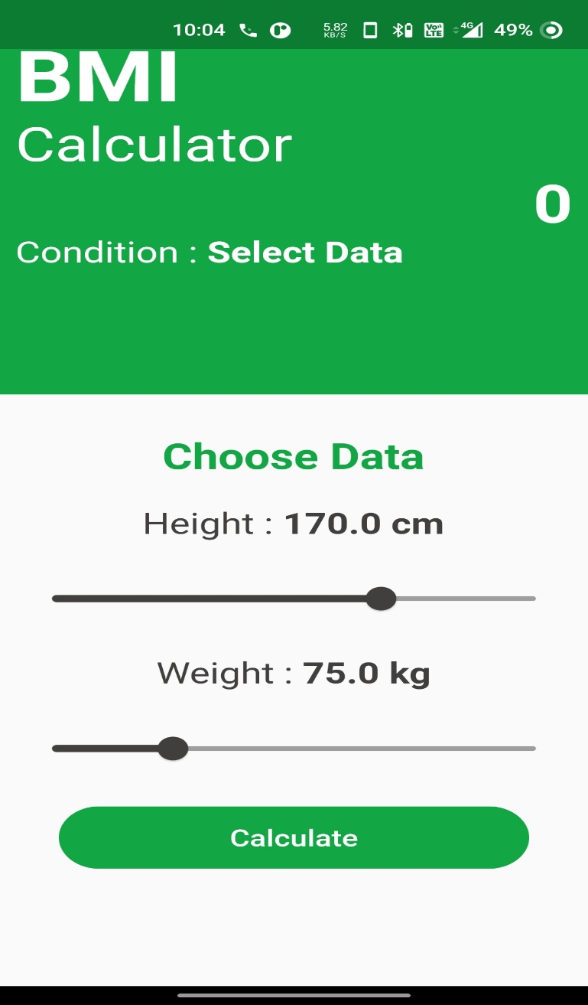
RESULTS
Start Screen

Slide 13
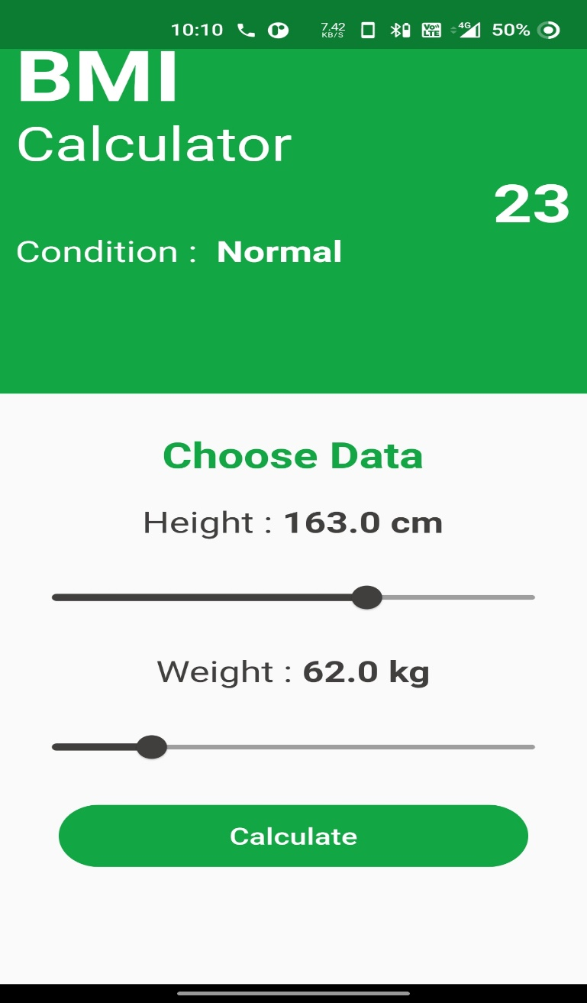
RESULTS
To Display Normal BMI

Slide 14
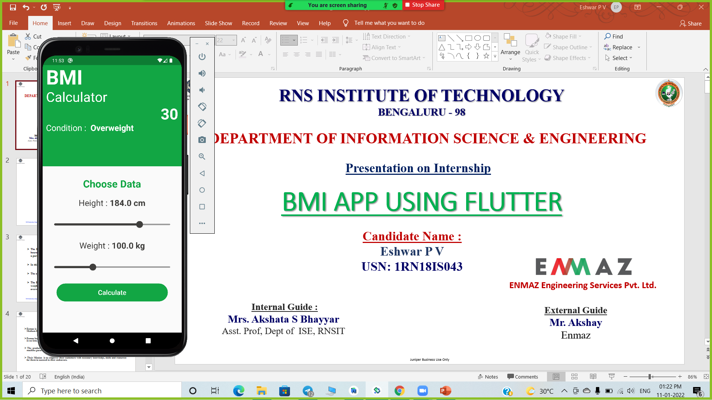
RESULTS
To Display Overweight BMI

Slide 15
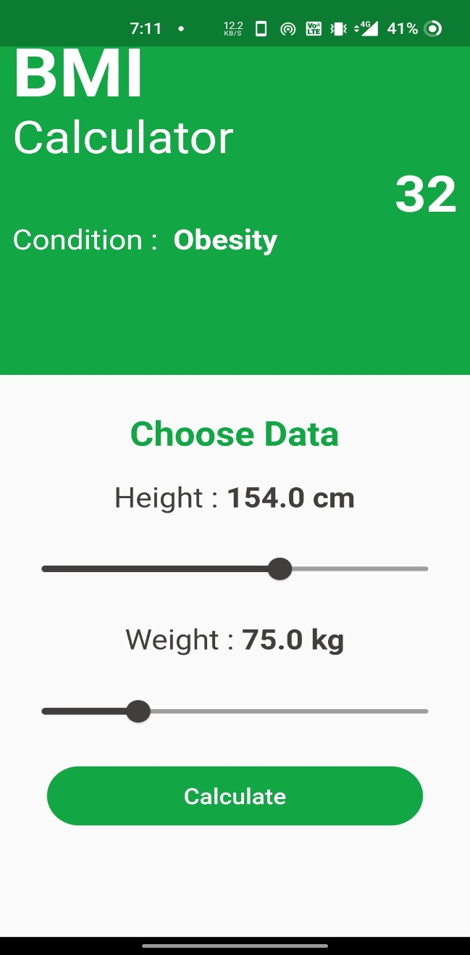
RESULTS
To Display Obesity BMI

Slide 16
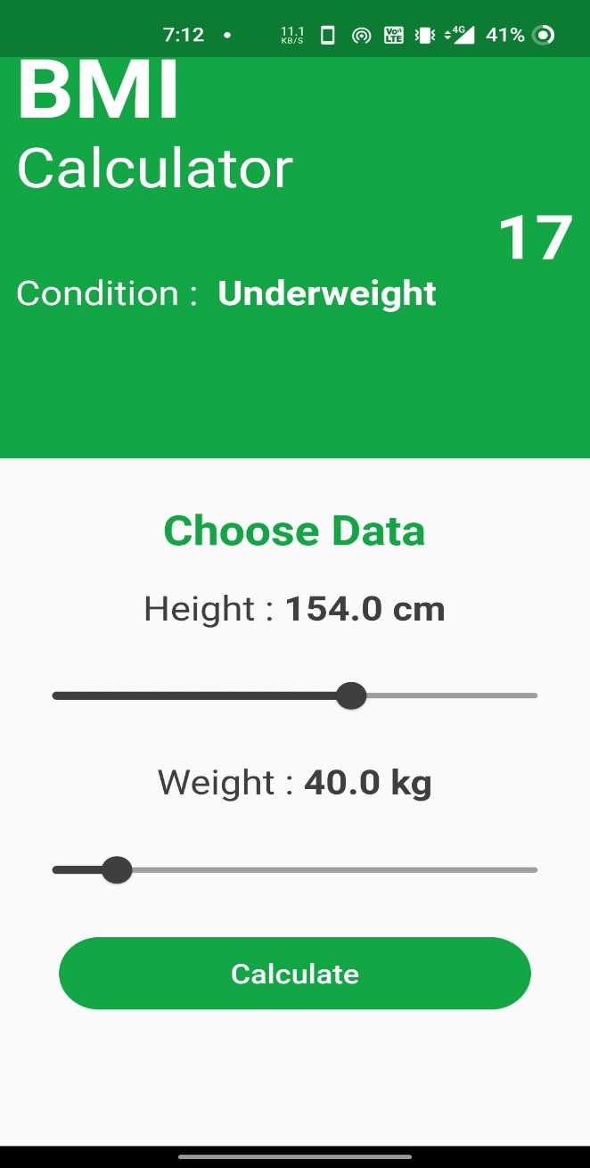
RESULTS
To Display Underweight BMI

Slide 17
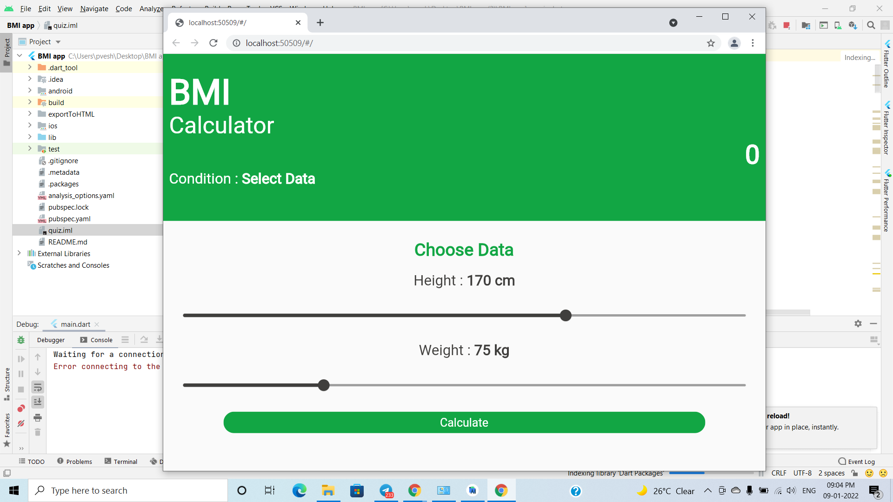
RESULTS
Web Version

Slide 18
CONCLUSIONS
The package was designed in such a way that future modifications can be done easily.
Automation of the entire system improves the efficiency
This app is light and portable and widely compatible
It effectively overcomes the time complexity.

Slide 19
FUTURE ENHANCEMENTS
This app avoids the manual work and the problems concern with it. Centralized management of the database and one app to manage the BMI Calculator of different section of people.
Create Individual Profiles
We can add suggestion message to the person to eat and exercise according to their BMI.

Slide 20
REFERENCES
[1] https://flutter.dev/
[2] https://www.javatpoint.com/flutter
[3] https://www.geeksforgeeks.org/flutter-tutorial/
[4] https://medium.com/flutter

Slide 21
THANK YOU

