Slide 1






1.7M
ESHWAR PRIKY
@itachi_uchiya
Hai there!!!!
I am Eshwar Priky (a.k.a) Itachi.
I am a Vlogger, Gamer and Content Creator.
I have Quite a good amount of followers in Major Social media Platforms
0.7M
@itachi_uchiya
500K subs
I planned to become an “Influencer”. i.e I have lot of followers
I planned to suggest some of the well known products to my followers. i.e Marketing agent
I selected 1200 followers across all platform and conducted giveaway session. i.e Collected Data
I reached out to potential clients and shared my discovery. i.e Sold insights and got a lot of Money
Task:
@Boaster Vlogs

Slide 2

11%
Age
Name
Time Spent on Online Class
Online Class Rating
Gadget used for Online Class
Time spent on self study
Time spent on fitness
Time spent on sleep
Time spent on TV
Time utilized
Time spent on social media
Preferred social media platform
Stress busters
No of meals per day
Change in your weight
Health issue during lockdown
Do you find yourself more connected with your family, close friends , relatives ?
What you miss the most
TH
E
I conducted a give away session of my merchandise in all social media platforms. During giveaway I collected the data from my followers as a survey from SURVEY MONKEY
33%
55%
Yes No
D
A
T
A
72%
For data collection I used Stratified Sampling method. Most of my followers are youngsters (17-21 Yrs), So I collected more data from them. In order to negate the Placebo Effect, I conducted the survey at different intervals (shown as %) from my selected sample
88%
Yes No
Yes No
100%
Yes No

Slide 3
DATA
merchandise
DATA
DATA
DATA
TA
DATA
DATA
DATA
DA
DATA
DATA
DATA
DATA
EXPLORATION

Slide 4
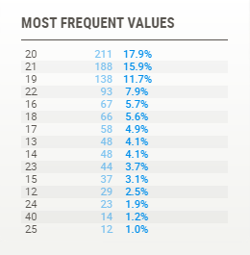
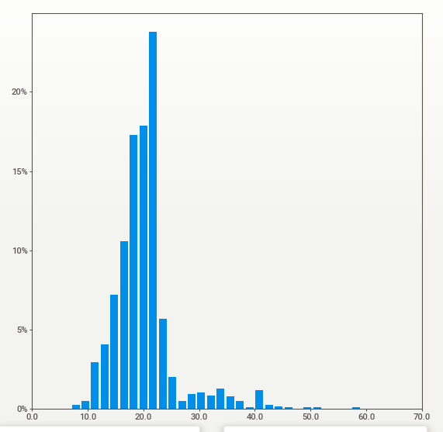
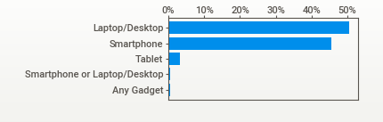
AGEs of My Followers
Most of my Followers falls Between 17-25 Yrs.
Its Evident that Nearly 71% of My followers are from this age group
While the age 19, 20, 21Yrs are more Dominating ones
(Need to be more careful as an influencer, As most
of my followers are youngsters)
1
Gadget’s Used

Slide 5
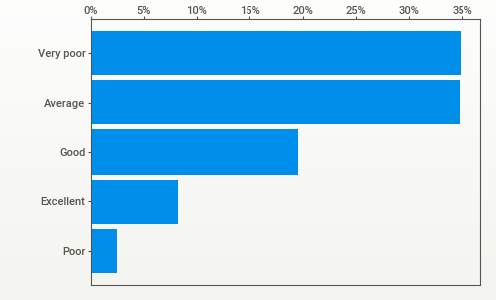
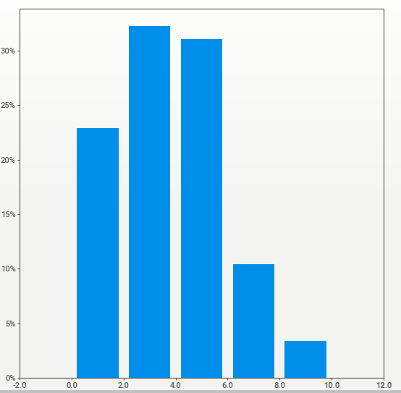
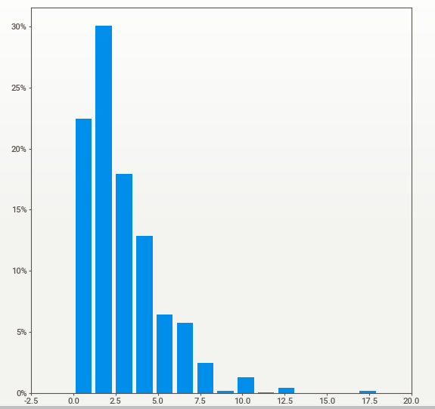
Time Spent on Online Class
Online Class Review
2
Time spent on Self Studies
People Who study less than 3hrs are nearly equal to 70%
While people who study 1,2,3 hrs are more Dominating
People Who spent less than 4hrs are nearly equal to 72%
While people who spent 2,3,4 hrs are more Dominating

Slide 6
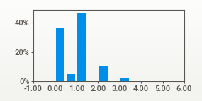
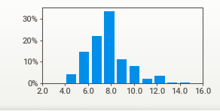
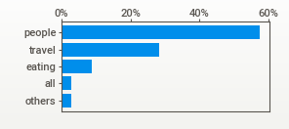
Time Spent on Fitness
Time spent on Sleeping
3
Nearly 35% of my followers haven’t involved in any Physical activity
Nearly 19% of my followers have less than or equal to 6hrs of sleep
What People Miss the Most?

Slide 7
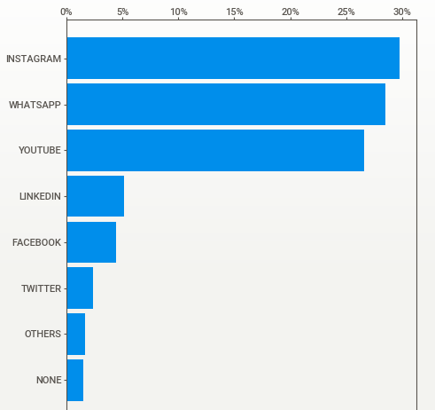
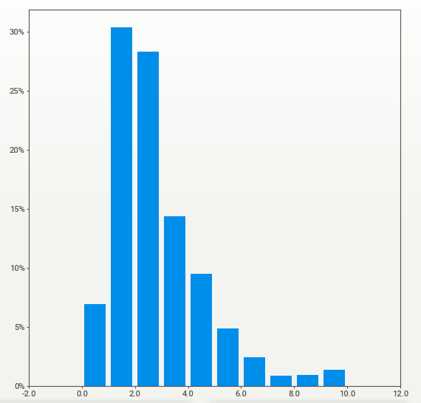
Time Spent on Social Media
Preferred Platform
4
Nearly 62.7% of my followers spent more than 2hrs of time in social media
The popular ones among them are Instagram, WhatsApp, YouTube

Slide 8
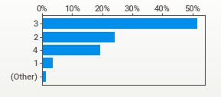
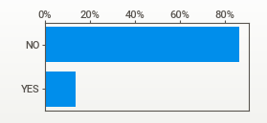
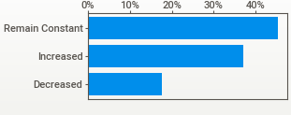
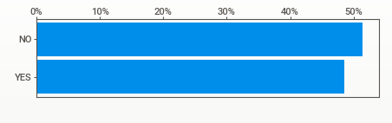
No of Meals/day
Health Issue
5
Change in Weight
Time Utilized Properly
Click the link for full report

Slide 9
STATS
STATS
STATS
STATS
STATS
ST
STATS
STATS
STATS
STATS
TS
STATS
STATS
STATS
STATS
STATS
STATISTICS
ST
STATS
STATS
STATS
STATS
TS
STATS
STATS
STATS
STATS
STATS
ST
STATS
STATS
STATS
STATS
TS
STATS
STATS
STATS
STATS
STATS

Slide 10


As this data's are collected from small sample, Our main aim is to calculate the Statistics from my sample and by using this statistics, We will calculate the parameters for my whole followers (Population).
Thanks to Central Limit Theorem, Z-Statistics, Standard Error & Python which makes the above mentioned step easier.
For Population parameters we will calculate the CONFIDENCE INTERVALS only, as calculating the exact values are out of my power ☹
1
Common steps followed to calculate the Population parameters (Confidence Intervals)
Calculate the Required Statistics (Mean µ / Proportion P & Std.Dev σ)
We will calculate the standard error S.E
Then Multiply standard error with 2.57 (Z-Score of 99% Confidence Interval)
Finally, ( [sample Mean /Proportion] ± confidence intervals )
This will give the estimate of Population Parameter
$$\text{S}\text{.}\text{E}\text{= }\text{σ}\text{/}√n\text{ (}\text{or}\text{) }\text{S}\text{.}\text{E}\text{= }√{p(1−p)}/n$$
$$\text{µ}\left(or\right)p \text{±}(S.E∗2.57)$$

Slide 11
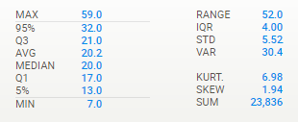
Age
% of Online Class Rating
We will consider Very poor and Poor as “Not liked “ & the rest as “Liked”
p (liked) = 62%
q (Not liked)= 38%
2
99% Confidence that Mean age of Population is with in 19.8-20.6 Yrs
99% Confidence that 34.4%-41.6% of my followers haven’t liked the Online Class
Preferred Social Media
We will consider Instagram, YouTube, Facebook as “Preferred “ & the rest as “Not Preferred”
p (liked) = 61%
q (Not liked)= 39%
99% Confidence that 57.35%-64.65% of my followers prefer social media where I have big followers list
Most of my population parameters are mostly same with sample statistics with only 3-5% change. For Full see the python file

Slide 12
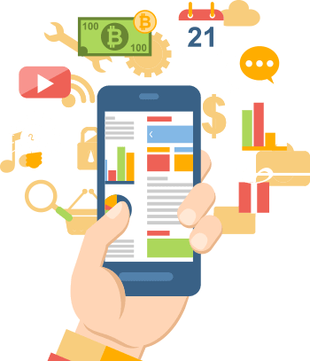
I
N
S
I
G
H
T
S
PRODUCT
SUGGESTION

Slide 13
But Before We Begin……
Why should Products need to be advertised in my Channels ?
If so, Will they get enough reach to the potential Customers?

Slide 14
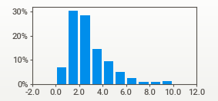
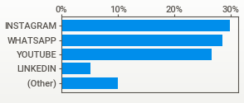
First I will answer for the 1st Question..
Nearly 95% of my audience own a Laptop/Desktop or Smart Phone.
(Please check the above chart represents gadgets used for online class)
You may ask that How owning this gadgets necessarily related to my Channels…
Wait Patiently, Here Comes the Main Pictures
Nearly 61% of my followers Prefer Social media platforms Where I have big fan followers.
Nearly 62.7% of my followers spent more than 2hrs of time in social media.

Slide 15
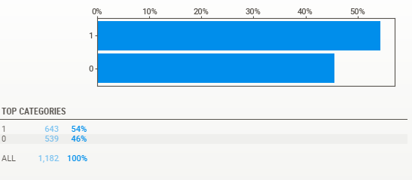
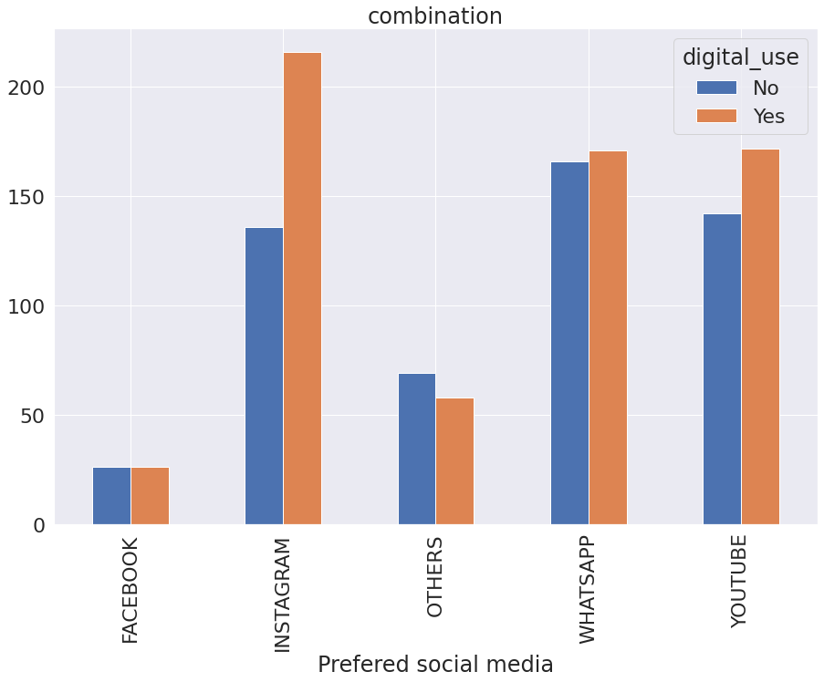
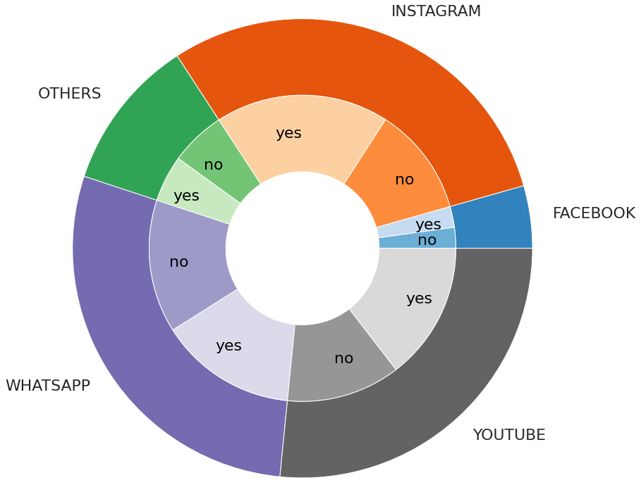
I have Calculated another INDIRECT- PARAMETER from survey, Which is that data collected under “Stress Busters” Can be classified with the involvement of Digital gadgets.
So we will See the result of my INDIRECT-PARAMETER
Nearly 54% of my followers spent time with there Digital gadgets when they are bored/stressed.
I have further grouped this Digital_gadget_users@bored into there Preferred Social media platforms…And the results are here
And found out that the people who are Digital_gadget_users@bored and prefered social media platform where I have Big Followers are 32.7%

Slide 16
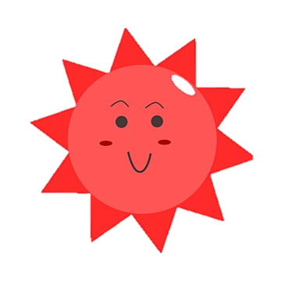
When we talk in term of percentage it seems to be relatively small, But 30%, 40%, 50% @ 1Million or .5Million is relatively a BIG BIG BIGGG number
Now I am sure that I answered 1st question well.
It seems to be I am quite a popular fellow
Before Jumping into the last question I want to tell you about some other indirect Parameters and its Correlations.

Slide 17
Indirect Parameters
X1 = (Time spent on Online Class < 6 hrs) AND (Online class Review is “Poor”, “Very poor”, Average)
X2 = (Time spent on self studies < 3 hrs) AND (Time Utilized = “No”)
X3 = (Time Spent on Fitness < 1hr) AND (Weight Change = “Increased”)
X4= (Health Problem = ‘Yes’) or ( Weight Change = “Decreased”)
X5= Stressbusters involves Digital Gadgets
X6= (No of Meals >= 3) OR (Stressbusters involves Digital Gadgets ) or (What they miss is ‘Eating’)
X7= What they miss the most involves ‘People ‘
X8= What they miss most is ‘Travel’
Now We will Discus about these Parameters with a product Suggestions
Caution:
The above Classifications are performed by trained professionals. Please don’t try this at Home :P

Slide 18
Now We will Discus about these Parameters with a product Suggestion
That will Automatically our answer the 2nd Question

Slide 19
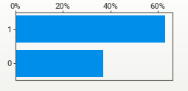
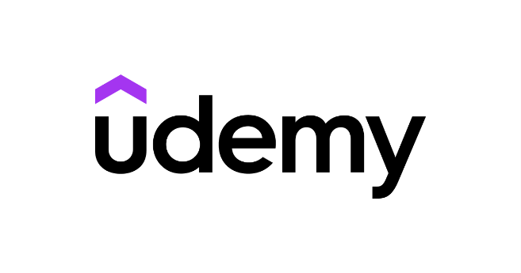


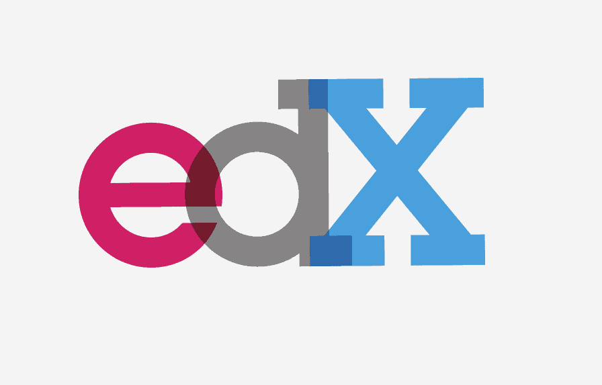
Parameter -1
Extra-Teaching
The Base Conditions for this parameter are Students who attend Online Class less than 6hrs/day and they are Not satisfied with the content delivered by there teachers.
1 = Conditions Met
0= Not Met
67% of my followers are not satisfied with there teaching
I can act as an Learning Partner to this Platforms and Promote these Platforms to my followers.
When we think of lack of Teaching, there is no other platforms except these comes to our mind…….
Udemy, Coursera, Edx,
**As Education is Important to All, I can promote Education Platforms at low cost

Slide 20
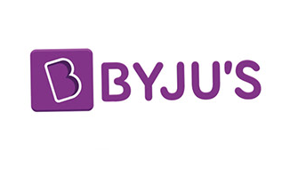
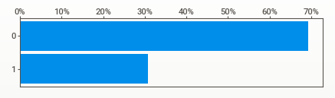



Parameter -2
Extra-Mentoring
The Base Conditions for this parameter are Students who has less than 3hrs of self study and Time utilized as “No”
1 = Conditions Met
0= Not Met
31% of my followers are not concentrated
In there studies.
I can act as an Learning Partner to this Brands and Promote these brands to my followers.
During exam time, these students needed extra preparation as they haven’t studied properly mostly. In last moment hurry they needed that extra coaching. When it comes to coaching these brands are the dominant players Byjus, Unacademy, Vedanthu,..
**Platforms Mentioned in the above slide can also be considered for these parameter

Slide 21
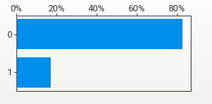


Parameter -3
Fitness Partner
The Base Conditions for this parameter are follower who has less than 1hrs of Physical activity and there Weights are ‘Increased’
1 = Conditions Met
0= Not Met
17% of my followers have met the above conditions
When it comes to Fitness there is one and only dominant player here and its CULTFIT.
These conditions also includes promotion of GYMs, Dancing clubs and other physical activity clubs & Platforms available.
I can act as an Fitness Partner to these Brands and Promote there brands to my followers.

Slide 22
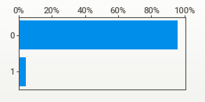

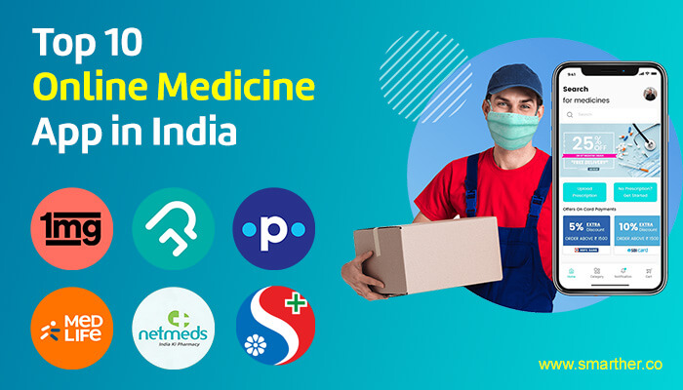
Parameter -4
Online_Consulting
The Base Conditions for this parameter is, Followers who has Health Problem or Has Decreased Weight
1 = Conditions Met
0= Not Met
4% of my followers have met the above conditions
We can Promote them Some Online Doctor Consulting App like Practo.. or Online Pharmacy Delivery App like 1mg, MED life, Netmeds, Pharmeasy With Some coupon Codes.

Slide 23
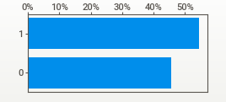



Parameter -5
Media Partner
The Base Conditions for this parameter is, Followers who use Digital gadgets when they are Bored or Stressed (StressBuster)
1 = Conditions Met
0= Not Met
54% of my followers have met the above conditions
I can act as an Media Partner to these Brands and Promote there Movies, series to my followers.
We can Promote the OTT Platforms to these
Categories people with Different Movies or Series.
No words Only 2 Brands- Netflix, Amazon Prime Video
On how I classified this Digital gadget user or not from stressbuster category , Check out my python file

Slide 24
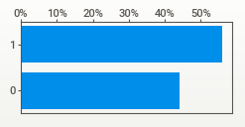


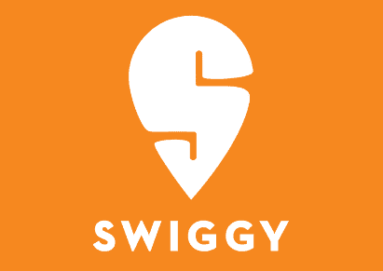
Parameter -6
Food_order
The Base Conditions for this parameter are follower who have meals greater than 2 times or use Digital gadgets when they are Bored or Stressed (StressBuster) or followers who response comes under ‘Eating’ category when they asked about- What they miss the most?
1 = Conditions Met
0= Not Met
I can act as an Consumer Partner to this Brands and Promote these brands to my followers by tasting different foods and reviewing them.
56% of my followers have met the above conditions
In Modern Era Stress Eating becomes the new normal, Due to the advent of food Delivery platforms like ZOMATO, SWIGGY,etc.. this habit spread among people like a rapid fire.
The power of having your liked food at any time will be most welcomed by many people

Slide 25
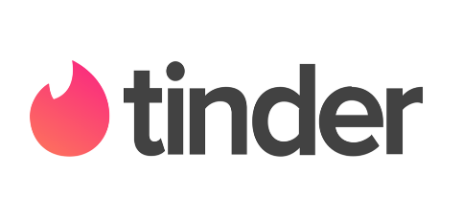
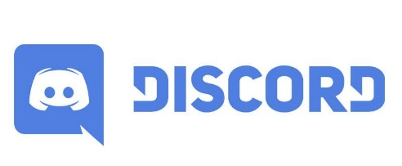



Parameter -7
Socialize_app
The Base Conditions for this parameter are follower who response comes under ‘people’ category when they asked about- What they miss the most?
1 = Conditions Met
0= Not Met
57% of my followers have met the above conditions
I can act as an Brand Ambassador to this Brands/Channels/Apps and Promote them to my followers.
I can even signup in these platforms and conduct a give away session on stuffs related to it
In Modern Era Socializing becomes very easy, with just few clicks you can connect to any person at any time. Apps like Tinder, Snapchat, Discord, Gaming Channels/ Live Stream, Games, can remove the feeling-solitude

Slide 26
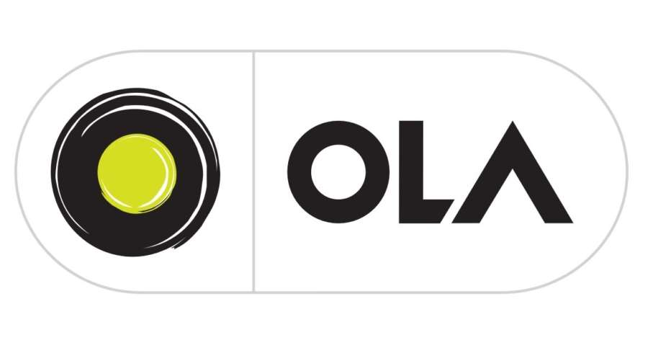


Parameter -8
Travel_prom
The Base Conditions for this parameter are follower who response comes under ‘travel’ category when they asked about- What they miss the most?
1 = Conditions Met
0= Not Met
28% of my followers have met the above conditions
I can act as an Traveling partner. I can even promote some trip organizing groups in my platforms
When it comes to traveling, UBER, OLA,. Comes before our houses even before we start to think about it

Slide 27
CONCLUSION
As I came to the Closing part of this product suggestion session, I hope that I answered those 2 questions that I raised early, with my analysis and particular product suggestions.
You May Still think that I mentioned 30%, 40%, 50% are potential customer, But in actual will they buy…?
For this questions there are 2 answers
If at least 1% of my followers purchase/sign up, it’s a win-win situation for both me(influencer) & Product owner.
If you are Still not convinced with my answers…. :8
Go to Google and search → “ Influencer vs Marketing/Sales Agent”
To the best of my Knowledge Marketing agent/Sales agent has targets to comply with
but , but, but Influencer don’t have any….
THANK YOU!!!!!
Here is the python file

