Slide 1
编译原理课程展示
小组成员：***
2022.5.30

Slide 2
C Compiler
基于Lex、Yacc、LLVM
实现的
C语言类型系统，包括基本类型、数组和指针、结构和联合、枚举
大部分常用C语言关键字
C语言所有运算符
函数声明，包括可变参数函数
基本的宏语法
……
未实现的
u、L、e、f等常量修饰符
指向const的指针、函数指针、数组指针等复杂指针声明
volatile、register修饰符
struct的位域语法
#pragma、##、#等宏指令
多维数组、结构和联合的初始化，本地数组的初始化
对表达式使用sizeof运算符
内联汇编

Slide 3
工作流程
宏展开
Lex 词法分析
主程序
Yacc 语法分析
LLVM 中间代码生成
Clang编译LLVM IR

Slide 4
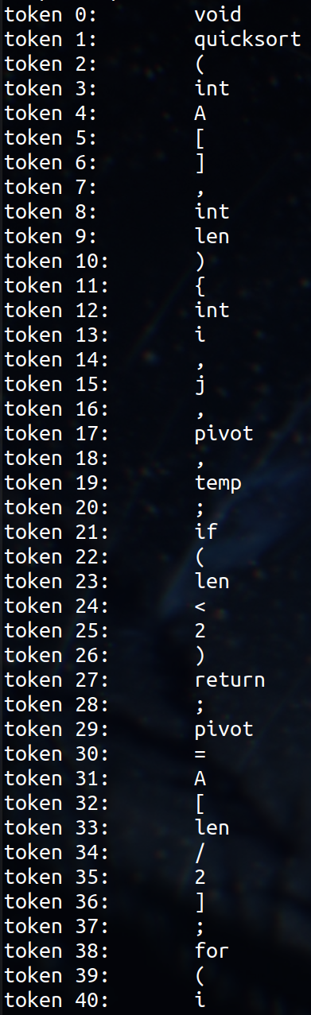
词法分析
"int" { return INT; }
0|([1-9][0-9]*) {
yylval.longValue = atoll(yytext);
return NUM;
}
(\"([^"]|\\\")*\")+ {
yylval.stringValue = new string(yytext);
return STRING;
}
...

Slide 5
语法分析
program : translation-unit { $$ = new Program($1); program = $$; }
;
translation-unit : external-decl { $$ = $1; }
| translation-unit external-decl {
$$ = $1;
$$->tail->next = $2;
}
;
external-decl : function-definition { $$ = $1; }
| decl { $$ = $1; }
;
function-definition : decl-specs declarator compound-stat {
$$ = new FunctionDeclaration($1, $2, $3);
}
| declarator compound-stat {...}
;
...

Slide 6
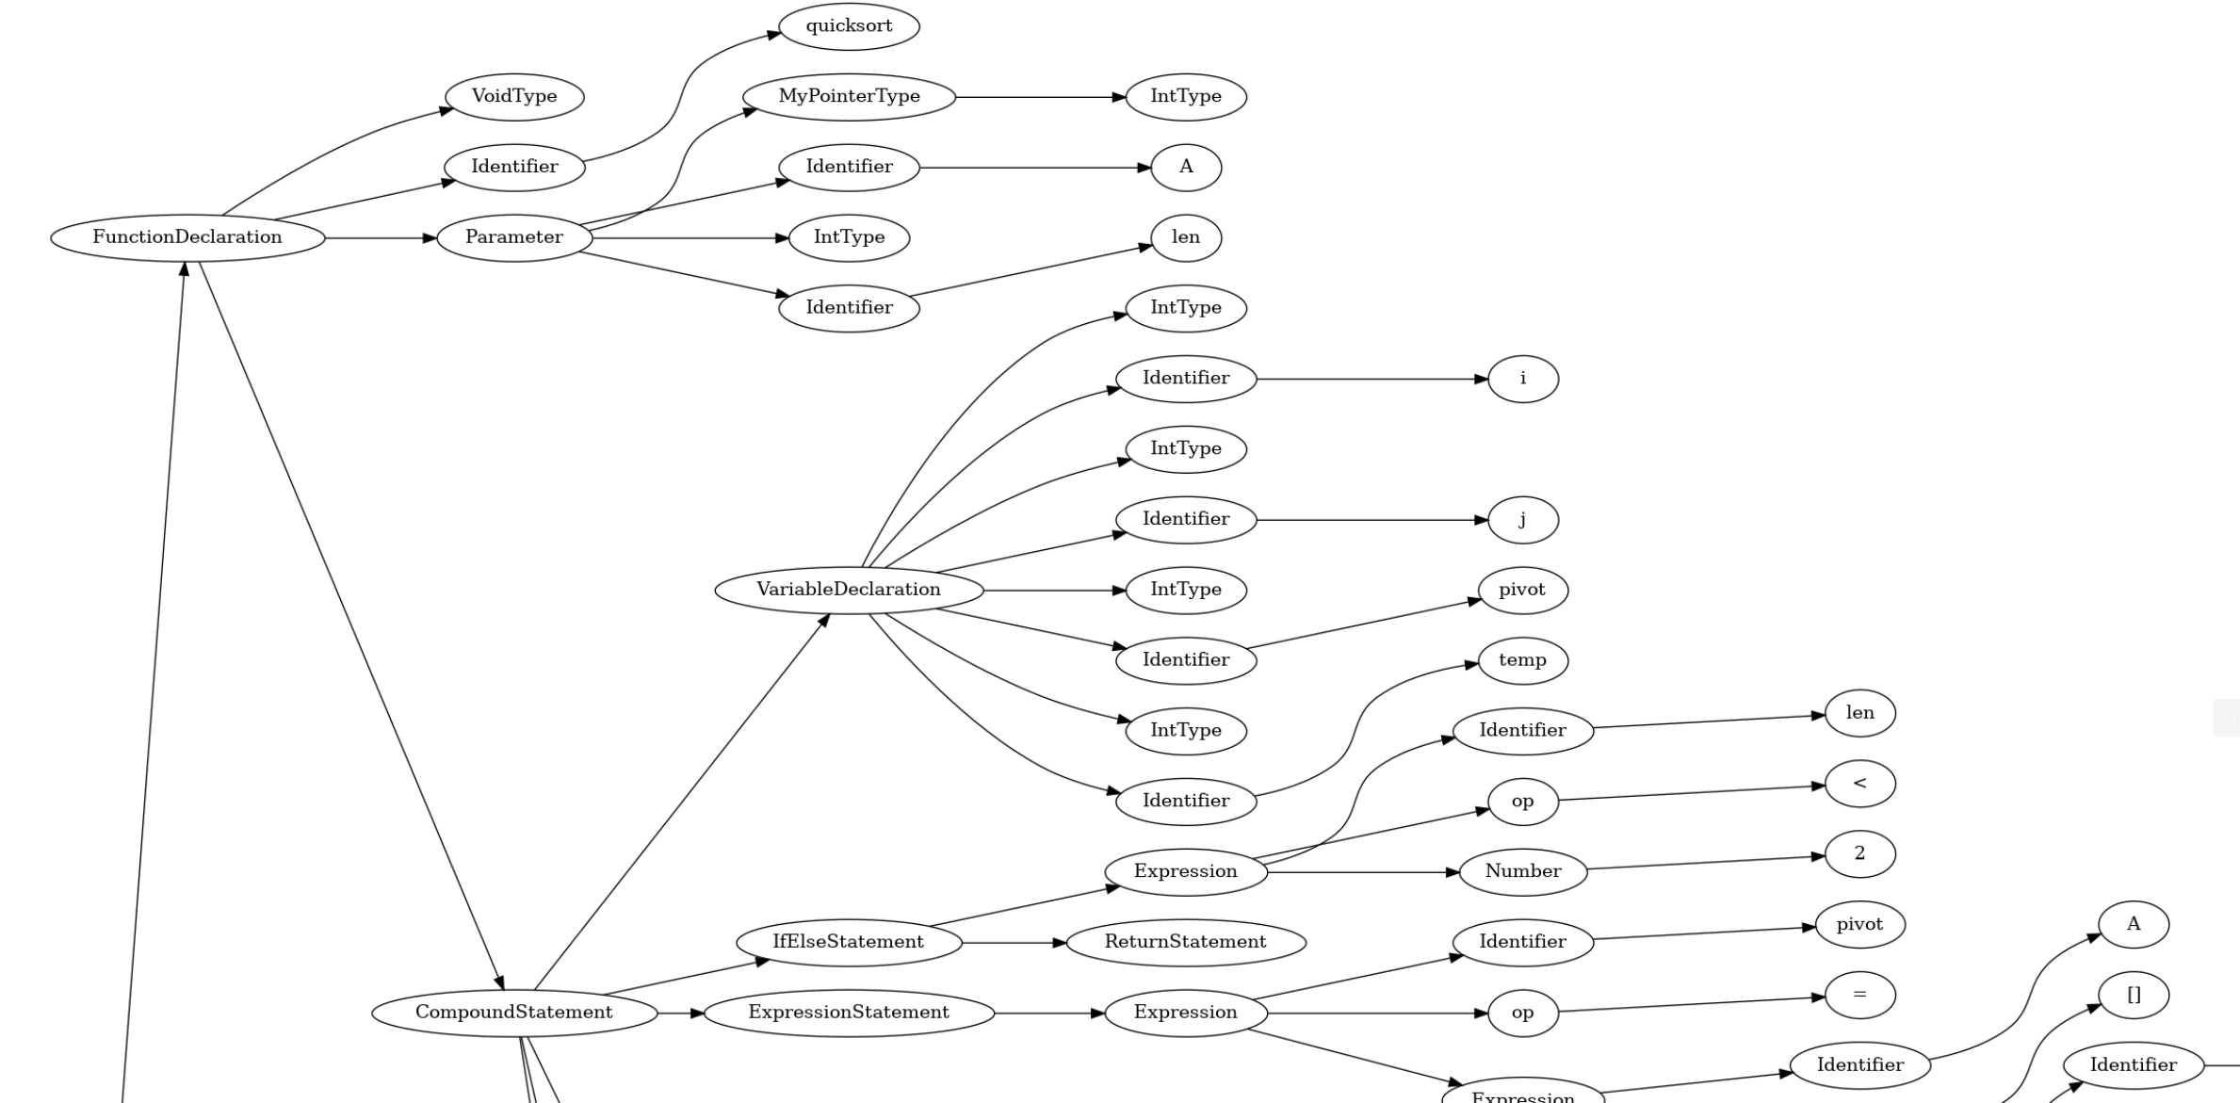

Slide 7
中间代码生成
LLVM IR：
define void @quicksort(i32* %A, i32 %len) {
entry:
%A1 = alloca i32* store i32* %A, i32** %A1
%len2 = alloca i32
store i32 %len, i32* %len2
%i = alloca i32 %j = alloca i32
%pivot = alloca i32
%temp = alloca i32
br label %if.cond
if.cond: ; preds = %entry
%0 = load i32, i32* %len2
%1 = icmp slt i32 %0, 2
br i1 %1, label %if.then, label %if.else
...
for.out: ; preds = %if.then7
%13 = load i32*, i32** %A1
%14 = load i32, i32* %i
call void @quicksort(i32* %13, i32 %14)
%15 = load i32, i32* %i
%16 = load i32*, i32** %A1
%17 = getelementptr i32, i32* %16, i32 %15
%18 = load i32, i32* %i
%19 = load i32, i32* %len2
%20 = sub i32 %19, %18
call void @quicksort(i32* %17, i32 %20)
ret void
...
}
llvm::Value *Program::codeGen(CodeGenerator &ctx)
{
for (Declaration *p = decl; p; p = p->next)
p->codeGen(ctx);
...
}

Slide 8
宏展开
#include "header.h“
#define DEBUG
#define BBB(x, y) x * y + AAA
#define AAA CCC
#define CCC 10
#define PRINT_MAX(x, y) \
if (x > y) \
printf("%d\n", x); \
else \
printf("%d\n", y);
int main()
{
printf("variable 'a' defined in header.h = %d\n", a);
#ifdef DEBUG
puts("debug macro has been defined");
#else
puts("not defined");
#endif
#undef DEBUG
#ifdef DEBUG
puts("debug macro is still defined");
#else
puts("debug macro has been undefined");
#endif
printf("macro AAA = %d\n", AAA);
printf("macro BBB(2, 3) = %d\n", BBB(2, 3));
printf("macro BBB(2 + 3, 3 + 2) = %d\n", BBB(2 + 3, 3 + 2));
printf("macro BBB(BBB(2, 3), 4) = %d\n", BBB(BBB(2, 3), 4));
PRINT_MAX(3, 5)
return 0;
}
int a = 1;
int main()
{
printf("variable 'a' defined in header.h = %d\n", a);
puts("debug macro has been defined");
puts("debug macro has been undefined");
printf("macro AAA = %d\n", 10);
printf("macro BBB(2, 3) = %d\n", 2 * 3 + 10 );
printf("macro BBB(2 + 3, 3 + 2) = %d\n",
2 + 3 * 3 + 2 + 10 );
printf("macro BBB(BBB(2, 3), 4) = %d\n",
2 * 3 + 10 * 4 + 10 );
if (3 > 5)
printf("%d\n", 3);
else
printf("%d\n", 5);
return 0;
}

Slide 9
语义检查
函数、变量、标签、类型是否重复定义或在使用时还未定义
continue关键字是否在迭代语句中使用、break关键字是否在迭代语句或switch语句中使用
赋值运算、++、--的目标值是否是左值
下标访问和解引用的对象是否是数组或指针
数组定义的大小是否为常量
算术等运算符操作数类型是否不符合要求，如对浮点数执行位运算
……

Slide 10
常量折叠
int main()
{
int a = (((3 + 5) * 9 - 2) / 7 - 2) >> 1;
printf("%d\n", a);
return 0;
}
define i32 @main() {
entry:
%a = alloca i32
store i32 4, i32* %a
%0 = load i32, i32* %a
%1 = call i32 (i8*, ...) @printf(
i8* getelementptr inbounds (
[4 x i8], [4 x i8]* @“%d\0A”, i32 0, i32 0
),
i32 %0)
ret i32 0
}

Slide 11
Demo

