Slide 1
Assignments
Example with the first assignment

Slide 2
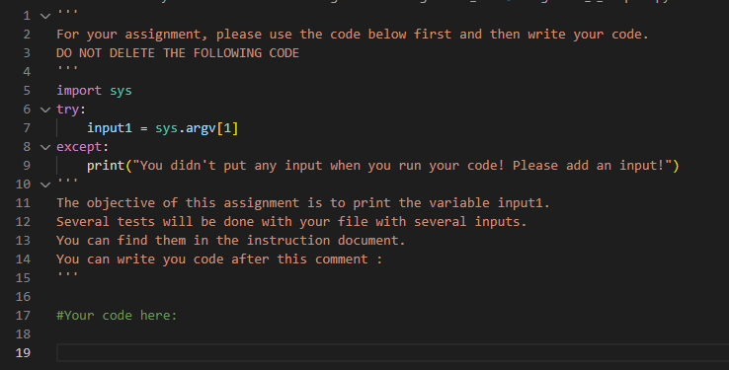
Assignment 1
Extremely easy
Use the template code and print input1
Template is available in teams

Slide 3
Test your assignment on VSCode/Spyder/Pycharm
To test your assignment on your interpreter, add the input at the end of the command to run the file.
For example:
If you want to test the input “Hi” and the command to run your file is
“python assignment_1.py”, you should do :
- python assignment_1.py “hi“

Slide 4
In my case:
Command which is running my code
Command which is running my code with the input Hi

Slide 5
Difficulties ?
If you are getting this message:
“You didn't put any input when you run your code! Please add an input! “
You need to add an input to the command (see previous slides)

Slide 6
Upload your assignment
Upload the assignment on codepost.io: tutorial here
Test with two different inputs will be done on your code to check than your are really printing the input
Do not forget to name your file as the required file for the assignment (assignment_1.py)
Check the results of tests to be sure than you did it correctly

Slide 7
Your turn
Please join the course

