Slide 1
Lecture 12: Machine Learning IV
Information and Communication Technologies

Slide 2
Practice 11:
Legend:
- Scaler method
DATA
MODEL
RESULT OF MODEL
fit
Standardized Training data
Model training
Equation
Score on train
75%
Training data
transform
(x, y)
Labelled Data
Standardized Testing data
25%
Testing data
Model testing
Score on test
transform
(x, y)
Standardized unlabelled data
Unlabelled Data
Standardized predictions
Model Use
Predictions
transform (x)
inverse
transform (y)

Slide 3
Logistic regression: classification
Used to predict non-continuous classes
With two or more classes
Examples:
Price goes up or down (2 classes)
E-mail is spam or not (2 classes)
Animal on the image (several classes)
Product than a customer will buy (several classes)
Y
1
0
X

Slide 4
Logistic regression
Example for a two classes:
Predict the gender prediction with hair length
0 = Man | 1 = Woman
Gender
1
Hair length (cm) | Gender | Gender code
1 | Male | 0
100 | Female | 1
25 | Female | 1
10 | Male | 0
60 | Female | 1
5 | Male | 0
30 | Female | 1
0
Hair length

Slide 5
Logistic/Linear regression
Gender
Gender
1
1
0
0
Hair length
Hair length
Linear Regression
Logistic Regression

Slide 6
Logistic regression in Python
Scale only the features not the labels (0 or 1)
Create a model: LogisticRegression() function
Like a linear regression, train it and use the predict() function or the predict_proba() function

Slide 7
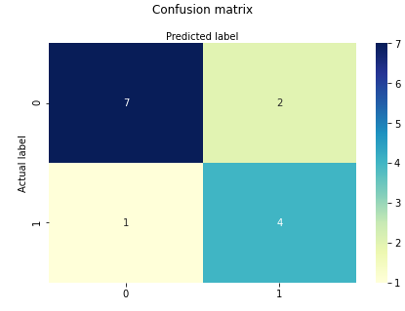
Logistic regression: confusion matrix
Confusion_matrix() function from the module sklearn.metrics
Top left and bottom right are correct values
Top right and bottom left are incorrect values

Slide 8
Scikit-learn tool for encoding
Use LabelEncoder() from module sklearn.preprocessing

Slide 9
Logistic regression: several classes
Nominal or ordinal classes ?
Nominal Variable (Categorical): Variable comprises a finite set of discrete values with no relationship between values. (ex: colors: blue, red, …
Ordinal Variable: Variable comprises a finite set of discrete values with a ranked ordering between values. (ex: state of a car: “New”, “almost new”, “broken”, …)

Slide 10
Logistic regression: Ordinal classes
Same thing than 2 classes
Remember to order them when converted to code
Example with car state:
New = 0
Almost new = 1
Normal = 2
Used = 3
Broken = 4

Slide 11
Logistic regression: Nominal classes
For Nominal classes
One versus rest (OVR)
Example: 3 classes (blue, red, green)
One model per class (3 models)
Each model has two classes:
Blue and not blue
Red and not red
Green and not green
The class with the highest probability is chosen
In Scikit-learn, use the multi_class = ‘ovr’ parameter when you create the model

